Slide 1
1 | 10 | 7 | 12 | 8 | 6 | 16 | 4 | 2 | 19
1 | 2 | 4 | 6 | 7 | 8 | 10 | 12 | 16 | 19

Slide 2
n1
Level = 0
Level = 1
n2
n3
n4
n6
Level = 2
n5
n7
Level = 3

Slide 3
d
Index | Key | Left | Right
1 | d | 2 | 3
2 | b | 4 | NULL
3 | f | 5 | 6
4 | a | NULL | NULL
5 | e | NULL | NULL
6 | g | NULL | NULL
b
f
a
e
g

Slide 4
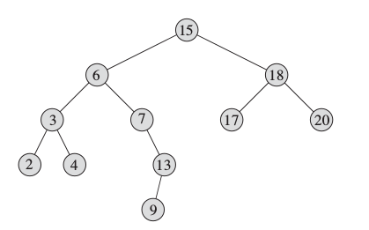

Slide 5
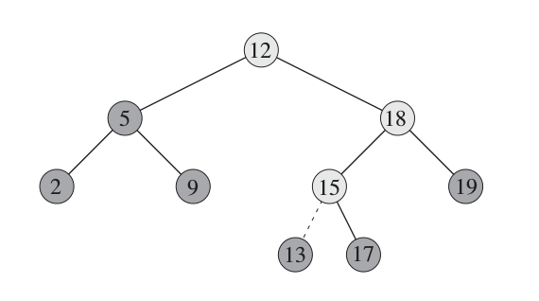

Slide 6
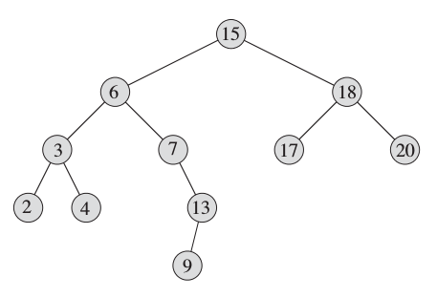

Slide 8
Successor

Slide 9
Successor 2

Slide 10
Predecessor

Slide 11
Predecessor 2

