Slide 1
Model Evaluation

Slide 2
Model Evaluation
Metrics for Performance Evaluation
  How to evaluate the performance of a model?
Methods for Performance Evaluation
  How to obtain reliable estimates?
Methods for Model Comparison
  How to compare the relative performance among competing models?

Slide 3
Model Evaluation
Metrics for Performance Evaluation
  How to evaluate the performance of a model?
Methods for Performance Evaluation
  How to obtain reliable estimates?
Methods for Model Comparison
  How to compare the relative performance among competing models?

Slide 4
Metrics for Performance Evaluation
Focus on the predictive capability of a model
  Rather than how fast it takes to classify or build models, scalability, etc.
Confusion Matrix:
 | PREDICTED CLASS
ACTUAL CLASS |  | Class=Yes | Class=No
 | Class=Yes | a | b
 | Class=No | c | d
a: TP (true positive)
b: FN (false negative)
c: FP (false positive)
d: TN (true negative)

Slide 5
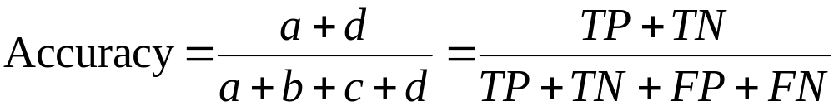
Metrics for Performance Evaluation…
Most widely-used metric:
 | PREDICTED CLASS
ACTUAL CLASS |  | Class=Yes | Class=No
 | Class=Yes | a (TP) | b (FN)
 | Class=No | c (FP) | d (TN)

Slide 6
Limitation of Accuracy
Consider a 2-class problem
  Number of Class 0 examples = 9990
  Number of Class 1 examples = 10
If model predicts everything to be class 0, accuracy is 9990/10000 = 99.9 %
  Accuracy is misleading because model does not detect any class 1 example

Slide 7
Cost Matrix
 | PREDICTED CLASS
ACTUAL CLASS | C(i|j) | Class=Yes | Class=No
 | Class=Yes | C(Yes|Yes) | C(No|Yes)
 | Class=No | C(Yes|No) | C(No|No)
C(i|j): Cost of misclassifying class j example as class i

Slide 8
Computing Cost of Classification
Cost Matrix | PREDICTED CLASS
ACTUAL CLASS | C(i|j) | + | -
 | + | -1 | 100
 | - | 1 | 0
Model M₁ | PREDICTED CLASS
ACTUAL CLASS |  | + | -
 | + | 150 | 40
 | - | 60 | 250
Model M₂ | PREDICTED CLASS
ACTUAL CLASS |  | + | -
 | + | 250 | 45
 | - | 5 | 200
Accuracy = 80%
Cost = 3910
Accuracy = 90%
Cost = 4255

Slide 9
Cost vs Accuracy
Count | PREDICTED CLASS
ACTUAL CLASS |  | Class=Yes | Class=No
 | Class=Yes | a | b
 | Class=No | c | d
Accuracy is proportional to cost if
1. C(Yes|No)=C(No|Yes) = q
2. C(Yes|Yes)=C(No|No) = p
N = a + b + c + d
Accuracy = (a + d)/N
Cost = p (a + d) + q (b + c)
= p (a + d) + q (N – a – d)
= q N – (q – p)(a + d)
= N [q – (q-p) × Accuracy]
Cost | PREDICTED CLASS
ACTUAL CLASS |  | Class=Yes | Class=No
 | Class=Yes | p | q
 | Class=No | q | p

Slide 10
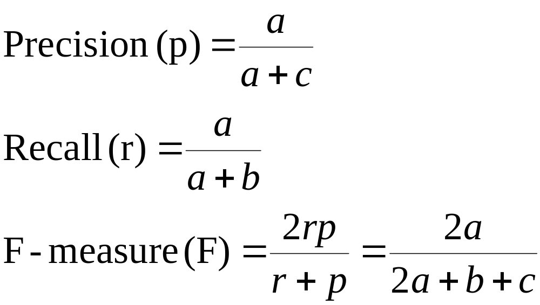
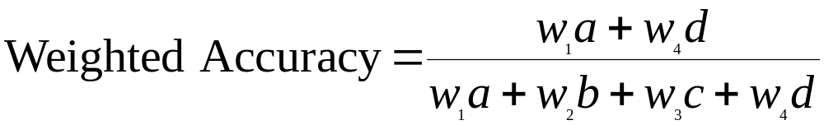
Cost-Sensitive Measures
Precision is biased towards C(Yes|Yes) & C(Yes|No)
Recall is biased towards C(Yes|Yes) & C(No|Yes)
F-measure is biased towards all except C(No|No)

Slide 11
Model Evaluation
Metrics for Performance Evaluation
  How to evaluate the performance of a model?
Methods for Performance Evaluation
  How to obtain reliable estimates?
Methods for Model Comparison
  How to compare the relative performance among competing models?

Slide 12
Methods for Performance Evaluation
How to obtain a reliable estimate of performance?
Performance of a model may depend on other factors besides the learning algorithm:
  Class distribution
  Cost of misclassification
  Size of training and test sets

Slide 13
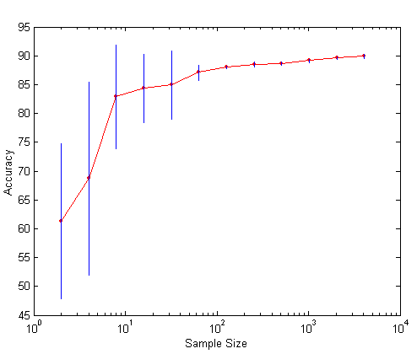
Learning Curve
Learning curve shows how accuracy changes with varying sample size
Requires a sampling schedule for creating learning curve:
  Arithmetic sampling
  (Langley, et al)
  Geometric sampling
  (Provost et al)
Effect of small sample size:
  Bias in the estimate
  Variance of estimate

Slide 14
Methods of Estimation
Holdout
  Reserve 2/3 for training and 1/3 for testing
Random subsampling
  Repeated holdout
Cross validation
  Partition data into k disjoint subsets
  k-fold: train on k-1 partitions, test on the remaining one
  Leave-one-out: k=n
Stratified sampling
  oversampling vs undersampling
Bootstrap
  Sampling with replacement

Slide 15
Step 1: Split data into train and test sets
THE PAST
Results Known
+
Training set
+
-
-
Data
+
Testing set

Slide 16
Step 2: Build a model on a training set
THE PAST
Results Known
+
Training set
+
-
-
Data
+
Model Builder
Testing set

Slide 17
Step 3: Evaluate on test set
Results Known
+
Training set
+
-
-
Data
+
Model Builder
Evaluate
Predictions
+
-
+
-
Y
N
Testing set

Slide 18
A note on parameter tuning
It is important that the test data is not used in any way to create the classifier
Some learning schemes operate in two stages:
  Stage 1: builds the basic structure
  Stage 2: optimizes parameter settings
The test data can’t be used for parameter tuning!
Proper procedure uses three sets: training data, validation data, and test data
  Validation data is used to optimize parameters

Slide 19
Making the most of the data
Once evaluation is complete, all the data can be used to build the final classifier
Generally, the larger the training data the better the classifier (but returns diminish)
The larger the test data the more accurate the error estimate

Slide 20
Classification: Train, Validation, Test split
Results Known
+
Model
Builder
+
Training set
-
-
Data
+
Evaluate
Model Builder
Predictions
+
-
+
-
Y
N
Validation set
+
-
+
-
Final Evaluation
Final Test Set
Final Model

Slide 21
Evaluation on “small” data
The holdout method reserves a certain amount for testing and uses the remainder for training
  Usually: one third for testing, the rest for training
For “unbalanced” datasets, samples might not be representative
  Few or none instances of some classes
Stratified sample: advanced version of balancing the data
  Make sure that each class is represented with approximately equal proportions in both subsets

Slide 22
Evaluation on “small” data
What if we have a small data set?
  The chosen 2/3 for training may not be representative.
  The chosen 1/3 for testing may not be representative.

Slide 23
Repeated holdout method
repeated holdout method
Holdout estimate can be made more reliable by repeating the process with different subsamples
  In each iteration, a certain proportion is randomly selected for training (possibly with stratification)
  The error rates on the different iterations are averaged to yield an overall error rate
Still not optimum: the different test sets overlap.
  Can we prevent overlapping?

Slide 24
Cross-validation
Cross-validation avoids overlapping test sets
  First step: data is split into k subsets of equal size
  Second step: each subset in turn is used for testing and the remainder for training
This is called k-fold cross-validation
Often the subsets are stratified before the cross-validation is performed
The error estimates are averaged to yield an overall error estimate

Slide 25
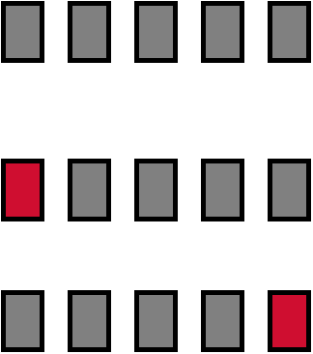
Cross-validation example:
Break up data into groups of the same size
Hold aside one group for testing and use the rest to build model
Repeat
Test

Slide 26
More on cross-validation
Standard method for evaluation: stratified ten-fold cross-validation
Why ten? Extensive experiments have shown that this is the best choice to get an accurate estimate
Stratification reduces the estimate’s variance
Even better: repeated stratified cross-validation
  E.g. ten-fold cross-validation is repeated ten times and results are averaged (reduces the variance)

Slide 27
Leave-One-Out cross-validation
Leave-One-Out:
a particular form of cross-validation:
  Set number of folds to number of training instances
  I.e., for n training instances, build classifier n times
Makes best use of the data
Involves no random subsampling
Very computationally expensive
  (exception: NN)

Slide 28
Summary of Evaluation Methods
Use Train, Test, Validation sets for “LARGE” data
Balance “un-balanced” data
Use Cross-validation for small data
Don’t use test data for parameter tuning - use separate validation data
Most Important: Avoid Overfitting

Slide 29
Model Evaluation
Metrics for Performance Evaluation
  How to evaluate the performance of a model?
Methods for Performance Evaluation
  How to obtain reliable estimates?
Methods for Model Comparison
  How to compare the relative performance among competing models?

Slide 30
ROC (Receiver Operating Characteristic)
Developed in 1950s for signal detection theory to analyze noisy signals
  Characterize the trade-off between positive hits and false alarms
ROC curve plots TP (on the y-axis) against FP (on the x-axis)
Performance of each classifier represented as a point on the ROC curve
  changing the threshold of algorithm, sample distribution or cost matrix changes the location of the point

Slide 31
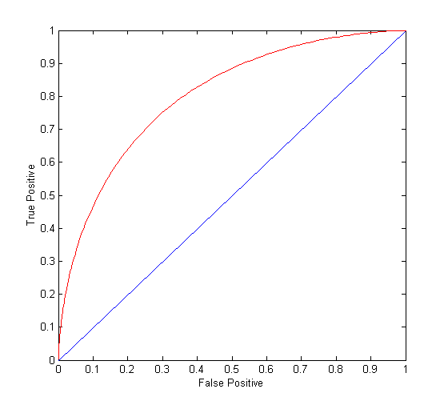
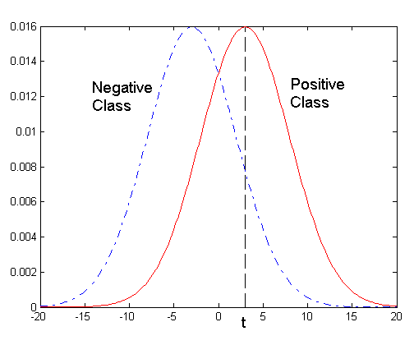
ROC Curve
- 1-dimensional data set containing 2 classes (positive and negative)
- any points located at x > t is classified as positive
At threshold t:
TP=0.5, FN=0.5, FP=0.12, FN=0.88

Slide 32
ROC Curve
(TP,FP):
(0,0): declare everything
to be negative class
(1,1): declare everything
to be positive class
(1,0): ideal
Diagonal line:
  Random guessing
  Below diagonal line:
    prediction is opposite of the true class

Slide 33
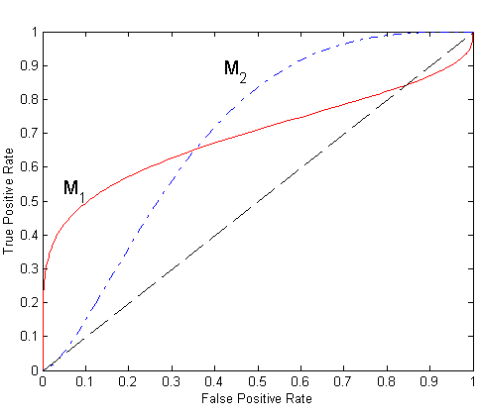
Using ROC for Model Comparison
No model consistently outperform the other
  M₁ is better for small FPR
  M₂ is better for large FPR
Area Under the ROC curve
  Ideal:
    Area = 1
  Random guess:
    Area = 0.5

Slide 34
How to Construct an ROC curve
Use classifier that produces posterior probability for each test instance P(+|A)
Sort the instances according to P(+|A) in decreasing order
Apply threshold at each unique value of P(+|A)
Count the number of TP, FP,
TN, FN at each threshold
TP rate, TPR = TP/(TP+FN)
FP rate, FPR = FP/(FP + TN)
Instance | P(+|A) | True Class
1 | 0.95 | +
2 | 0.93 | +
3 | 0.87 | -
4 | 0.85 | -
5 | 0.85 | -
6 | 0.85 | +
7 | 0.76 | -
8 | 0.53 | +
9 | 0.43 | -
10 | 0.25 | +

Slide 35
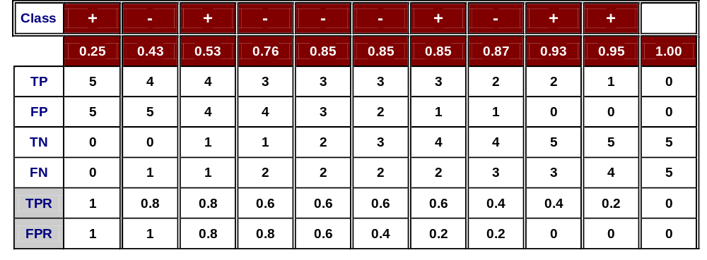
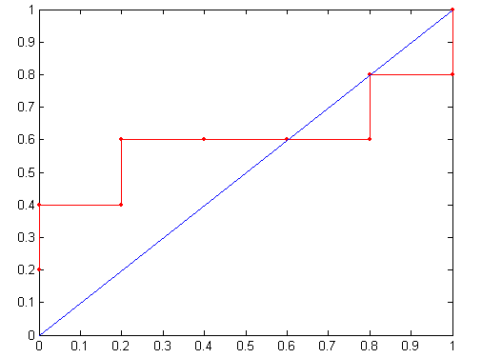
How to construct an ROC curve
Threshold >=
ROC Curve:

Slide 36
Slide References
Slides for Chapter 4 from “Introduction to Data Mining” by Pang-Ning Tan, Michael Steinbach, Vipin Kumar
Some slides from Dr.Chengkai Li’s lecture on Model evaluation

