Slide 1
Dynamic Flight Fare Forecasting Using Macroeconomic Regressors
Final Review | Project ML06 | Time series forecasting

Slide 2
Problem
• Airfares move with fuel, inflation and demand
• History-only forecasts cannot say why fares change
• Regression alone ignores time and risks spurious results

Slide 3
Data (FRED)
• Airline fares: CUSR0000SETG01
• jet_fuel: DJFUELUSGULF
• cpi: CPIAUCSL
• unemp: UNRATE
• sentiment: UMCSENT
• 437 months, Apr 1990 to Aug 2026

Slide 4
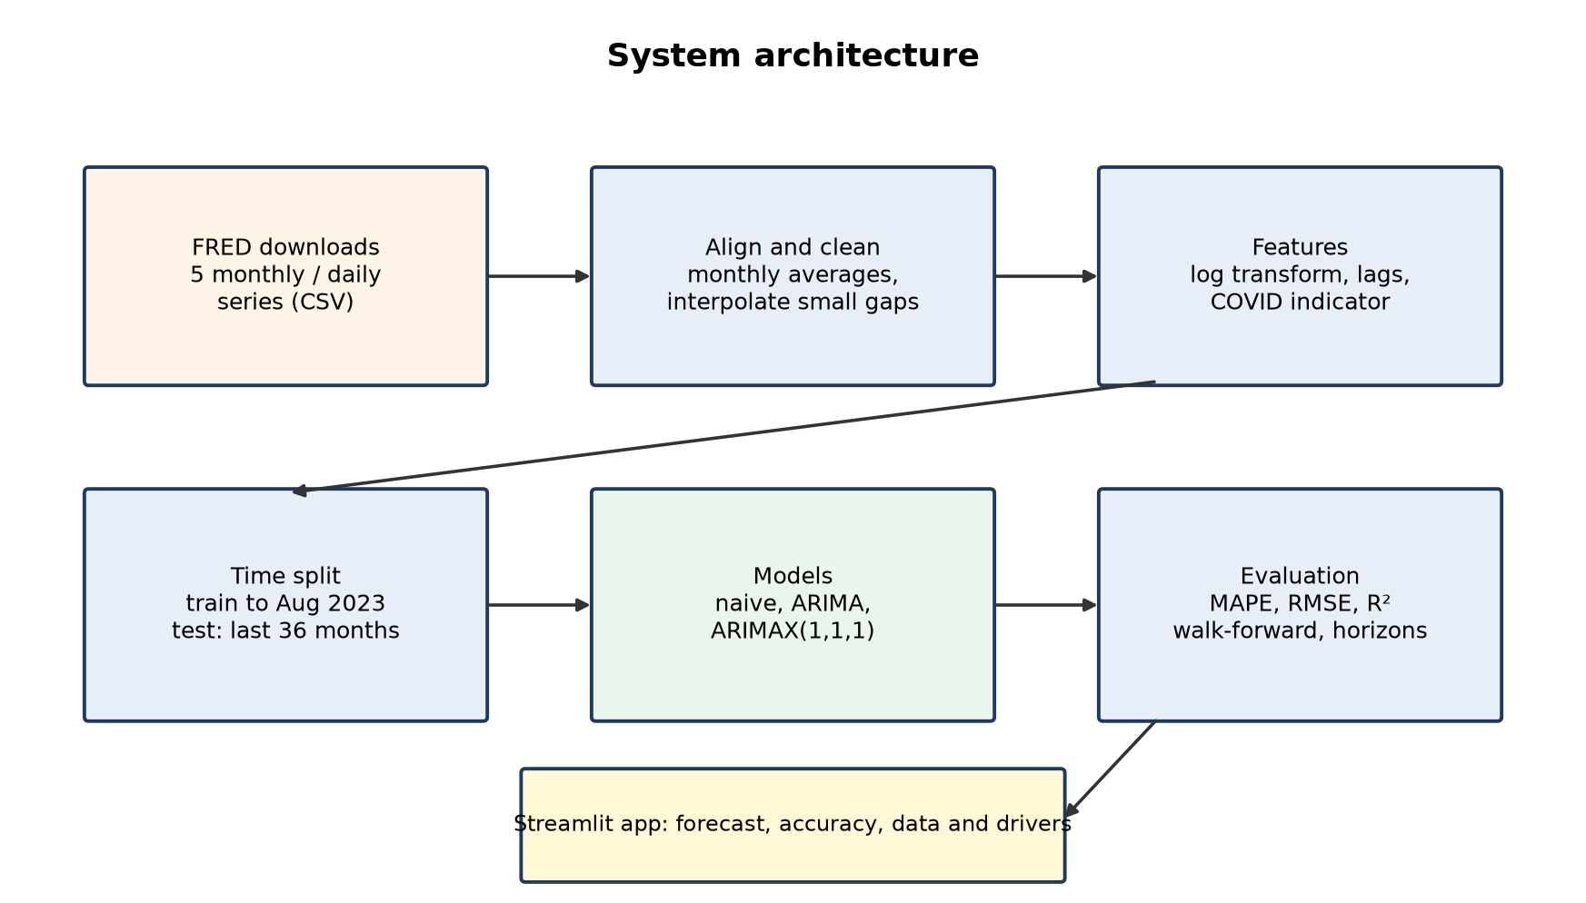
Architecture

Slide 5
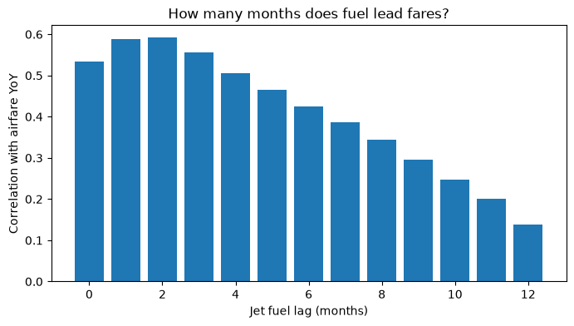
Exploration
• Correlations on year-over-year changes
• Best jet fuel lag: 2 months
• Fuel and CPI move with fares, unemployment against

Slide 6
Model 1: Linear regression
• fuel: 0.1344
• cpi: 0.5643
• unemp: 0.0250
• sentiment: 0.0049
• covid: -0.3000
• Test MAPE 11.729%, R² -1.771

Slide 7
Model 2: ARIMAX(1,1,1)
• Monthly change in log fares
• Last month's change and error
• Fuel lagged 2, others 1 month; COVID indicator
• Train Jun 1990 to Aug 2023, test last 36 months

Slide 8
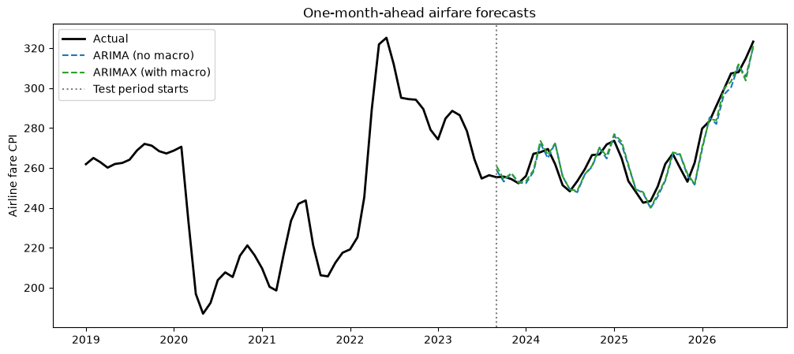
Results
• ARIMAX (with macro): MAPE 1.771%
• ARIMAX tuned (1, 1, 2): MAPE 1.782%
• ARIMAX walk-forward (with macro): MAPE 1.805%
• Naive: MAPE 2.152%
• Linear regression: MAPE 11.729%

Slide 9
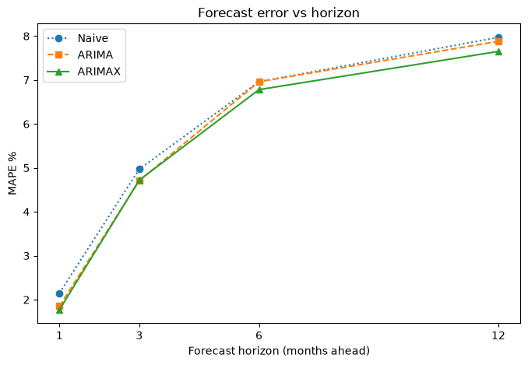
Horizons
• 1 month(s): ARIMAX 1.77%, naive 2.15%
• 3 month(s): ARIMAX 4.72%, naive 4.97%
• 6 month(s): ARIMAX 6.78%, naive 6.96%
• 12 month(s): ARIMAX 7.65%, naive 7.97%

Slide 10
Demo App
• Forecast tab
• Model accuracy tab
• Data and drivers tab
• Run: streamlit run flight_app.py

Slide 11
Conclusion & Future Work
• History + economy forecasts best
• Indicators add a consistent, modest gain
• Next: Diebold-Mariano test, airline data, Indian fares

Slide 12
References
• [1] B. Atems et al. (2019). Do jet fuel price movements help forecast airline fares and the demand
• [2] R. J. Hyndman et al. (2006). Another look at measures of forecast accuracy
• [3] F. X. Diebold et al. (1995). Comparing predictive accuracy
• [4] C. W. J. Granger et al. (1974). Spurious regressions in econometrics
• [5] S. Seabold et al. (2010). statsmodels: Econometric and statistical modeling with Python
• [6] R. J. Hyndman et al. (2021). Forecasting: Principles and Practice, 3rd edition (chapter 10, Dynamic

