Slide 1
Interpretable Prediction of 30-Day Hospital Readmission in Diabetic Patients
Final Review | Project ML11 | Machine Learning

Slide 2
Problem
• 11.4% of diabetic hospital stays end in readmission within 30 days
• Staff need to know before discharge who is at high risk
• Existing scores (LACE) separate patients poorly
• Black-box models cannot be checked at the bedside

Slide 3
Data
• UCI Diabetes 130-US hospitals, 101,766 stays
• 99,340 stays from 69,987 patients after cleaning
• Split by patient: 79,567 train / 19,773 test
• Validation set for choosing model sizes

Slide 4
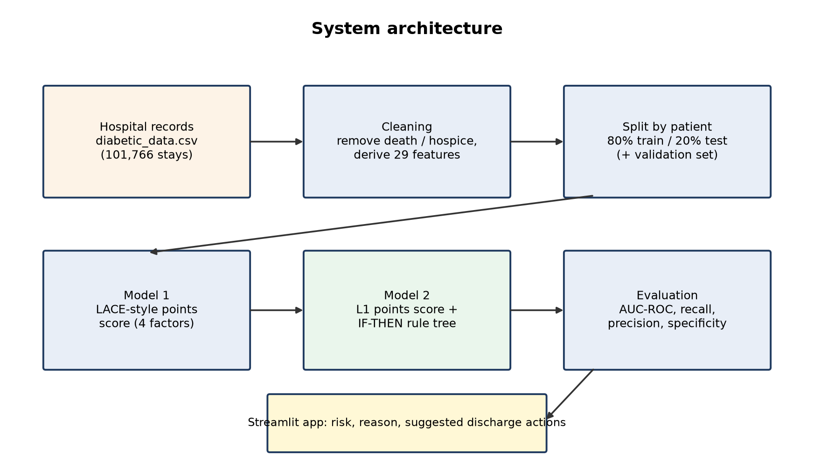
Architecture

Slide 5
Model 1: LACE-style score
• Length of stay: 1 day = 1, 2 = 2, 3 = 3, 4-6 days = 4, 7-13 = 5, 14+ = 7
• Emergency admission: Yes = 3, No = 0
• Number of diagnoses: 1 point per diagnosis above 4
• Emergency visits (past year): 1 point per visit
• High risk: score 11+

Slide 6
Model 2: learned points score
• Inpatient admissions (past year) >= 2: 5 points
• Inpatient admissions (past year) >= 1: 4 points
• Discharged to a care facility: 2 points
• Emergency visits (past year) >= 1: 1 points
• Discharged home: -3 points
• High risk: score 2+

Slide 7
IF-THEN rules
• Rule 1: IF Inpatient admissions (past year) >= 5 AND Emergency visits (past year) >= 1 → 42.2%
• Rule 2: IF Inpatient admissions (past year) >= 5 AND Emergency visits (past year) = 0 AND Age <= 70 → 36.2%
• Rule 3: IF Inpatient admissions (past year) >= 5 AND Emergency visits (past year) = 0 AND Age >= 71 → 26.9%
• ... 16 rules in total

Slide 8
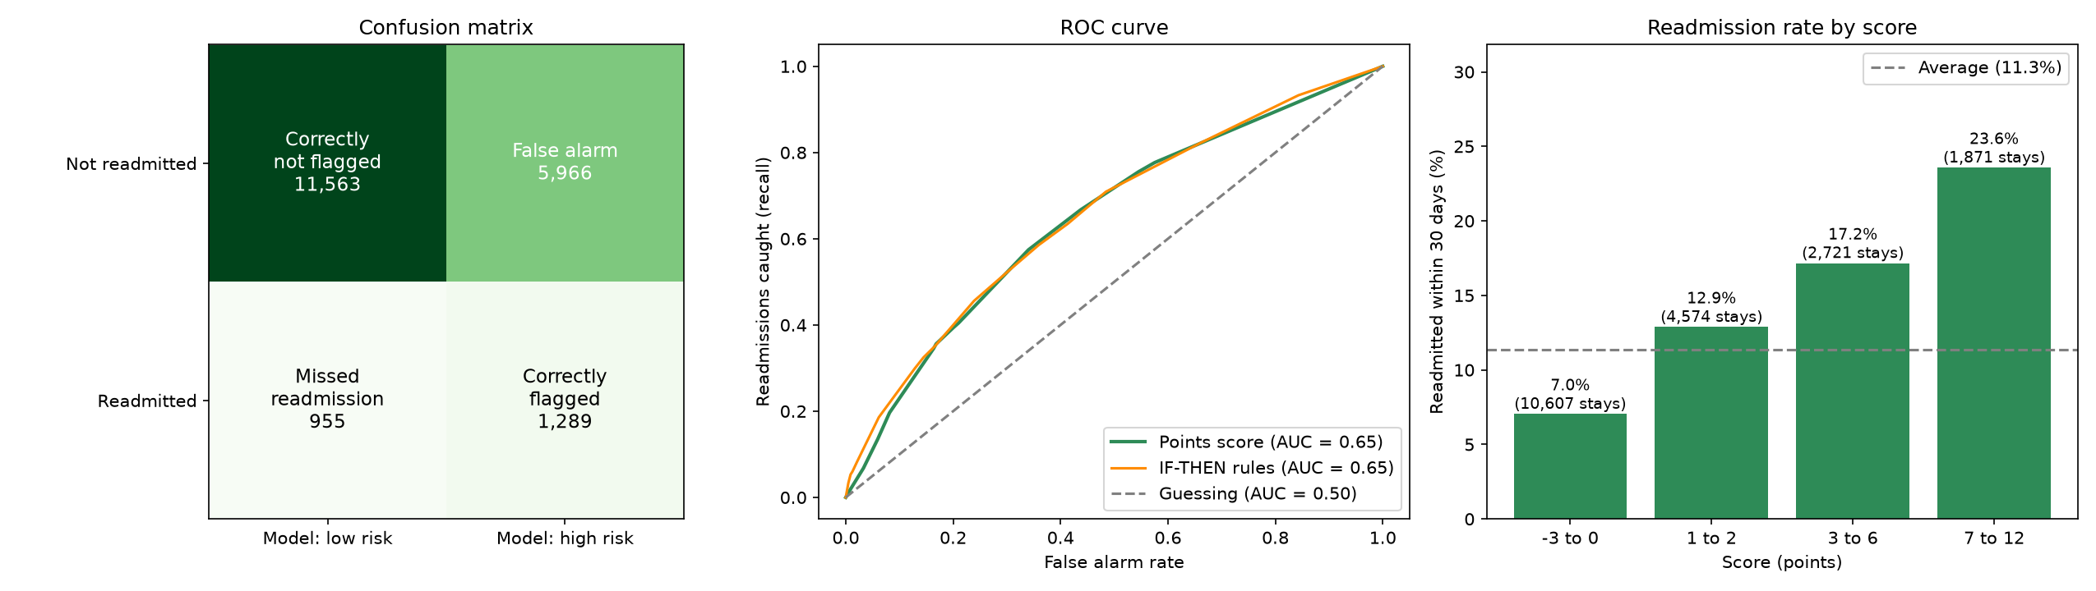
Results
• AUC-ROC: 0.563 → 0.648 (+0.085)
• Recall: 0.346 → 0.574
• Black box: 0.669 (only 0.021 higher)
• Model 2 selected

Slide 9
Demo App
• Check a patient: both scores, matching rule, action checklist
• How the models work: points tables and rules
• Model performance: comparison and charts
• Run: streamlit run app.py

Slide 10
Conclusion & Future Work
• Readable models lose very little accuracy
• Next: richer data (MIMIC-IV), all diagnoses, clinician-agreed cut-off

Slide 11
References
• [1] B. Strack et al. (2014). Impact of HbA1c Measurement on Hospital Readmission Rates: Analysis of
• [2] C. van Walraven et al. (2010). Derivation and validation of an index to predict early death or unplan
• [3] D. Kansagara et al. (2011). Risk Prediction Models for Hospital Readmission: A Systematic Review
• [4] B. Ustun et al. (2016). Supersparse linear integer models for optimized medical scoring system
• [5] C. Rudin et al. (2019). Stop explaining black box machine learning models for high stakes deci
• [6] R. Tibshirani et al. (1996). Regression shrinkage and selection via the lasso

