Slide 1
Fair Student Dropout Early-Warning System using Machine Learning
Final Review | Project ML14 | Machine Learning

Slide 2
Problem
• Dropout is noticed too late to help
• Advisors need an early, ranked watch list
• The list must catch at-risk students of every gender and age group equally
• Data: 4424 students, Realinho et al. 2022 [1]

Slide 3
Existing vs Proposed
• Existing: late, accuracy-only models, one threshold, no fairness check
• Proposed: early warning with recall target
• Reweighing (M1) and equal-opportunity thresholds (M2)
• Per-group audit with confidence intervals
• Explained risk levels in a web app

Slide 4
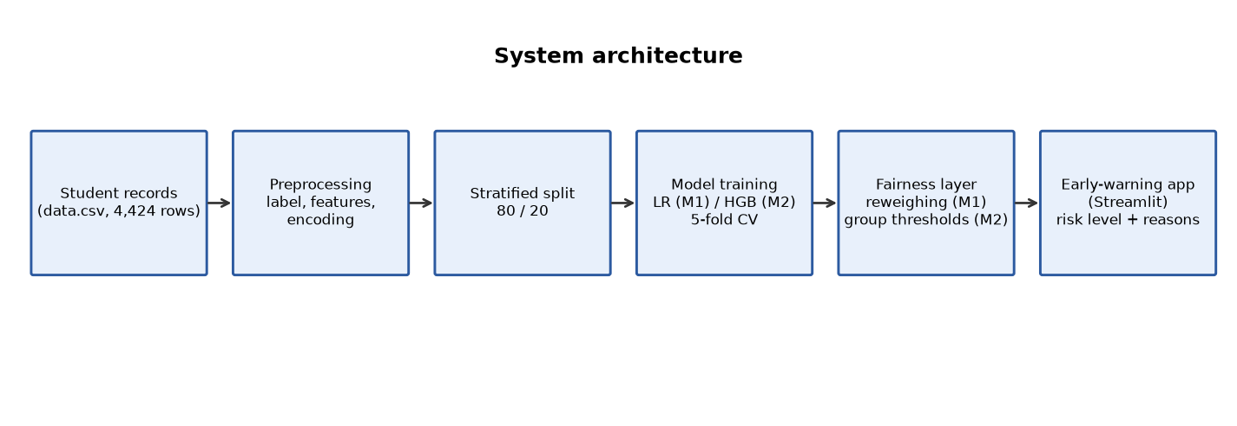
Architecture

Slide 5
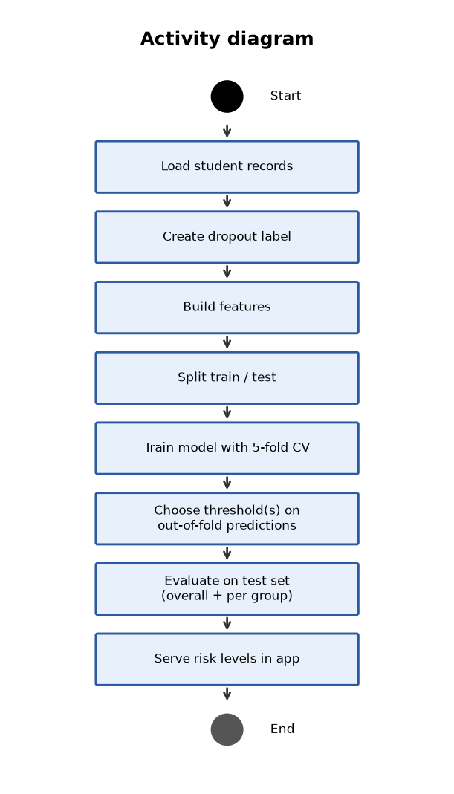
Models
• M1: logistic regression, 22 enrolment features, reweighing by gender x age
• M2: tuned gradient boosting, 34 features incl. 1st semester, CV ROC-AUC 0.9001
• Thresholds chosen on out-of-fold predictions only
• Stratified 80/20 split, 5-fold CV

Slide 6
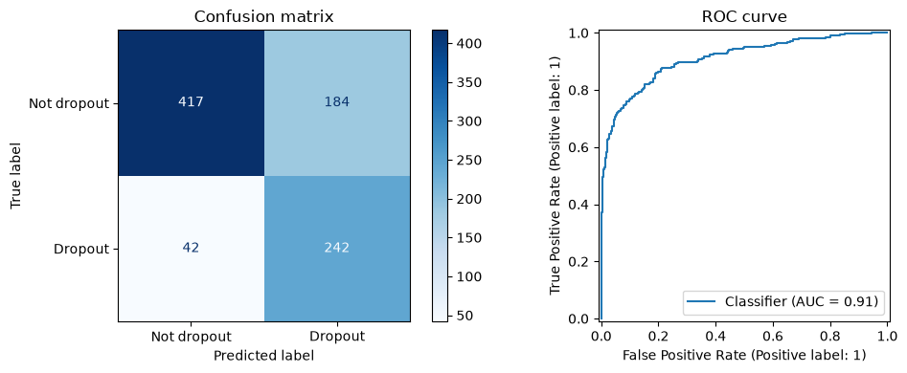
Results
• M1: ROC-AUC 0.796, recall 0.761, F1 0.604
• M2: ROC-AUC 0.910, recall 0.852, F1 0.682
• Selected: M2

Slide 7
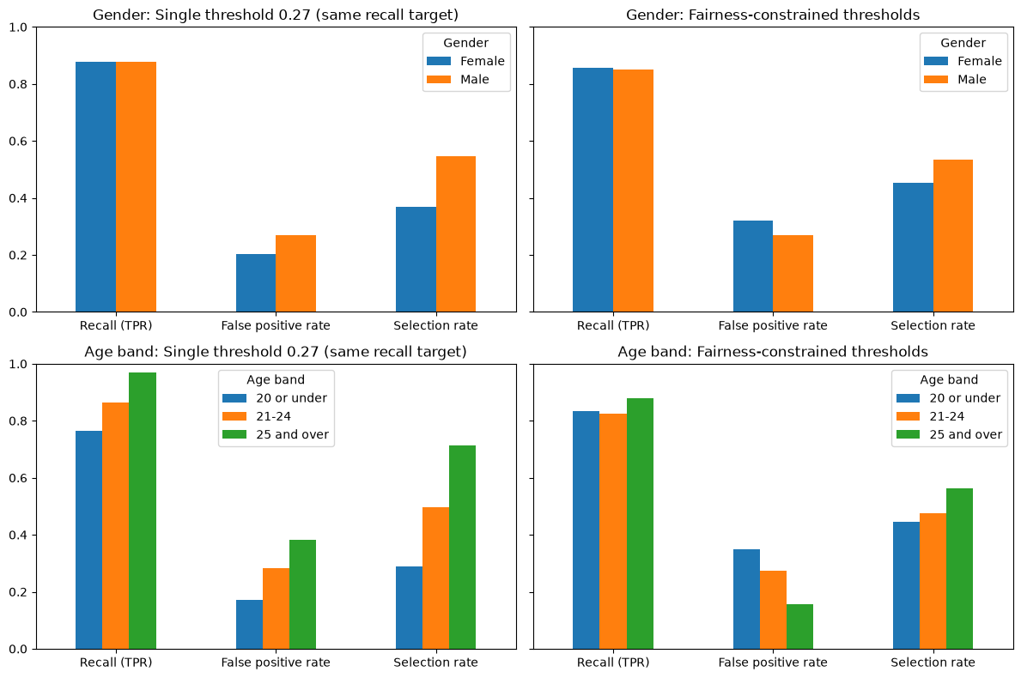
Fairness
• M2 age-band recall gap: 0.283 at threshold 0.5 -> 0.054 with group thresholds
• M2 gender recall gap: 0.006
• Cost: lower precision, more students flagged

Slide 8
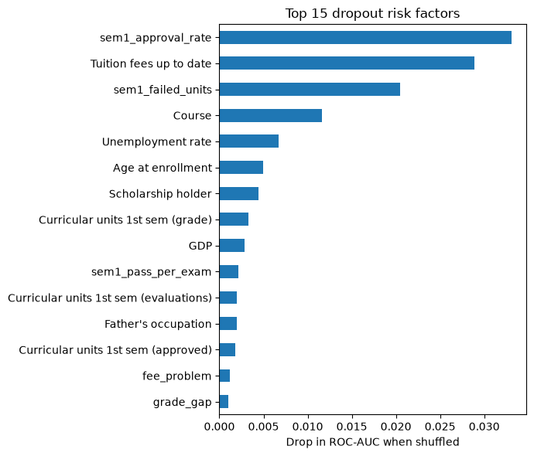
Top Risk Factors

Slide 9
Demo App
• Check a student: risk level + reasons
• Watch list for advisors
• Fairness tab
• Model performance tab
• Run: streamlit run app.py

Slide 10
Conclusion & Future Work
• Fair early warning is feasible with modest precision cost
• Validate on other cohorts / institutions
• Add 2nd-semester stage, calibration and drift monitoring

Slide 11
References
• [1] V. Realinho, J. Machado, L. Baptista, M. V. Martins (2022). Predicting Student Dropout and Academic Success.
• [2] F. Kamiran, T. Calders (2012). Data preprocessing techniques for classification without discrimination.
• [3] M. Hardt, E. Price, N. Srebro (2016). Equality of Opportunity in Supervised Learning.
• [4] J. Gardner, C. Brooks, R. Baker (2019). Evaluating the Fairness of Predictive Student Models Through Slicing Analysis.
• [5] R. F. Kizilcec, H. Lee (2020). Algorithmic Fairness in Education.
• [6] G. Ke, Q. Meng, T. Finley, T. Wang, W. Chen, W. Ma, Q. Ye, T.-Y. Liu (2017). LightGBM: A Highly Efficient Gradient Boosting Decision Tree.

