Slide 1
Saravanan R

Slide 2
Debugging
Debugging is the process of identifying and fixing any issues in the source code of a program. Modern IDEs like Eclipse provide debugging tools that make it easier for developers to walk through their code interactively and inspect it to spot and resolve any issues.
Eclipse allows running an application in Debug mode which helps with stepping through each line of code in a program. Eclipse also provides a Debug Perspective which is a set of views grouped together that help inspect code and make the debugging process very effective.

Slide 3
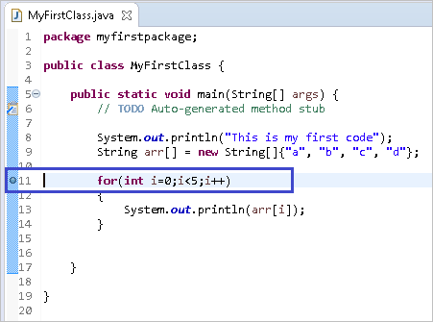
Breaking Points
A breakpoint is a point in code where the program execution pauses during debugging. This allows the programmer to inspect code and the flow of execution at the defined breakpoint.
To define a breakpoint, either double click on the left margin in the editor or right click and select Toggle Breakpoint:

Slide 4

Stepping Commands
Step Into
Step Out
Step Over
Resume
Suspend
Terminate

Slide 5
Step Into the Function
Executes the current statement and then stops at the next statement. If the current statement is a function or script call, then the debugger steps into that function or script, otherwise it stops at the next statement.
Press F5 or the Step Into icon in the toolbar to enter into the Step into Function.

Slide 6
Step Over the Function
Executes the current statement and then stops at the next statement. If the current statement is a function or script call then the debugger executes the whole function or script, and it stops at the next statement after the function call.
Press F6 or the Step Over icon in the Toolbar to execute the current line of code and go to the next one

Slide 7
Step out the Function
Steps out of the current function and up one level if the function is nested. If in the main body, the script is executed to the end, or to the next breakpoint. The skipped statements are executed, but not stepped through.
Press F7 or the Step Out icon in the toolbar to execute the Step Out Funtion.

Slide 8
Resume ,Suspend ,Terminate
Resumes normal execution of the program until the next breakpoint is reached.
Suspends the selected thread of a target so that you can browse or modify code, inspect data, step, and so on.
Terminates the selected debug target.

Slide 9
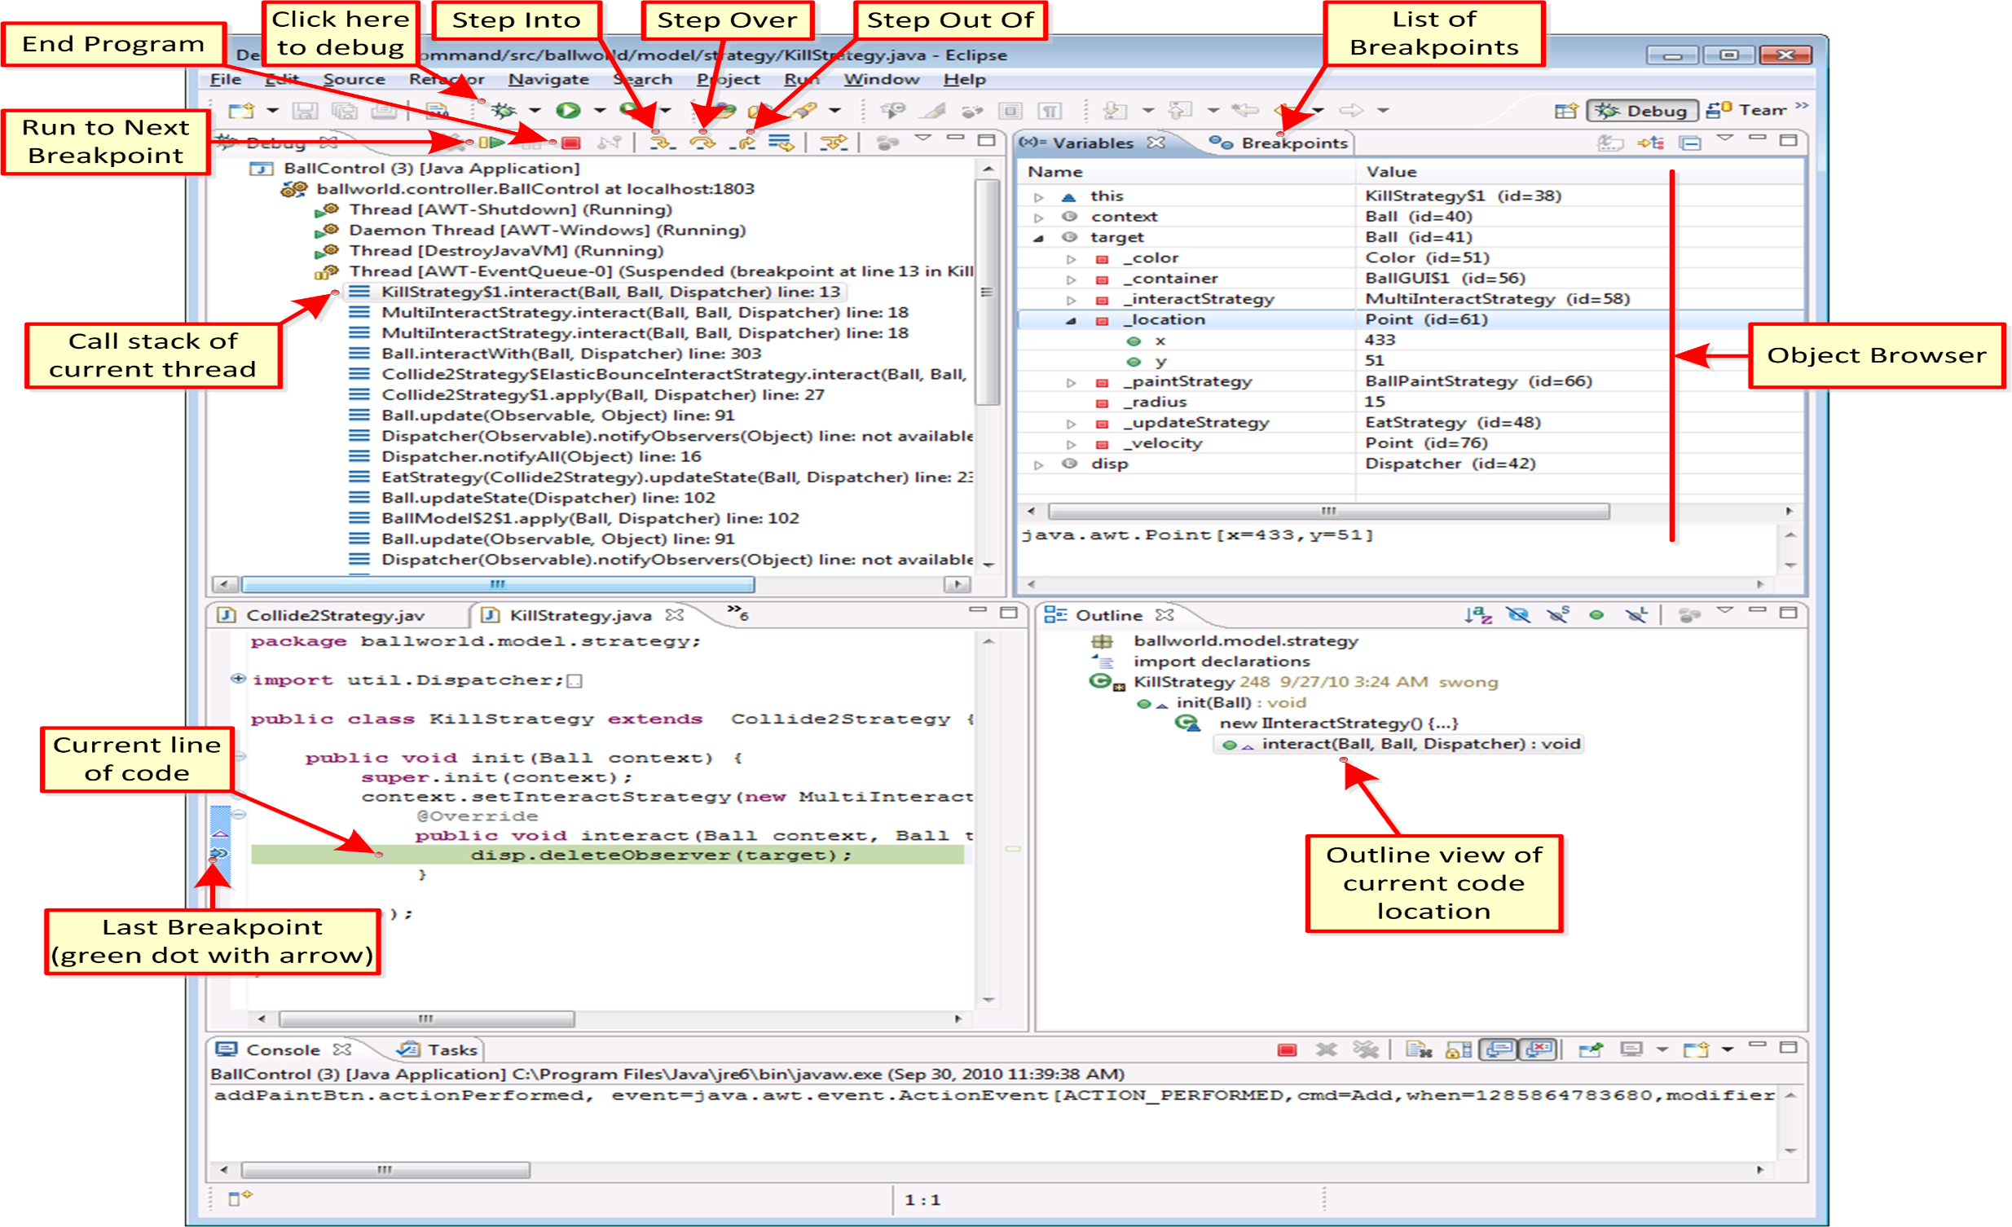

Slide 10
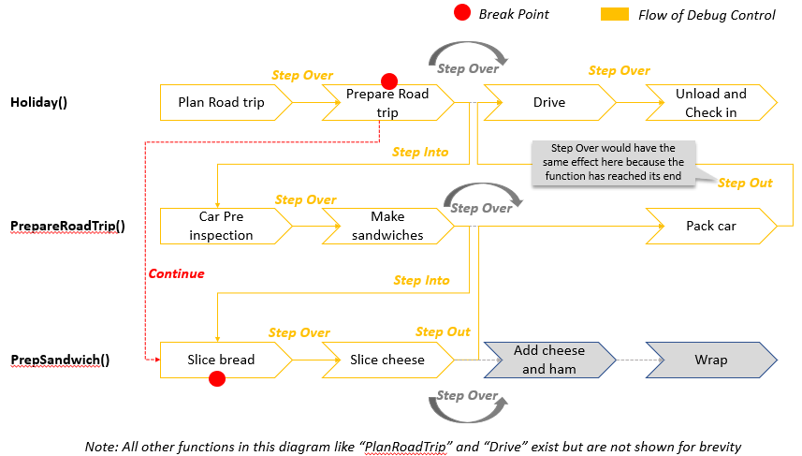
Example for Debugging

