Slide 1
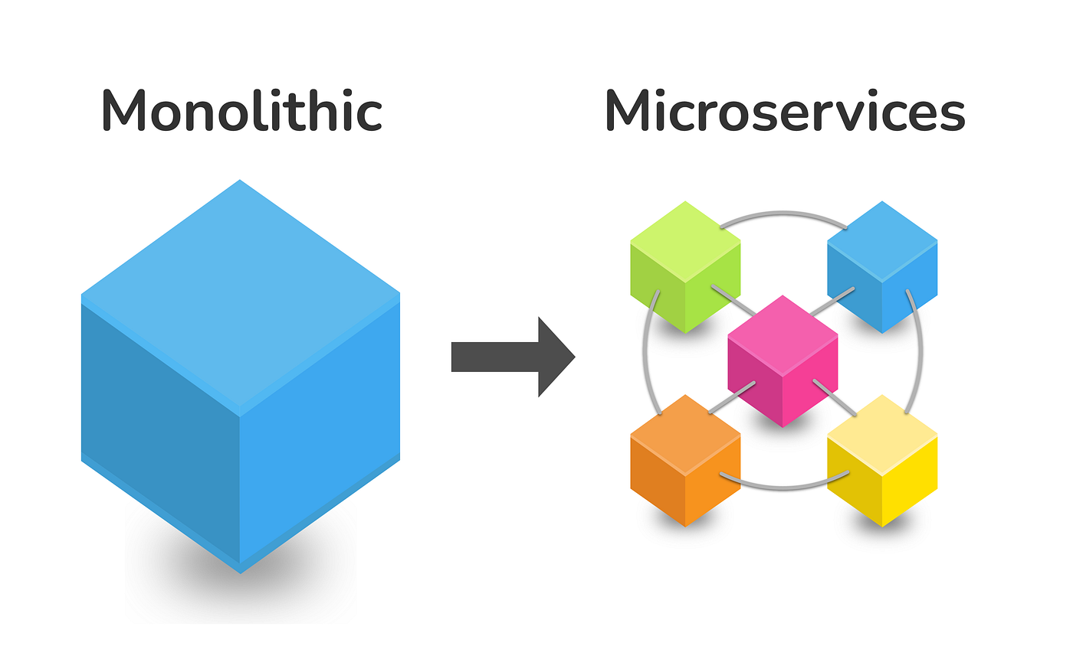
Mastering Microservices: From Fundamentals to Real-World Applications with Spring Boot 3
Empowering Scalability and Agility in Modern Software Development

Slide 2
What We'll Cover Today
Introduction
What Are Microservices?
Key Benefits
Core Principles of Microservices
Comparison: Monolithic vs. Microservices
Key Components in Microservices Architecture
Challenges and Solutions
Real-World Use Cases
Introduction Spring Boot 3
Q&A

Slide 3
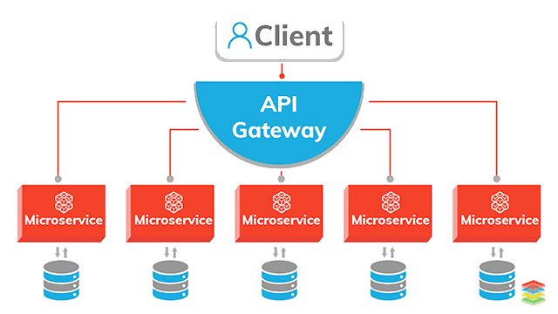
Introduction to Microservices
Define Microservices: "An architectural style that structures an application as a collection of small, independent services"
Key Characteristics:
Loosely coupled
Independently deployable
Organized around business capabilities

Slide 4
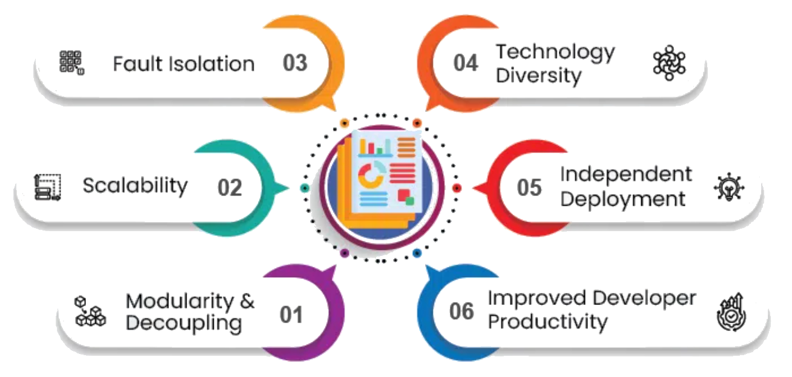
Key Benefits
Modularity & Decoupling
Improved Fault Isolation
Independent Deployment
Scalability
Technology Diversity
Enhanced Developer Productivity
Advantages of Microservices Architecture

Slide 5
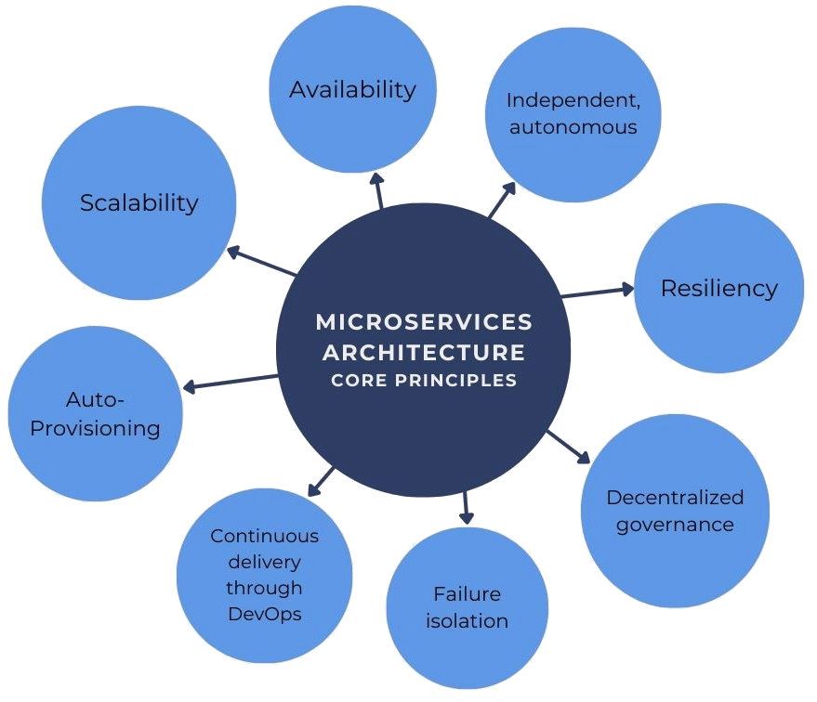
Core Principles of Microservices
Decentralized Governance Resilience and Fault Tolerance
Service Independence Continuous Delivery

Slide 6
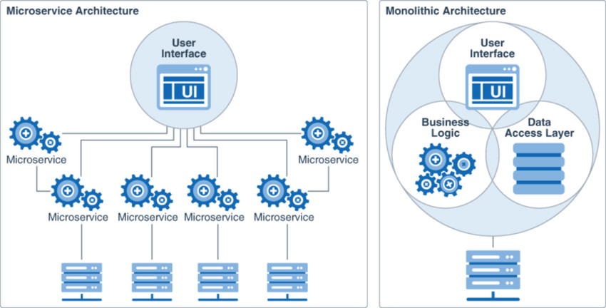
Monolithic vs. Microservices
Monolithic: Single-tiered, tightly coupled vs Microservices: Multi-tiered, loosely coupled
Architecture comparison

Slide 7
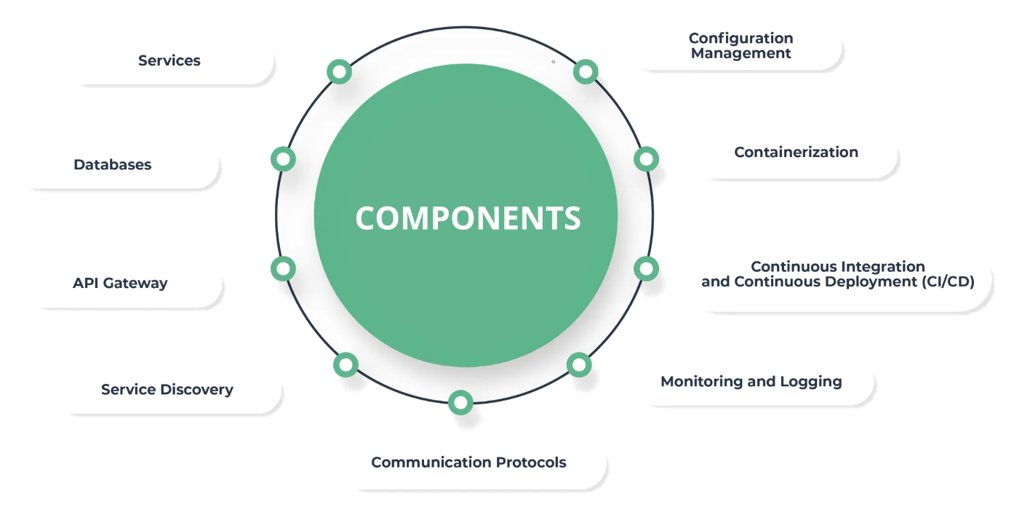
Key Components of Microservices Architecture
API Gateway Containerization (Docker, Kubernetes)
Load Balancer Event Streaming (Kafka, RabbitMQ)
Service Discovery

Slide 8
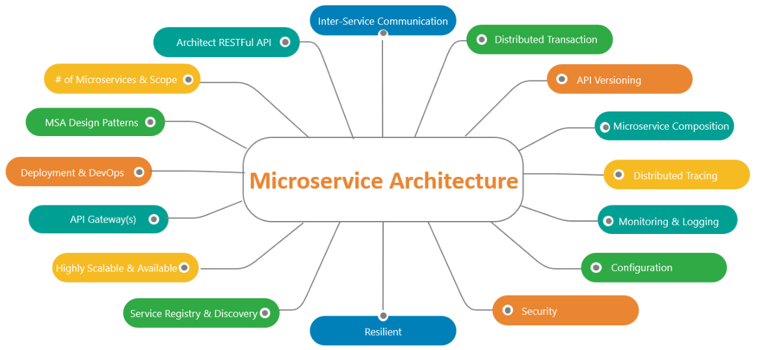
Challenges and Solutions Challenge: Monitoring and Debugging
Solution: Logging (ELK), Distributed Tracing (Jaeger, Zipkin)
Challenge: Inter-Service Communication
Solution: REST, gRPC, Messaging Queues
Challenge: Data Management
Solution: Event Sourcing, CQRS

Slide 9
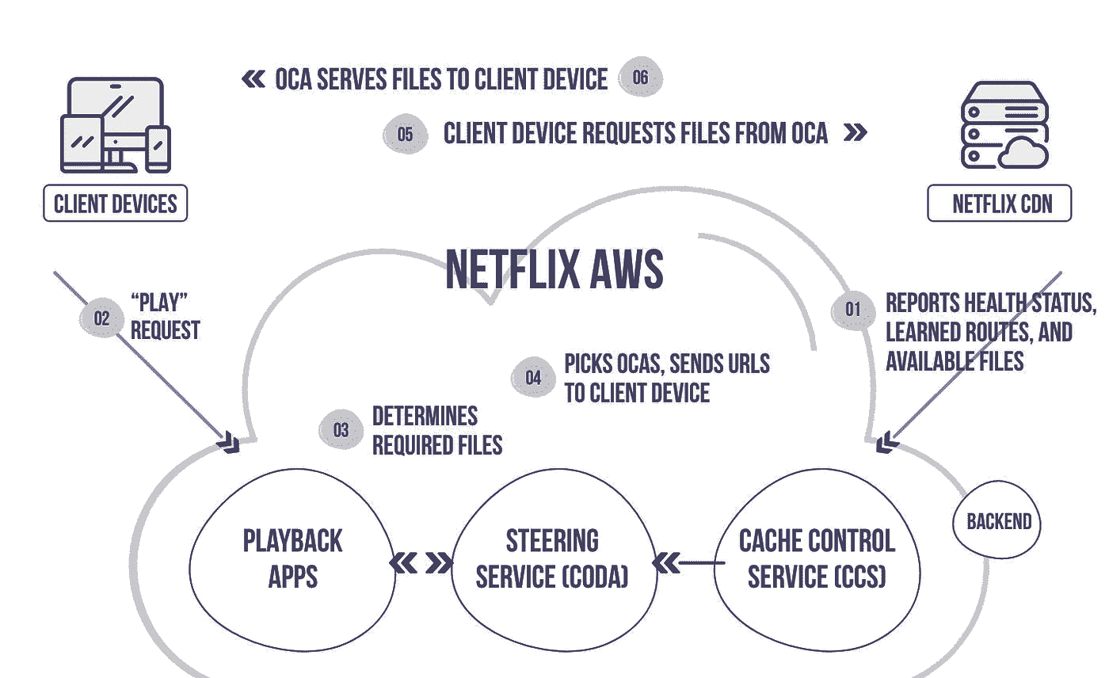
Real-World Use Cases
Examples of Companies Using Microservices: Netflix: Video Streaming Platform

Slide 10
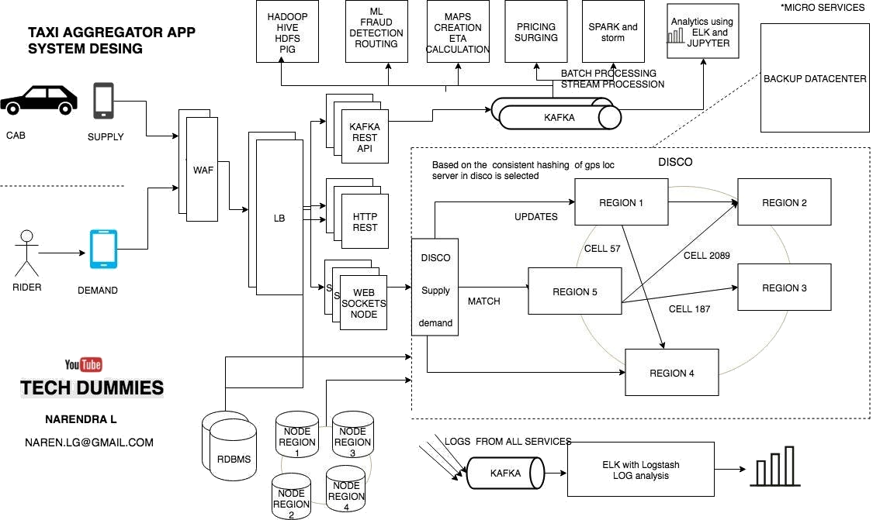
Real-World Use Cases
Examples of Companies Using Microservices: Uber: Ride-Hailing Application

Slide 11
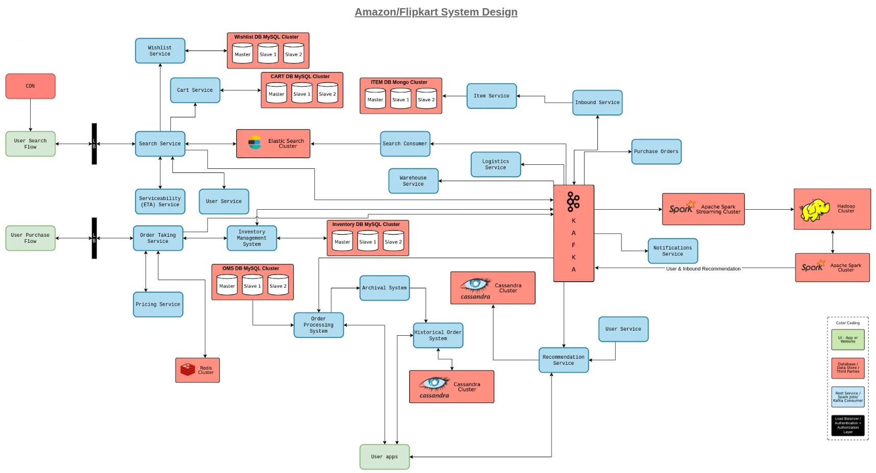
Real-World Use Cases

Slide 12
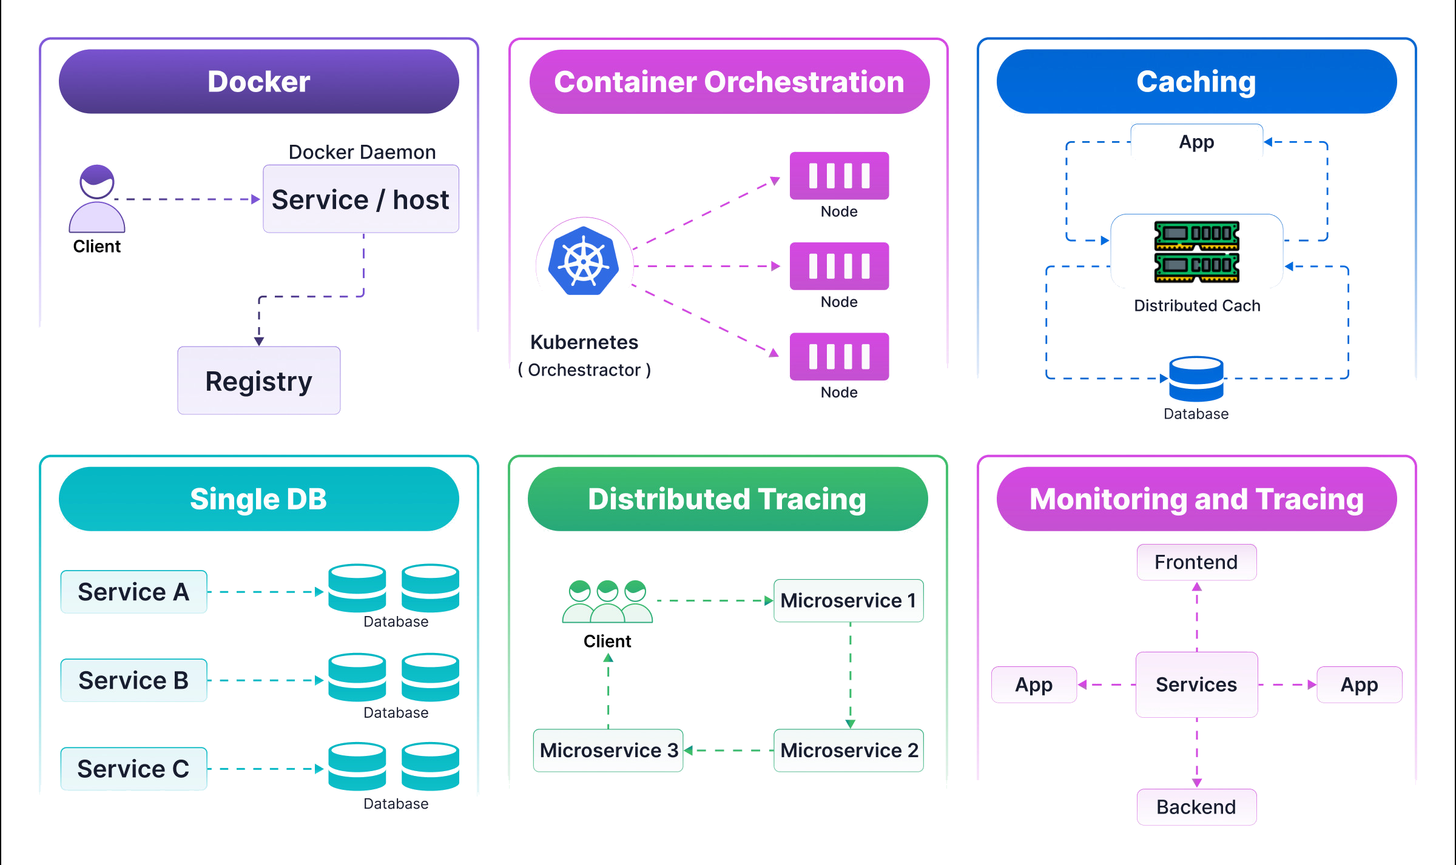
Best Practices
Design for Failure, Use Domain-Driven Design, Keep Services Small and Focused, Automate Testing and Deployment

Slide 13
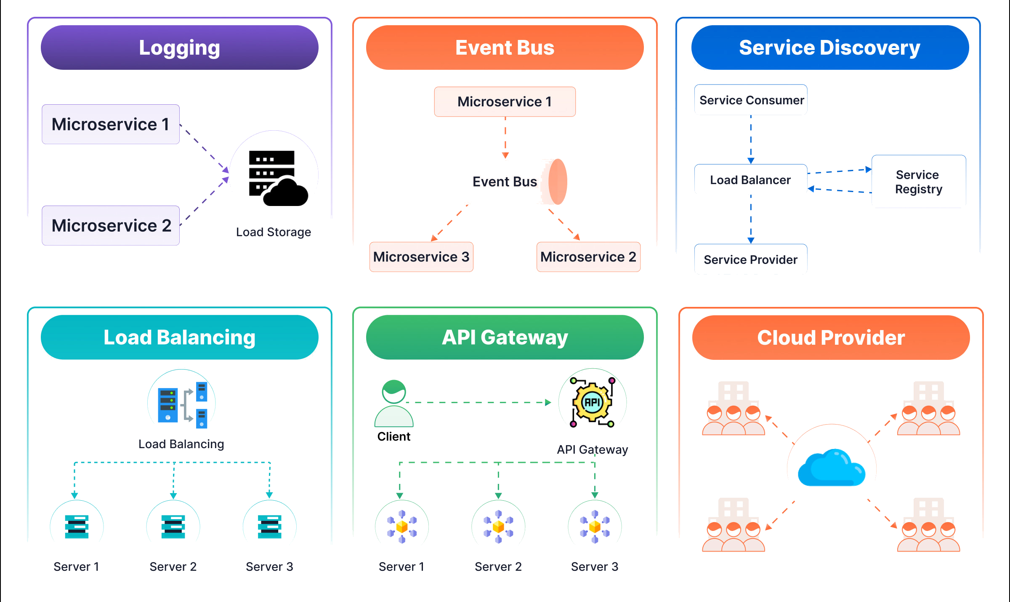
Best Practices
Design for Failure, Use Domain-Driven Design, Keep Services Small and Focused, Automate Testing and Deployment

Slide 14
Recap the key takeaways
Benefits of Microservices
How they compare to monoliths
Tools and techniques for implementation
Key Benefits
Scalability
Flexibility in Technology Stack
Faster Time to Market
Improved Fault Isolation
Enhanced Developer Productivity
Aspect | Monolithic | Microservices
Codebase | Single, unified. | Multiple, independent per service.
Deployment | All components deployed together. | Services deployed independently.
Database | Centralized. | Decentralized, per service.
Communication | In-memory. | API or network-based.
Scaling | Entire application scaled. | Individual services scaled.
Failure Isolation | Failure impacts the whole system. | Failures isolated to specific services.
Technology Choice | Limited to a single stack. | Flexible, polyglot architecture.
Use Case | Small to medium, simpler apps. | Large, complex, scalable apps.

Slide 15
Introduction to Spring Boot 3
What is Spring Boot 3?
A framework for building production-ready, Java-based applications quickly
and efficiently.
Built on top of the Spring Framework, it simplifies the development of standalone,
microservice-style applications.
Key Features of Spring Boot 3
Built for Java 17+
Leverages modern Java features like records, pattern matching, and sealed classes.
Native Support for GraalVM
Enables faster startup and reduced memory footprint through native image generation.
Improved Observability
Enhanced integration with Micrometer and OpenTelemetry for metrics and distributed tracing.
Simplified Configuration
Enhanced YAML/Properties support with streamlined APIs.
Enhanced Security
Updated Spring Security to support modern authentication mechanisms (e.g., OAuth2, JWT).
Why Spring Boot 3 for Microservices?
Efficient Development: Built-in support for REST APIs, WebFlux, and messaging.
Scalability: Seamless integration with cloud platforms like AWS, Azure, and Kubernetes.
Resilience: Circuit breakers, retries, and fallback mechanisms via Spring Cloud.
Production-Ready: Actuator endpoints for health checks, metrics, and diagnostics.

Slide 16
Thank You!
Resources Links
https://microservices.io/
https://aws.amazon.com/microservices/
https://cloud.google.com/learn/what-is-microservices-architecture
Webinar Feedback Form
https://forms.gle/Q9uQpvajHxWJMd216
https://gathr.com/e/310c6bd7
Email Id : mail4saravananks@gmail.com
Continue !!!

