Slide 1
SMART WATER Monitoring

Slide 2
Problem Statement
Project Definition: The project involves implementing IoT sensors to monitor water consumption in public places such as parks and gardens. The objective is to promote water conservation by making real-time water consumption data publicly available. This project includes defining objectives, designing the IoT sensor system, developing the data-sharing platform, and integrating them using IoT technology and Python.

Slide 3
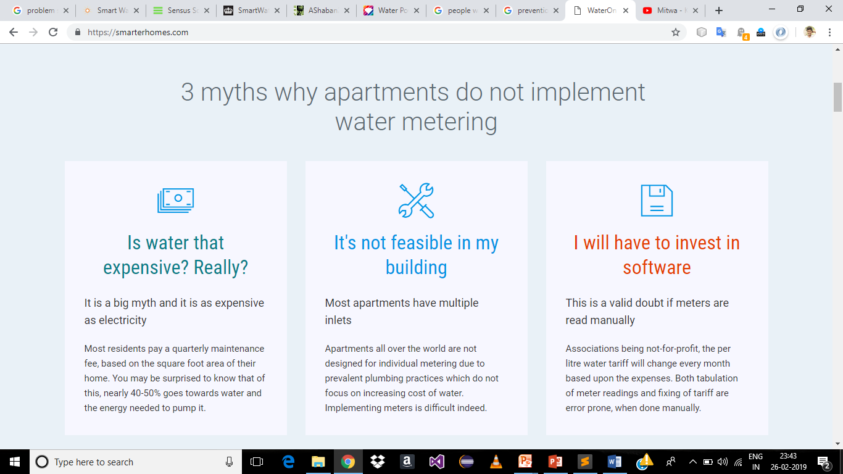
3 myths why apartments do not implement water metering

Slide 4
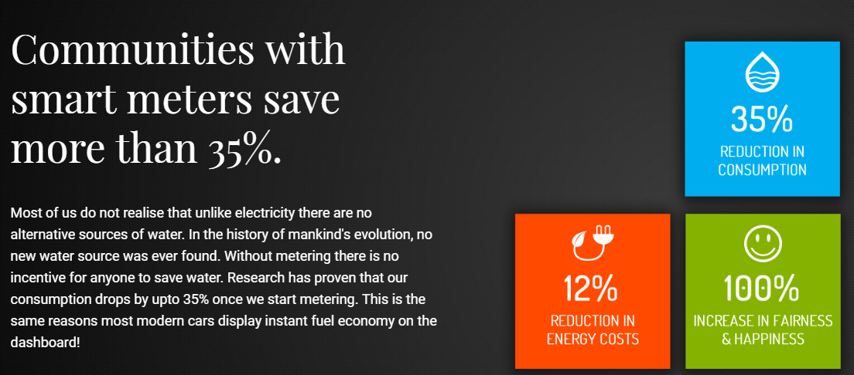
Statistics

Slide 5

Smart Water Meter
Smart Water Metering System aims to give consumers the information that they need to make intelligent decisions, the ability to execute those decisions and a variety of choices leading to substantial benefits they would not have enjoyed otherwise.
Our Primary focus:
To track the consumed quantity
To ensure safety
To detect leaks

Slide 6
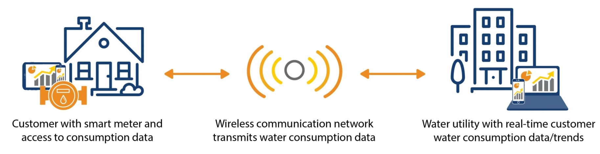
Old mechanical meters degrade over time and may fail to provide accurate measurement readings.
Benefits:
Timely water usage data
Water revenue optimization
Scalable
Water leak detection

Slide 7
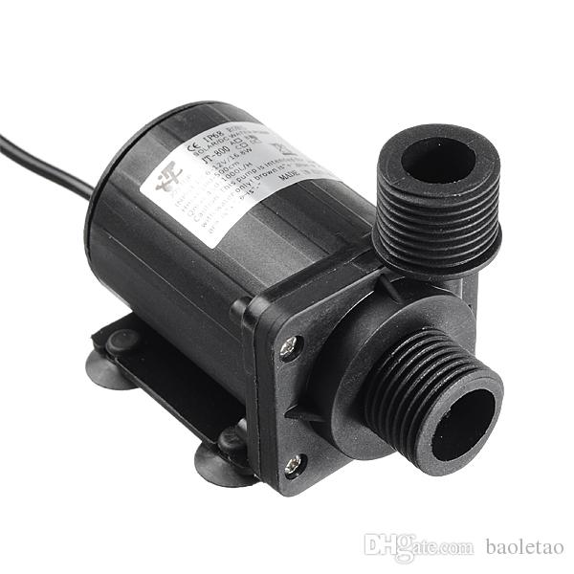
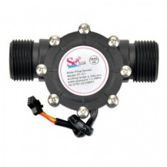
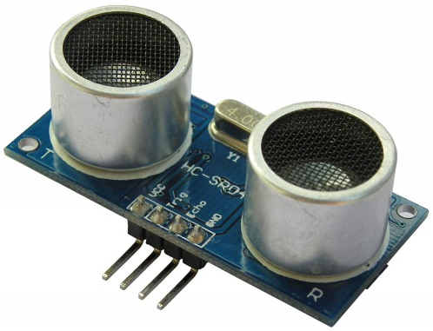
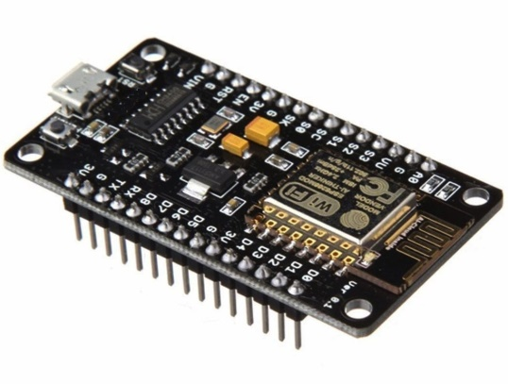
Hardware Requirements
Our Primary focus:
NodeMCU
Mechanical Flow Sensor
Ultrasonic Sensor
Arduino GSM Shield

Slide 8
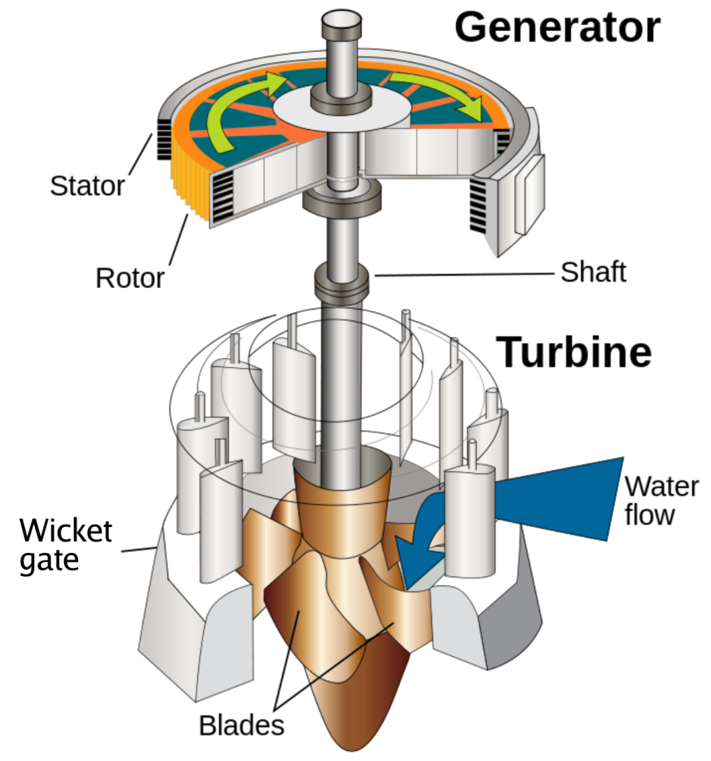
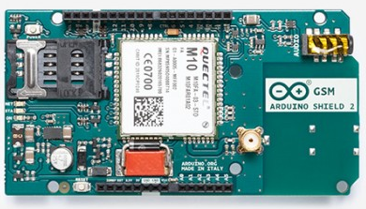
Wi-Fi Availability and Power

Slide 9
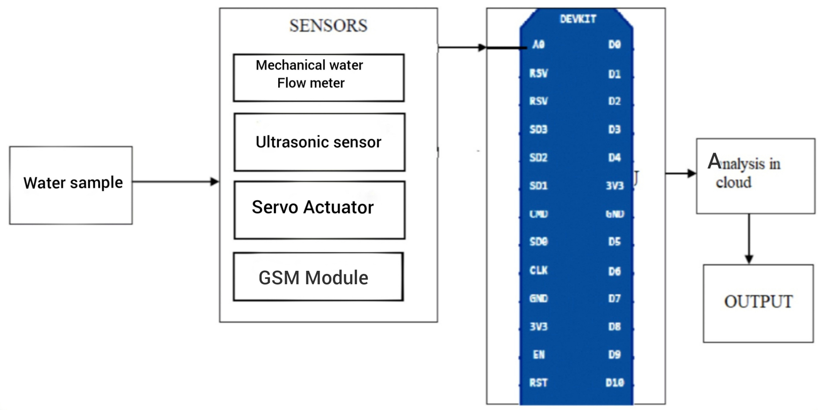
Hardware Design

Slide 10
Software Requirements
Arduino IDE
Python Visualization

Slide 11
Reference Model
Physical Devices | Mechanical Flow Sensor, Ultrasonic sensor, Arduino GSM Shield .
Connectivity | Sensors connected to Node MCU which is connected to cloud via WiFi Module
Edge Computing | Node MCU uses the received data and Analysis is done in cloud.

Slide 12
Reference Model
Data Accumulation | The data is uploaded in Google Firebase.
Data Abstraction | Console is provided to the users to find the quantity of water used by them.
Application | Application which displays the quantity and parameters

Slide 13

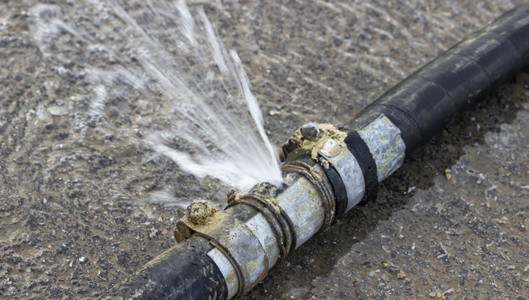
Future
Using smart water meter, usage pattern can be found.
The data obtained can be analysed using Machine Learning which will be helpful for water resource planning
Proper implementation of water leak detection.

Slide 14
THANK YOU
By
Neeraj Menon S
K.Rohith Kumar
Roshan R Bhat
Hamad Yousuff

