Slide 2
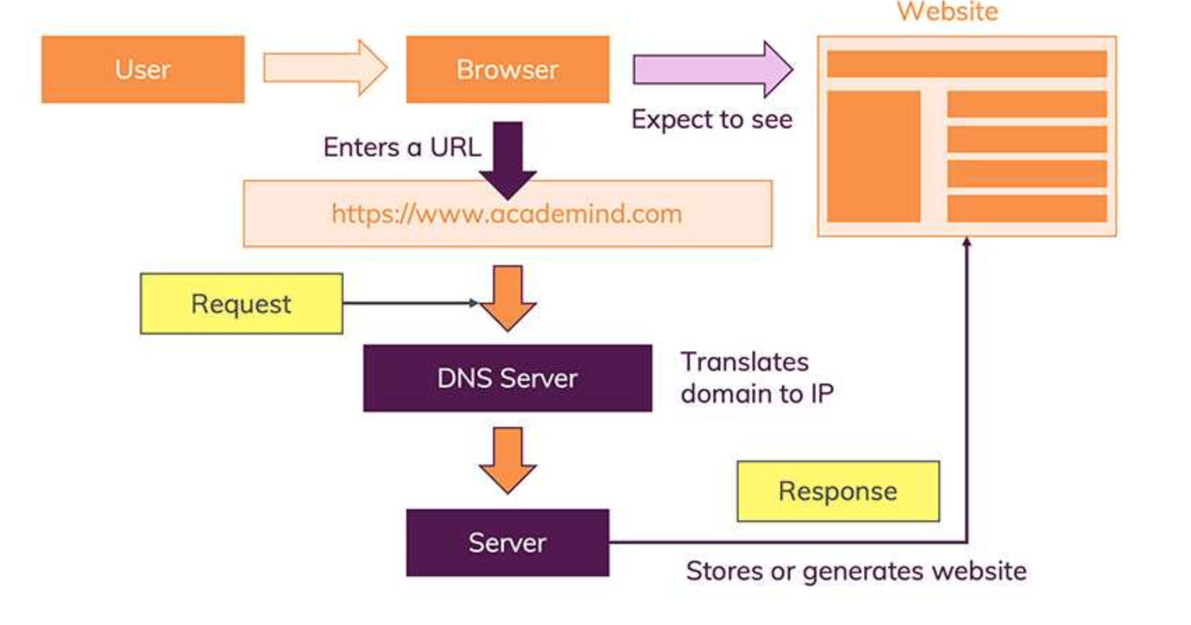

Slide 3
The moment you enter this address in your browser and you hit ENTER, a lot of different things happen:
The URL gets resolved
A Request is sent to the server of the website
The response of the server is parsed
The page is rendered and displayed

Slide 4
Step 1 - URL Gets Resolved
The website code is obviously not stored on your machine and hence needs to be fetched from another computer where it is stored. This “other computer” is called a “server”. Because it serves some purpose, in our case, it serves the website.
You enter “conceptsolutions.in” (that is called “a domain”) but actually, the server which hosts the source code of a website, is identified via IP (= Internet Protocol) addresses. The browser sends a “request” (see step 2) to the server with the IP address you entered (indirectly - you of course entered “conceptsolutions.in”).

