Slide 1
NETWORK TRAFFIC ANALYSIS
CYBER SECURITY
Presented By:
M.SARAVANAN
Salem college of engineering and technology
Computer science and engineering

Slide 2
OUTLINE
Problem Statement (Should not include solution)
Proposed System/Solution
System Development Approach (Technology Used)
Algorithm & Deployment
Result (Output Image)
Conclusion
Future Scope
References

Slide 3
Problem Statement
The ever-growing volume and complexity of network traffic make it increasingly difficult to distinguish between legitimate activity and malicious threats. Traditional security measures like firewalls are no longer sufficient to catch sophisticated cyberattacks that exploit vulnerabilities and blend in with normal network operations.

Slide 4
Proposed Solution
Data Collection:
Packet Capture: Capturing full network packets for deep inspection (useful for forensics but resource-intensive)
API Integration: Pulling data directly from network devices and security tools through APIs.
Data Preprocessing
Data Cleaning: Cleanse the collected data to remove errors and inconsistencies.
Normalization: Format the data into a consistent structure for easier analysis. This might involve converting timestamps to a common format or scaling numerical values.
Implementation:
Several commercial Network Traffic Analysis (NTA) and Network Detection and Response (NDR) solutions are available that offer these capabilities.
Open-source tools can also be used, but may require more expertise to implement and maintain.

Slide 5
System Approach
Data Analysis and Threat Detection:
Baseline Creation: Establish a baseline for "normal" traffic patterns within your network. This involves analyzing historical data to understand typical user behavior, application usage, and traffic volumes.
Anomaly Detection: Implement anomaly detection techniques to identify deviations from the established baseline. These techniques can be statistical (e.g., identifying unusual traffic volumes) or machine learning-based (e.g., using algorithms to detect patterns indicative of malicious activity).
Visualization and Reporting:
Network Traffic Visualization: Implement tools to visualize network traffic data for easier analysis. This can help identify trends, patterns, and potential bottlenecks.
Reporting: Generate reports on network traffic activity and security incidents. These reports can be used to monitor security posture, identify trends, and comply with regulations.

Slide 6
Algorithm & Deployment
Statistical Anomaly Detection:
Mean and Standard Deviation: Flags traffic exceeding a certain number of standard deviations from the average.
Interquartile Range (IQR): Identifies outliers falling outside the IQR, which encompasses the middle 50% of data points.
Machine Learning (ML) Algorithms:
Supervised Learning: Requires labeled data (normal vs. malicious) for training models like Support Vector Machines (SVM) or Random Forests to identify malicious patterns.
Unsupervised Learning: Analyzes unlabeled data to group similar traffic flows. K-Means clustering can be used to segment traffic based on features like source/destination IP, protocol, or port usage.
Deployment Considerations for Network Traffic Analysis
Scalability and Performance:Select hardware and software that can handle increasing network traffic volumes without compromising performance. Consider distributed processing or cloud-based solutions for large networks.
Expertise and Training:Personnel need training to understand the system, interpret results, and effectively respond to security incidents identified through NTA.

Slide 7
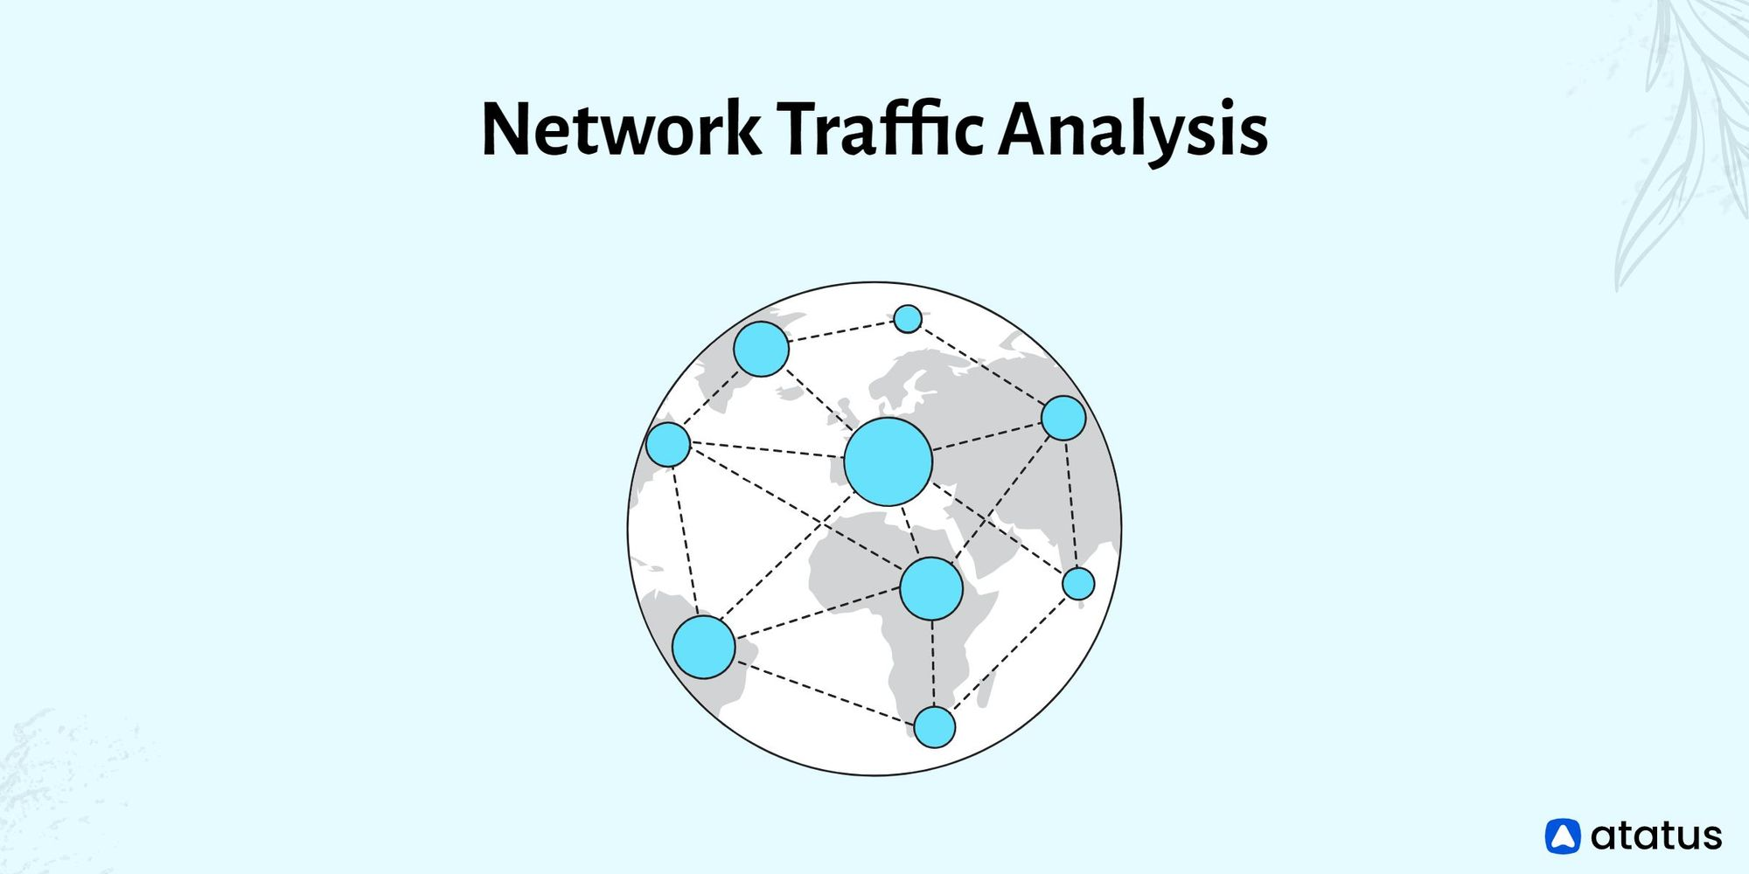
Result
Faster Incident Response:
Real-time analysis of network traffic allows for quicker identification and response to security incidents.
By prioritizing high-severity alerts, security analysts can focus on the most critical threats first.
Data-driven Security Decisions:
NTA generates valuable insights into network activity patterns and potential security risks.
This data can be used to improve security posture, optimize resource allocation, and make data-driven security decisions.

Slide 8
Conclusion
Key takeaways to emphasize in your conclusion:
Improved Network Visibility: NTA provides a comprehensive view of both traditional north-south traffic and often-overlooked east-west traffic within the network. This holistic view sheds light on potential vulnerabilities and communication patterns that might otherwise go unnoticed.
Data-Driven Security: The insights gleaned from NTA empower data-driven security decisions. Organizations can use this information to optimize resource allocation, prioritize security investments, and continuously improve their overall security posture.
In conclusion, network traffic analysis offers a powerful and multifaceted approach to cybersecurity. By leveraging its capabilities, organizations can significantly enhance their ability to detect, respond to, and ultimately prevent cyber threats.

Slide 9
Future scope
The future of network traffic analysis (NTA) is bright, driven by advancements in technology and the ever-evolving threat landscape.
1. Enhanced Automation and Machine Learning (ML):
Expect deeper integration of AI and ML for more sophisticated anomaly detection. Algorithms will become adept at identifying subtle deviations in encrypted traffic, zero-day attacks, and advanced persistent threats (APTs).
Automation will play a bigger role, with self-learning systems automatically adjusting baselines and prioritizing alerts, reducing the burden on security analysts.
Leveraging Network Traffic Analysis for Network Performance Optimization:
NTA's ability to identify traffic patterns can extend beyond security. It can be used to optimize network performance by pinpointing bottlenecks, identifying bandwidth hogs, and helping to prioritize critical traffic flows.

Slide 10
References
Here are some references for network traffic analysis:
"Practical Packet Analysis: Using Wireshark to Solve Real-World Network Problems" by Chris Sanders
"Network Forensics: Tracking Hackers through Cyberspace" by Sherri Davidoff and Jonathan Ham - This book covers network forensics techniques, including analyzing network traffic to detect and investigate security incidents.
These references cover various aspects of network traffic analysis,from basic techniques to advanced topics like network forensics and security monitoring. Depending on your specific interests and level of expertise, you can choose the most relevant resources for your needs.

Slide 11
THANK YOU

