Slide 1
Version Control VCS(Version control System)=> SCM(Source control Management) Linux Torvalds (author) =>CVS(Concurrent Version System) Example :
Assignment.doc
Assignment_update.doc
Assignment_V2.doc
--------
-------
Questions :
After few days, How do we know which is the correct version document ?
How do we track the software changes in the given set of files ?
How to achieve collaborative Software development among developers to increase Speed & Integrity ?
How to achieve CI (Continuous Integration)and CD(Continuous Deployment) ?
How Development team can understand the difference between Interim and Final Code ?

Slide 2
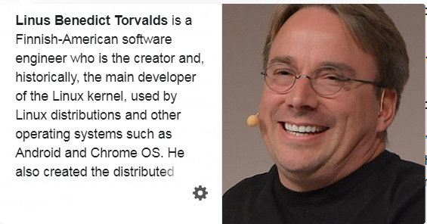

Slide 3
Git
Git is software for tracking changes in any set of files, usually used for coordinating work among programmers collaboratively developing source code during software development. Its goals include speed, data integrity, and support for distributed, non-linear workflows (thousands of parallel branches running on different systems).
Git was created by Linus Torvalds in 2005 for development of the Linux kernel, with other kernel developers contributing to its initial development. Since 2005, Junio Hamano has been the core maintainer. As with most other distributed version control systems, and unlike most client–server systems, every Git directory on every computer is a full-fledged repository with complete history and full version-tracking abilities, independent of network access or a central server.
Git is free and open-source software distributed under GNU General Public License Version 2.
Hint : patches & archive tar file

Slide 4
History
Git development began in April 2005, after many developers of the Linux kernel gave up access to BitKeeper, a proprietary source-control management (SCM) system that they had been using to maintain the project since 2002. The copyright holder of BitKeeper, Larry McVoy, had withdrawn free use of the product after claiming that Andrew Tridgell had created SourcePuller by reverse engineering the BitKeeper protocols. The same incident also spurred the creation of another version-control system, Mercurial.

Slide 5
Linus Torvalds
Linus Torvalds wanted a distributed system that he could use like BitKeeper, but none of the available free systems met his needs. Torvalds cited an example of a source-control management system needing 30 seconds to apply a patch and update all associated metadata, and noted that this would not scale to the needs of Linux kernel development, where synchronizing with fellow maintainers could require 250 such actions at once. For his design criterion, he specified that patching should take no more than three seconds, and added three more points
Take Concurrent Versions System (CVS) as an example of what not to do; if in doubt, make the exact opposite decision.
Support a distributed, BitKeeper-like workflow.
Include very strong safeguards against corruption, either accidental or malicious.
These criteria eliminated every version-control system in use at the time, so immediately after the 2.6.12-rc2 Linux kernel development release, Torvalds set out to write his own.
The development of Git began on 3 April 2005. Torvalds announced the project on 6 April and became self-hosting the next day. The first merge of multiple branches took place on 18 April. Torvalds achieved his performance goals; on 29 April, the nascent Git was benchmarked recording patches to the Linux kernel tree at the rate of 6.7 patches per second. On 16 June, Git managed the kernel 2.6.12 release.
Torvalds turned over maintenance on 26 July 2005 to Junio Hamano, a major contributor to the project Hamano was responsible for the 1.0 release on 21 December 2005 and remains the project's core maintainer.

Slide 6
Git – Naming and Data Structure
The man page describes Git as "the stupid content tracker". The read-me file of the source code elaborates.
Git's primitives are not inherently a source-code management system.
Version Control is a component of Software configuration management
Git has two data structures: a mutable index (also called stage or cache) that caches information about the working directory and the next revision to be committed; and an immutable, append-only object database.
The index serves as a connection point between the object database and the working tree.

Slide 7
Object database
A blob (binary large object) is the content of a file. Blobs have no proper file name, time stamps, or other metadata (A blob's name internally is a hash of its content.). In git each blob is a version of a file, it holds the file's data.
A tree object is the equivalent of a directory. It contains a list of file names, each with some type bits and a reference to a blob or tree object that is that file, symbolic link, or directory's contents. These objects are a snapshot of the source tree. (In whole, this comprises a Merkle tree, meaning that only a single hash for the root tree is sufficient and actually used in commits to precisely pinpoint to the exact state of whole tree structures of any number of sub-directories and files.)
A commit object links tree objects together into history. It contains the name of a tree object (of the top-level source directory), a timestamp, a log message, and the names of zero or more parent commit objects.
A tag object is a container that contains a reference to another object and can hold added meta-data related to another object. Most commonly, it is used to store a digital signature of a commit object corresponding to a particular release of the data being tracked by Git.
A packfile object is a zlib version compressed of various other objects for compactness and ease of transport over network protocols.

Slide 9
Reference
Heads (branches): Named references that are advanced automatically to the new commit when a commit is made on top of them.
HEAD: A reserved head that will be compared against the working tree to create a commit.
Tags: Like branch references but fixed to a particular commit. Used to label important points in history.
heads: refers to an object locally,
remotes: refers to an object which exists in a remote repository,
stash: refers to an object not yet committed,
meta: e.g. a configuration in a bare repository, user rights; the refs/meta/config namespace was introduced retrospectively, gets used by Gerrit

Slide 10
Git implements several merging strategies; a non-default strategy can be selected at merge time
resolve: the traditional three-way merge algorithm.
recursive: This is the default when pulling or merging one branch, and is a variant of the three-way merge algorithm.
When there are more than one common ancestors that can be used for a three-way merge, it creates a merged tree of the common ancestors and uses that as the reference tree for the three-way merge. This has been reported to result in fewer merge conflicts without causing mis-merges by tests done on prior merge commits taken from Linux 2.6 kernel development history. Also, this can detect and handle merges involving renames.
octopus: This is the default when merging more than two heads.

Slide 11
Type of VCS
CVCS (Centralized Version Control System)
DVCS (Distributed Version Control System)

Slide 12
CVCS
Example : Google Sheet and Google Doc, MS office 365
More than one people can work together.
Server is responsible for the changes which file is latest and latest changes are maintained.
It maintains log and track.
Drawback:
Proper connectivity is required
SPOF(Single point of Failure)
If Server is failure then we can’t find the recent changes
Server

Slide 13
DVCS
Multiple users can access the same file
User 1 sync at 12.30
User 2 sync at 2.30
User 3 sync at 3.30
User 3 commit
AT 11 .45AM
1.45 PM
4 PM
User 1 commit
At 11 AM
1 PM
3.30 PM
Server
centralized
User 2 commit
At 11.30 AM
12 PM
2 PM
Result at Server :
At 12.30 11.00 from user1
At 2.30 11.30,12,2 from user 2
At 3.30 11.45,1.45 from user 3

Slide 14
Advantage of DVCS
Even Server goes down, if we access another new server also we can restore back because the changes stored locally.
No more SPOF.

Slide 15
Git -> Part of Tech Stack
GitHub
GitLab
Bitbucket
Azure
AWS

Slide 16
How to install Git
http://git-scm.com/
Latest source Release 2.31.1
Release Notes (2021-03-26)Download 2.31.1 for Windows

Slide 17
Demo: https://github.com/login
Create a Remote repository first.
In Website : New rep-> enter repo url name
Enter desc
Ensure Public is selected
Click create

Slide 18
Commands
git - - version
git clone repo-url
Hidden folder is created with the name .git (Which manages Git).
cd <repo name>
ls
touch readme.md
vi readme.md
Type the text and save the file
cat readme.md
git log
git status
Which gives result as untracked file

Slide 19
Commands
git add readme.md
git status
No commit yet, changes to be committed
git commit –m ”Added readme.md”
git status
git push origin master
From local what is the content of master branch to remote repo.
Create another file sample.txt
touch sample.txt
vi sample.txt

Slide 20
Commands
git status
vi readme.md
git status
git add filename1 filename2
git add . // to add all the file changes
git status
git commit –m “modified readme.md & added sample.txt”
git push origin master
git log

Slide 21
Reference
Local Repository -> isolated repository in our own machine where we can work on local version of project.
Remote Repository-> Stored on remote server, useful for teams working on a single project. This a place where you can share your project code, and we can view other developers code shared as public.

Slide 22
Case study:
3 developers (Sam, Sarah, David) required to develop Home page App
1 Tech Lead (Jhon) -> Created a Repo.
Sam
David
Jhon
11.00 Am
05.00 PM
Sara
One task is completed working on their own pace & not intact.
At any given point of time still having old code and their branches can be deployed
Don’t want to wait for entire code for deployment
Initial file Index.hmtl is empty
Sam added code in Index.hmtl
Sara created format CSS
David created JavaScript
Home page can be CI & CD
At any time updated Home page is found

Slide 23
Trunk based development
A source-control branching model, where developers collaborate on code in a single branch called ‘trunk’ *, resist any pressure to create other long-lived development branches by employing documented techniques. They therefore avoid merge hell, do not break the build, and live happily ever after.
* main or master, in Git nomenclature
Trunk-Based Development is not a new branching model. The word ‘trunk’ is referent to the concept of a growing tree, where the fattest and longest span is the trunk, not the branches that radiate from it and are of more limited length.

Slide 24
Trunk based development
Trunk-Based Development is a key enabler of Continuous Integration and by extension Continuous Delivery. When individuals on a team are committing their changes to the trunk multiple times a day it becomes easy to satisfy the core requirement of Continuous Integration that all team members commit to trunk at least once every 24 hours. This ensures the codebase is always releasable on demand and helps to make Continuous Delivery a reality.
The dividing line between small team Trunk-Based Development and scaled Trunk-Based Development is a subject to team size and commit rate consideration. The precise moment a dev team is no longer “small” and has transitioned to “scaled” is subject to practitioner debate. Regardless, teams perform a full “pre integrate” build (compile, unit tests, integration tests) on their dev workstations before committing/pushing for others(or bots) to see.

Slide 26
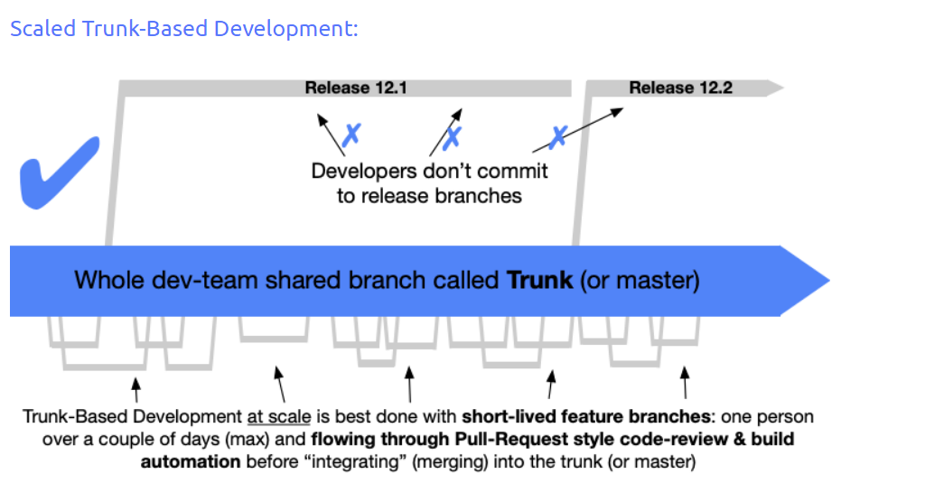

Slide 27
Revamp your Git Profile
Profile :
Adding picture profile
Adding Bio (employment)
Programming language we know
Project like to work
Repo : Commented, Indented
Readme.md is important file in Git
Any contribution to other project
Ensure which project wants to show case should be as public
Refer other java profile and use the same profile if matches
Never ever copy any project and put in Git as your own code
Reference Angular, React, Facebook, refer readme.md (mark down file) which talks about source
Example for readme.md ( In java project -> java lib, java RestApi using, how to install, how to use, what are the features, future scope, work in progress etc..)

Slide 28
Self Learning
https://git-scm.com/docs/git
https://git-scm.com/videos
https://www.youtube.com/watch?v=8JJ101D3knE&t=658s

