Slide 1
Digital Portfolio
STUDENT NAME: RITIKA S
REGISTER NO AND NMID:7603AAE6C48C392AA994DD7FDF416E4A
DEPARTMENT: ARTIFICIAL INTELLIGENCE & DATA SCIENCE
COLLEGE: KPR COLLEGE OF ATRS SCIENCE AND RESEARCH

Slide 2
PROJECT TITLE
Expense Tracker with Charts:
A browser-based application that helps users manage their income and expenses, visualize spending patterns, and maintain financial awareness—all built using HTML, CSS, and JavaScript.

Slide 3


AGENDA
Problem Statement
Project Overview
End Users
Tools and Technologies
Portfolio design and Layout
Features and Functionality
Results and Screenshots
Conclusion
Github Link
3/21/2024 Annual Review

Slide 4

PROBLEM STATEMENT
Many people struggle to manage their finances due to lack of visibility and structure. Manual tracking methods like notebooks or spreadsheets are time-consuming and don’t offer insights. This project solves that by providing:
A simple interface to log income and expenses.
Real-time balance updates.
Visual charts to understand spending patterns.
A browser-based tool built with HTML, CSS, and JavaScript.

Slide 5

PROJECT OVERVIEW
This is a client-side web application that allows users to:
Add income and expense transactions.
View total balance, income, and expenses.
See a history of all transactions.
Visualize data using charts.
Store data locally using localStorage.

Slide 6

WHO ARE THE END USERS?
Students learning budgeting and basic web development.
Freelancers and small business owners tracking daily expenses.
Educators teaching financial literacy or coding fundamentals.
Individuals who want a simple, visual tool to manage personal finances.
Beginner developers exploring DOM manipulation, local storage, and chart integration.

Slide 7

TOOLS AND TECHNIQUES
TECHNOLOGY PURPOSE
HTML Structure of the app
CSS Styling, layout, responsiveness
JavaScript Logic, DOM manipulation, chart rendering
Chart.js Drawing interactive pie/bar charts
LocalStorage Saving data between sessions

Slide 8
POTFOLIO DESIGN AND LAYOUT
Header: Expence Tracker.
Balance Section: Shows current balance, income, and expenses.
Form Section: Input fields for transaction name and amount.
Transaction List: Displays added transactions with delete option.
Chart Section: Canvas element for pie/bar chart .
Responsive Design: Works on mobile and desktop.
Dark Mode (optional): For better accessibility.
8

Slide 9
FEATURES AND FUNCTIONALITY
Add income or expense transactions.
Automatically update balance, income, and expense totals.
Delete transactions.
Store data in browser using.
Render charts using Chart.js.
Filter or categorize transactions (optional enhancement).
Responsive layout using CSS Flexbox/Grid

Slide 10
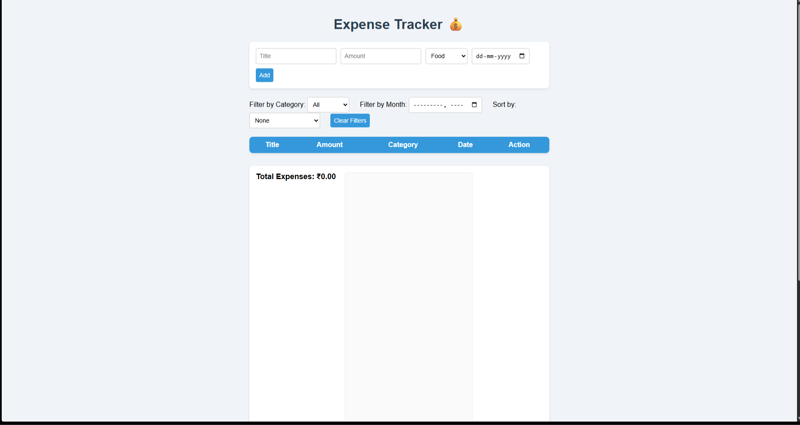

RESULTS AND SCREENSHOTS
3/21/2024 Annual Review
10

Slide 11
CONCLUSION
This project showcases how front-end technologies can be used to solve real-world problems. By combining HTML for structure, CSS for design, and JavaScript for logic and interactivity, the Expense Tracker delivers a clean, responsive, and insightful experience. It empowers users to take control of their finances while demonstrating key development skills like DOM manipulation, data visualization with Chart.js, and persistent storage using localstorage. A perfect addition to any portfolio or classroom toolkit.
11

