Slide 1


MINI PROJECT PRESENTATION ON
DOC TO HOME
SARAVANA KUMAR B

Slide 2
OBJECTIVE OF MINI PROJECT
The objective of this Mini-project is to apply the programming knowledge of object oriented programming into real-time applications to develop and provide solutions to several real-world problems in an effective and efficient manner and also to gain exposure and acquire the programming skills required for a good computer science engineer.

Slide 3
OBJECTIVE OF DOC TO HOME
Since Hospital is associated with the lives of common people and their day-to-day routines so I decided to work on this project.
• The manual handling of the record is time consuming and highly prone to error. The purpose of this project is to automate or make online, the process of day-to-day activities like Admission of New Patient, Discharge of Patient, Assign a Doctor, and finally compute the bill etc.

Slide 4
DESCRIPTION
This mini project has been basically programmed using JAVA. From this course, we will have a short research on the concept that is used for creation of a Graphical User Interface (GUI). i.e., Swing. Swing is a library of JAVA that provides many tools which is used for creation of a GUI.
We can also have a glance about MySQL, which is the database that is being used in this project. MySQL plays a very important role in storage management in this project.

Slide 5
We have also learnt how to connect JAVA to MySQL using a tool called JDBC. In order to perform operations on the MySQL table via JAVA, JDBC is required

Slide 6
Requirements
Hardware Specification
Processor : Intel i3 or above
RAM : 2 GB or above
Hard disk : 200 GB or above
Monitor : 15” color
Keyboard : 122 keys

Slide 7
Software Specification
Operating system : Windows 8 and above, Linux, MacOS
Language and Skills : JAVA, JDBC, Swings and SQL, MySQL
IDE : Eclipse, NetBeans, IntelliJ, VSCode
Knowledge of JAVA programming, Object Oriented Programming Concepts and libraries, and JDBC concepts etc.

Slide 8
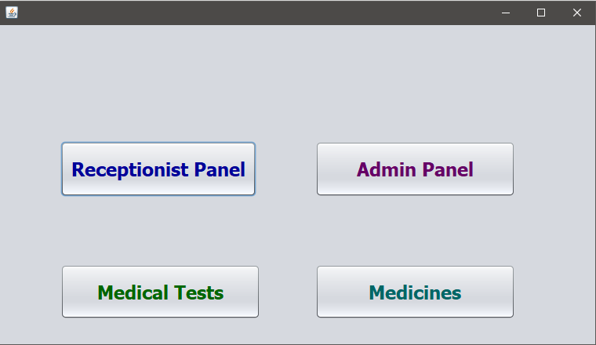
FUNCTIONING OF THE APPLICATION
The Home Page has 4 options –
Admin module
Receptionist Panel
Medical Test
Medicines
DOC TO HOME

Slide 9
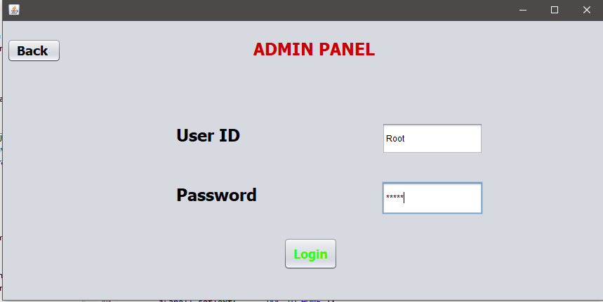
ADMIN LOGIN

Slide 10
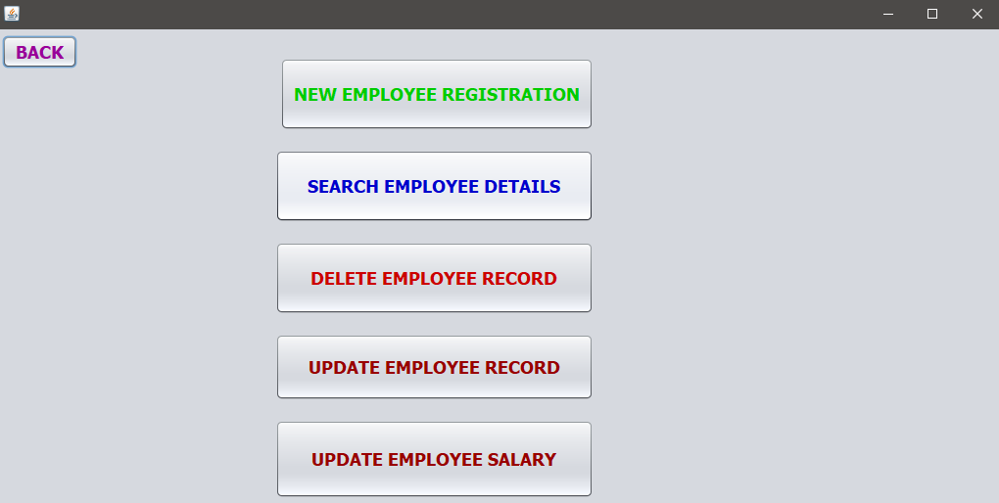
ADMIN LOGGED IN PAGE

Slide 11
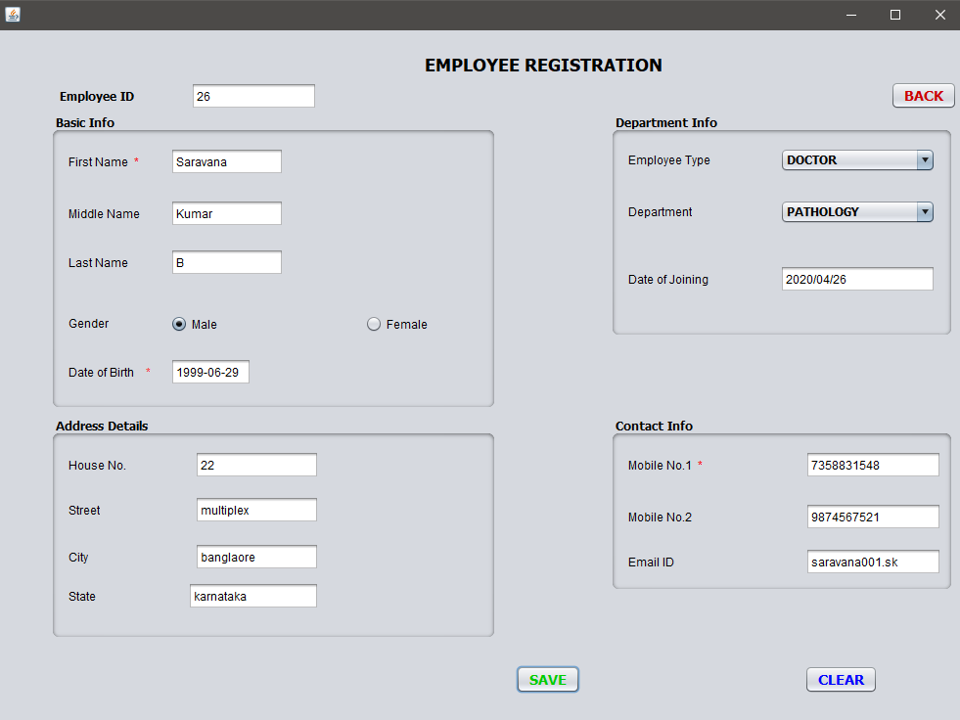
NEW EMPLOYEE

Slide 12
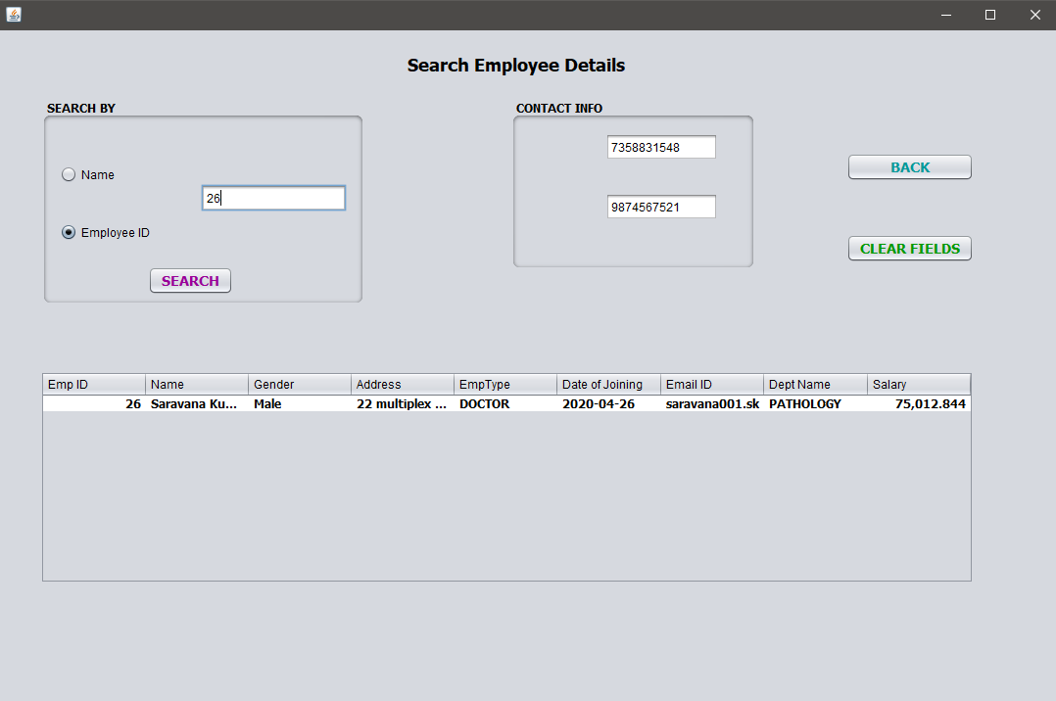
SEARCH EMPLOYEE

Slide 13
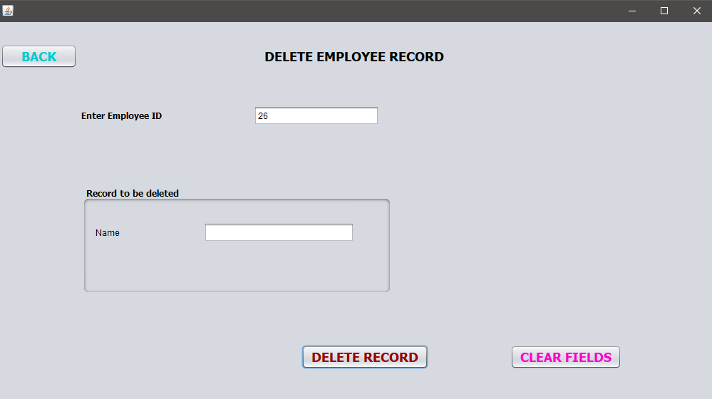
DELETE EMPLOYEE

Slide 14
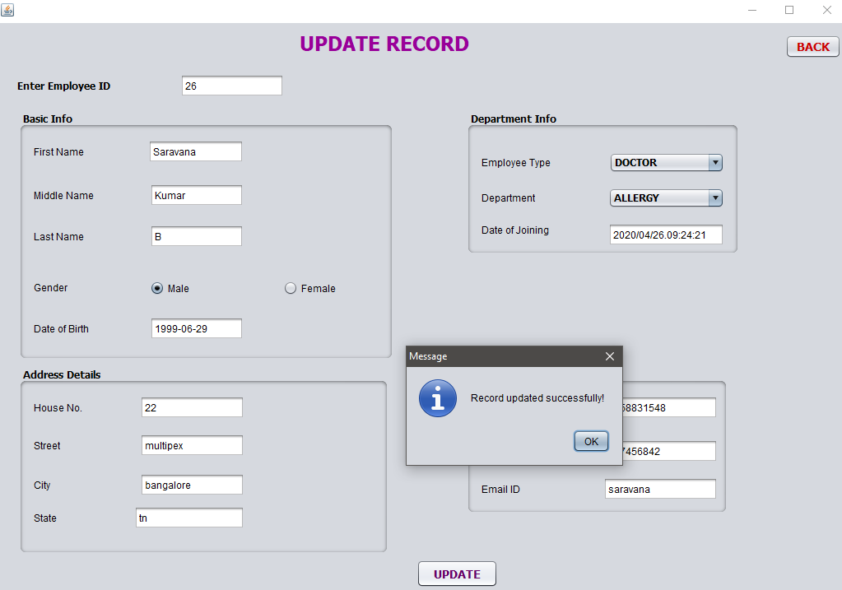
UPDATE EMPLOYEE

Slide 15
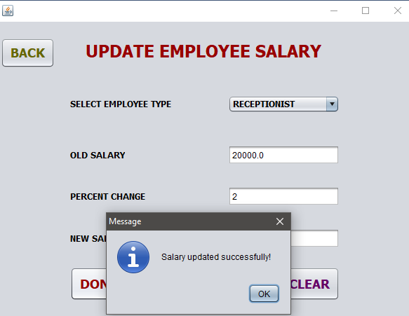
UPDATE SALARY

Slide 16
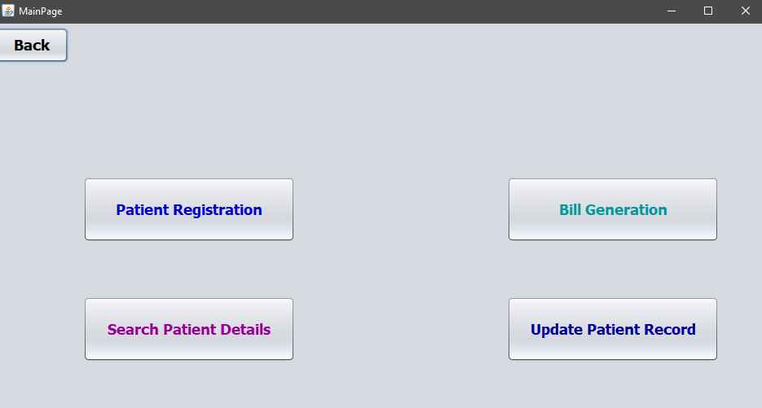
RECEPTIONIST PANEL

Slide 17
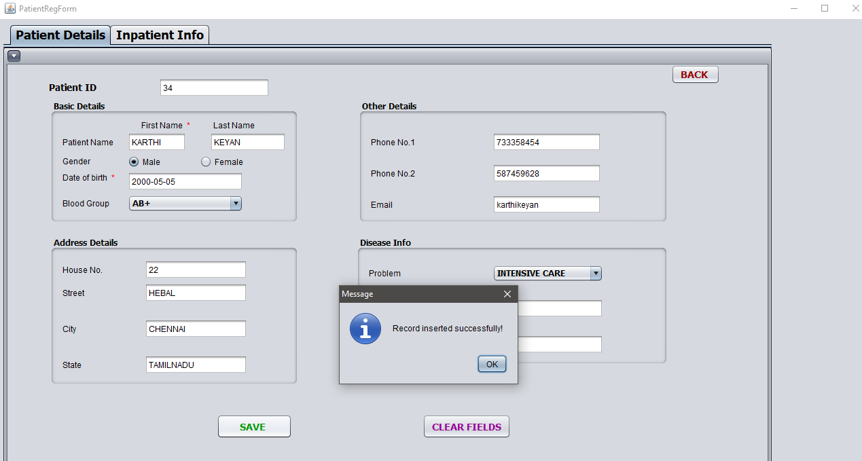
PATIENT REGISTRATION

Slide 18
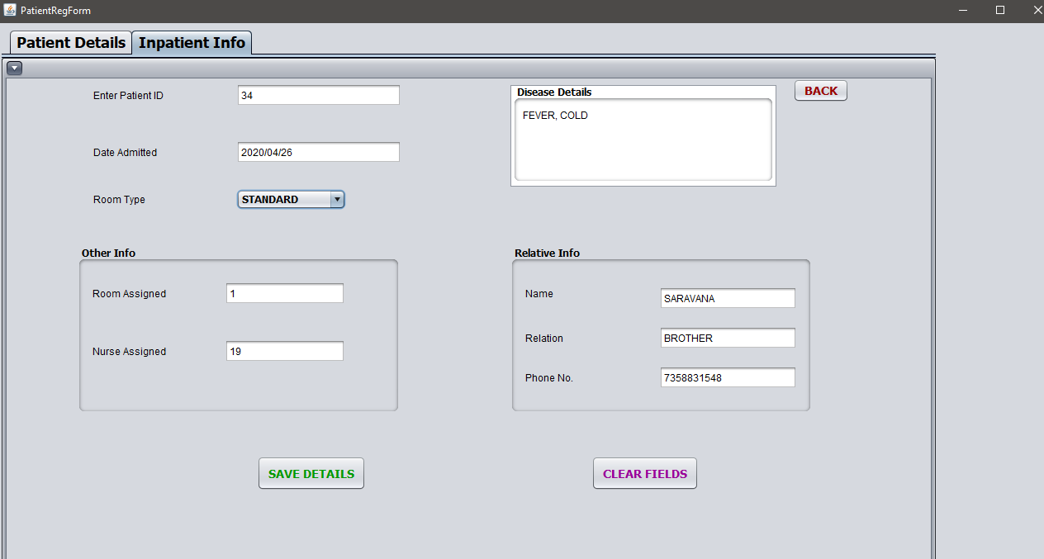
IN_PATIENT DETAILS

Slide 19
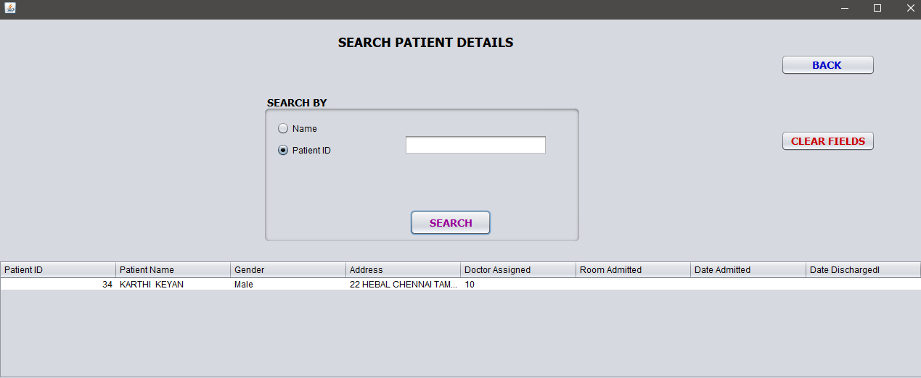
SEARCHING PATIENT

Slide 20
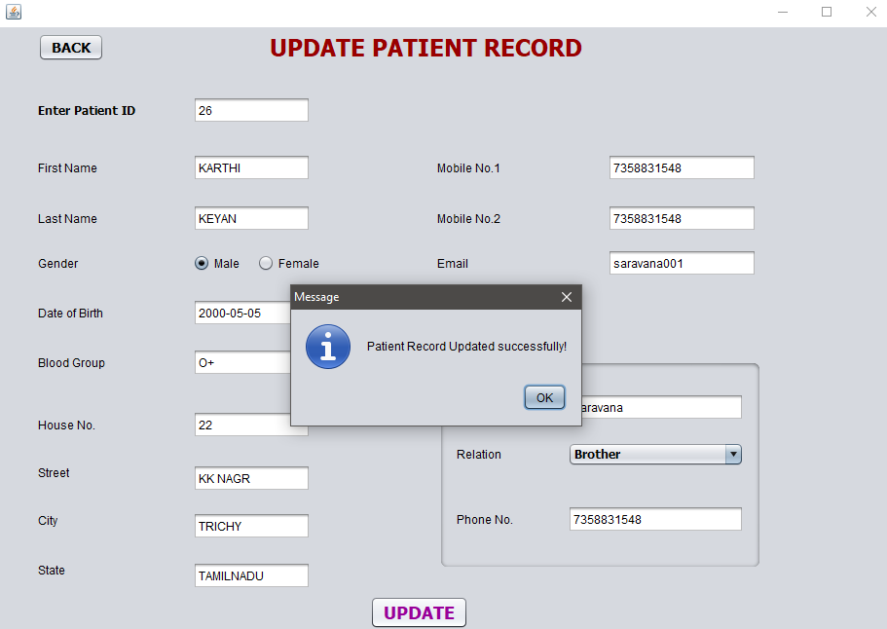
UPDATE PATIENT

Slide 21
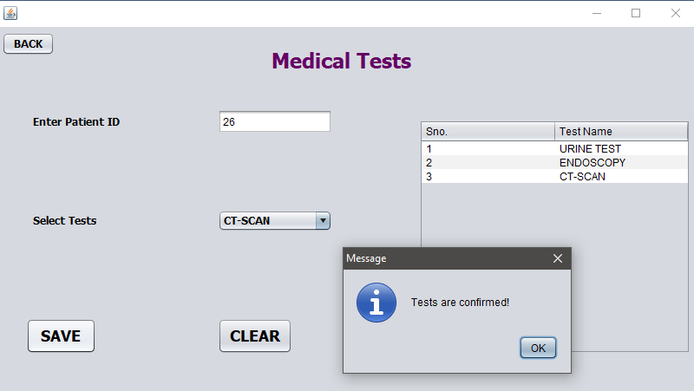
MEDICINE TEST

Slide 22
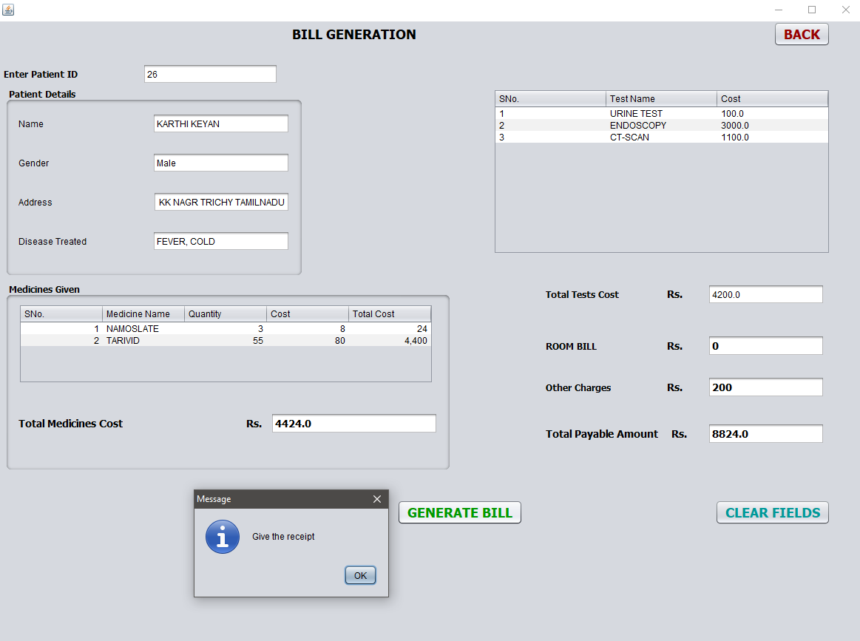
BILL GENERATION

Slide 23
BILL GENERATION

Slide 24
OBJECTIVES ACHIEVED
Implementation of this project helps to store all the kinds of records
provide coordination
user communication
improve day-to-day operations,
manage financial
human resources etc..,

Slide 25
THANK YOU !

