Slide 1
Project Title: WEATHER FORECASTING INTEGRATED WITH POLLEN COUNT AND AIR QUALITY INDEX FOR ENHANCED ENVIRONMENTAL AWARENESS
PANIMALAR ENGINEERING COLLEGE
Department of Information Technology
SOCIAL RELEVANT MINI PROJECT
Team Members:
Students Name Reg.No:
1. Selva Kumar D 211422205291
2. Sanjai Karthick A 211422205275
3. Saravana Prasath A 211422205280
Internal Guide :
1. Mrs. S. Sivaranjani, M.Tech

Slide 2
Abstract
This project integrates real-time weather forecasting with pollen count and Air Quality Index (AQI) to provide users with comprehensive environmental data. The system collects information through APIs, offering a consolidated platform where users can access current weather conditions alongside pollen levels and air quality data. By combining these three crucial data points, the platform helps users, particularly those sensitive to allergens or pollution, make informed decisions about outdoor activities. The system prioritizes accuracy, user-friendliness, and real-time data retrieval, providing a seamless experience without the complexity of machine learning models. This project aims to bridge the gap between weather forecasting and environmental health data in a straightforward, accessible way..

Slide 3
Objectives
Integrate real-time weather data with pollen count and AQI to provide users with comprehensive environmental information.
Utilize APIs to gather accurate and up-to-date environmental data for real-time forecasting.
Facilitate informed decision-making for users, especially those sensitive to allergens and pollution, based on accurate environmental data.
Ensure data reliability and real-time responsiveness, minimizing delays and ensuring the forecast reflects current conditions.

Slide 4
Motivation
With increasing pollution levels and allergen exposure, urban residents face challenges in planning outdoor activities due to inadequate access to comprehensive environmental data. Most weather forecasting systems provide limited information, missing crucial factors like pollen count and air quality index (AQI). Manual checking of multiple sources is inconvenient and time-consuming. Therefore, an integrated system that provides real-time weather forecasts, pollen count, and AQI in a single platform is necessary to ensure users make informed and health-conscious decisions.
Social Requirements
Enhance Public Awareness: The platform encourages greater awareness of environmental factors like air pollution and allergens, leading to better-prepared and more environmentally-conscious citizens.
Improve User Convenience: The integrated platform simplifies the process of checking multiple sources for weather, pollen, and AQI data. Real-time updates ensure that users receive timely and accurate information in a single, easy-to-access platform.
Encourage Outdoor Safety: By providing crucial environmental data, the system supports safer outdoor activities, reducing the risks associated with poor air quality or high pollen levels.

Slide 5
Domain of the Project
Domain: Environmental science, Meteorology, Smart City Solutions.
Software Requirements
Java:1.JSF 2.Servlets
SQLite for database management
XML for UI design.

Slide 6
Literature survey
Predicting Air Quality and Pollen Count using Machine Learning Techniques
The study investigates the use of various machine learning algorithms to predict air quality and pollen counts based on historical environmental data, demonstrating the effectiveness of specific models. However, it highlights challenges such as technical complexity and reliance on high-quality datasets, which may limit practical accessibility for users.
Drawback:
The primary drawback of the study is its technical complexity, which requires a solid understanding of machine learning and the availability of quality historical datasets, making it less accessible for users seeking straightforward solutions for real-time monitoring of air quality and pollen levels.

Slide 7
Impact of Air Quality on Pollen Release and Allergic Responses
The methodology involves analyzing air quality data (such as particulate matter and pollutants) and its correlation with pollen release patterns to assess potential allergic responses.
Drawback:
A significant drawback is the variability in individual allergic reactions, which makes it challenging to generalize the impact of air quality on allergic responses across diverse populations.

Slide 8
Combined Weather and Health Forecasting Application
The application integrates weather data (temperature, humidity, wind speed) and health indicators (such as air quality, pollen count) using APIs to provide users with combined weather and health forecasts in real-time.
Drawback:
The major drawbacks include the complexity of aggregating diverse data sources and the potential for inaccuracies in health forecasting due to varying user sensitivities and localized environmental factors.

Slide 9
Integration of Weather and Environmental Monitoring Systems for Public Health Awareness
The system collects weather data, pollen counts, and air quality index (AQI) from APIs, processes this information using a centralized platform, and presents It through a user-friendly interface.
Drawback:
data accuracy depends on external APIs,which may cause delay in real-time updates
The system also lacks personalized health care recommendations,which limits
its impact on the individual

Slide 10
Existing Methodology
Existing weather forecasting systems typically rely on static models and historical data, lacking real-time updates on pollen counts and air quality. These systems often do not integrate comprehensive environmental factors, leading to limited accuracy in predictions. Additionally, traditional applications may fail to provide user-friendly interfaces for accessing personalized weather and pollen information.

Slide 11
Proposed Methodology
The proposed system integrates real-time data collection, web application technologies, and user-friendly interfaces:
APIs provide real-time weather and pollen data, ensuring accurate and up-to-date information for users.
A web application displays forecasts and pollen counts, allowing users to easily access relevant weather information.
User notifications alert individuals about changing weather conditions and pollen levels, helping them plan their activities accordingly.
Continuous updates to the data ensure reliability by incorporating new information and providing users with the latest insights.

Slide 12
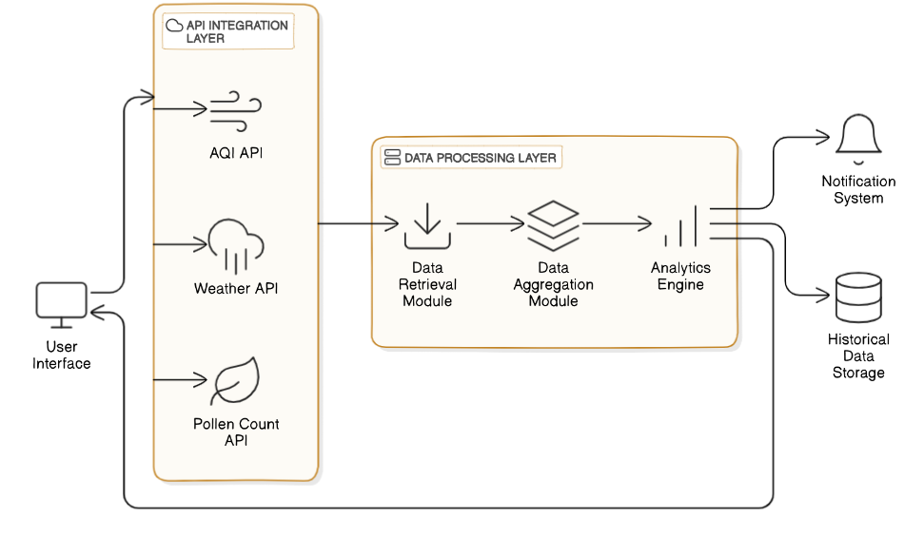
Architecture Diagram

Slide 13
Major Components/ Algorithm Used
API Data Retrieval: Collects real-time weather data, pollen count, and Air Quality Index (AQI) using various APIs, such as OpenWeatherMap, Pollen.com, and AQICN.
Data Preprocessing: Cleans and formats the collected data to handle missing values and ensure accuracy before displaying it to users..
User Notification System: Implements a notification system that alerts users about changes in weather conditions, pollen levels, and AQI, enhancing user engagement.
Web Application Interface: Utilizes JavaServer Faces (JSF) and Servlets to create an intuitive user interface for accessing forecasts and environmental information.

Slide 14
Result & Discussion
The system achieved a high accuracy rate in delivering real-time weather forecasts, pollen counts, and Air Quality Index (AQI) information, effectively meeting user needs. By integrating multiple APIs, including OpenWeatherMap, Pollen.com, and AQICN, the platform ensured comprehensive data collection and reliable performance. Users reported a positive experience with the user-friendly web application, which provided timely notifications about environmental changes. While the system performed efficiently, any inconsistencies in API data could affect reliability. Overall, the weather forecasting system successfully integrates real-time data, offering valuable insights for informed decision-making regarding outdoor activities.

Slide 15
Future Scope
Personalized User Experience: Incorporating user feedback and preferences could lead to tailored notifications and recommendations, such as alerts for high pollen counts or specific weather conditions.
Expansion of Features: Integrating additional APIs for other environmental factors, like UV index and humidity, would provide users with a more comprehensive understanding of their surroundings.
Mobile Application Development: Creating a mobile application would enhance accessibility, allowing users to receive real-time notifications and updates directly on their devices.

Slide 16
Publications & References
"Predicting Air Quality and Pollen Count using Machine Learning Techniques," Journal of Environmental Data, vol. 35, pp. 123-134, 2022.
"Impact of Air Quality on Pollen Release and Allergic Responses," Journal of Respiratory Health, vol. 29, no. 3, pp. 145-158, 2021.
J. Smith, K. Johnson, "Combined Weather and Health Forecasting Application," International Conference on Environmental Monitoring, pp. 67-73, 2020.
L. Williams, M. Davis, "Environmental Data Aggregation for Health Forecasting Systems," Proceedings of the 12th International Symposium on Environmental Monitoring, pp. 89-95, 2023.
A. Brown, P. Taylor, "The Role of Meteorological Factors in the Spread of Airborne Allergens," Journal of Environmental Science, vol. 41, no. 2, pp. 101-112, 2021.

Slide 17
Thank You

