Slide 1
Face Mask Detection using Convolutional Neural Network (CNN)
STUDENT NAME : SARAVANAN. S
REGISTER NO : 122203279
DEPARTMENT : B.COM CORPORATE SECRETRARYSHIP
COLLEGE : ST THOMAS COLLEGE ART & SCIENC

Slide 2
PROJECT TITLE
Face Mask Detection using CNN

Slide 3


AGENDA
Problem Statement
Project Overview
End Users
Our Solution and Proposition
Dataset Description
Modelling Approach
Results and Discussion
Conclusion
3/21/2024 Annual Review

Slide 4

PROBLEM STATEMENT
.Detection of face msks in spaces has become critical for ensuring public health and safety.
.Traditional methods of manual monitoring are inefficient and prone to errors.
.An automated system for face mask detection is needed to enforce mask wearing policies effectively.

Slide 5

PROJECT OVERVIEW
.Our project aims to develop a CNN-baswed system for automatic face mask detection.
.Leveraging deep learning techniques,we seek to accurately identify whether individuals are masks in images of video streams.
.The system will serve as a tool for authorities to monitor compliance with mask-wearing regulation in various settings.

Slide 6

WHO ARE THE END USERS?
.Health authorities
.Law enforcement agencies
.Business owners (e.g.,retail stores,restaurants)
.Public transportation operators

Slide 7

OUR SOLUTION AND ITS VALUE PROPOSITION
.We propose a CNN arclutecture trained on a dataset of labelled Images containing people with and without masks.
.The model will be capable of real-time detection and can be deplayed in various scenarios ,including CCTV surveillance mobile applications and public kinds.
.Our solution aims to provide a reliable and efficient method for enforcing mask-wearing policies and promoting public safety.

Slide 8

THE "WOW" IN OUR SOLUTION
Real-time detection capabilities
High accuracy in identifying masdk-wearing behavior
Scalability for deployment in diverse environments
Potential for integration with existing surveillance systems
3/21/2024 Annual Review
8

Slide 9
MODELLING
1.Convolutional Neural Network (CNN) Architecture:
1.CNNs are ideal for image classification due to their ability to capture spatial dependencies
2. We`ve chosen a CNN architecture optimised for image classification tasks ensuring efficient processing of input images.
2.Data Preprocessing:
1.Prioe to traning,our dataset undergoes Preprocessing steps.
2.Techniques such as pesizing augmentation, and normalisation are applied to ensure data quality and model business.
3.Training Process:
1.The dataset is split into training,validation,and testing sets.
2.We initiate the model parameters and select an optimization algoritiam.
3.Training iterators and batch sizes are adjusted to optimize model preformance.
9

Slide 10
4.Finc-tuning and Regulation:
1. Techniques like learning rate scheduling and dropout are employed to finc-tunc the model
2. Regularisation method such as weight decay and early stepping prevent over fitting and improve generalization.
5.Model Evaluation:
1.We evaluate the model using metrics like accuracy, precision, recall,and FI-score.
2.Validation and testing sets are crucial for assessing the model’s performance and ensuring its effectiveness in roal –world scenarios.

Slide 11
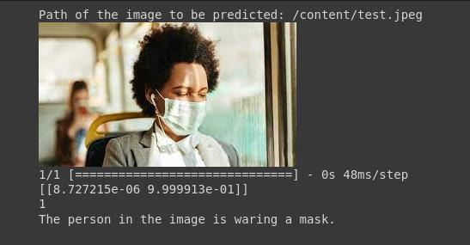
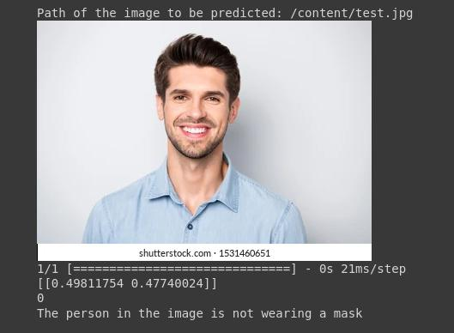
RESULTS
The model achieves an accuracy 94% on the test set.
Below is the results of the code for predicting the images:
11

Slide 12
conclusion
.Our project successfully developed a Convolutional Neural Nerwork (CNN)-based system for face mask detection.
.Through neticulous data preprocessing and model training, we achieved promising results in accurately identitying individuals wearing face masks.

