Slide 1
STACKPILOT AI ENTERPRISE PLATFORM
Unified Operations & Business Intelligence OS
Bridging Technical Engineering, CRM, Automated Billing, and AI-Driven Execution in One Cohesive Architecture.
7 Workflow States
From Backlog to QA & Delivery
300ms Search
Debounced Instant Auto-complete
Bimodal Resilience
Express/Mongo + Offline Continuity
StackPilot AI v1.0.6 Enterprise Edition | Slide 1 of 10 | Confidential & Proprietary

Slide 2
EXECUTIVE BRIEFING
The Enterprise Operational Challenge & Solution
THE SPREAD & SILO PROBLEM
• Engineering Disconnect: Developers operate in technical jargon without clear business requirement mappings.
• Opaque Delivery Status: Client sponsors lack real-time visibility into active sprints and velocity.
• Manual Billing Friction: Finance teams waste hours calculating milestone hours, tax, and PDF invoices.
• QA Specification Gaps: Testers lack structured acceptance criteria and automated test case scaffolding.
THE STACKPILOT AI SOLUTION
• Unified Workspaces: Plain-language business boards connect executives, developers, and clients seamlessly.
• Real-Time Telemetry: Transparent milestone metrics, automated sprint reports, and SLA health tracking.
• Instant Financial Billing: Automated invoice generator with customizable 18% GST/Tax and instant export.
• AI Generative Acceleration: Integrated AI tool suite for automated test cases, bug reports, and estimates.
StackPilot AI v1.0.6 Enterprise Edition | Slide 2 of 10 | Confidential & Proprietary

Slide 3
TEAM GOVERNANCE
Specialized Personas & Role-Based Access (RBAC)
👑 Super Administrator
Security Audit & System Health — Complete access to telemetry, global user management, audit logs, and infrastructure configurations.
👔 Project Delivery Lead
Sprints, Scope & Approvals — Monitors task pipelines, sprint velocity, milestone deadlines, and scope change requests.
💻 Lead Developer
7-Column Board & AI Tools — Dedicated agile boards, automated code review assistants, and interactive technical documentation.
🧪 QA Test Engineer
UAT Scenarios & Bug Audits — QA column management, automated test case generator, and verification telemetry logs.
📊 Finance Coordinator
Invoices, Tax & Client SLAs — Automated invoice dispatch, 18% tax calculation, client retainer tracking, and balance reporting.
StackPilot AI v1.0.6 Enterprise Edition | Slide 3 of 10 | Confidential & Proprietary

Slide 4
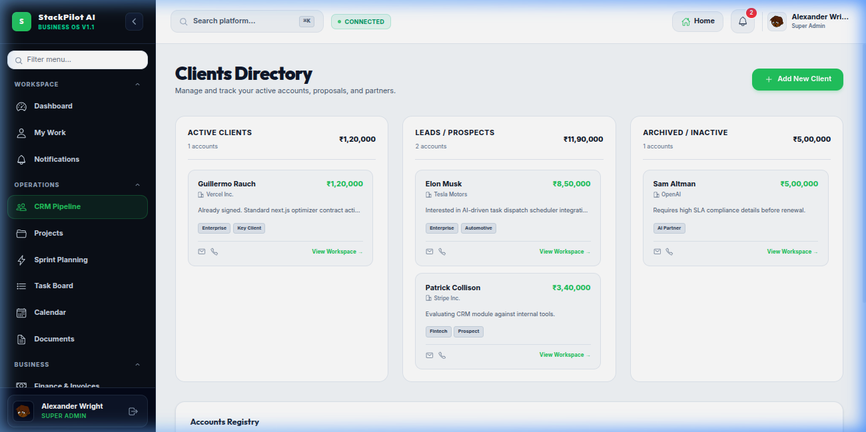
CUSTOMER RELATIONSHIP MANAGEMENT
CRM & Client Lifecycle Hub
KEY CAPABILITIES
• Active Accounts Registry
Real-time visibility into client retainers, active agreements, and lifetime value metrics.
• Leads & Prospects Board
Direct management of high-value deals with instant status tracking and conversion.
• 1-Click Project Conversion
Instantly spin up dedicated workspace projects from closed client deals.
• SLA & Contract Alerts
Automated flags for pending contract renewals and client SLA deliverables.
StackPilot AI v1.0.6 Enterprise Edition | Slide 4 of 10 | Confidential & Proprietary

Slide 5
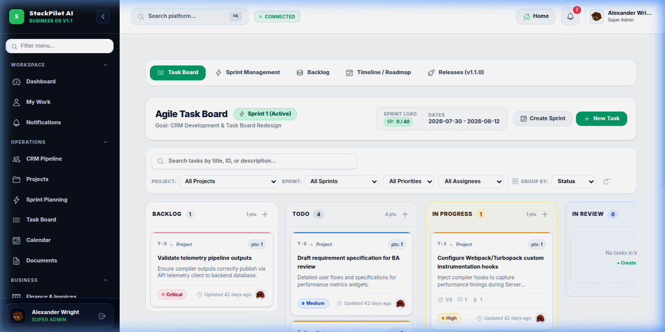
ENGINEERING EXECUTION
7-Column Agile Task Board & Sprint Engine
KEY CAPABILITIES
• 7 Granular Workflow Columns
Backlog, Todo, In Progress, In Review, QA Testing, and Completed states.
• Sprint Capacity Telemetry
Real-time story point tracking and workload balancing per team member.
• Multi-Dimensional Toolbar
Instant filtering across Projects, Sprints, Priority, Assignees, or Group-By.
• Drag-and-Drop Experience
Fluid 60fps micro-animated task status transitions with audit tracking.
StackPilot AI v1.0.6 Enterprise Edition | Slide 5 of 10 | Confidential & Proprietary

Slide 6
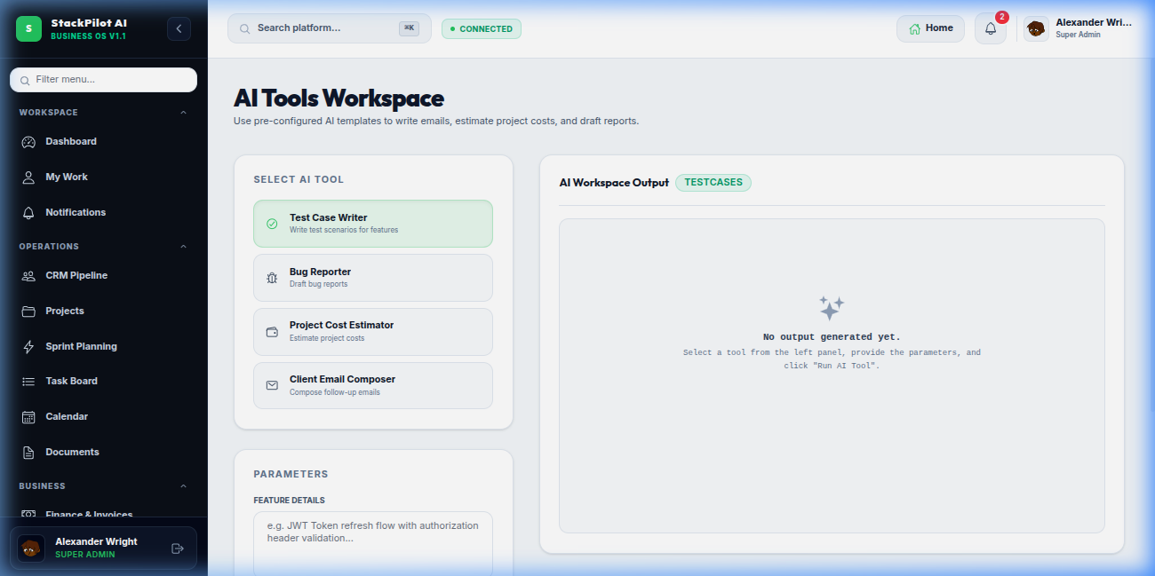
GENERATIVE AUTOMATION
AI Productivity Suite & Engineering Assistants
KEY CAPABILITIES
• UAT Test Case Writer
Instantly draft comprehensive test scenarios directly from feature requirements.
• Bug Reporter & Triage
Scaffolds standardized bug reports with reproduction steps and severity tags.
• Project Scope & Cost Estimator
Calculates accurate budget, timeline, and resource estimates from project specs.
• Client Communication Composer
Generates polished client update emails and milestone progress briefs.
StackPilot AI v1.0.6 Enterprise Edition | Slide 6 of 10 | Confidential & Proprietary

Slide 7
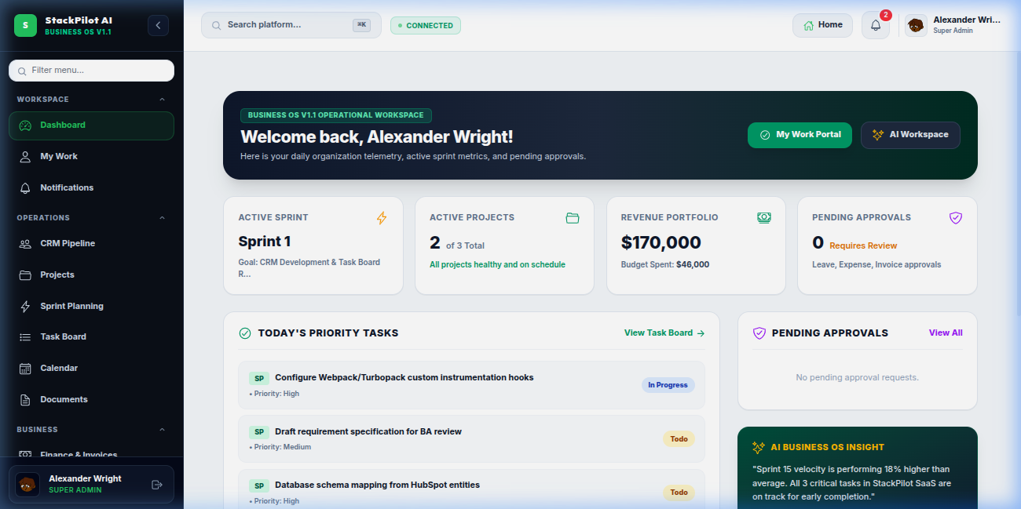
EXECUTIVE OVERSIGHT
Unified Operations & Financial Telemetry
KEY CAPABILITIES
• Revenue Portfolio Telemetry
Live metrics tracking total portfolio value, active retainers, and budget spent.
• Today's Priority Focus
Automated task allocation mapped to active sprints and team assignments.
• AI Velocity Telemetry
Real-time burndown calculations and delivery confidence scoring.
• Cross-Functional Approvals
Pending approval queues for milestone sign-offs, releases, and expenses.
StackPilot AI v1.0.6 Enterprise Edition | Slide 7 of 10 | Confidential & Proprietary

Slide 8
INFRASTRUCTURE & ENGINEERING
High-Performance Technical Architecture
300MS DEBOUNCE
Universal Search
Debounced search engine across tasks, clients, documents, and logs without UI stutters.
EXPRESS & IN-MEMORY
Bimodal Persistence
Gracefully falls back to browser local persistence if backend network connection drops.
VITE + REACT 19 + TS
Modern Frontend
Ultra-fast HMR (< 200ms) with full strict TypeScript typing and Tailwind v4.
FRAMER MOTION 12
Fluid Animations
Hardware-accelerated layout transitions delivering a native desktop app feel.
StackPilot AI v1.0.6 Enterprise Edition | Slide 8 of 10 | Confidential & Proprietary

Slide 9
ENTERPRISE TRUST
Security, Privacy & Compliance Architecture
ENTERPRISE SECURITY VERIFICATION CHECKLIST
✔ Strict CORS & Origin Allowlist
Backend configured with strict origin protection against unauthorized API requests.
✔ Security Middleware Suite
Equipped with helmet headers, express-rate-limit, and strict payload sanitization.
✔ Token-Based Authentication
Stateless JWT authentication backed by bcryptjs cryptographic salted password hashing.
✔ Immutable Audit Logs
System logs all critical actions (auth, create, update, delete) with IP and timestamp telemetry.
✔ WCAG AA Accessibility
High-contrast emerald-on-dark slate color palette ensuring compliance for all team members.
StackPilot AI v1.0.6 Enterprise Edition | Slide 9 of 10 | Confidential & Proprietary

Slide 10
PRODUCTION-READY & QA AUDITED
Deploy StackPilot AI in Your Enterprise
Ready for self-hosted container deployment, cloud VPC, or managed SaaS instances. Accelerate your engineering delivery and streamline operations today.
• Product Version: v1.0.6 Enterprise Edition
• Source Repository: saravanaselvi2705/stackpilot-ai
• Contact & Sales: creovixstack@gmail.com / sales@stackpilot.ai
• Website & Demo: https://stackpilot.ai
StackPilot AI v1.0.6 Enterprise Edition | Slide 10 of 10 | Confidential & Proprietary

