Slide 1
Autumn games 2021 Languages and Algorithms for Ai Module 1 Traditional Project - constraints
Sara Vorabbi
sara.vorabbi@studio.unibo.it
0001026226
University of Bologna – Artificial Intelligence

Slide 2
The project
Aim: propose a program which solves one (or more) of the puzzles from Autumn games – a yearly mathematical competition
2021 Training for the Autumn games
Deliver a solution for the puzzles using logic based or constraint language
Paradigm: CP – constraint programming
declare a set of constraints for a set of variables
MiniZinc free and open-source constraint modeling language

Slide 3
The project
The following exercises are implemented (11 out of 18):
cat CE: 1 – 4
cat C1: 5 – 6
cat C2: 8 – 9
cat L1: 11 – 12 – 13
cat L2: 14 – 17
The following exercises are presented:
1 – Red and black
4 – The smallest
5 – A magic triangle
6 – A maximum triangle
9 – Four digits for a date
17 – With the ten digits

Slide 4
Exercises

Slide 5
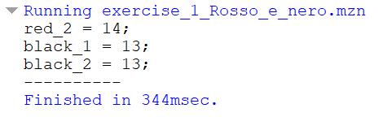
Ex. 1 – Red and black
“In a deck of 52 cards there are 26 red cards and 26 black cards. The deck is separated into two bundles: the first of 25 cards, the second of 27. If the first deck contains 12 red cards, how many black cards are there in the second deck?”
1 int: cards = 52;
2 int: deck_1 = 25;
3 int: deck_2 = 27;
4 int: red_1 = 12;
5
6 var int: red_2 ;
7 var int: black_1 ;
8 var int: black_2 ;
9
10 constraint red_1 + red_2 = 26;
11 constraint black_1 + black_2 = 26;
12
13 constraint red_1 + black_1 = deck_1;
14 constraint red_2 + black_2 = deck_2;
15
16 solve satisfy;

Slide 6
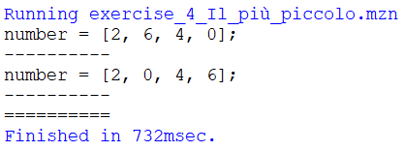
Ex. 4 – The smallest
“What is the smallest number (positive integer) of four digits, all of which are even and different from each other, that is a multiple of 11? (a number cannot can begin with the digit 0)”
1 include "globals.mzn";
2
3 array[1..4] of var 0..9: number;
4
5 constraint forall (i in 1..4)(( number[i] mod 2) == 0);
6 constraint number[1] != 0;
7 constraint all_different(number);
8 constraint (( number[1]*1000 + number[2]*100 + number[3]*10 + number[4]) mod 11) == 0;
9
10 solve minimize ( number[1]*1000 + number[2]*100 + number[3]*10 + number[4]);

Slide 7
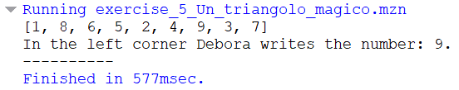
Ex. 5 – A magic triangle
“The slots of the triangle in the Figure 1 contain all integer numbers from 1 to 9. Some of the numbers have already been written down. Debora completed the figure, writing the numbers in each slot in such a way that the sum of the numbers that appear on the same side of the triangle is always equal to 20. What number did Debora write in the bottom left vertex slot?”
1 include "globals.mzn";
2 array[1..9] of var 1..9: triangle;
3
4 constraint triangle[1] == 1;
5 constraint triangle[2] == 8;
6 constraint triangle[4] == 5;
7 constraint triangle[6] == 4;
8 constraint triangle[9] == 7;
9
10 constraint triangle[1] + triangle[2] + triangle[3] + triangle[4] == 20;
11 constraint triangle[4] + triangle[5] + triangle[6] + triangle[7] == 20;
12 constraint triangle[7] + triangle[8] + triangle[9] + triangle[1] == 20;
13
14 constraint all_different(triangle);
15
16 solve satisfy;

Slide 8
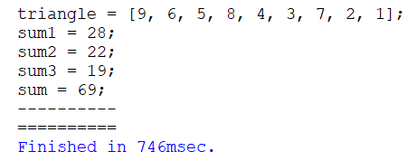
Ex. 6 – A maximum triangle
“Debora, after crossing out all nine numbers (see previous question), issues a challenge to Alexander: - Write the nine numbers, one in each box, so that the sum of the three sums of the numbers that appear on the same side of the triangle is the maximum possible. How much is that sum worth?”
1 include "globals.mzn";
2 array[1..9] of var 1..9: triangle;
3 var int: sum1;
4 var int: sum2;
5 var int: sum3;
6 var int: sum;
7
8 constraint triangle[1] + triangle[2] + triangle[3] + triangle[4] == sum1;
9 constraint triangle[4] + triangle[5] + triangle[6] + triangle[7] == sum2;
10 constraint triangle[7] + triangle[8] + triangle[9] + triangle[1] == sum3;
11
12 constraint all_different(triangle);
13
14 constraint sum = sum1 + sum2 + sum3;
15
16 solve maximize sum;

Slide 9
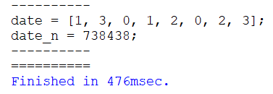
Ex. 9 – Four digits for a date
“19.09.2021 (September 19, 2021) is written using four digits, each employed twice. What will be the next date (written with the same format as the previous one) that has the same property of being written with four digits, each employed twice?”
1 include "globals.mzn";
2 array[1..8] of var 0..9: date;
3 var int: date_n;
4 int: date_prev = 2021*365 + 9*31 + 19;
5
6 constraint date[1] <= 3;
7 constraint date[1] == 3 -> (date[2] == 0 \/ date[2] == 1);
8
9 constraint date[3] <= 1;
10 constraint date[3] == 1 -> ( date[4] == 0 \/ date[4] == 1 \/ date[4] == 2);
11
12 constraint date[5] >= 2;
13 constraint (date[5] == 2 /\ date[6] == 0) -> (date[7] >= 2);
14 constraint (date[5] == 2 /\ date[6] == 0 /\ date[7] == 2) -> date[8] > 1;
15
16 constraint forall(i in 1..8)(count(date, date[i], 2));
17
18 constraint date_n = (date[5]*1000 + date[6]*100 + date[7]*10 + date[8])*365 +
19 (date[3]*10 + date[4])*30 + ( date[1]*10 + date[2]);
20
21 constraint date_n > date_prev;
22
23 solve minimize date_n;

Slide 10
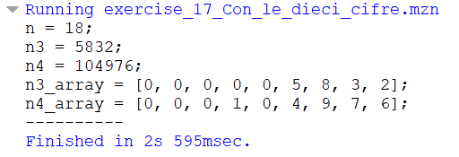
Ex. 17 – With the ten digits
“A number N, positive integer, is such that all ten digits from 0 to 9 are used to write its third power, N3, and its fourth power, N4. What is the value of N?”
1 include "globals.mzn";
2
3 var int: n;
4 var int: n3;
5 var int: n4;
6
7 array[1..9] of var 0..9: n3_array;
8 array[1..9] of var 0..9: n4_array;
9
10 constraint n3 = sum(i in 1..9)(10^(9 - i) * n3_array[i]);
11 constraint n4 = sum(i in 1..9)(10^(9 - i) * n4_array[i]);
12
13 constraint n3 = pow(n, 3);
14 constraint n4 = pow(n, 4);
15
16 constraint forall(i in 1..9)(exists(j in 1..9)(n3_array[j] = i \/ n4_array[j] = i));
17
18 solve satisfy;

Slide 11
THANK YOU!

