Slide 1
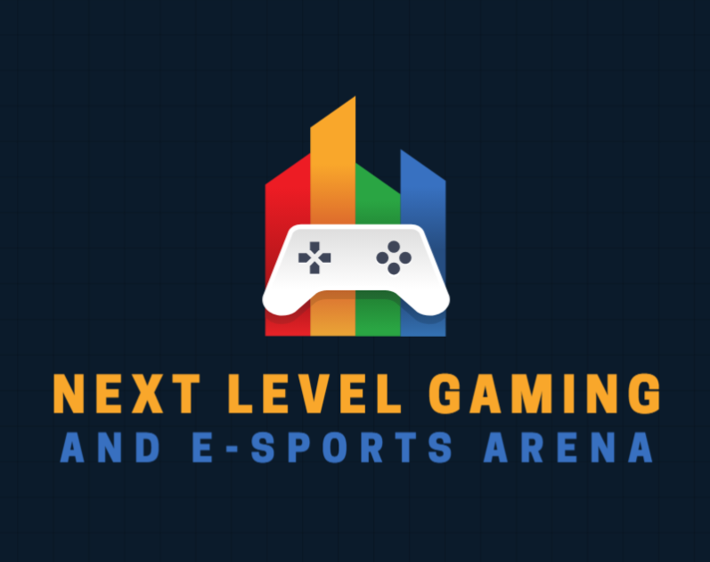
WIL | XHAW5112 | TASK 3 GROUP PRESENTATION
BOMBERS
UNITED
Next Level Gaming & Esports Arena
Website and mobile app design: from concept to wireframes to live demo
Saravan Jeeth Naidoo
ST10510632
Jordan Linsei Naidoo
ST10529327
Aaren Ryan Naidoo
ST10511005
Muhammad Suleman Pharos
ST10515860
Module lecturer: Liehan Els | Programme: HMAW0501
Notes:
Welcome everyone. We are Bombers United. Introduce each member by name. Today we walk through the website and mobile app we designed for Next Level Gaming & Esports Arena: why we chose the scenario, our brand, the research behind our design choices, our wireframes, and then a live demo.

Slide 2


OUR SCENARIO AT A GLANCE
THE SCENARIO
Next Level Gaming & Esports Arena is a Johannesburg entertainment venue founded by avid gamer Jason Naidoo in 2023. It gives gamers of all ages access to high-performance equipment, esports tournaments and a place to socialise, from casual players and families to schools and corporate events.
2023
7
Established
Offerings: 4 gaming packages + 3 individual experiences
WHAT WE WERE ASKED TO BUILD
15%
JHB
WEBSITE
MOBILE APP
Advertise the business, receive booking requests, provide quotations
The same journey, designed thumb-first for gamers on the move
Top discount: more bookings, bigger saving
Johannesburg, South Africa
Discounts: 1 booking 0% | 2 = 5% | 3 = 10% | 4+ = 15%
PRESENTING: SARAVAN
Notes:
Brief scenario. Jason Naidoo founded Next Level Gaming & Esports Arena in 2023 in Johannesburg. Customers are individuals, families, schools, gaming clubs and businesses. The client asked for a web page AND a mobile app to advertise the business, receive booking requests and provide quotations. Customers can book more than one experience: the more they book the bigger the discount, from 0% for one booking up to 15% for more than three. The client also wanted modern, high-tech, vibrant images, fonts and colours.

Slide 3




WHY WE CHOSE THIS SCENARIO
OUR MOTIVATION
Specific, not generic
SARAVAN'S STORY
Anyone can say "I like gaming". A PS4 that can't hold 60fps is something you can picture.
I spent years playing fast-paced FPS games on a PS4 that could barely hold 60fps. In competitive shooters reaction time is everything: when your frame rate can't keep up, you lose fights you should have won.
It mirrors the business
The frustration and the arena's purpose are the same problem, so the link is not an accident.
The link: Jason built the arena so players can use high-spec PCs, current-gen consoles and decent peripherals without owning any of it. That is exactly the problem Saravan lived.
It sets up the platform goals
Browsing packages, working out costs and booking without a fight become the real point.
PRESENTING: SARAVAN
Notes:
Each of us wrote our own motivation and Saravan's won. It is specific: a PS4 that cannot hold 60fps and what that does to you mid-match. It also ties directly to what the arena exists to fix, high-spec PCs and consoles without owning them. Jordan pointed out that once you say 'I have actually lived this', the platform goals stop sounding like assignment requirements and start sounding like the real point. Aaren's individual report adds that South Africa has very few venues like this, so there is real business potential.

Slide 4
FOUR VOICES, ONE DIRECTION
TEAMWORK
S
SARAVAN
A
AAREN
J
JORDAN
M
MUHAMMAD
Wrote the winning motivation
Designed the logo and palette
Connected the dots
Backed the icon choice
Lived experience beat a generic "I like gaming" pitch.
Tied every choice back to Jason's brief: modern, high-tech, vibrant.
The arena-at-night palette was "basically the whole pitch" for him.
The controller icon just works: no caption needed to know it's gaming.
HOW WE DECIDED
1
Everyone wrote their own version
2
We compared them side by side
3
The most specific and brief-aligned won
4
We justified it against the client's needs
PRESENTING: SARAVAN
Notes:
How we came up with the direction as a group. Every member wrote up their own take, and we compared them. We picked the work that was most specific and best matched the client's brief. Saravan's motivation won; Aaren's logo and palette won. Jordan and Muhammad each gave their reasons, and the group agreed, because each choice could be justified against what Jason asked for.

Slide 5



DESIGNING FOR REAL PEOPLE
USER-CENTRED DESIGN
We placed users' needs, behaviours and goals at the centre of every decision, not what we personally think looks cool.
GAMERS
PARENTS
SCHOOLS AND CLUBS
Want a fast, visually engaging experience that lets them browse and book quickly.
Need something easy to use and completely trustworthy.
Want to see the venue and equipment before they commit to an outing.
OUR RESPONSE
Fast navigation, clear pricing, quick booking flow
OUR RESPONSE
Clear inclusions, fees and booking confirmations
OUR RESPONSE
Rich photography of the arena and the kit
PRESENTING: SARAVAN
Notes:
User-centred design from Aaren's Phase 1 report. Three audiences: gamers want speed and a good-looking experience; parents want trust and clarity about what is included and what it costs; schools and clubs want to see the venue and equipment. Every wireframe decision you will see later maps back to one of these needs.

Slide 6


THE LOGO
BRAND IDENTITY
The game controller
A universal symbol of gaming. No caption is needed to know what the brand is.
PlayStation-style button colours
Red, orange, green and blue tie the logo to the palette, so they read as one system.
Bold, all-caps wordmark
Grabs attention and reinforces an important, competitive tone.
Built to the client's brief
One controller, four button colours: logo and palette work as a single system.
Jason asked for modern, high-tech and vibrant. This delivers all three.
PRESENTING: MUHAMMAD
Notes:
Aaren designed the logo, and Muhammad presents it for the group. It is built around a game controller, the symbol of the gaming sector, set against the four button colours of a PlayStation controller. That gives the logo its vibrant look and links it to the palette. The wordmark is bold and in capitals to feel important and competitive. Jason asked for modern, high-tech and vibrant, and this matches. Muhammad's point: the controller just works, you do not need a caption.

Slide 7
COLOUR PALETTE AND PSYCHOLOGY
COLOUR SYSTEM
#1F2A44
BACKGROUND
#F2A93B
PRIMARY
#E63946
ACCENT
#3AAF57
SECONDARY
#2E86DE
SECONDARY
NAVY
ORANGE / GOLD
RED
GREEN
BLUE
Depth, trust and focus. The "arena at night" backdrop that makes every colour glow.
Energy, enthusiasm and reward. An "act now" colour that invites the click.
Excitement, urgency and competition. It pulls the eye to what is hot.
Success, go-ahead and reassurance. It tells users it worked.
Trust, technology and calm. It signals information, not alarm.
USED FOR
Backgrounds, headers, navigation
USED FOR
Logo wordmark, action buttons
USED FOR
Alerts, tournaments, highlights
USED FOR
Confirmations, availability, bookings
USED FOR
Links, info elements, VIP
White text 14.3 : 1
7.1 : 1 on navy
3.4 : 1 on navy (large text)
5.1 : 1 on navy
3.8 : 1 on navy (large text)
PRESENTING: MUHAMMAD
Notes:
Not five colours picked because they look nice together: it is a system with roles. Navy is the arena-at-night background. Orange is the primary, used for the logo wordmark and every action button, because it signals energy and invites a click. Red is the accent for alerts and tournaments: urgency and competition. Green confirms success and availability. Blue is for links, info and the VIP experience: trust and technology. The badges show contrast ratios against the navy background; our research notes WCAG asks for 4.5:1 on normal text and 3:1 on large text, so red and blue are only used for large text and UI elements, while orange and green pass for normal text.

Slide 8




THE RULES WE DESIGNED BY
GROUP RESEARCH
NAVIGATION
SCREEN LAYOUT
RESPONSIVE
UI DESIGN
≤ 7
1 column
Mobile first
4.5 : 1
top-level menu items (Miller, 1956)
on mobile; one primary task per screen
480 / 768 / 1024 px breakpoints
minimum text contrast (WCAG 2.1)
Web: sticky header and breadcrumbs
Mobile: bottom nav in thumb reach
Web: 12-column grid, CTA above the fold
Mobile: key actions in the lower two-thirds
Start with what is essential
Fluid grids, flexible images
16px body text, 44pt / 48dp touch targets
Labels on icons, visible button states
Sources: Miller (1956); Krug (2014); Wroblewski (2011); Marcotte (2010); Apple HIG (2023); Google Material Design (2023); W3C WCAG 2.1 (2018)
PRESENTING: JORDAN
Notes:
Before we drew a single screen we researched navigation, layout, responsive design and UI design for web and mobile. Navigation: keep the menu to around seven items, sticky headers on the web, bottom navigation within thumb reach on mobile. Layout: a grid and clear hierarchy on the web, a single column and one primary task per screen on mobile. Responsive: design the smallest screen first, with breakpoints where the layout breaks. UI: 4.5:1 contrast for normal text, 16px body text, 44pt (Apple) or 48dp (Google) touch targets, and labels on icons. Every wireframe on the next slides follows these rules.

Slide 9
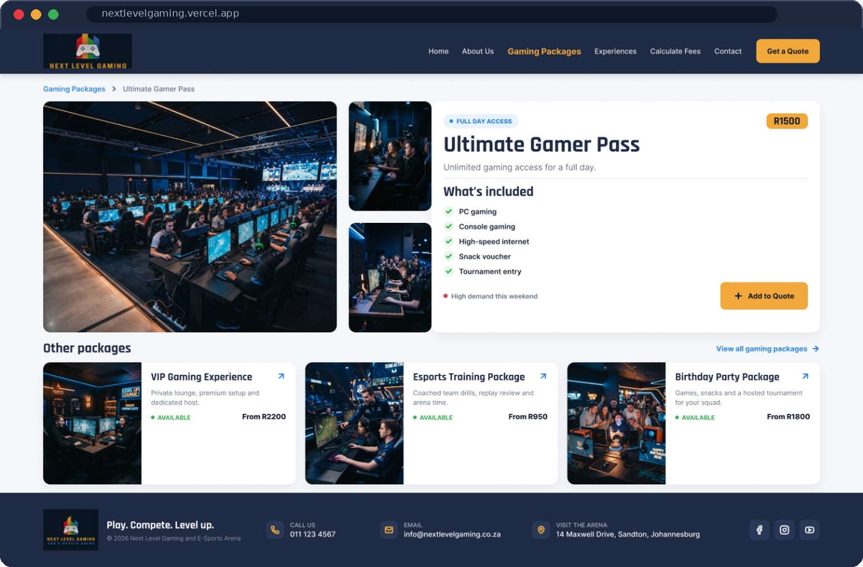
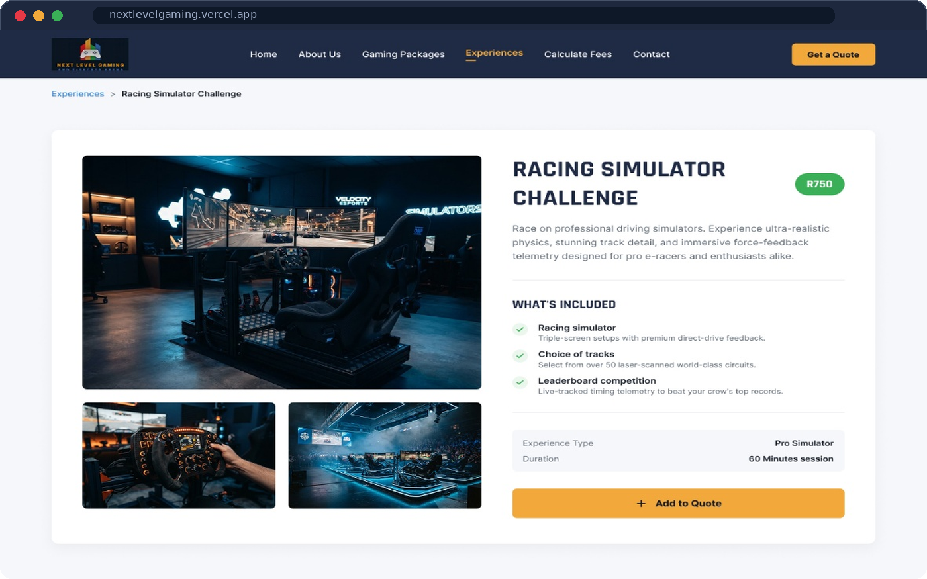
WEBSITE WIREFRAMES
WEBSITE
1
4
2
3
5
PACKAGE DETAIL
EXPERIENCE DETAIL
1 Sticky nav with an orange "Get a Quote" button, always in reach
2 "What's included" ticks, then one clear Add to Quote action
3 Other packages keep the user browsing
4 Large photo gallery sells the experience to schools and clubs
5 Price tag, session length and the same orange CTA, so the pattern stays consistent
PRESENTING: JORDAN
Notes:
These are two of our web wireframes, built in Figma. Left, the package detail page. (1) The header is sticky, so the orange Get a Quote button is always one click away. (2) What's included uses green ticks, the success colour, then a single Add to Quote button in our primary orange. (3) Other packages keeps people browsing and booking more, which also earns them a bigger discount. Right, the experience detail page uses the same pattern: (4) a large gallery because schools and clubs want to see the equipment, (5) price, session length and the same CTA. Consistency means users learn the pattern once.

Slide 10
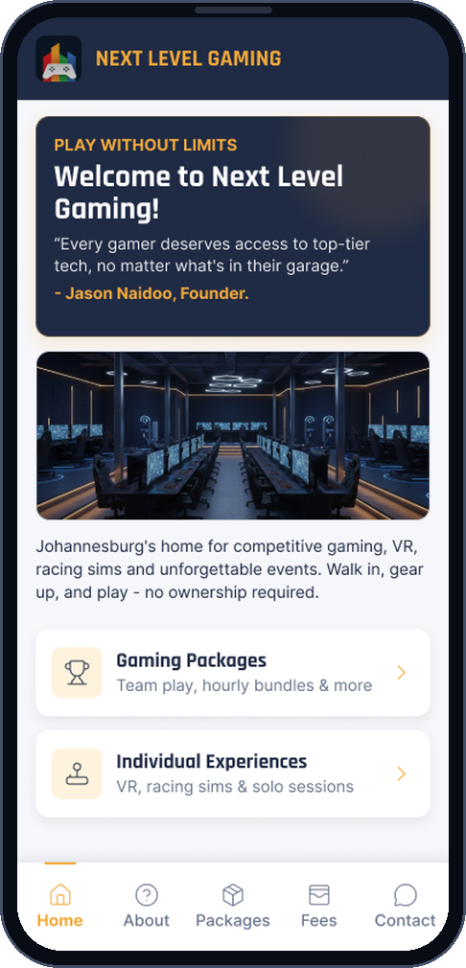
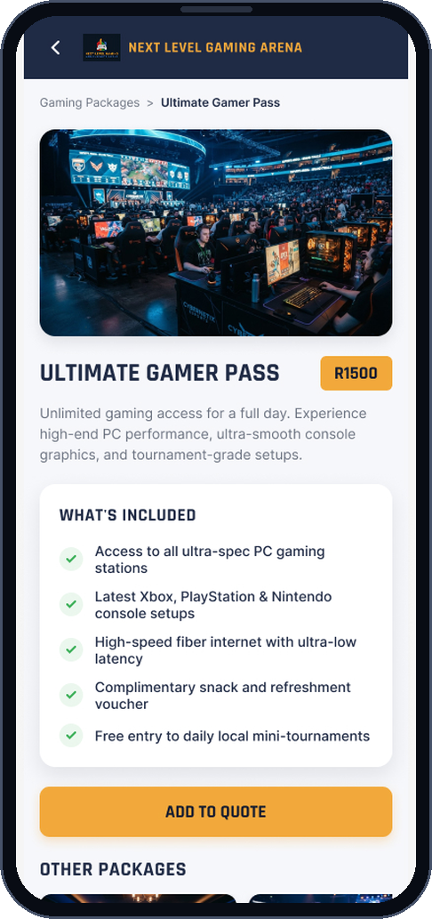
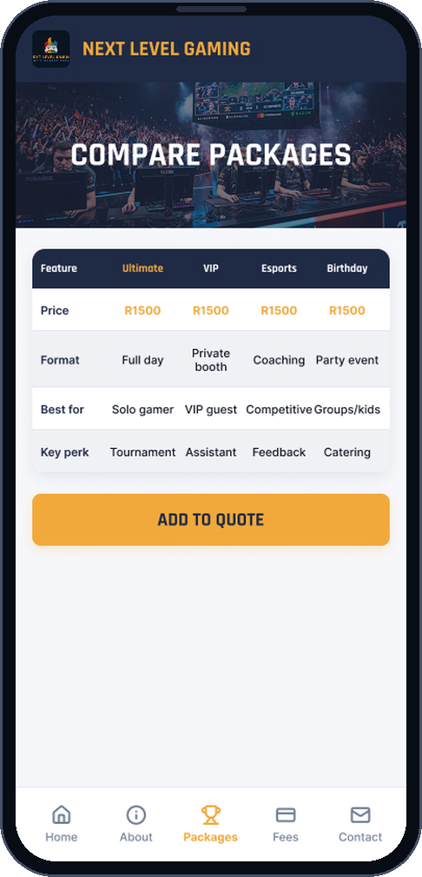
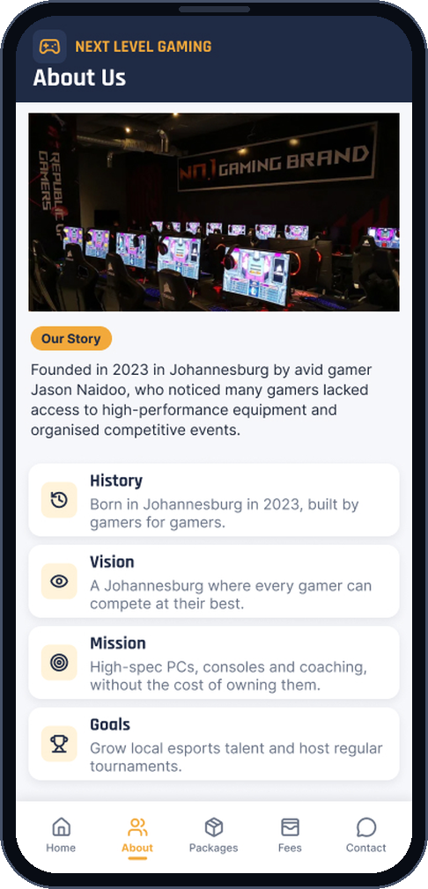
MOBILE WIREFRAMES: THUMB-FIRST
MOBILE APP
HOME
PACKAGE DETAILS
COMPARE PACKAGES
ABOUT US
Welcome hook and two big doors: Gaming Packages and Individual Experiences
Green ticks show what's included. One orange "Add to Quote" button
Side-by-side table so parents can see the difference at a glance
History, vision, mission and goals build trust before anyone books
PRESENTING: JORDAN
Bottom navigation: Home, About, Packages, Fees, Contact
Notes:
Mobile follows Apple and Google guidance: primary navigation sits at the bottom, in thumb reach, with five clearly labelled tabs. Home gives a short welcome and two big entry points. Package details uses a single column, green ticks for what's included, and one primary action. Compare Packages puts the four packages in one table so parents and schools can decide quickly. About Us builds trust with history, vision, mission and goals. Cards and buttons are big enough for fingers: 44pt minimum on iOS, 48dp on Android.

Slide 11
FROM BROWSING TO A QUOTE IN FOUR STEPS
BOOKING FLOW
Choose
packages and experiences
Calculate
discount and VAT, instantly
Your details
name, number, email
Confirmation
consultant will contact you
1
2
3
4
THE MORE YOU BOOK, THE MORE YOU SAVE
WORKED EXAMPLE: 2 BOOKINGS
Ultimate Gamer Pass
R1 500.00
Virtual Reality Experience
R750.00
Discount 5% (2 bookings)
−R112.50
Subtotal
R2 137.50
VAT 15%
R320.63
TOTAL
R2 458.13
The discount is applied before VAT is added.
PRESENTING: AAREN
Notes:
The business goal is to turn browsing into a booking request, so we kept the flow to four steps: choose, calculate, your details, confirmation. The calculator applies the discount rules from the brief: no discount for one booking, 5% for two, 10% for three and 15% for more than three, then adds 15% VAT. In this example a customer picks the Ultimate Gamer Pass at R1 500 and the Virtual Reality Experience at R750. That is R2 250, less 5% (R112.50) gives R2 137.50, plus VAT of R320.63, for R2 458.13. Customers see their total before they commit, which builds trust, and the green confirmation screen closes the loop.

Slide 12
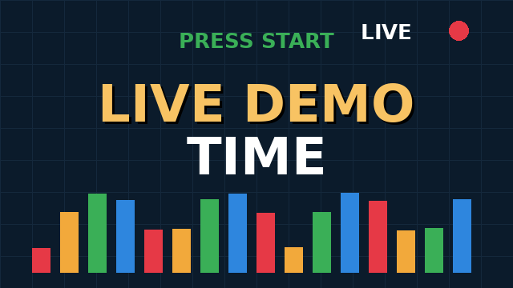


LIVE DEMO TIME
DEMONSTRATION
WHAT YOU WILL SEE
Browse gaming packages and individual experiences
Compare packages side by side
Book more than one and watch the discount grow
Get an instant quote with VAT
Submit a request and see the confirmation
The same journey on the mobile app
SCAN TO TRY IT YOURSELF
Open the site on your phone and book along with us.
WEBSITE
nextlevelgaming.vercel.app
PRESENTING: AAREN
Notes:
Switch to the live site and the mobile app. Suggested run: open the Gaming Packages page, open Compare, add the Ultimate Gamer Pass and the Virtual Reality Experience to a quote, calculate to show the 5% discount and VAT, submit with sample details, show the confirmation, then repeat the key steps on the phone. Keep the browser tab and the phone ready before the slide appears. If the connection fails, fall back to the wireframes on slides 9 to 11.

Slide 13
THANK YOU
for listening to our presentation
QUESTIONS?
BOMBERS UNITED
Saravan Jeeth Naidoo
ST10510632
Jordan Linsei Naidoo
ST10529327
Aaren Ryan Naidoo
ST10511005
Muhammad Suleman Pharos
ST10515860
Notes:
Thank the audience. Invite questions. Any team member can answer; point to the member who presented the relevant part.

