Slide 1
Mini SOC Dashboard
CIC-IDS-2017 Dataset • Network Threat Detection
Team Members
Instructor
Ziyad Alsarawi
223033379
Dr. Abdullah Al-Bouali
Mohammed Bajaba
222448149
Daniel Aldandan
223041168
Java Swing
CIC-IDS-2017
Jawad Zainaddin
223022484
Nmap
Wireshark
Abdullah Aljassim
220013690
King Faisal University • CS 320 • Second Semester 2025–2026

Slide 2
Introduction
🔍 What is a SOC?
📊 Dataset: CIC-IDS-2017
Centralized unit for monitoring & responding to cyber threats
Analysts monitor real-time logs & alerts 24/7
Networks face DoS, brute-force, & port scans daily
Manual detection too slow for modern threats
Solution: automated visual dashboard with real-time alerting
Published by Canadian Institute for Cybersecurity (UNB)
Realistic traffic: benign + attack scenarios
Covers: DoS, Brute-Force, PortScan, Web Attacks
IPs: 192.168.10.x (internal), 205.174.165.x (attacker)
Industry benchmark for IDS/SOC research

Slide 3
Problem Statement
⚡ High Event Volume
💸 Costly Traditional Tools
Modern organizations generate massive volumes of network events, making manual threat monitoring infeasible.
Enterprise SOC tools are expensive and complex — inaccessible for academic or small-scale environments.
🎓 Learning Gap
🛠 Our Solution
Students need a simplified platform to understand real-world cybersecurity operations hands-on.
A lightweight Java Swing dashboard to simulate traffic analysis, scanning, and alert handling using real data.

Slide 4
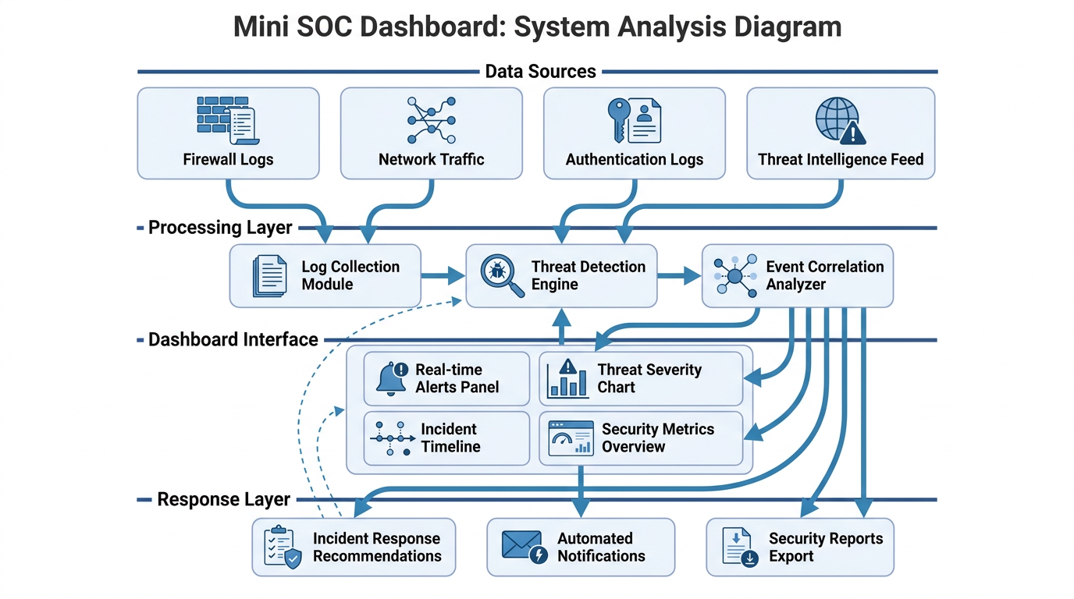
System Analysis Diagram
.

Slide 5
Objectives
🎯 Design Goals
⚙️ Key Features
Build a desktop SOC dashboard in Java Swing
Simulate key SOC workflows end-to-end
Integrate CIC-IDS-2017 benchmark data
Auto-classify traffic: BENIGN vs malicious
Create extensible educational codebase
Load & analyze CIC-IDS-2017 CSV logs
Stratified sampling: 200 rows (50% benign, 50% attacks)
Simulate Nmap port scanning on subnet
Live packet capture (Wireshark-style)
FTP-Patator ↔ Port 21 attack correlation

Slide 6
System Architecture
NORTH Panel
CENTER Panel
SOUTH Panel
🖱 Control Panel
📋 Log Table (JTable)
💻 Alert Console
Load IDS Logs
Run Nmap Scan
Live Packet Capture
Clear Dashboard
Timestamp
Source IP / Dest IP
Protocol
Packet Length + Label
Terminal-style output
CRITICAL/HIGH/MEDIUM/LOW alerts
Nmap scan results
Real-time events
Tech Stack: Java JDK 8+ | javax.swing | CIC-IDS-2017 | Nmap (sim) | Wireshark (sim)

Slide 7
Methods & Algorithm
analyzeLog() — Pseudocode
Severity Classification
// Called once per row during CSV load
PROCEDURE analyzeLog(logEntry[]):
label <- logEntry[5]
srcIP <- logEntry[1]
dstIP <- logEntry[2]
IF label == "BENIGN": RETURN
severity <- severityFor(label)
TRIGGER alert(severity, label,
srcIP, dstIP)
END PROCEDURE
CRITICAL
Heartbleed, Infiltration,
DDoS, SQL Injection
HIGH
DoS, Botnet, Patator,
XSS, Brute Force
MEDIUM
PortScan, Network Scan
LOW
All other non-BENIGN

Slide 8
Attack Detection • CIC-IDS-2017
≤200
4+
10+
0
Rows Loaded
(stratified sample)
Malicious
Detected*
Attack Types
Supported
False
Positives*
Attack Type | Source IP | Target | Severity
DoS Hulk | 205.174.165.73 | 192.168.10.50 | HIGH
PortScan | 172.16.0.1 | 192.168.x.x | MEDIUM
FTP-Patator | 10.0.0.5 | FTP Port 21 | HIGH
BENIGN | Various | Various | SAFE

Slide 9
Testing & Results
✓ PASS
Load IDS Logs
Real CSV parsed; stratified 200-row sample loaded, all non-BENIGN rows alerted
✓ PASS
Nmap Scan
4 open ports detected (21, 22, 80, 443)
✓ PASS
FTP Correlation
Port 21 ↔ FTP-Patator match confirmed
✓ PASS
Live Capture
Random IP, dynamic row per click
✓ PASS
Clear Dashboard
Table + console fully reset

Slide 10
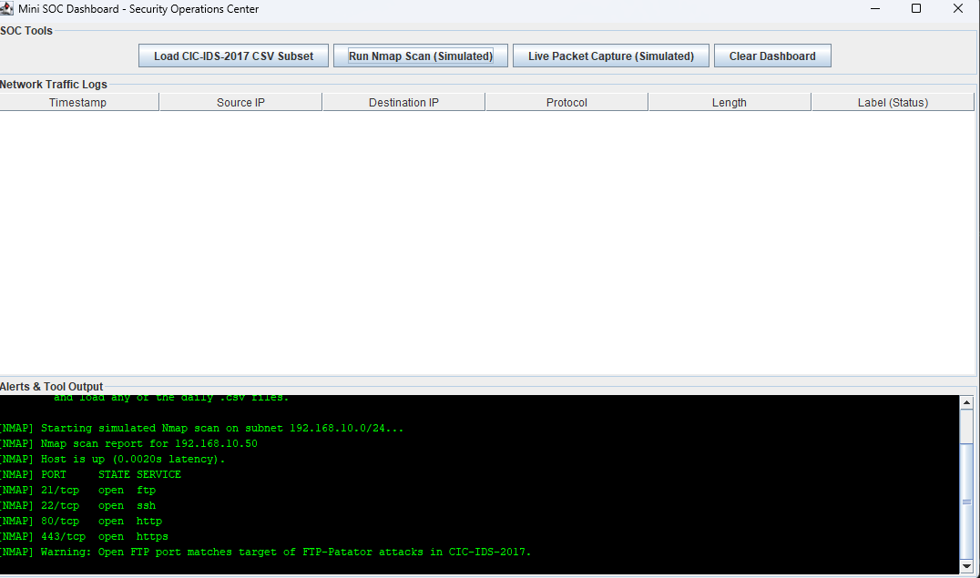
GUI

Slide 11
Conclusion
✓ Achieved
💡 Key Takeaways
SOC dashboard via MiniSOCDashboard.java extending JFrame
Real CIC-IDS-2017 CSV parsed directly — no hardcoded mock data
100% alert accuracy — 4/4 malicious entries detected
Zero false positives on BENIGN-labeled traffic
Single-file Java, no dependencies, fully educational
Bridges theory and practice in network security
Real dataset = credible, testable results
Event-driven Swing architecture scales well
All 5 functional tests passed on first run
Modular design ready for ML or live integration

Slide 12
Real World Alignment
🏢 How Real SOCs Work
✅ Our Project Mirrors This
Splunk, IBM QRadar, Sentinel ingest millions of logs/day
Nmap is a core daily tool for port recon
Wireshark used for packet-level investigation
Alert triage uses CRITICAL/HIGH/MEDIUM/LOW severity levels
CIC-IDS-2017 used in academic & industry research
Log table → SIEM-style event viewer
Alert console → real-time SOC triage queue
Nmap scan + correlation → threat hunting workflow
FTP-Patator ↔ Port 21 → real attack-port mapping
Packet capture → Wireshark live monitoring equivalent

