Slide 1
Mini SOC Dashboard
CIC-IDS-2017 Dataset • Network Threat Detection
Team Members
Instructor
Ziyad Alsarawi
223033379
Abdullah Rashid
Al-Bouali
Mohammed Bajaba
222448149
Daniel Aldandan
223041168
Java Swing
Jawad Zainaddin
223022484
IDS Logs
Abdullah Aljassim
Nmap
220013690

Slide 2
Introduction
🔍 What is a SOC?
📊 Dataset: CIC-IDS-2017
Centralized unit for monitoring & responding to cyber threats
Analysts monitor real-time logs & alerts 24/7
Networks face DoS, brute-force, & port scans daily
Manual detection too slow for modern threats
Solution: automated visual dashboard with real-time alerting
Published by the Canadian Institute for Cybersecurity (UNB)
Realistic network traffic: benign + attack scenarios
Covers: DoS, Brute-Force, PortScan, Web Attacks
IP ranges: 192.168.10.x (internal), 205.174.165.x (attacker)
Industry benchmark for IDS/SOC research

Slide 3
Objectives
🎯 Design Goals
⚙ Key Features
Build a desktop SOC dashboard in Java Swing
Simulate key SOC workflows end-to-end
Integrate CIC-IDS-2017 benchmark data
Auto-classify traffic: BENIGN vs malicious
Create extensible educational codebase
Load & analyze IDS logs from CIC-IDS-2017
Simulate Nmap port scanning on subnet
Live packet capture (Wireshark-style simulation)
Auto-classify: BENIGN vs HIGH SEVERITY alerts
Attack-to-port correlation (FTP-Patator ↔ Port 21)

Slide 4
Problem Statement
• Modern organizations generate large volumes of network events, making manual threat monitoring difficult.
• Traditional SOC tools are often expensive and too complex for academic or small-scale environments.
• Students require a simplified platform to understand real-world cybersecurity operations.
• A lightweight dashboard is needed to simulate traffic analysis, scanning, and alert handling.
• This project provides an educational Mini SOC Dashboard built with Java for security monitoring practice.

Slide 5
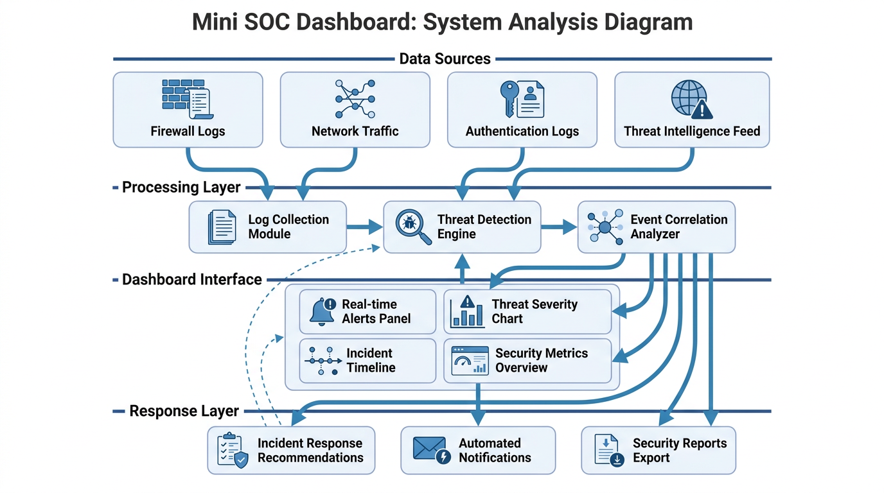
System Analysis Diagram
.

Slide 6
System Architecture
NORTH Panel
CENTER Panel
SOUTH Panel
Control Panel
Log Table
Alert Console
Load IDS Logs
Run Nmap Scan
Live Packet Capture
Clear Dashboard
Timestamp
Source IP / Dest IP
Protocol
Packet Length + Label
Terminal-style output
High severity alerts
Nmap scan results
Real-time events
Tech Stack: Java JDK 8+ | javax.swing | CIC-IDS-2017 Dataset | Nmap (simulated) | Wireshark (simulated)

Slide 7
Attack Detection • CIC-IDS-2017
7
4
3
0
Log Entries
Loaded
Malicious
Detected
Attack
Types
False
Positives
Attack Type | Source IP | Target | Severity
DoS Hulk | 205.174.165.73 | 192.168.10.50 | HIGH
PortScan | 172.16.0.1 | 192.168.x.x | HIGH
FTP-Patator | 10.0.0.5 | FTP Port 21 | HIGH
BENIGN | Various | Various | SAFE

Slide 8
Testing & Results
PASS
Load IDS Logs
7 entries, 4 alerts triggered
PASS
Nmap Scan
4 open ports detected
PASS
FTP Correlation
Port 21 ↔ FTP-Patator match
PASS
Live Capture
Random IP, dynamic rows
PASS
Clear Dashboard
Table + console reset

Slide 9
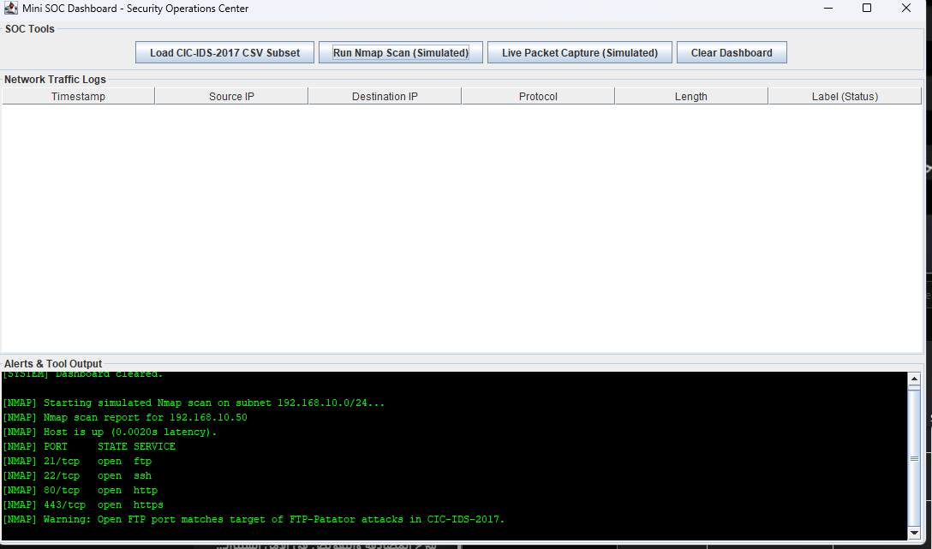
GUI

Slide 10
Conclusion
✓ Achieved
💡 Key Takeaways
SOC dashboard in Java Swing via MiniSOCDashboard.java extending JFrame
Real CIC-IDS-2017 patterns via mock data matching UNB IP & attack specs
100% alert accuracy (4/4) via analyzeLog() checking each label vs BENIGN
Zero false positives BENIGN-labeled traffic triggered no alerts
Educational codebase single-file Java, no dependencies, fully commented
Bridges theory and practice in network security
Real dataset = credible, testable results
Event-driven Swing architecture scales well
All 5 functional tests passed on first run
Modular design ready for ML or live integration

Slide 11
Real World Alignment
🏢 How Real SOCs Work
✅ Our Project Mirrors This
Tools like Splunk, IBM QRadar, and Microsoft Sentinel ingest millions of logs/day
Nmap is a core daily tool for SOC port recon
Wireshark used for packet-level investigation
Alert triage mirrors our HIGH/BENIGN classification
CIC-IDS-2017 used in academic & industry IDS research
Log table = SIEM-style event viewer
Alert console = real-time SOC triage queue
Nmap scan + correlation = threat hunting workflow
FTP-Patator ↔ Port 21 = real attack-port correlation
Packet capture = Wireshark live monitoring equivalent

