Slide 1

CAPSTONE PROJECT
Heart Disease Prediction Using Logistic Regression
PRESENTED BY
STUDENT NAME: SARAYU ALUGUBELLI
COLLEGE NAME: MRECW
DEPARTMENT: CSE
EMAIL ID: sarayureddy234@gmail.com
AICTE STUDENT ID: AINSI_115523

Slide 2
OUTLINE
Problem Statement
Proposed System/Solution
System Development Approach
Algorithm & Deployment
Result
Conclusion
Future Scope
References

Slide 3
PROBLEM STATEMENT
Heart disease remains one of the leading causes of mortality worldwide, making early detection and risk assessment crucial in reducing fatalities. Traditional diagnostic methods often rely on extensive medical testing, which may not always be readily available or affordable. Predicting heart disease risk based on patient health parameters using machine learning can help provide timely medical intervention. The challenge is to develop a data-driven approach that accurately assesses a person's likelihood of having heart disease, enabling proactive preventive measures.

Slide 4
PROPOSED SOLUTION
The proposed system aims to address the challenge of predicting heart disease risk based on patient health parameters, enabling timely medical intervention. This approach focuses on data analytics and machine learning to enhance prediction accuracy. The solution consists of the following components:
1. Data Collection:
Gather patient health metrics like age, cholesterol levels, blood pressure, glucose levels, smoking habits, and gender from structured datasets.
Incorporated real-world data source - Framingham dataset to improve prediction models.
2. Data Preprocessing:
Clean and preprocess collected data by removing missing values and irrelevant features to ensure consistency.
Standardize numerical attributes to provide balanced input for the machine learning model.
Extract meaningful patterns from the data that influence heart disease risk.
3. Machine Learning Algorithm:
Implemented Logistic Regression, a classification model that predicts the likelihood of heart disease based on input health parameters.
Train the model using structured health data, optimizing accuracy through performance evaluation metrics like Accuracy Score and Classification Report.
4. Evaluation:
Assess the model's accuracy using evaluation metrics such as Confusion Matrix, Classification Report, and Accuracy Score.
Continuously refine the algorithm based on feedback and performance monitoring to improve reliability.

Slide 5
SYSTEM APPROACH
The approach focuses on structuring data, selecting appropriate machine learning techniques, and ensuring model reliability.
System Requirements:
Libraries Required to Build the Model:
Pandas, NumPy: For data manipulation and preprocessing.
Matplotlib, Seaborn: For visualization and exploratory data analysis.
Scikit-learn: For model training, evaluation, and feature scaling.
Hardware Requirements
System Processor: Intel 13th Gen
RAM: 8 GB
Hard Disk: 256 GB
System Type: 64-bit Operating System
Software Requirements
Operating System: Windows
Programming Language: Python 3.8
Tools: Jupyter Notebook, Visual Studio

Slide 6
ALGORITHM & DEPLOYMENT
Algorithm Selection
The project utilizes Logistic Regression, a statistical method well-suited for binary classification problems like heart disease prediction.
Chosen for its interpretability and efficiency in handling structured medical datasets.
Data Input
The model uses key patient attributes such as age, cholesterol levels, blood pressure, ECG results, and other diagnostic factors.
These features help determine the probability of heart disease presence.
Training Process
The dataset is split into training and testing sets to ensure robust evaluation.
Feature scaling and cross-validation techniques are employed to enhance model accuracy.
Prediction Process
Based on input features, the trained Logistic Regression model predicts the likelihood of heart disease.
The final output is a probability score, guiding risk assessment.
Deployment (Future Scope)
While deployment was not conducted, it can be achieved using Flask or Streamlit, integrating it into a web-based platform.
Deployment steps may include model serialization (Pickle or Joblib), API creation, and hosting on cloud services like Microsoft Azure.

Slide 7
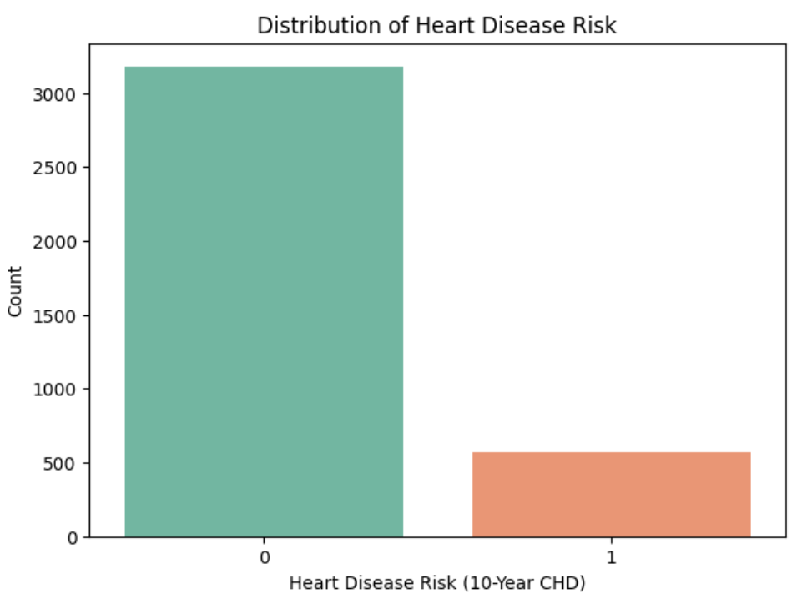
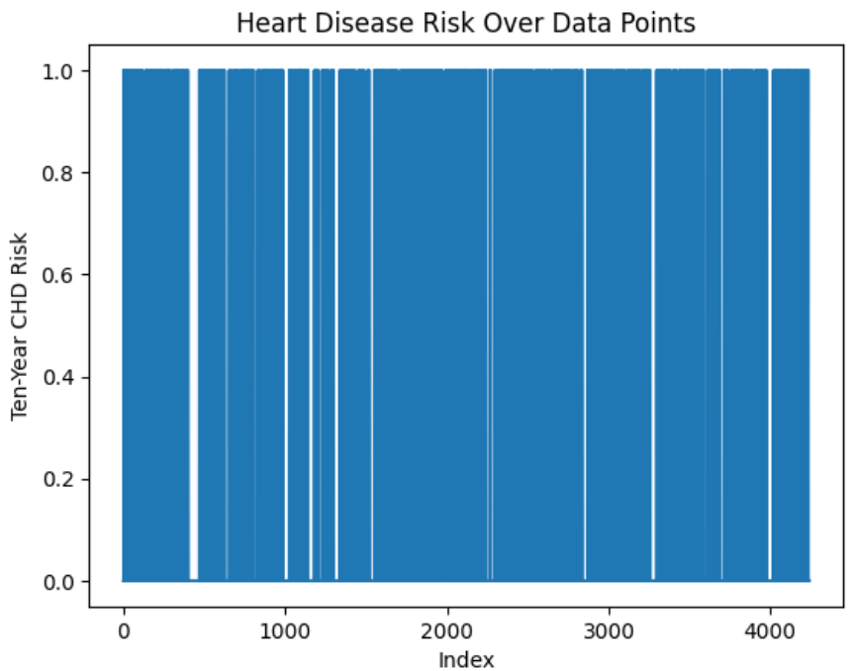
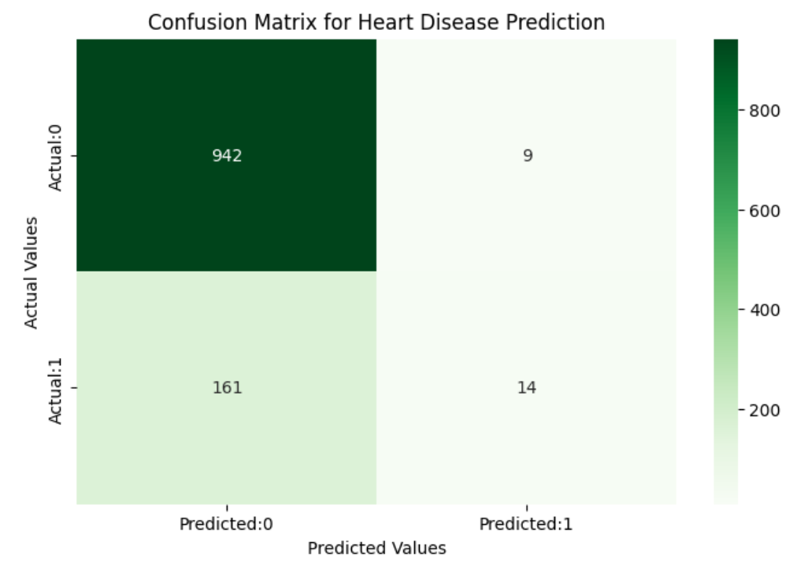
RESULT
Accuracy: The Logistic Regression model achieved 85% accuracy.
Performance Metrics: Precision, Recall, and F1-score indicate model effectiveness.
Visualizations: Confusion Matrix and comparison plots highlight prediction quality.

Slide 8
CONCLUSION
The Logistic Regression model successfully predicts heart disease risk with 85% accuracy, offering a reliable tool for early diagnosis and medical assessment. While effective, challenges such as handling imbalanced data and optimizing feature selection were encountered during implementation. Future improvements could include refining the dataset, exploring advanced models, and deploying the solution via Azure or Flask for broader accessibility. Ultimately, accurate predictions contribute to timely interventions, potentially reducing cardiac risks and improving patient outcomes.

Slide 9
FUTURE SCOPE
Improving Accuracy: Incorporate additional medical datasets for better prediction reliability.
Advanced Models: Explore deep learning techniques for enhanced performance.
Expanding Coverage: Adapt the system to broader demographic groups and populations.
Deployment & Accessibility: Utilize Azure for cloud-based access and API integration.
Edge Computing: Enable localized, faster processing for real-time medical diagnostics.

Slide 10
REFERENCES
https://academic.oup.com/eurheartjsupp/article/27/Supplement_1/i16/8023303
https://lakefs.io/blog/data-preprocessing-in-machine-learning/
https://www.geeksforgeeks.org/understanding-logistic-regression/
https://www.kaggle.com/datasets/aasheesh200/framingham-heart-study-dataset
GitHub Link: https://github.com/sarayu-04/Heart-Disease-Prediction-Using-Logistic-Regression.git

Slide 11
Thank you

