Slide 1

Predictive Analysis of Housing Prices Using Machine Learning
Abhishek Goyal
Sarayu Rayabharapu

Slide 2
Introduction to Machine Learning in Real Estate Analysis
Overview & Scope
Exploration: Unveiling machine learning's transformative role at the juncture of data science and property markets.
Application: Utilizing Boston's diverse housing data, predicting prices through variables like crime rates, zoning, and property features.
Insight Generation: Beyond forecasting, we aim to decode urban trends and provide actionable insights to stakeholders.
Background & Objectives
Transitioning Methods: Moving from traditional market analyses to machine learning's advanced, multifaceted data analysis.
Mission: Crafting an ML application for precise valuations and market insights, fostering informed decision-making in real estate.
End Goal: Support informed decisions by investors, planners, and policymakers through a comprehensive, data-centric analytical tool.

Slide 3
Problem Statement
Traditional Challenges:
Machine Learning Edge:
Project Focus:
Using the Boston housing dataset to model the effects of various urban factors on property values.
Aimed at enhancing investment strategies, urban planning, and market risk assessments.
Real estate analysis grapples with dynamic factors: neighborhood shifts, economic changes, and environmental impacts.
Existing methods lack precision in capturing these complex market influencers.
Machine learning excels in decoding these complexities, offering a comprehensive market view.
Our approach leverages this strength to predict prices and understand urban market dynamics accurately.

Slide 4
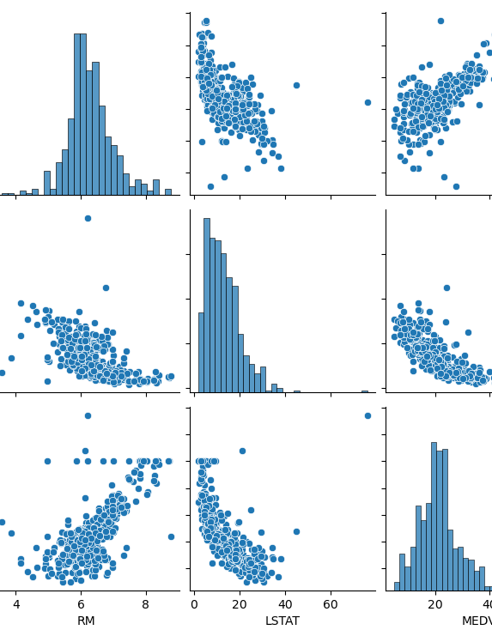
Exploratory Data Analysis Insights
RM (Average Number of Rooms): The histogram shows a normal distribution, indicating most homes have around 6 rooms. The scatter plot suggests a positive correlation between RM and MEDV, indicating that larger homes tend to be more expensive.
LSTAT (% Lower Status of the Population): The distribution is skewed to the right, meaning a higher number of areas have a lower percentage of "lower status" population. The scatter plot shows a negative correlation with MEDV, meaning that property values tend to be lower in areas with a higher LSTAT percentage.
MEDV (Median Value of Owner-Occupied Homes): This histogram also appears right-skewed, indicating that a majority of homes fall into the lower price bracket, with fewer homes valued at the higher end. The scatter plots show that MEDV has a potential non-linear relationship with both RM and LSTAT.

Slide 5
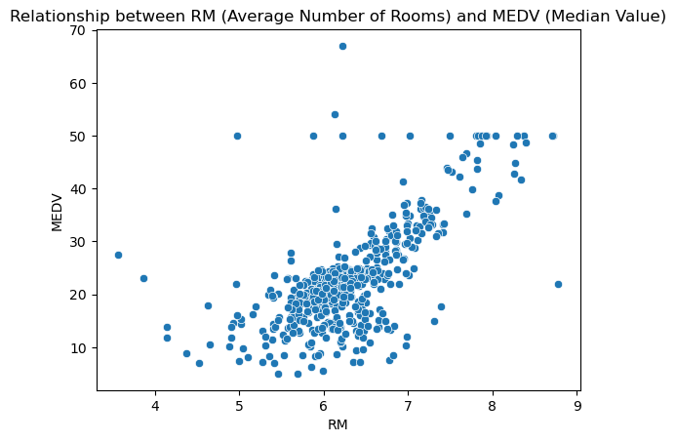
Correlation Between Room Count and Home Value
Key Observation:
The scatter plot illustrates a clear positive correlation between the number of rooms in a home (RM) and the home's median value (MEDV).
As the average number of rooms increases, there is a general trend of rising home values, suggesting that more spacious homes command higher prices in the market.
Implications for Real Estate Market:
Room Count as a Value Indicator: The number of rooms can be a significant indicator of property value, useful for buyers, sellers, and real estate professionals in the valuation process.
Strategic Insight: Developers and investors might consider the room count as a critical factor in project development and investment decisions to align with market expectations.

Slide 6
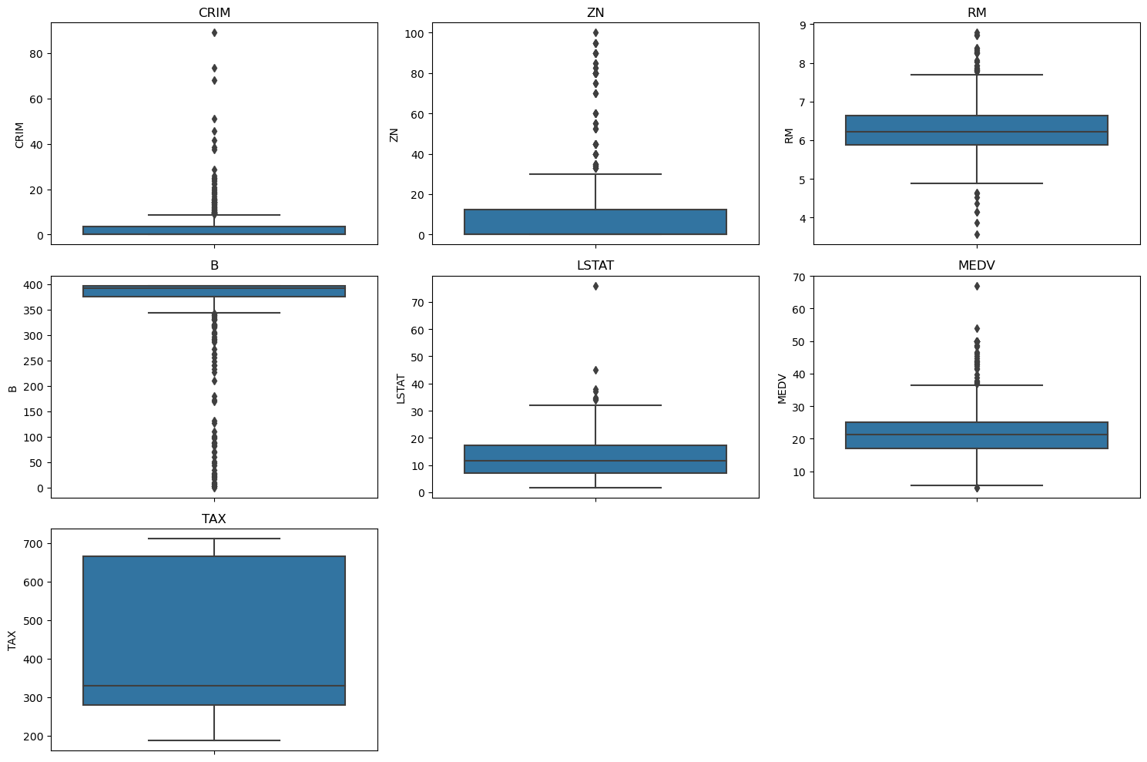
Key Distributions in Housing Data
RIM & ZN: Most areas have low crime rates and residential zoning, with a few significant outliers indicating specific high-crime or highly zoned areas.
RM & MEDV: Normal room distribution suggests consistency in housing size, while median values indicate a market spanning from affordable to luxury homes.
LSTAT & B: Lower status population percentages are generally low, but with outliers; a similar pattern is observed in the proportion of Black residents.
TAX: Two prevalent tax rates suggest a possible categorization of areas within the dataset.
Concise Insight: Outliers highlight specific zones for detailed analysis, crucial for targeted real estate strategies and policymaking.

Slide 7
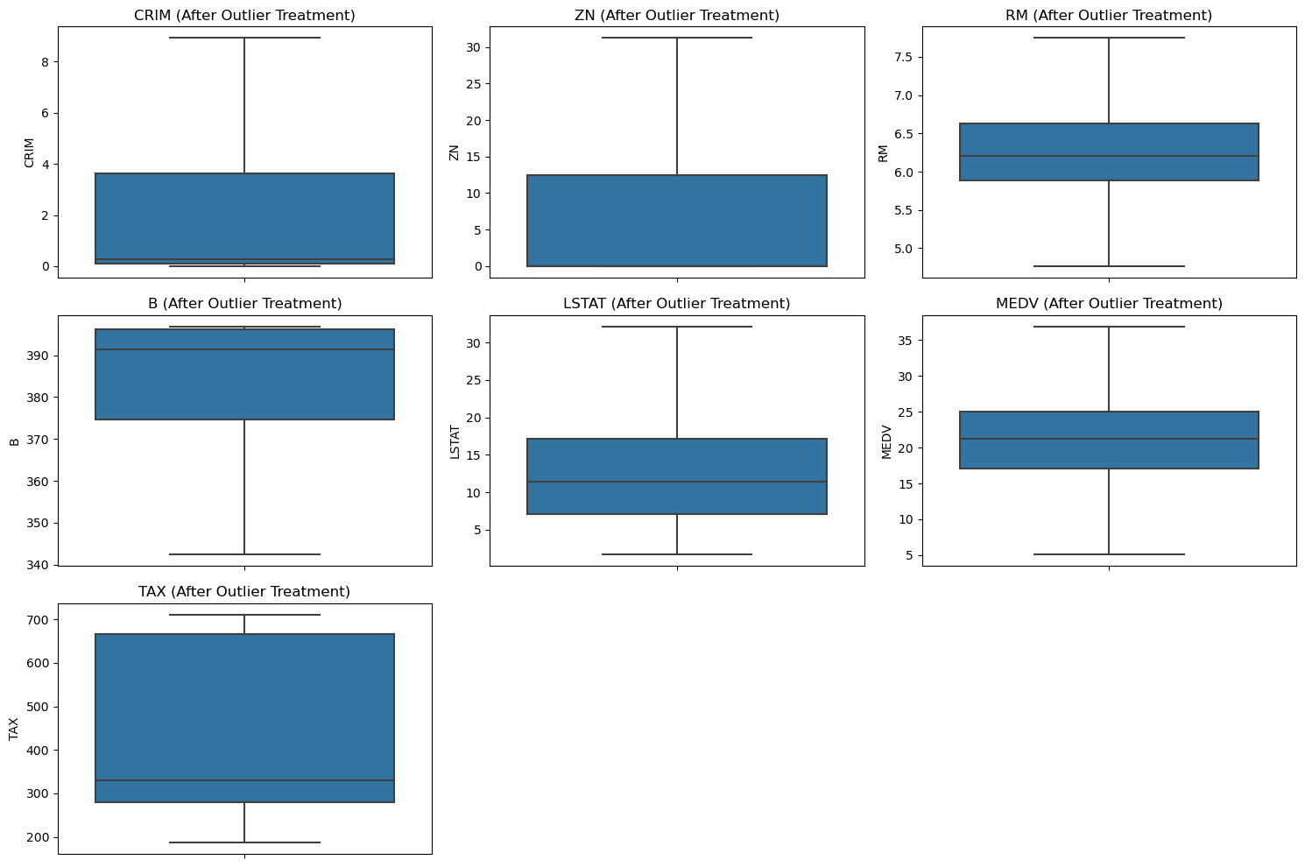
Post-Outlier Treatment Insights
Refined Dataset: Outliers managed using the IQR method for cleaner, more accurate modeling.
Key Features Normalized: CRIM, ZN, RM, and MEDV now show more typical distributions, enhancing model reliability.
Socio-Economic and Tax Data: LSTAT and B distributions are more homogeneous; TAX rates exhibit clearer common brackets.
Modeling Implication:
Improved data quality ensures robust model performance, focusing on representative market trends.

Slide 8
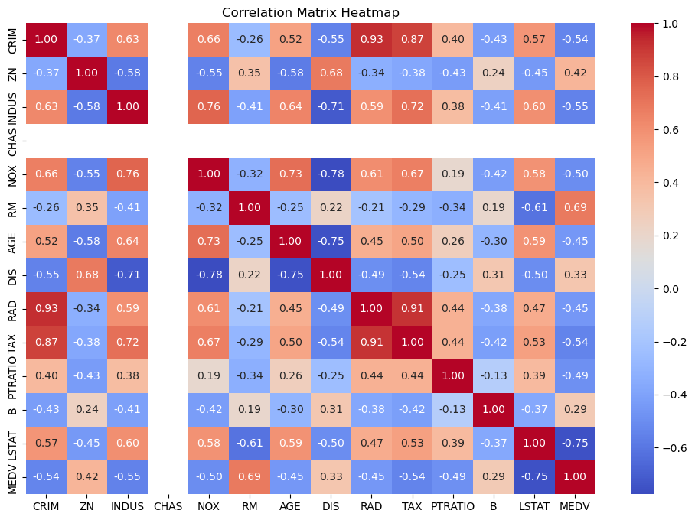
Inter-feature Correlations in Housing Data
High Positive Correlation: Notable positive correlations include the number of rooms (RM) with median value (MEDV), suggesting larger homes generally have higher prices.
Negative Correlation: Higher crime rates (CRIM) and percentage of lower status population (LSTAT) are negatively correlated with home values (MEDV), indicating these factors might lower property prices.
Taxation Insights: Property tax rates (TAX) show a strong positive correlation with the accessibility to highways (RAD), possibly reflecting infrastructure funding.
Insightful Takeaways:
Correlations guide feature importance for predictive modeling and highlight potential intervention points for policy and investment.

Slide 9
Linear Regression Model Implementation
Model Foundation: Utilized Linear Regression to predict MEDV (Median Home Values) based on housing data features.
Data Preparation: Applied PowerTransformer and feature engineering to optimize data for model input.
Training Details: Model trained on an 80/20 train-test split to ensure validation of predictions.
Objective: Aimed at establishing a baseline for predictive performance with a focus on interpretability.

Slide 10
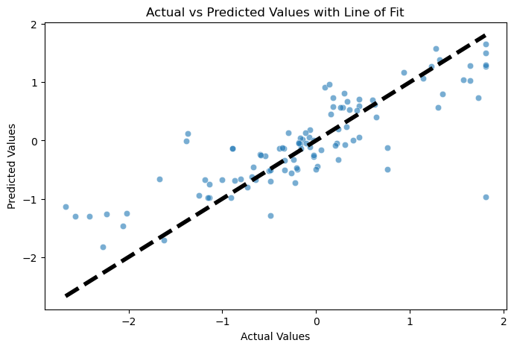
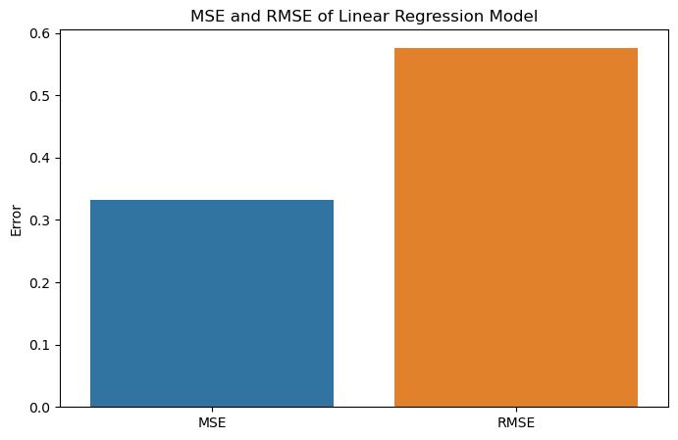
Test Results - Linear Regression
Performance Metrics:
MSE (Mean Squared Error): 0.3322
RMSE (Root Mean Squared Error): 0.5764
R² (Coefficient of Determination): 0.6737
Interpretation:
The model accounts for approximately 67.37% of the variance in housing prices.
The RMSE indicates an average estimation error of 0.5764 in the scaled data units.

Slide 11

Random Forest
Model Selection: Chose Random Forest for its robustness to overfitting and ability to handle non-linear relationships.
Training Process: Model trained with a diverse set of features after preprocessing, including outlier capping and feature transformations.
Objective: To capture complex patterns in the data for more accurate predictions of MEDV (Median Home Values).

Slide 12
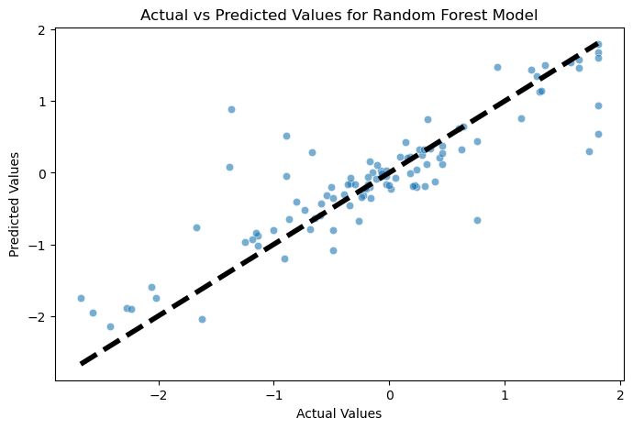
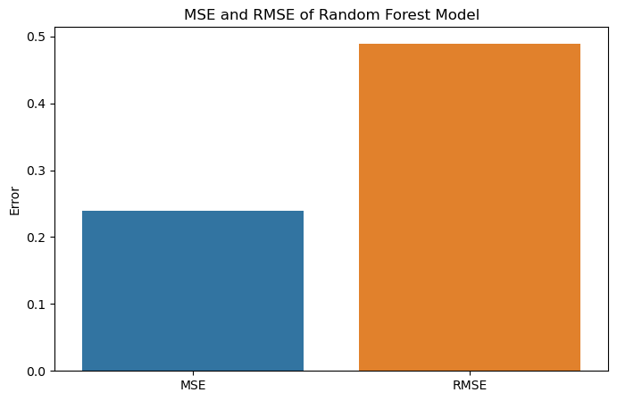
Performance Evaluation of Random Forest
Performance Metrics:
MSE (Mean Squared Error): 0.2397
RMSE (Root Mean Squared Error): 0.4896
R² (Coefficient of Determination): 0.7646
Interpretation:
The R² value indicates that the Random Forest model explains approximately 76.46% of the variance in housing prices.
Lower MSE and RMSE values compared to the Linear Regression model suggest better prediction accuracy.

Slide 13
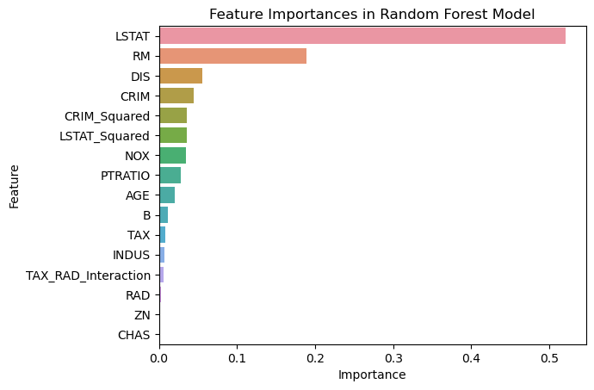
Key Drivers in Home Value Prediction
Top Predictors: LSTAT and RM are key in determining home values.
Influential Factors: Proximity to employment (DIS) and crime rate (CRIM) significantly influence prices.
Policy Insight: LSTAT highlights socio-economic impacts, whereas RM reflects the importance of living space.

Slide 14
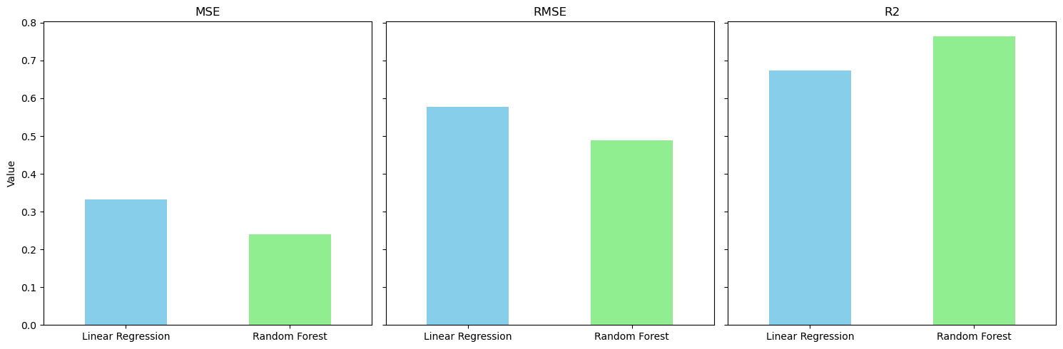
Model Performance: Linear Regression vs Random Forest
Comparative Analysis:Observed a lower MSE and RMSE for the Random Forest model, indicating a better fit to the data.
The R-squared value is higher for the Random Forest model, suggesting a stronger explanatory power.
Implications:
The results suggest that the Random Forest model outperforms the Linear Regression in predicting home values with this dataset.
Lower error rates and higher R-squared values from the Random Forest model provide more accurate and reliable predictions.

Slide 15
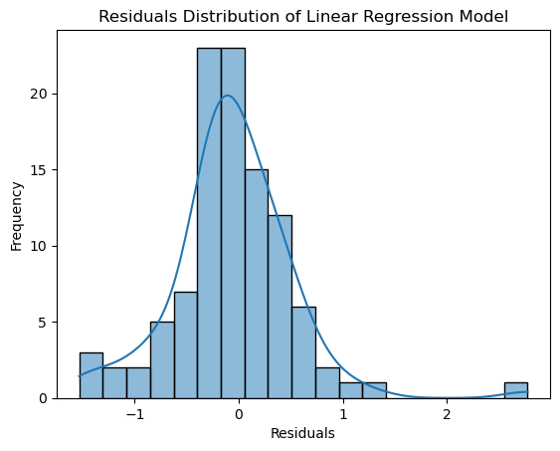
Residual Analysis for Linear Regression
Content:
Residuals Overview: Distribution centered around zero; suggests accurate predictions on average.
Normality Indicator: The near-normal distribution aligns with model assumptions.
Skewness & Outliers: Minor skewness and outliers indicate potential for model refinement.
Insights:
Critical for model validation and highlights improvement opportunities.

Slide 16
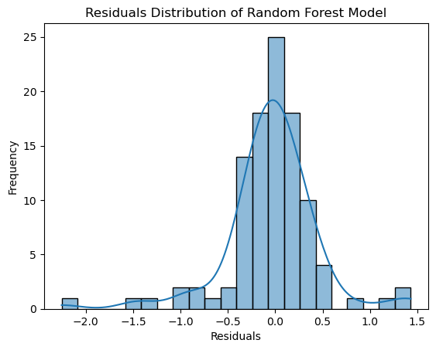
Evaluating Random Forest Residuals
Residuals Pattern: Centered near zero, suggesting good model accuracy.
Distribution: Approximately normal, indicative of well-fit model assumptions.
Diagnostics: Minimal skewness; some residual clustering signals prediction consistency.
Takeaway:
Validates Random Forest's predictive reliability, with room for minor enhancements.

Slide 17
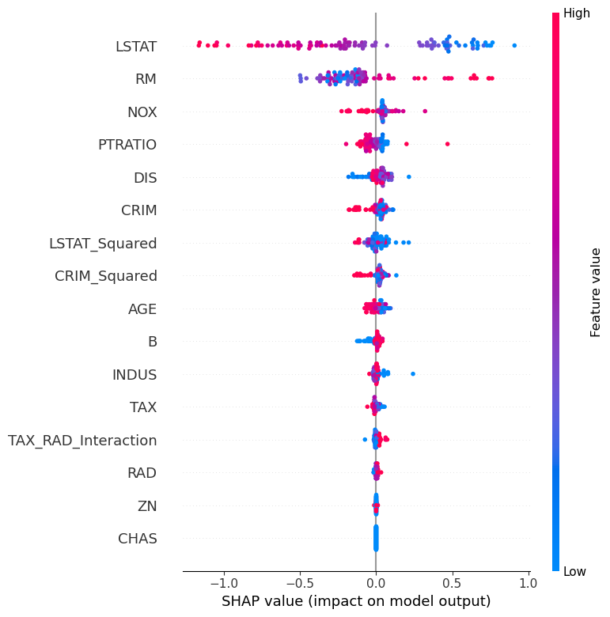
SHAP Value Insights
Feature Impact Analysis: SHAP values reveal how much each feature contributes to the model's predictions.
Key Influencers: LSTAT, RM, and NOX are the top features affecting home value predictions.
Interpretation: High SHAP values for LSTAT and RM suggest strong impacts on predictions, with higher values of LSTAT likely decreasing home values, while higher RM increases them.
Visualization:
Include the SHAP value plot image, showing the spread of impacts for each feature.

Slide 18
Conclusion
Model Efficacy: The Random Forest model demonstrates a strong predictive capability, with significant features driving home value estimations.
Interpretability: SHAP analysis offers clarity on feature influence, ensuring model transparency.
Future Direction: Insights from model diagnostics and feature importance pave the way for targeted data collection and further refinement of predictive algorithms.
Strategic Value: The ability to interpret model predictions enriches strategic decision-making in real estate investments and policy formulation.
Final Remark:
We've leveraged advanced machine learning techniques to not only predict but also understand the key factors influencing real estate prices, marking a step forward in data-driven decision-making.

