Slide 1


Cognitive Load Detection
This presentation will introduce our Artificial Intelligence project, Cognitive load detection

Slide 2
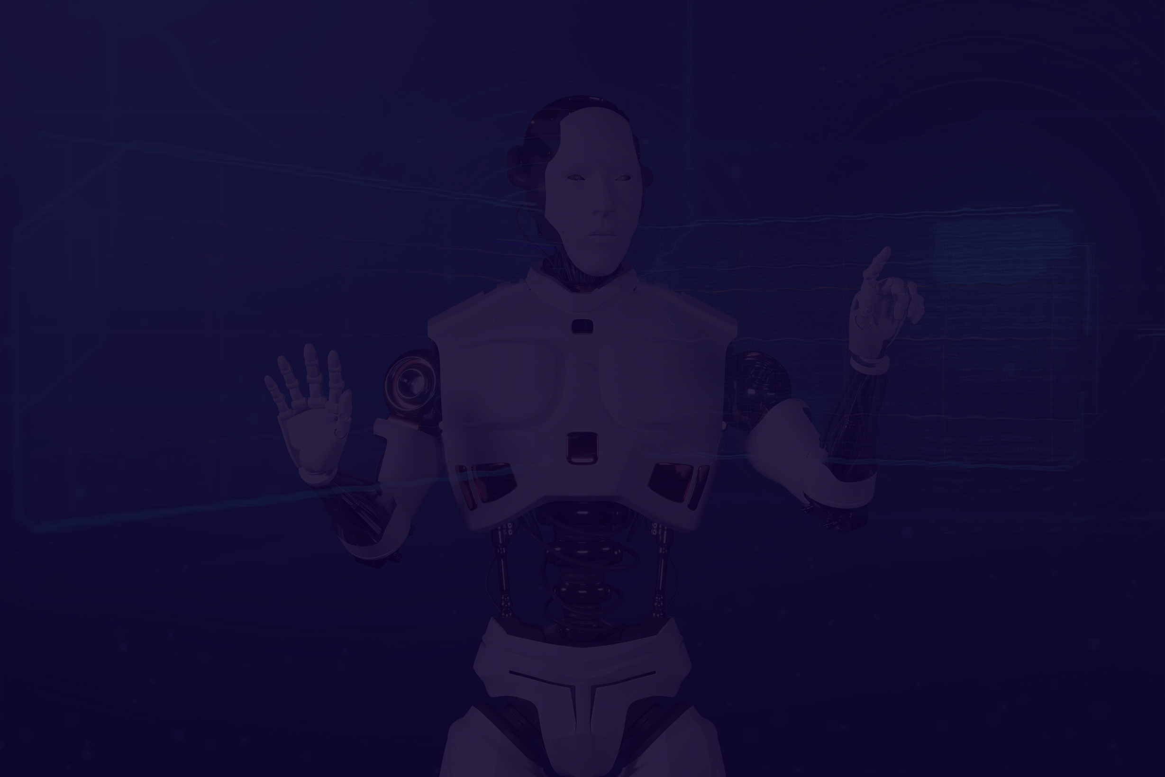

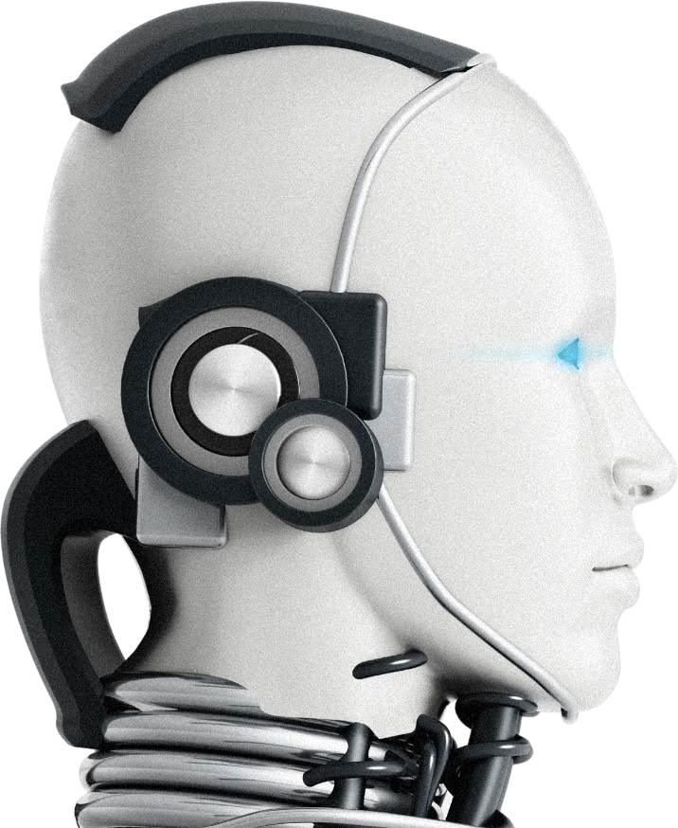
02
Where do we implement this
This system can be implemented in smart classrooms or online learning platforms in schools, where each student uses a device with a webcam during digital lessons. The AI model runs locally (or on a school server) to analyze facial expressions in real time, estimate cognitive load, and dynamically provide guidance to help students regulate their learning—such as increasing challenge when load is low or simplifying content when load is high. It can also be integrated into existing e-learning systems to support adaptive instruction and improve engagement, focus, and overall learning effectiveness while maintaining student privacy through on-device processing.

Slide 3

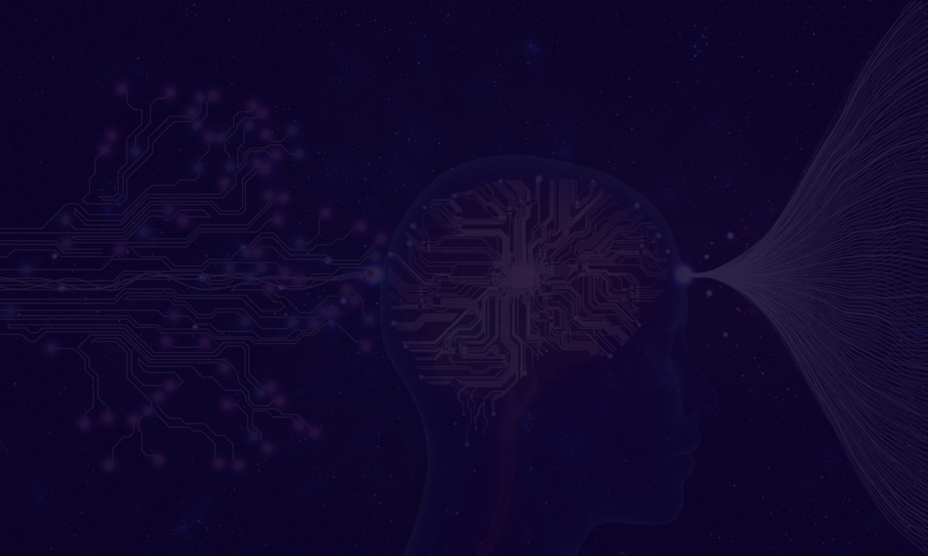
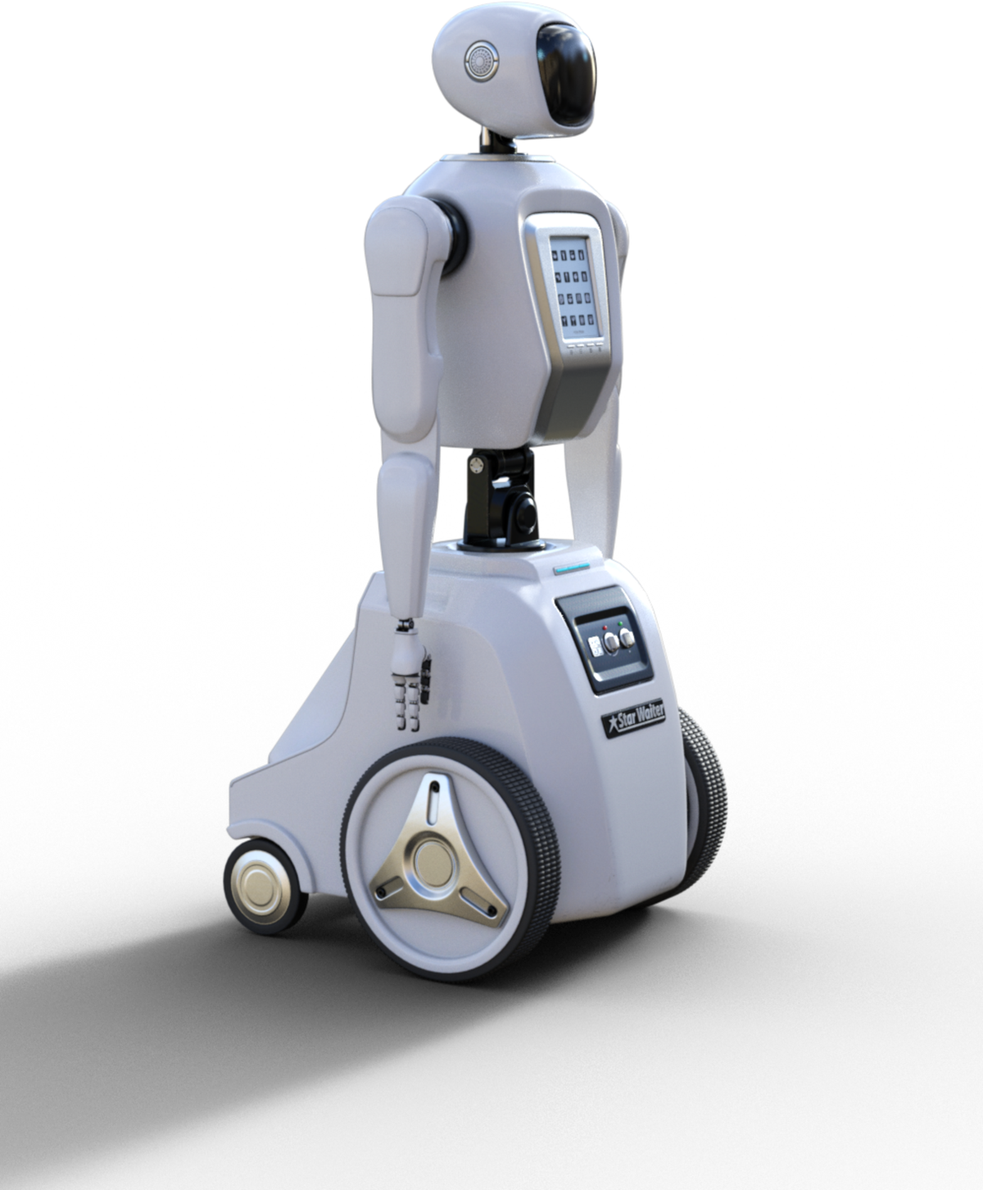
03
How do we take the camera access from the user.
In this project, camera permission is obtained through the web browser using the WebRTC API, specifically the navigator.mediaDevices.getUserMedia({ video: true }) function in JavaScript. When the user clicks the “Allow Camera Access” button on the first webpage, the browser automatically displays a permission popup asking the user to allow or deny camera access. The webcam activates only if the user explicitly grants permission; otherwise, access is blocked and the system does not proceed to the detection page. This ensures user consent and follows standard web security and privacy practices, since modern browsers require explicit approval before any application can access camera hardware.

Slide 4



04
What is the domain of the project.
The domain of this project is Artificial Intelligence (AI), specifically under Deep Learning and Computer Vision. The system uses a trained Convolutional Neural Network (CNN) to analyze facial images captured from a webcam and classify emotions, which are then mapped to cognitive load levels. Since it interprets human emotions to assess mental effort, it also falls under Affective Computing—a subfield of AI that focuses on emotion recognition and human-centered intelligent systems. In an educational context, it additionally connects to Adaptive Learning Systems and Human–Computer Interaction (HCI), as it dynamically guides students based on their detected cognitive state.

