Slide 1
Smart Thermostat Energy Analysis: Exploring Indoor Climate & Energy Patterns
A data analysis project examining seasonal HVAC usage, indoor comfort, and outdoor temperature patterns
By
Saranyadevi Muthulingam
8/8/2025

Slide 2
Project Overview
From May 2024 to July 2025, smart thermostat runtime data and local weather records were analyzed to understand how outdoor conditions and indoor comfort settings influence HVAC usage.
By identifying seasonal trends, daily usage patterns, and comfort maintenance, this project provides insights that can help optimize energy use and maintain comfort year-round.

Slide 3
Key Findings

Slide 4
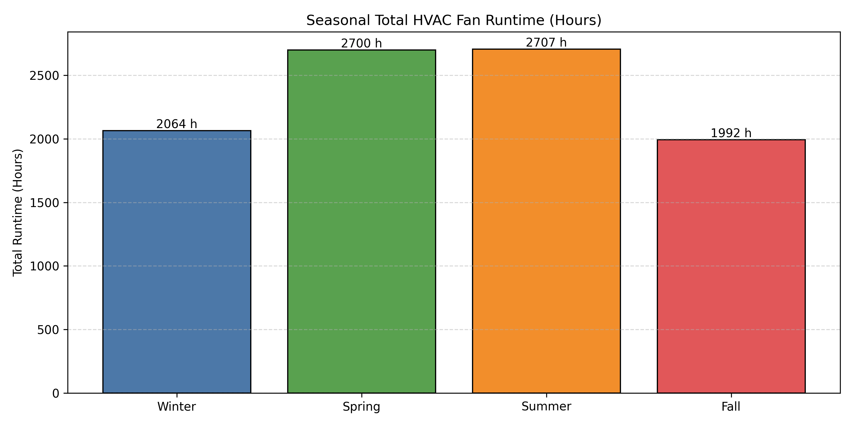
Key Finding #1: Seasonal Demand
HVAC runtime peaked in summer (2,707 hours) and spring (2,700 hours).
Usage dropped in winter (2,064 hours) and fall (1,992 hours).
Seasonal trends align with extreme temperature periods.

Slide 5
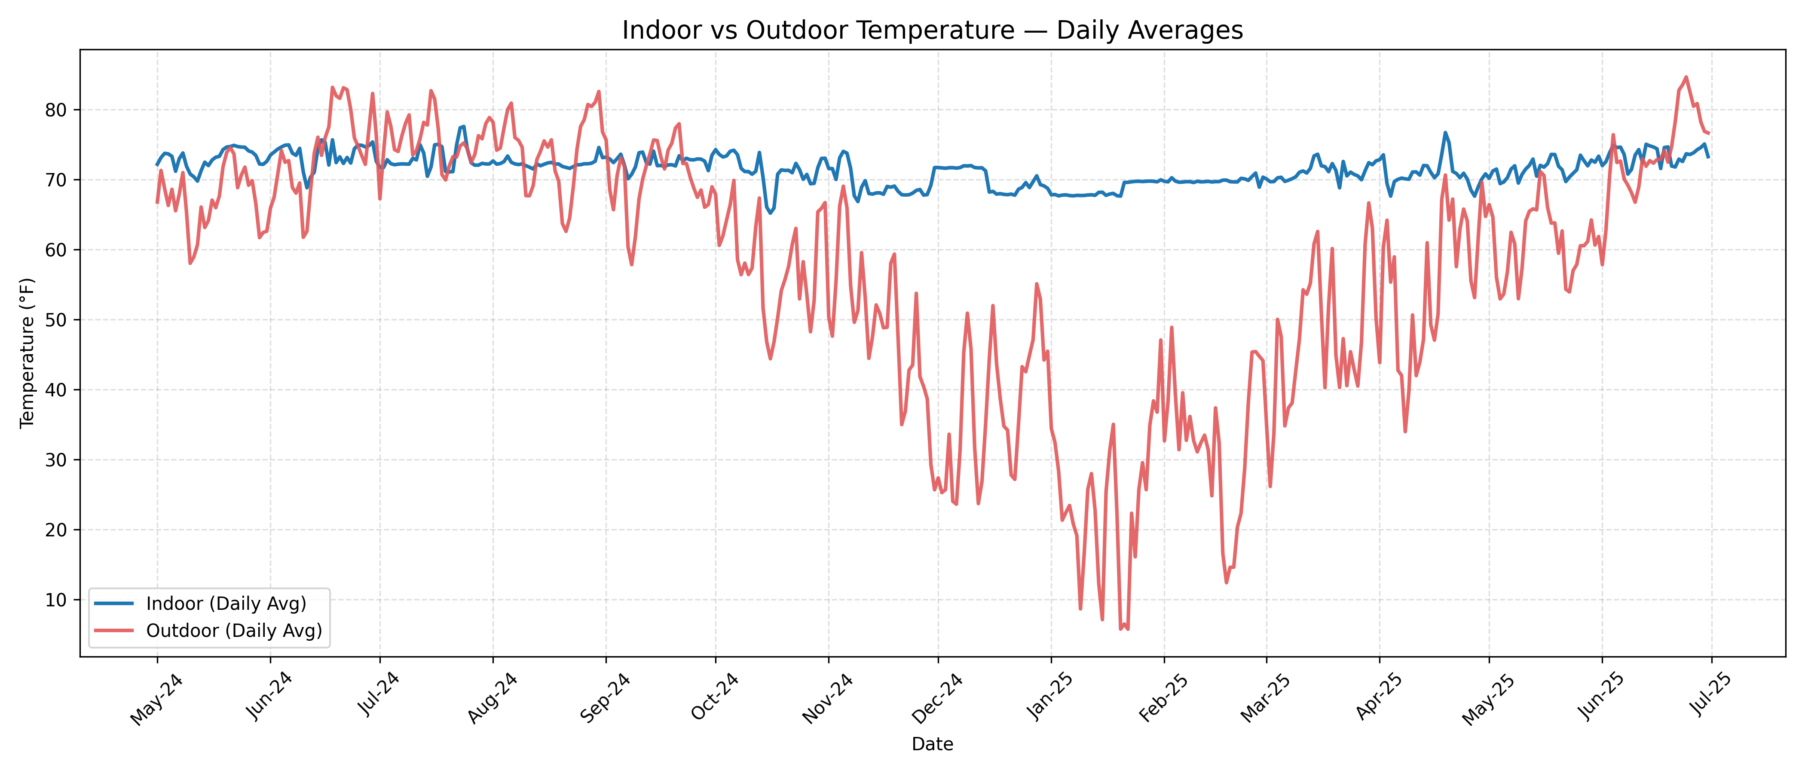
Key Finding #2: Temperature & Comfort
In summer, indoor temperatures averaged 0.64°F warmer than outdoors.
In winter, indoor temperatures averaged 1.75°F cooler than outdoors.
Small seasonal deviations show the HVAC system responds effectively to changing outdoor conditions.
Average Temp Difference by Season (°F)
Seasons | Temp_Diff(current_temp – set_point)
Winter | -1.75
Spring | -0.51
Summer | 0.64
Fall | -0.61

Slide 6
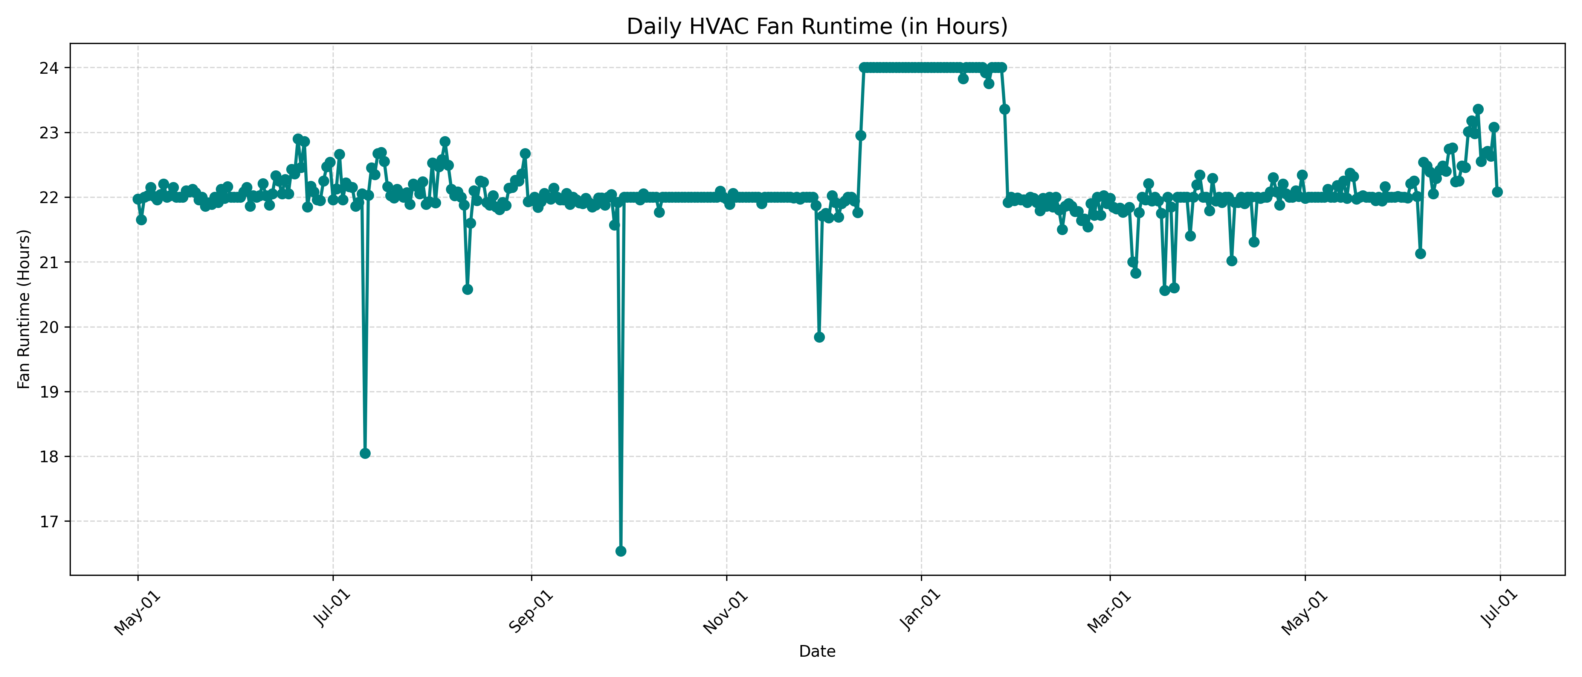
Key Finding #3: Daily Patterns
HVAC ran 21–24 hours daily on average.
Peak activity occurred during the hottest and coldest parts of the day.
Shorter runtime periods coincided with moderate outdoor temperatures.

Slide 7
Limitations & Data Issues
Some days had missing or incomplete readings, possibly affecting totals and averages.
Outdoor weather data came from a nearby source, so exact local conditions may differ slightly.
Runtime measured by fan operation may not fully capture actual heating or cooling energy usage.

Slide 8
Conclusions
Seasonal HVAC usage is driven by extreme outdoor temperatures.
The system maintained comfortable indoor temperatures year-round with minimal deviations from setpoints.
Daily runtime patterns show predictable peaks during temperature extremes.

Slide 9
Additional Considerations & Future Plans
Adjust thermostat schedules to reduce runtime during mild weather.
Fine-tune seasonal setpoints for greater energy efficiency.
Link runtime data to energy bills for cost impact analysis.
Use the cleaned dataset to develop predictive models for HVAC usage.
Expand analysis to multiple homes or regions to identify broader energy efficiency patterns.

