Slide 1
Time Lapse Image Acquisition
By Sarayu Managoli
Under the Guidance of Dr. Sam Siewert for the course ECEN 5623 Real Time Embedded Systems
University of Colorado Boulder
Summer 2020

Slide 2
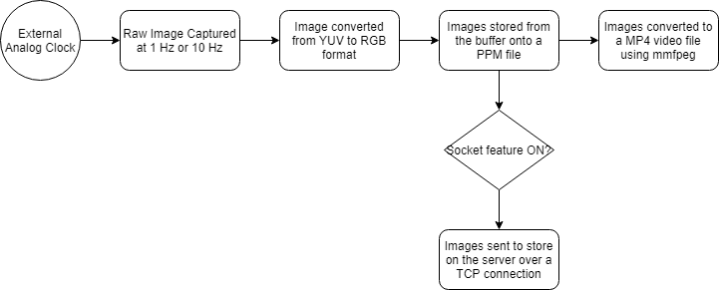
System Overview

Slide 3
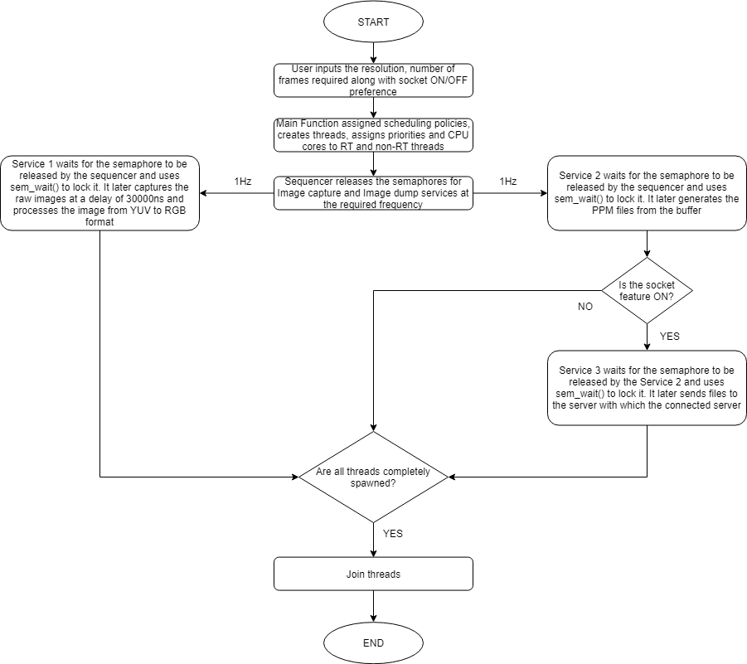
Software Overview

Slide 4
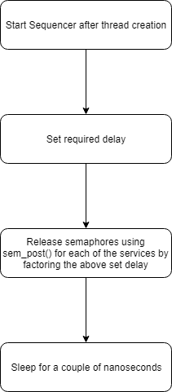
Sequencer

Slide 5
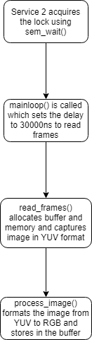
Image Capture Service

Slide 6
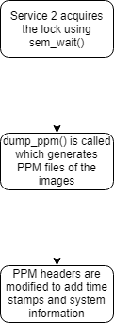
Image Dump Service

Slide 7
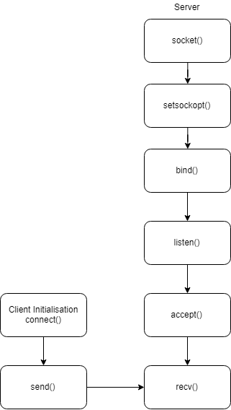
Client-Server Socket

Slide 8
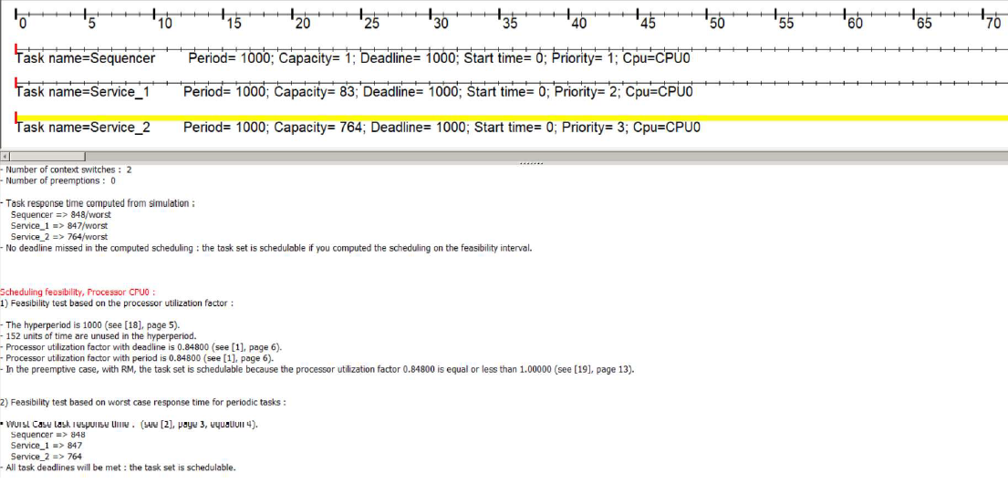
Cheddar Analysis – 1 Hz
Based on WCET

Slide 9
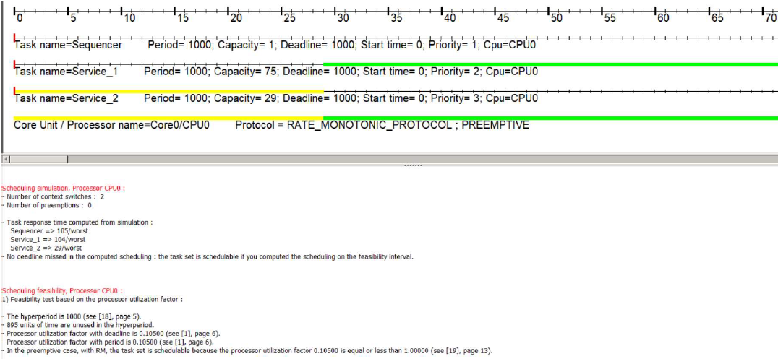
Cheddar Analysis – 1 Hz
Based on Average Execution

Slide 10
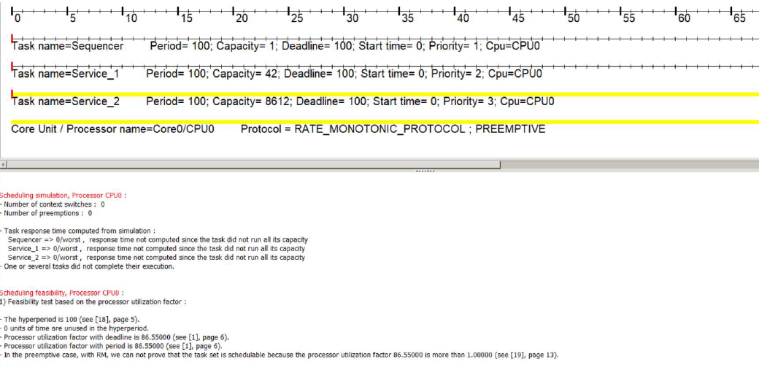
Cheddar Analysis – 10 Hz
Based on WCET

Slide 11
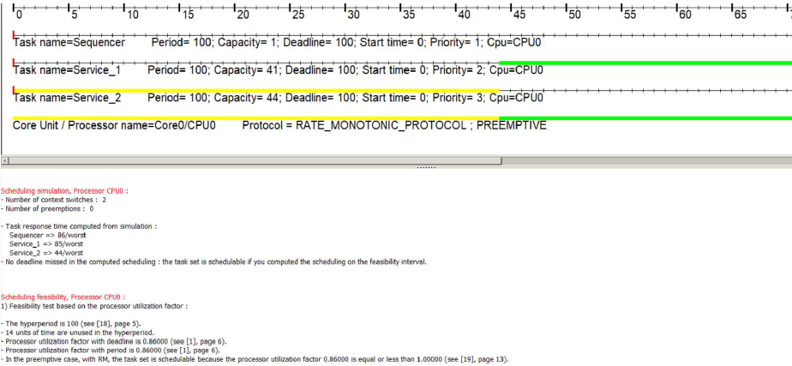
Cheddar Analysis – 10 Hz
Based on Average Execution

Slide 12
Corrected Jitter for 10 Hz
Service | Jitter
Sequencer | -0.651 ms
Service 1 | -0.651 ms
Service 2 | -18.461 ms

Slide 13
Challenges
Getting the timing right! (Sequencing)
Time stamps on the image using ImageMagick
Loss of frames during storage and during socket transmission for 10 Hz
Handling WCET
Planning and management (hardware issues)
Handling PPM headers

Slide 14
Lessons learnt
Application of concepts for better understanding
Time management
Refresher in terms of socket implementation
Better understanding threading and sequencing
Reduce redundancy

Slide 15
Thank you!

