Slide 1

ECEN 5833
Low Power Embedded Design Techniques

Slide 2


Team EM-Power Gitanjali Suresh, Sarayu Managoli

Slide 3
Presentation Roadmap
Project Description & Use Cases
System Block Diagram
Low Power Mode Timeline
Hardware Design
Software Design
Proof of Concept Implementation
Summary and Lessons Learned

Slide 4
Project Description & Use Cases
This project deals with a security system that is designed to sense and authenticate the users in order to permit them into a common space such as a lab, room, etc.
The device communicates with the phone over the Bluetooth indicating whether the user is authenticated, if not, it displays an alert.
The application can be used to track the users who accessed the room

Slide 5
Project Description & Use Cases
With the advent of energy efficient devices and low power nodes, we are designing nodes in order to consume minimal energy.
If an unauthenticated user tried to gain access through the module, an alert LED is turned ON.

Slide 6
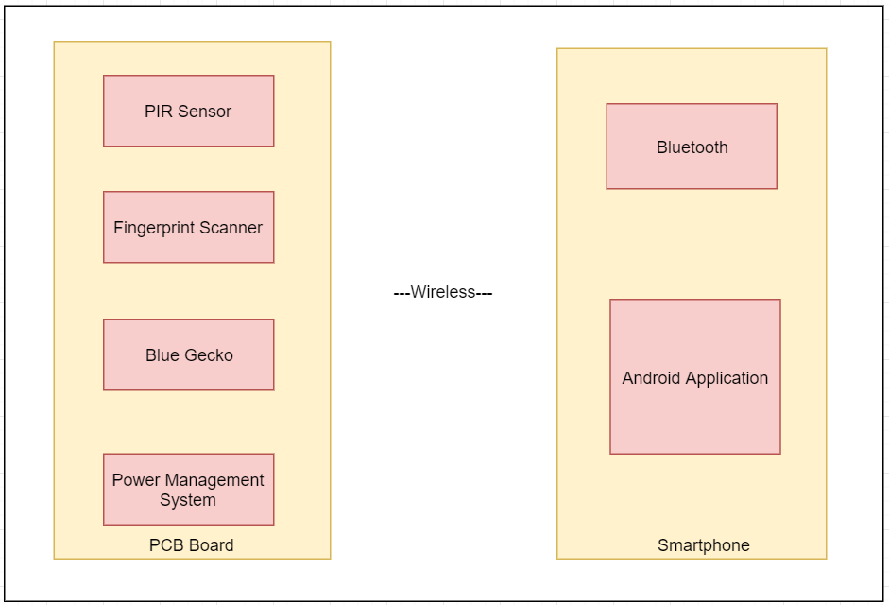
System Block Diagram

Slide 7
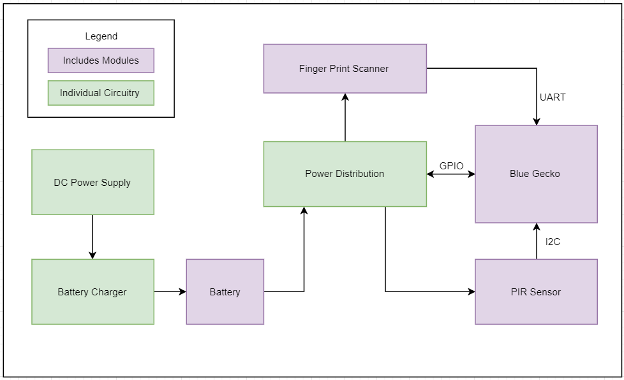
Hardware Block Diagram
7

Slide 8
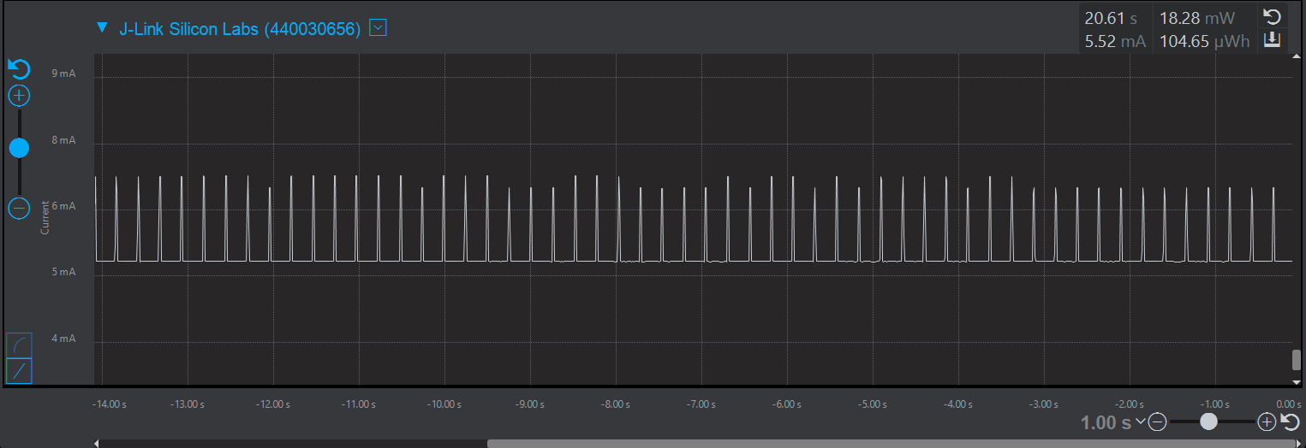
Low Power Mode Timeline
Timeline during Bluetooth advertisement

Slide 9
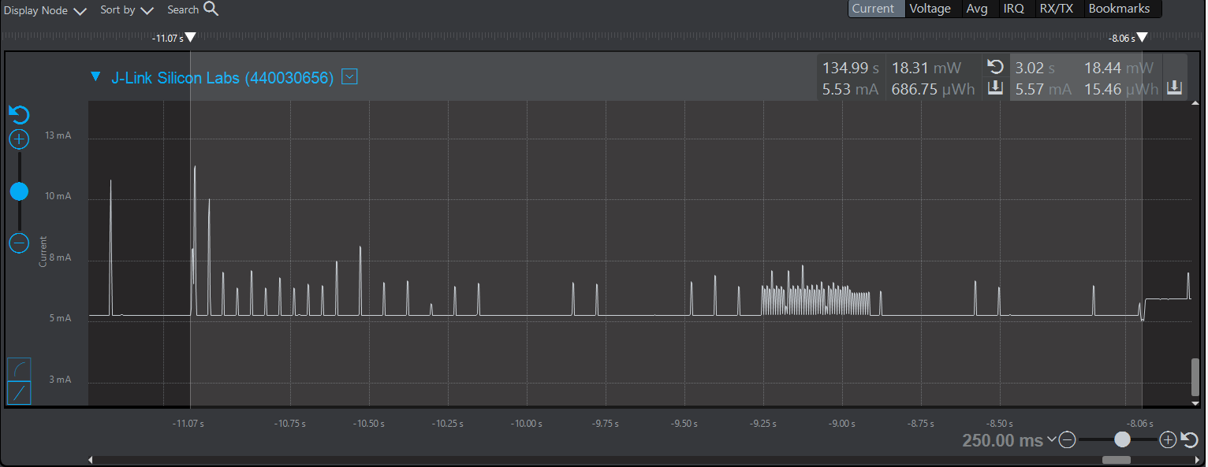
Low Power Mode Timeline
Timeline during Bluetooth connection initiation

Slide 10
Low Power Mode Timeline
Here, connection interval is set as 75ms
If the connection does not happen within that period, then Bluetooth notifies a failure in establishing connection

Slide 11
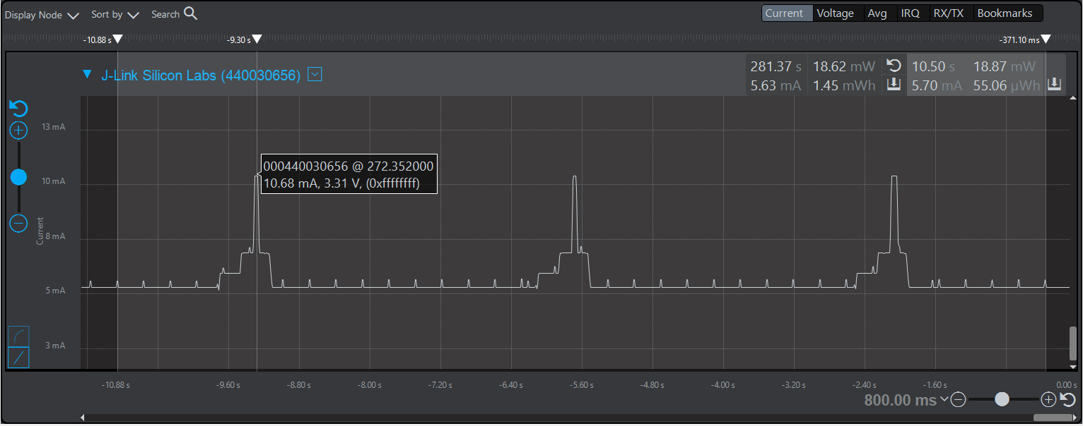
Low Power Mode Timeline
I2C operation in EM2 (IR sensor operation)

Slide 12
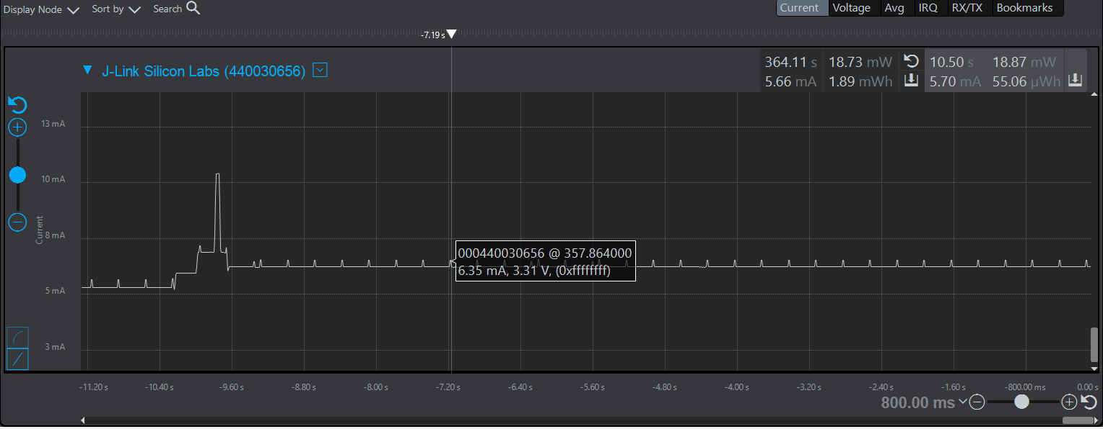
Low Power Mode Timeline
When a human presence is detected

Slide 13
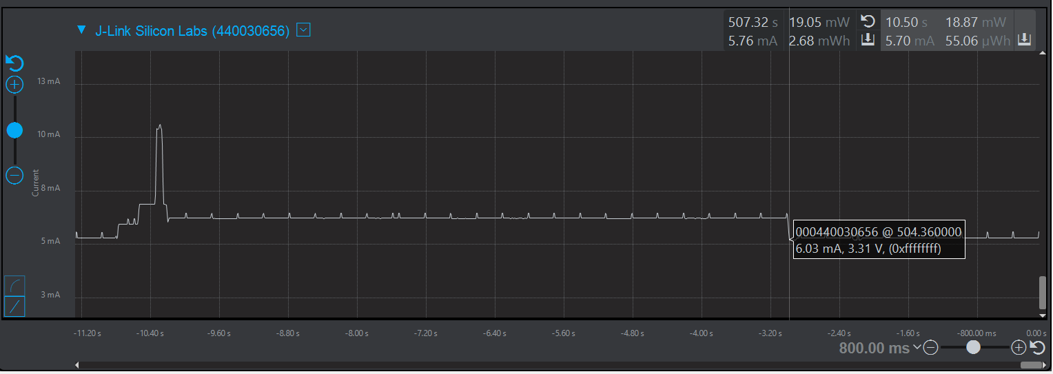
Low Power Mode Timeline
The low current consumption here indicates that the fingerprint operation is complete, and the control is switched back to the main function

Slide 14
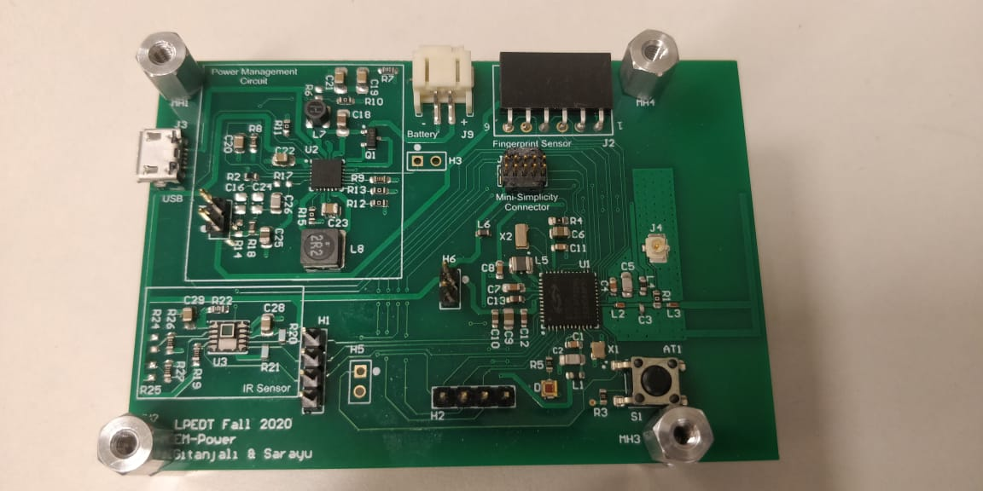
Hardware Design

Slide 15
On-board Hardware Design
MCU
EFR32BG13 Blue Gecko by Silicon Labs
Boost Regulator and LDO output
Linear Tech LTC3566
Boost regulator, upon enable, provides power to fingerprint sensor which works on 5V
LDO provides a constant 3.3V to the processor and the IR sensor
IR sensor
Low power, compact IR sensor
Consists 4 integrated IR sensors and one temperature sensor
Our application is limited to IR

Slide 16
Software Design
IDE: Simplicity studio
Communication protocols: UART, I2C
On board debugger to program SOC
Minimum Energy Mode: EM2

Slide 17
Demonstration
Video

Slide 18
Issues faced
UART baud rate mismatch; incomplete responses reception
PMIC successfully gives 5V rail. However, when connected to the fingerprint module, the voltage is pulled down to 3V
Bluetooth app used could not connect with the Android versions 10 and 11

Slide 19
Proof-of-concept Realization
Successfully able to derive two power rails from the PMIC as intended
We were also able to integrate the IR module on the board
F-antenna design successfully enables the Bluetooth operations
The Bluetooth pairs the processor and the phone

Slide 20
Summary
We were able to achieve the following:
Designing power management and processor circuit
Battery can independently power the system
Integrating inverted-F antenna and designing the circuit for Bluetooth communication
Integrating interfacing IR module on the board
Successfully achieved BLE pairing with the phone
Achieving Low power mode by designing state machine for BLE
Designed an Android app
Communication between Android app and processor

Slide 21
Lessons Learned
Always verify your PCB footprints
Verify the parts before placing an order
Verify calculations before selecting the components
Check solder and connections even if they seem connected
Have through-hole connectors for better and firm grip
Always follow and update Gantt chart

Slide 22
Thank you!

