Slide 1
Predicting Flight Delay
Sara Zong
Feb 10th, 2021

Slide 2

Motivation:
Being stuck at the airport is horrible.
Moreover, if we are traveling on a tight business schedule, we want more control over our schedule.
The goal is to help travelers avoid flight delay.
Notes:
Being stuck at the airport for hours due to flight delay is one of those experiences that you would never want to have. Plus, if we are traveling on a tight business schedule, we would want to have more control of our schedules. The goal of my project is to predict flight delay and help travelers plan their trips.

Slide 3



Tools:
Notes:
I obtained the flight performance data from the bureau of transportation and analyzed the data with python. Specifically, I used the scikitlearn module for model building.

Slide 4
Data Comes from the Bureau of Transportation
Time: January 2019
Size: 565,963 records for one month
Features: Date, Airlines, Origin, Destination, Scheduled departure, Scheduled arrival, Airtime, Distance, incoming flights, interaction of scheduled arrival and incoming flights
Target: Arrival delay > 15min
Notes:
Since the dataset is huge for 2019 and there's time variation in percent of flight delay around the year, I chose to focus on on records from January 2019. The features in the dataset include date of the flight, airlines, origin airport, destination airport, scheduled departure, scheduled arrival, airtime, distance, and I count all the incoming flights per day of an airport as an indicator of how busy the airport is. Also, I added in the interaction term of schedule arrival and the incoming flights in my model. My target is arrival delay for more than 15 mins.

Slide 5
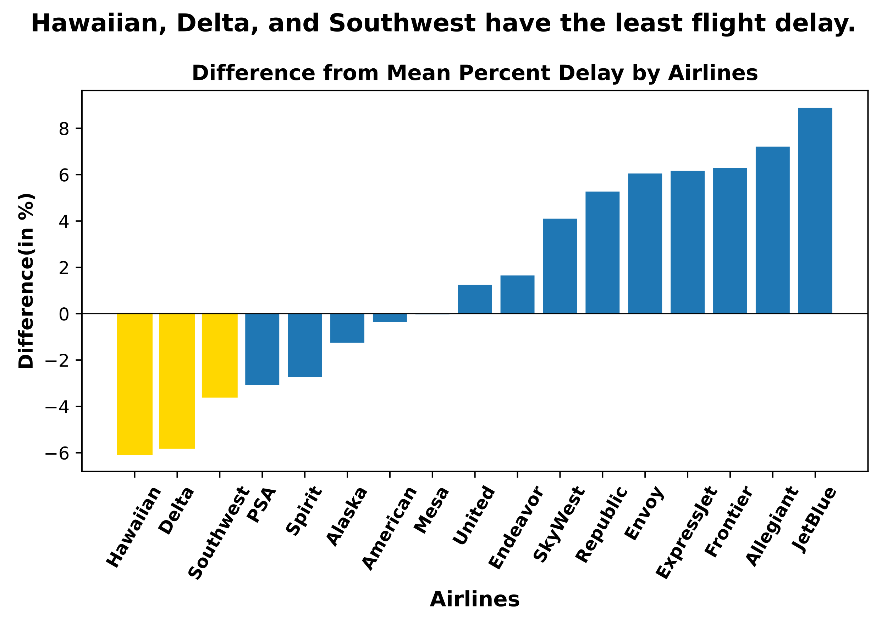
Ranking of airlines with the least to the most delay
Notes:
All airlines have flight delay, but compare to the average percent of delay, Hawaiian, Delta, and Southwest are doing the best job. If there are different airlines providing services for our travel, maybe consider booking with the airlines that tend to have less delay.

Slide 6
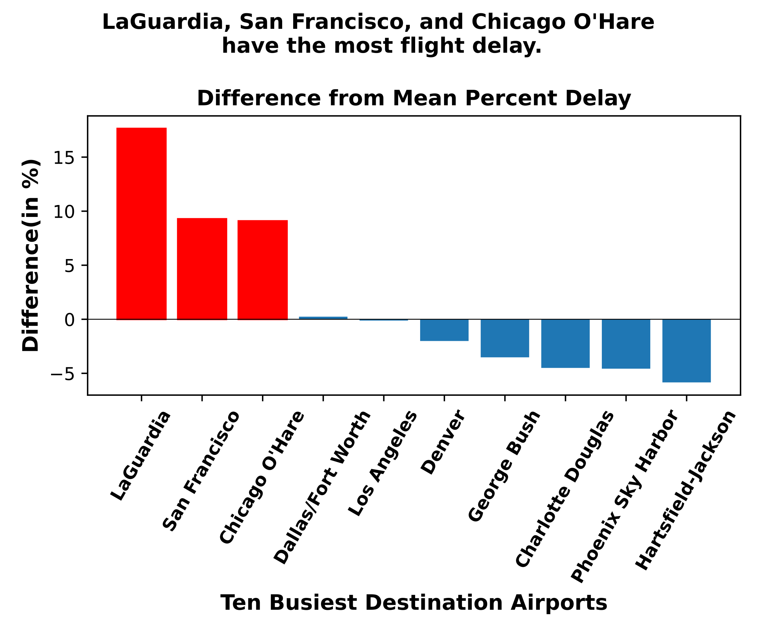
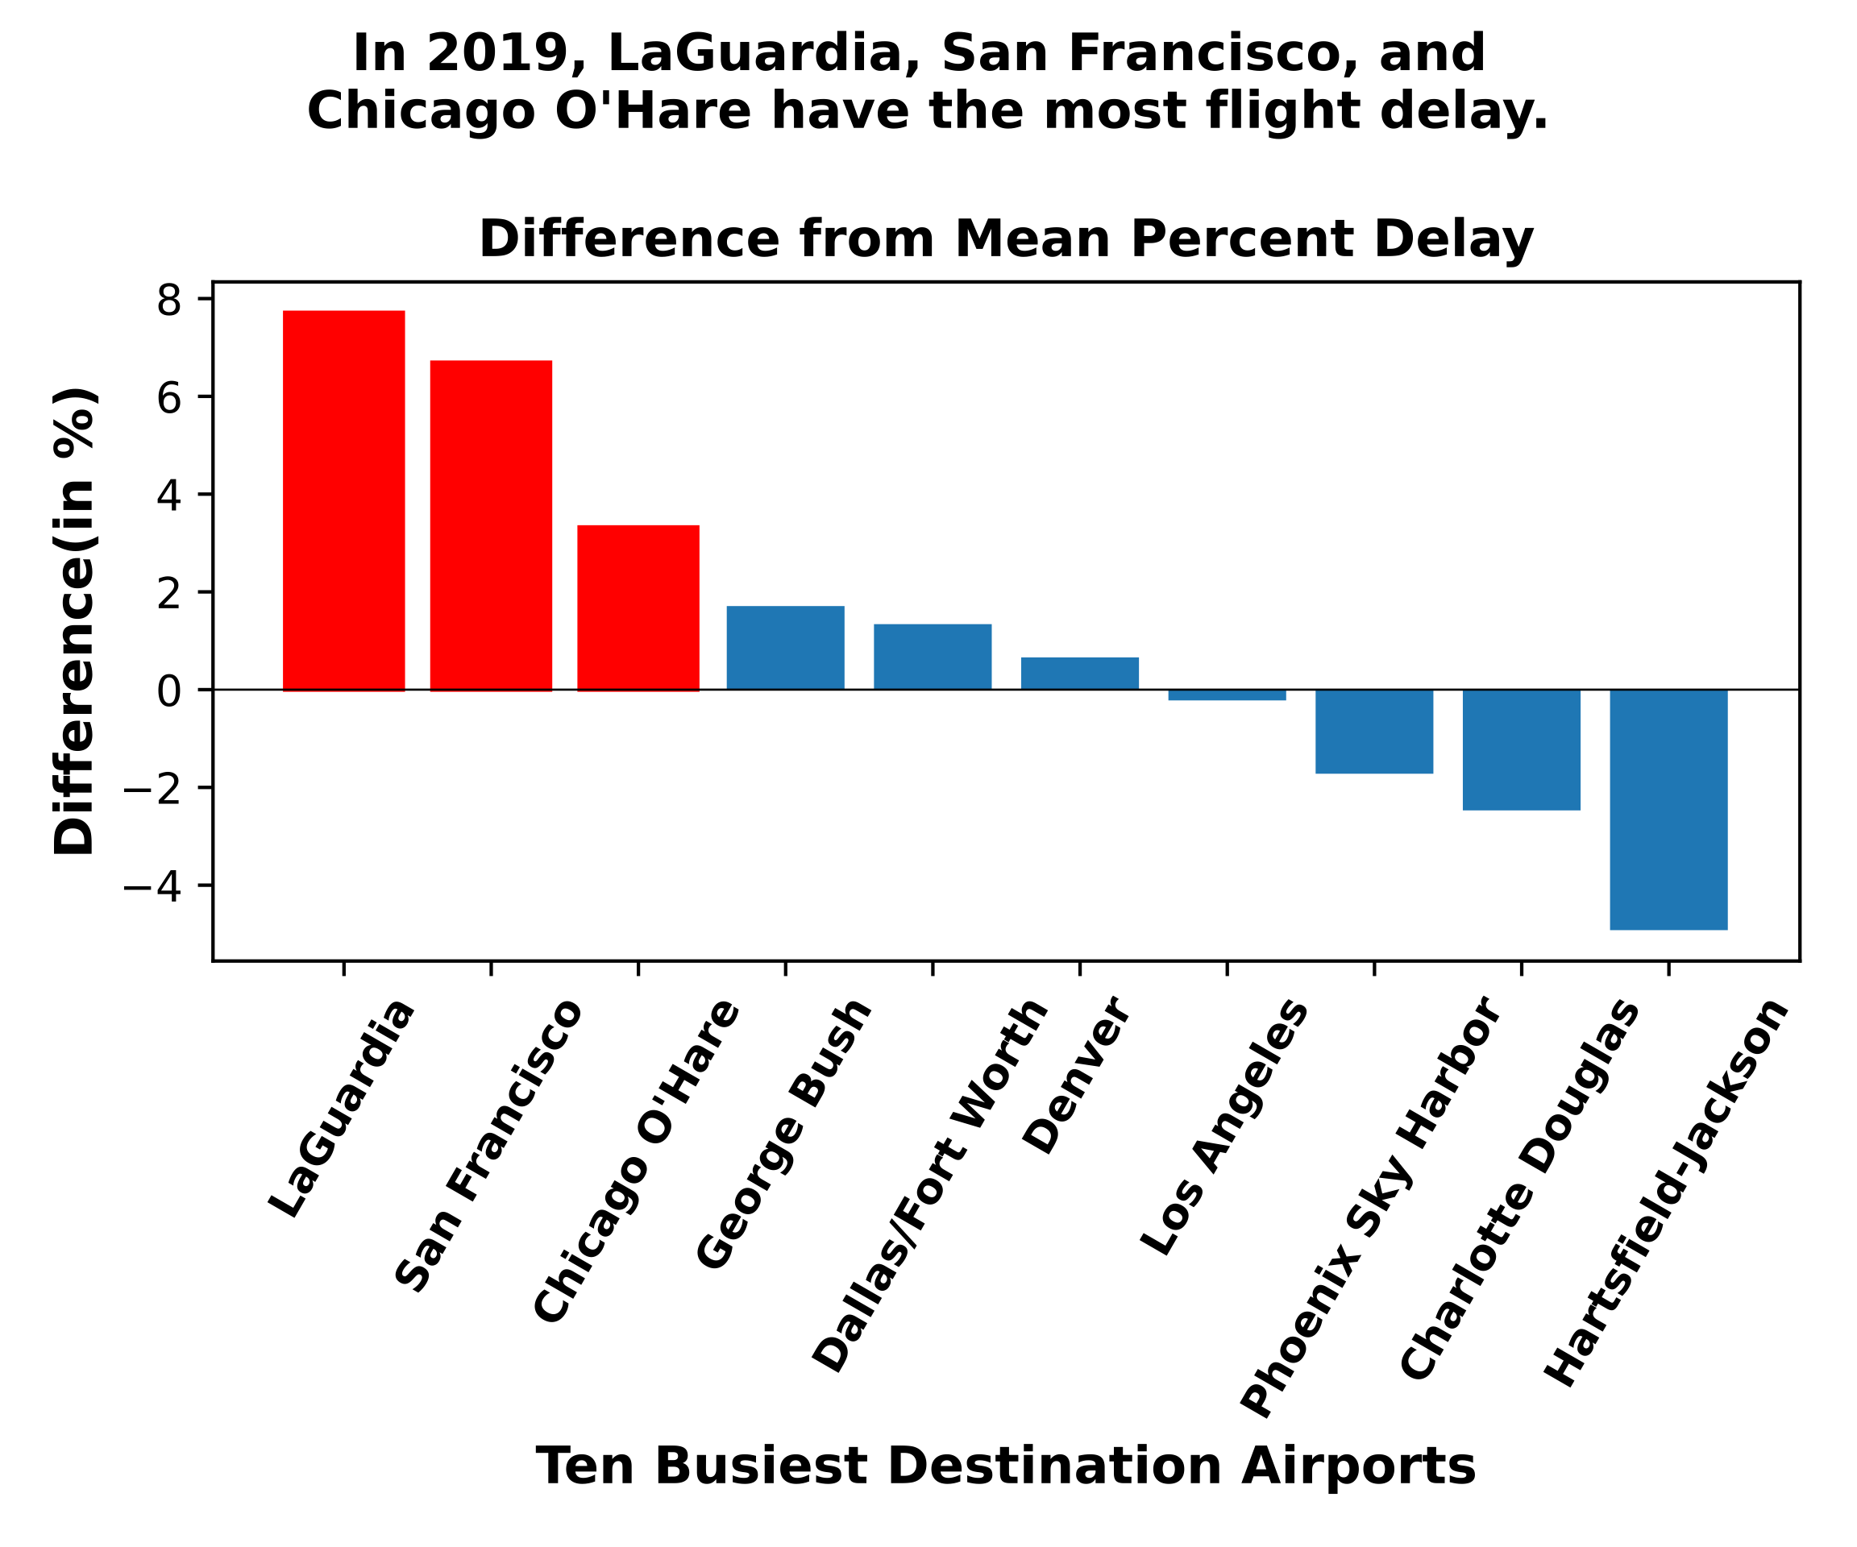
Ranking of airports with the most to the least delay
Notes:
Some airports do better jobs than the others. LaGuardia, San Francisco, and Chicago O’Hare airports have more delay than the others. However, one thing I found from EDA is that even the same airport, the percent of delay in a particular month could be very different from the year-round average percent of delay. When we plan our traveling, the month in the year and the destination both affect the probability of experiencing flight delay.

Slide 7
Random Forests works the best with the dataset.
RF | Precision | recall | F1 score
Delay(TH 0.5) | 0.51 | 0.23 | 0.32
Delay(TH 0.3) | 0.37 | 0.45 | 0.41
Delay(TH 0.1) | 0.25 | 0.79 | 0.38
Of about 20,000 delays, about 5,000 would be classified delay (at threshold of 0.5).
Notes:
Since the goal is to avoid flight delay, the metrics we are focusing on is the recall for delay so we can identify as many flight delay as possible. Random Forests produced the best recall rate with the dataset. Unfortunately, the recall for delay is quite low at classification threshold of 0.5. We can decrease the threshold to increase the recall rate, BUT at the expense of having a lot more false positive, meaning have on-time flights classified as delay.

Slide 8
Conclusions:
Some airlines tend to be better than the others on having less flight delay.
Some airports tend to be better than the others on having less flight delay, but we will also need to consider when we are traveling.
Random Forests is the best model so far, but for sure more work could be done to improve the recall rate.

Slide 9
Future work:
Focus on a small area (for example, SF bay area) and bring in weather information.
Feature engineering: count the number of flight delay per airport per airline a couple days in advance

Slide 10

Thanks!
any
questions
?

Slide 11

Credits
https://www.transtats.bts.gov/DL_SelectFields.asp?Table_ID=236&DB_Short_Name=On-Time
Presentation template by SlidesCarnival
https://timesofmalta.com/articles/view/air-passenger-rights-when-flights-are-delayed-or-cancelled.709080

Slide 12

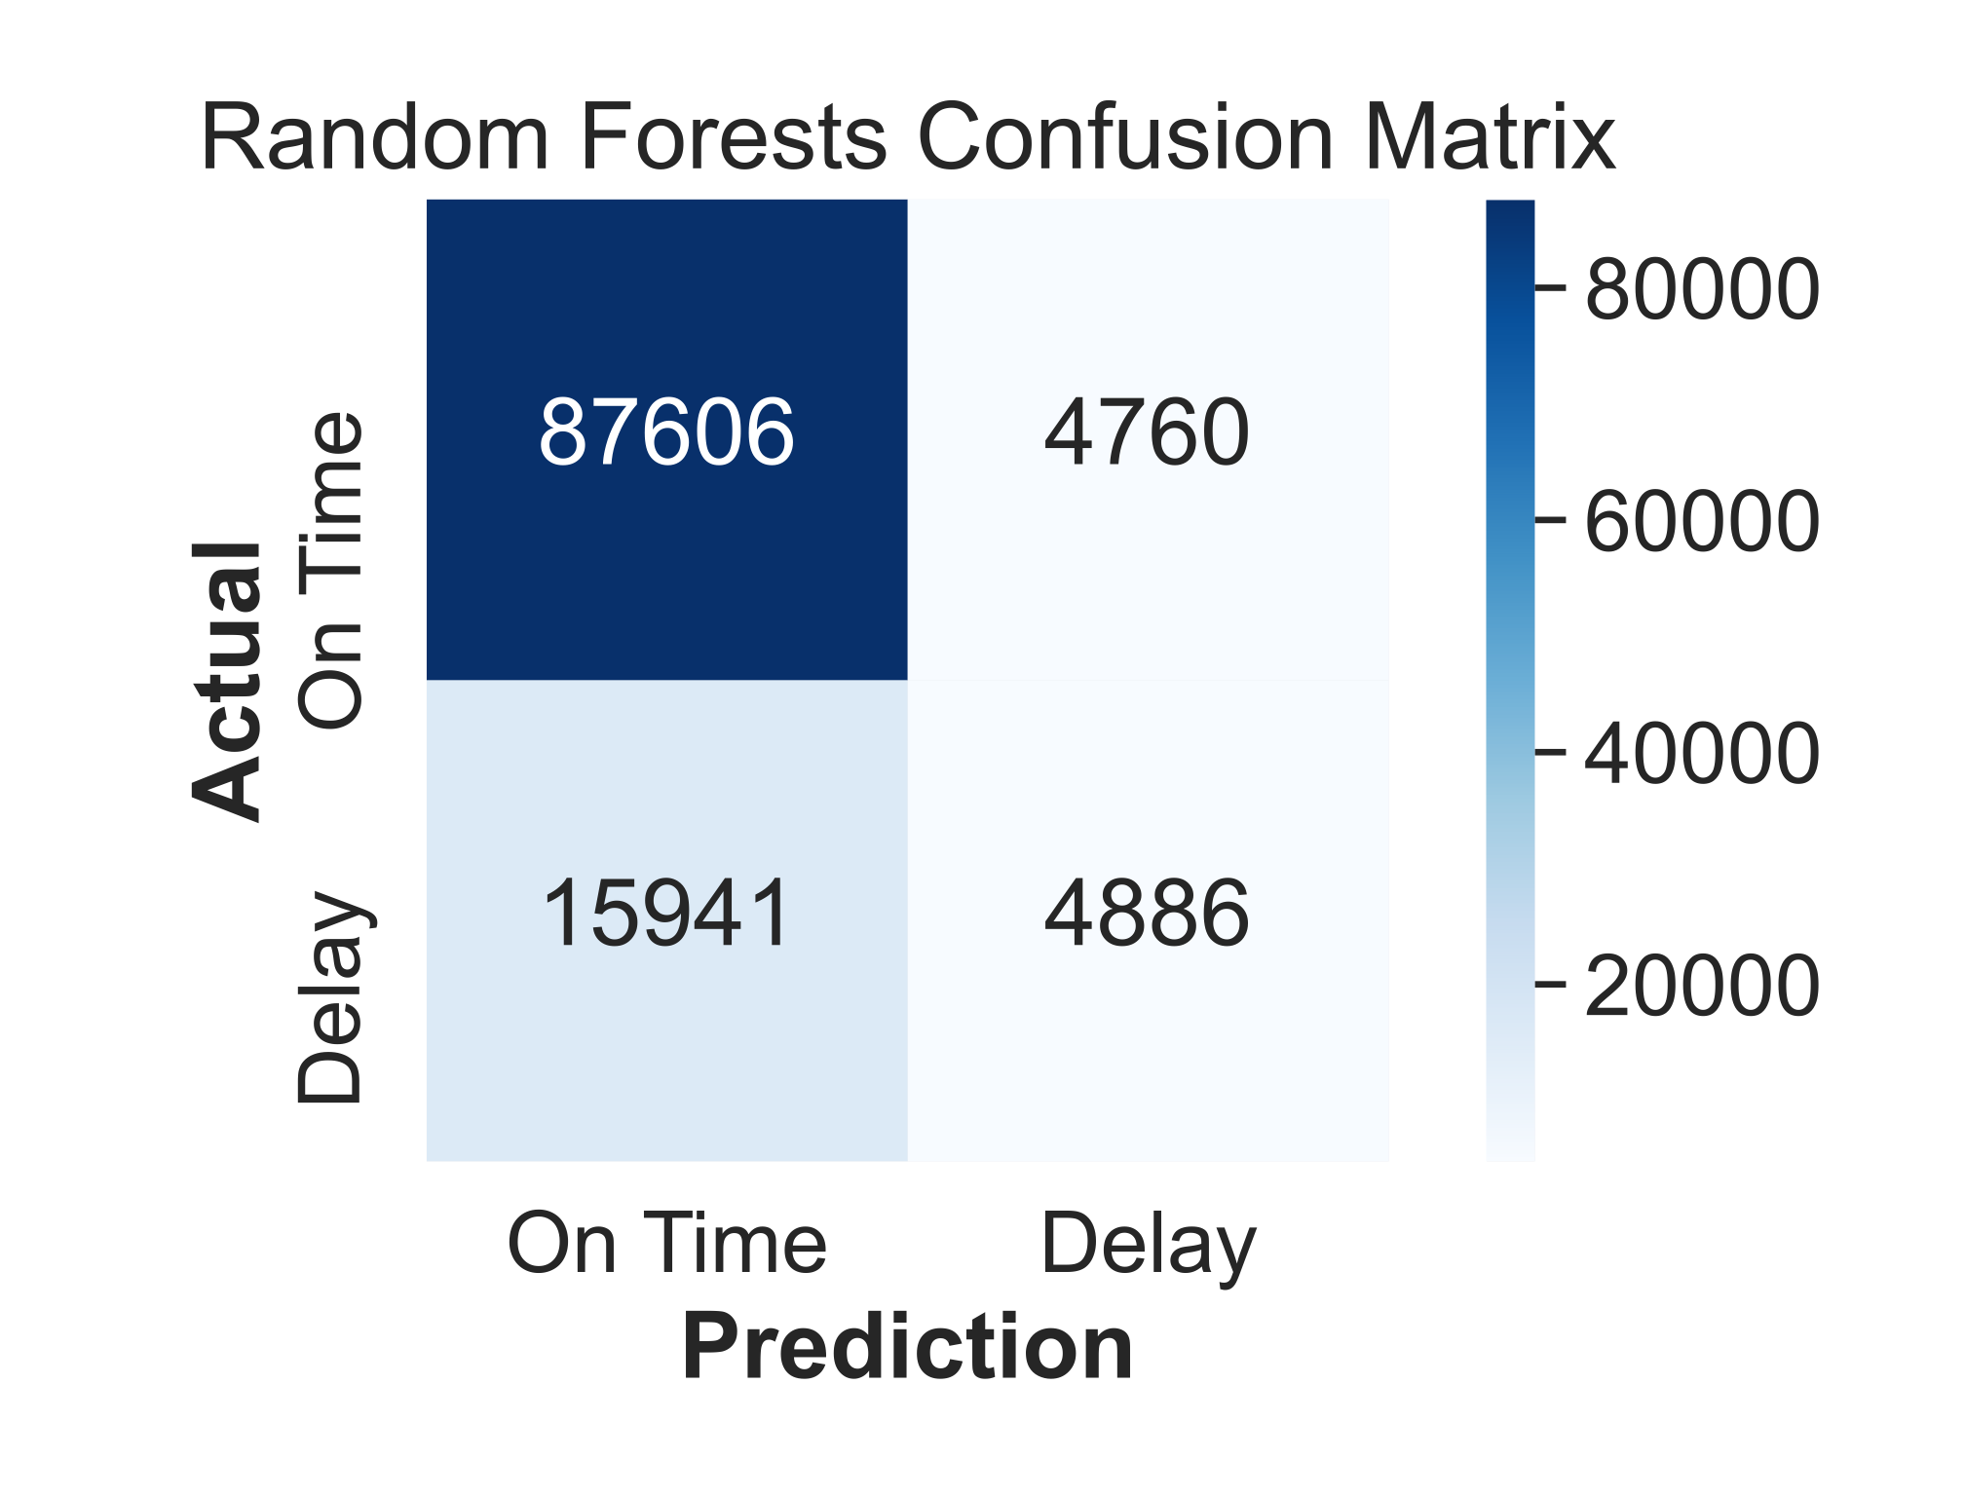
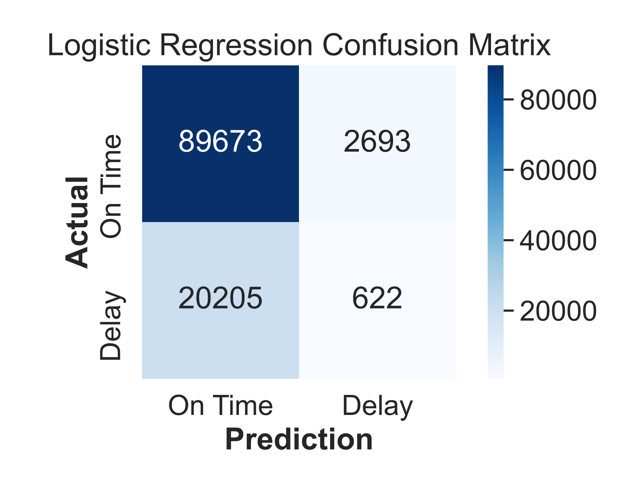
Appendix:

Slide 13
Appendix:
LR | Precision | recall | f1-score
On Time | 0.82 | 1.00 | 0.90
Delay | 0.76 | 0.02 | 0.04
Ensemble | Precision | recall | f1-score
On Time | 0.82 | 1.00 | 0.90
Delay | 0.87 | 0.01 | 0.03

