Slide 1



Mastering CSS
Multiple Background Properties for Web Design
by Sarbajit Acharjee

Slide 2

Introduction to CSS Multiple Backgrounds
In this presentation, we will explore CSS background properties.CSS allows you to apply multiple background images to a single element.Useful for creating complex designs without additional HTML elements.
Syntax: background-image: url(image1.png), url(image2.png);

Slide 3

Syntax and Properties
.element {
background- image:url(image1.png),url(image2.png); background-position: left top, right bottom;
background-size: auto, cover; background-repeat: no-repeat, no- repeat;
background-blend-mode: multiply;
}

Slide 4

Use Cases and Examples
Overlapping Images:
Example: A texture overlay on top of a gradient.
Layered Effects:
Example: Combining patterns with solid colors for depth.
Responsive Designs:Different backgrounds for mobile vs. desktop.
Blending Modes:Enhancing visual effects
by blending backgrounds.

Slide 5
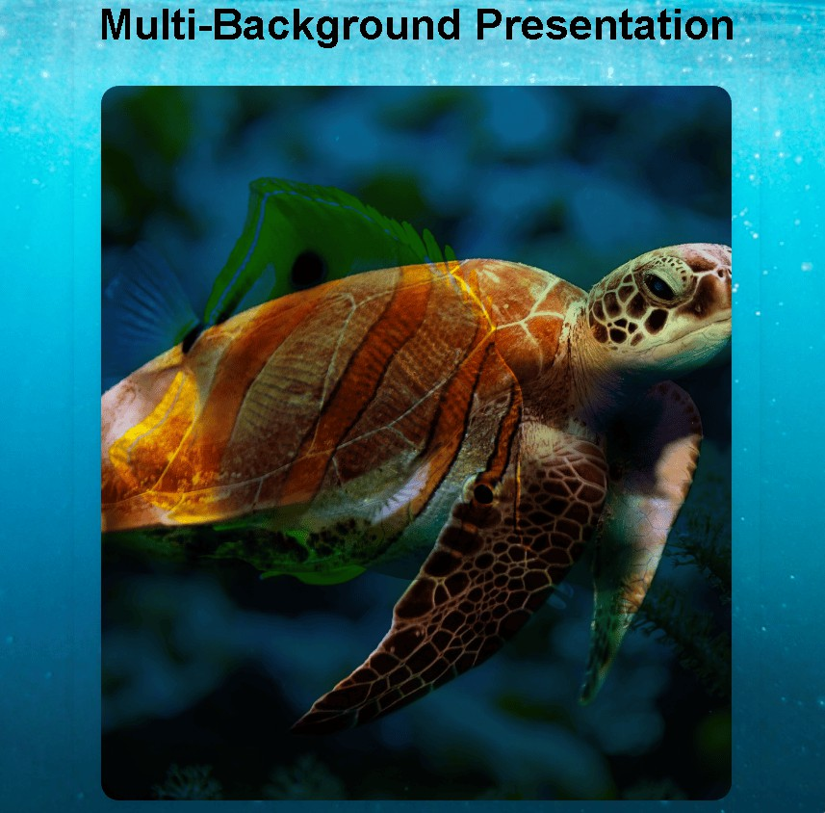
<div class="background- example"></div>
l
E
a
x
c
i
a
t
m
c
a
p
r
l
P
e

Slide 6

Thanks!

