Slide 1
Combined Cycle Power Plant Energy Output Prediction
Machine Learning Regression Project
Presented by [Sarbashree Ray]

Slide 2
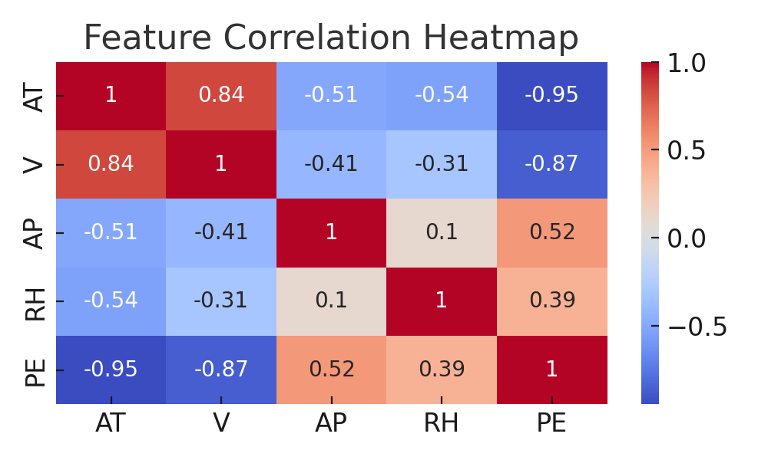
Problem Statement & Dataset
Goal: Predict net hourly electrical energy output (PE) using environmental data.
Features: Temperature (AT), Exhaust Vacuum (V), Ambient Pressure (AP), Relative Humidity (RH)
Target: Power Output (PE)
Dataset size: 9568 rows

Slide 3
Modeling Approach
• Type: Supervised Regression
• Metric: RMSE & R²
• Validation: 5-Fold Cross Validation
• Models: Linear Regression, Random Forest
Approach: Train-test split and cross-validation to evaluate performance.

Slide 4
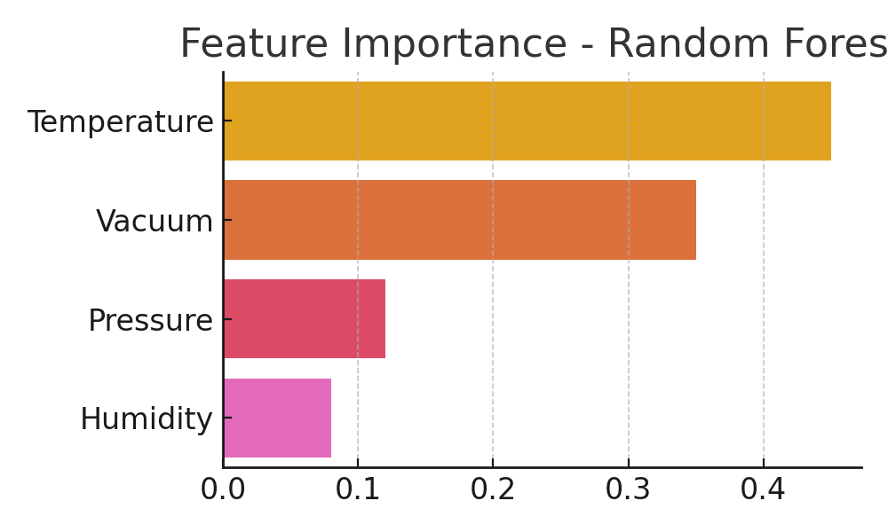
Model Results
Linear Regression → R² ≈ 0.93, RMSE ≈ 4.5 MW
Random Forest → R² ≈ 0.96, RMSE ≈ 3.8 MW
Random Forest captures non-linear patterns better.

Slide 5
Model Interpretation
Feature importance shows:
• Temperature ↓ → lower output (negative correlation)
• Vacuum ↑ → higher output (positive correlation)
Pressure and Humidity have smaller effects.

Slide 6
Evaluation & Conclusion
✅ Final Model: Random Forest Regressor
✅ RMSE ≈ 3.8 MW, R² ≈ 0.96
✅ Explains 96% of the variance in output
Temperature and Vacuum are key drivers.
The model helps forecast plant performance accurately.

