Slide 1
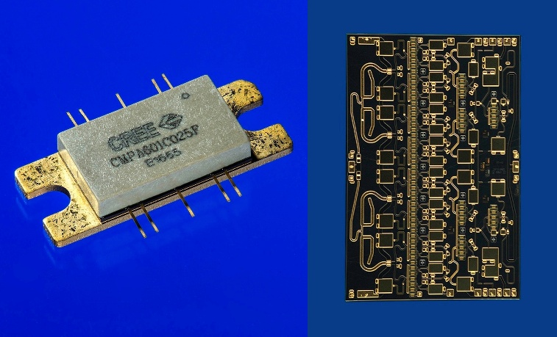
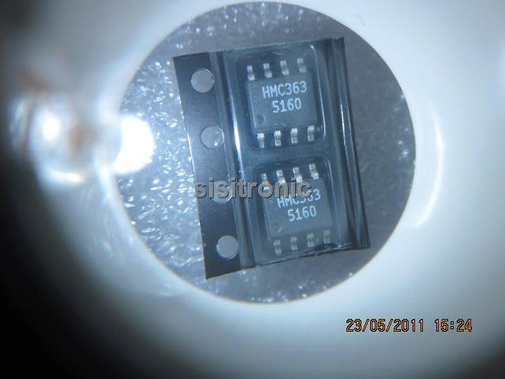
Design and Simulation of NiCr Resistor for High Frequency MMIC Application
SUBMITTED BY :
Sarbjit Kaur
B.E (ECE) 8th Semester
SG-14533

Slide 2
CONTENT
INTRODUCTION TO ELECTRONIC COMPONENTS
INTRODUCTION TO INTEGRATED CIRCUIT
DESIGN AND SIMULATION OF NiCr RESISTOR USING ADS (Advanced Design System)
STUDY THE EFFECT OF TEMPERATURE ON S-PARAMETER OF NiCr RESISTOR
CONCLUSION

Slide 3
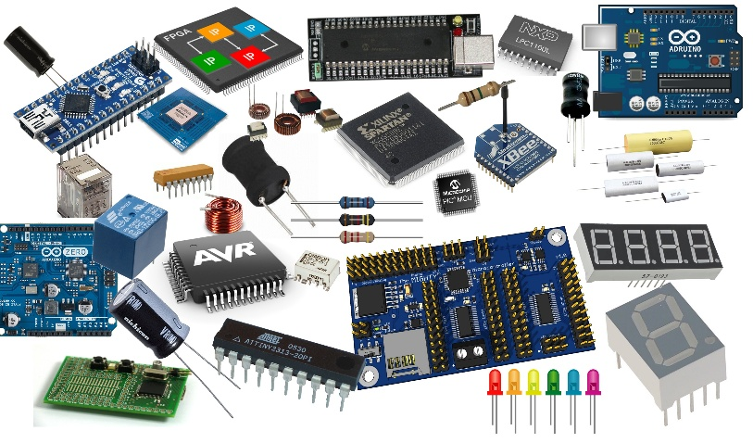
INTRODUCTION OF ELECTRONIC COMPONENETS
ELECTRONIC COMPONENTS are basic discrete device or physical entity in an electronic system used to affect electrons or their associated fields also help in its functioning.
They can be classified into two types i.e.
Active Component
Passive Component
ACTIVE COMPONENTS are those which required
power to process and amplify any electrical signal. For example:-
Transistor, amplifier and tunnel diode etc.
PASSIVE COMPONENTS are those which do not require power to process and amplify any electrical signal. For example:- Resistor, Capacitor and Inductor etc. They are flow current in both direction that’s why its called bilateral device.

Slide 4
ACTIVE COMPONENTS
TRANSISTOR is a semiconductor device used to amplify and switch electronic signals and electrical power.
There are many types of transistor are BJT, FET, JFET, MOSFET, MESFET, HEMT etc.
BJT (Bipolar Junction Transistor) is a solid-state device in which the current flow between two terminals (the collector and the emitter) is controlled by the amount of current that flows through a third terminal (the base).
FET (Field Effect Transistor) is a three terminal device that uses an electric field to control the current flowing through the device - it also has a high input impedance which is useful in many circuits. The field effect transistor, FET is a key active device for the electronics industry.
JFET (Junction Field Effect Transistor) ) has no PN-junctions but instead has a narrow piece of high resistivity semiconductor material forming a “Channel” of either N-type or P-type silicon for the majority carriers to flow through with two ohmic electrical connections at either end commonly called the Drain and the Source respectively.

Slide 5
MOSFET (Metal Oxide Semiconductor Field Effect Transistor) is a four terminal device with source(S), gate (G), drain (D) and body (B) terminals. The body of the MOSFET is frequently connected to the source terminal so making it a three terminal device like field effect transistor. The MOSFET is very far the most common transistor and can be used in both analog and digital circuits.
MESFET (Metal Semiconductor Field Effect Transistor) is a high performance form of field effect transistor that is used mainly for high performance microwave applications and in semiconductor RF amplifiers.
HEMT (High Electron Mobility Transistor) is a type of field effect transistor (FET),that is used to offer a combination of low noise figure and very high levels of performance at microwave frequencies.

Slide 6
PASSIVE COMPONENTS
PASSIVE COMPONENTS are composed of lumped elements such as resistors, capacitors and inductors and distributed elements such as transmission lines.
ON CHIP RESISTORS:-
In MMIC technology, the resistors are extensively used in feedback circuits, bias circuits and as terminations.
Two types of resistors are commonly used in MMIC fabrication i.e. thin films of lossy metals and lightly dopes GaAs active layer (Mesa Resistor).
Metal thin-film resistors are more temperature stable and are used as precision resistors of low to moderate values.
They are usually fabricated from TaN and NiCr although other metals may be used.
NiCr resistors have low thermal coefficient of resistance (TCR), small parasitic values and are widely used in a variety of circuit designs.

Slide 7
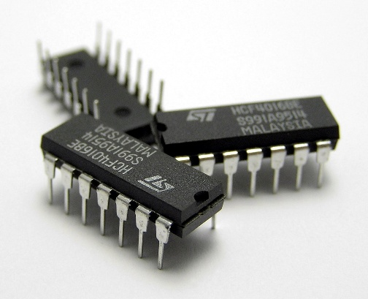
INTRODUCTION TO INTEGRATED CIRCUIT
An integrated circuit is a semiconductor wafer on which thousands or millions of tiny resistors, capacitors and transistors are fabricated. It is also called a chip or microchip. An IC can function as amplifier, oscillator, timer, counter, computer memory or microprocessor.
MICs (Microwave Integrated Circuits) are fabricated by inter-connecting a number of individual chips. It is an integrated circuit designed for operation at frequencies of approximately 1 gigahertz or more. It is large in size and their speed is low. But it is less expensive.
MMICs (Monolithic Microwave Integrated Circuits) which are fabricated entirely on single chips that includes active and passive components. Its operates at microwave frequency (300MHz to 300GHz). It is small in size and very expensive.
Application of GaN based MMIC:- Radar, Broadcast Amplifier, Sitcom & Point to Point Radio etc.

Slide 8
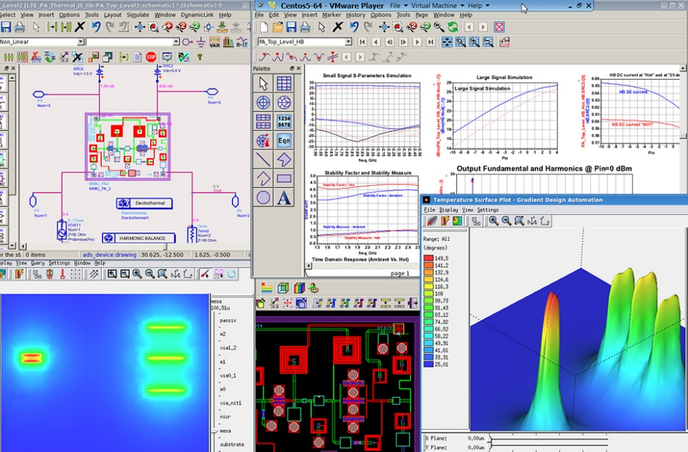
ADVANCED DESIGN SYSTEM (ADS)
ADS (Advanced Design System) is the world’s leading electronic design automation software for RF, microwave and high speed digital application such as radar system, satellite communication, high speed data link etc.
KEY BENEFITS OF ADS:- Complete, integrated set of fast, accurate and easy-to-use system, circuit & EM simulators enable first-pass design success in a complete desktop flow.

Slide 9
DESIGN AND SIMULATION OF NiCr RESISTOR USING ADS
NICHROME (NiCr) RESISTOR are commonly used as part of the process of fabricating monolithic microwave integrated circuits.
There are many properties of NiCr resistor which are vary with temperature i.e. Electrical resistivity and conductivity, density etc.
NiCr resistor have been fabricated on gallium nitride (GaN) semiconductor substrate as shown in figure:
Silicon Nitride
Metal (MT)
Silicon Nitride (2000-3000À)
NiCr (0.5-1 µm)
Silicon Nitride (1500-2500À)
Metal (MB)
Silicon Nitride (1500-2500Å)
GaN (2-3µm)
SiC

Slide 10
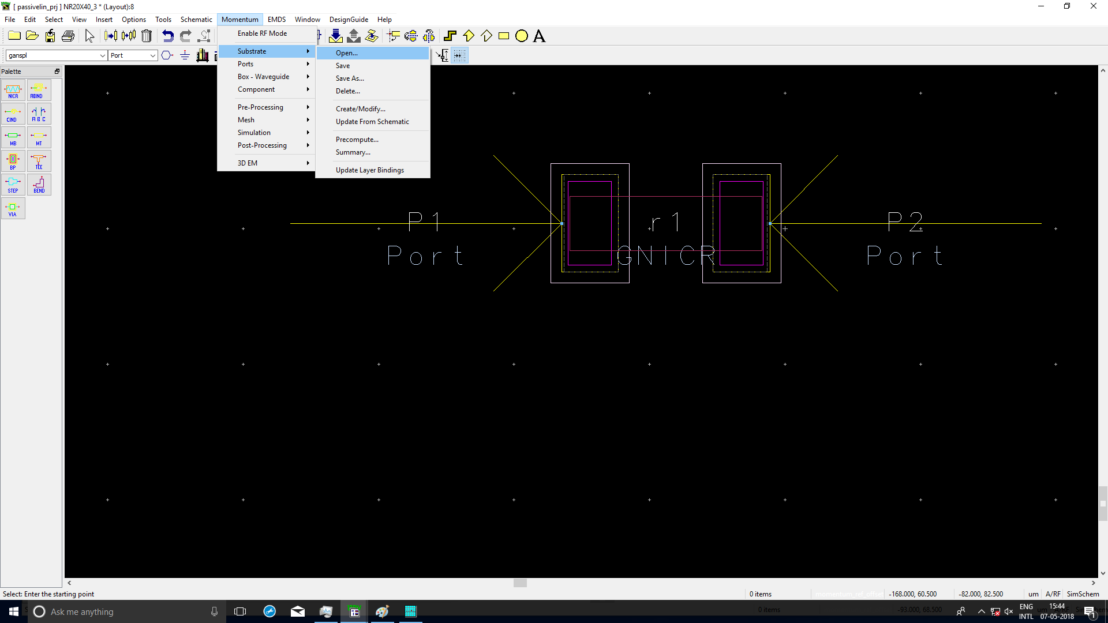
The Simulation of NiCr Resistor is been carried out on ADS Layout Window :-
Open the layout window from schematic window ->layout. Following window will be open.
SUBSTRATE DEFINING :-
Select Momentum ->
Substrate ->Open.

Slide 11
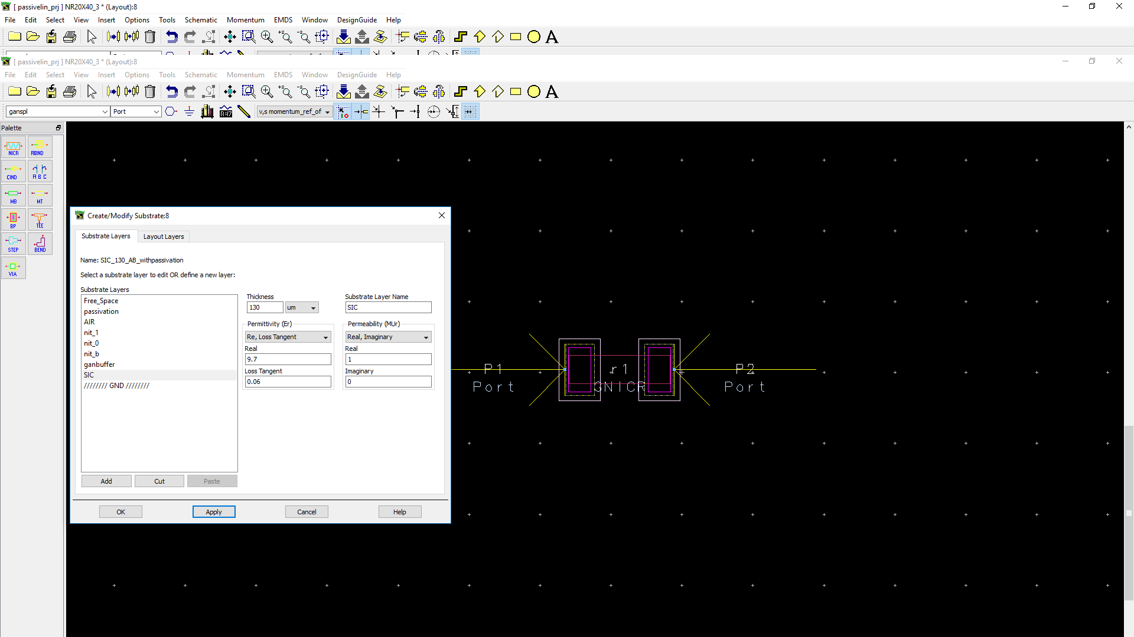
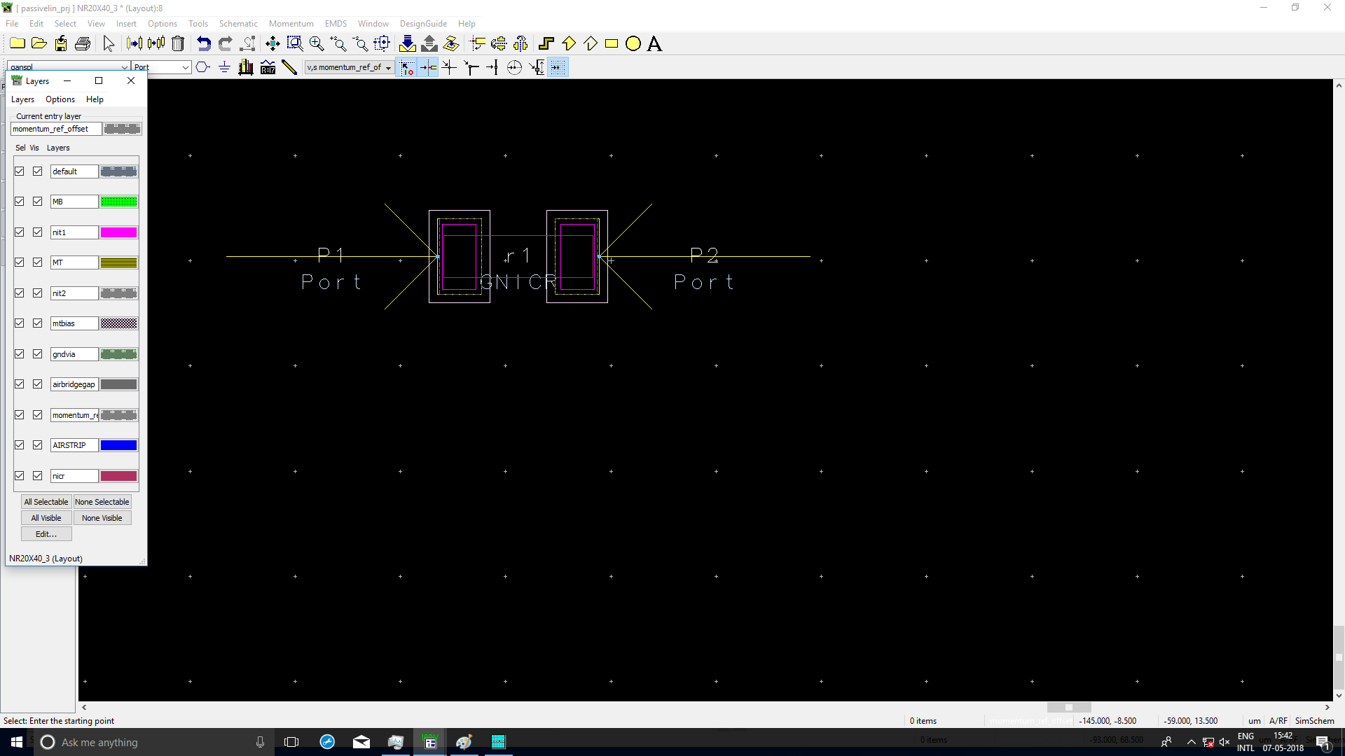
Select the substrate of GaN semiconductor from the dialog box as shown in figure.
After defining the substrate, fabricate
the NiCr resistor on substrate of GaN
semiconductor with defining different
material layers of different color
layout window.

Slide 12
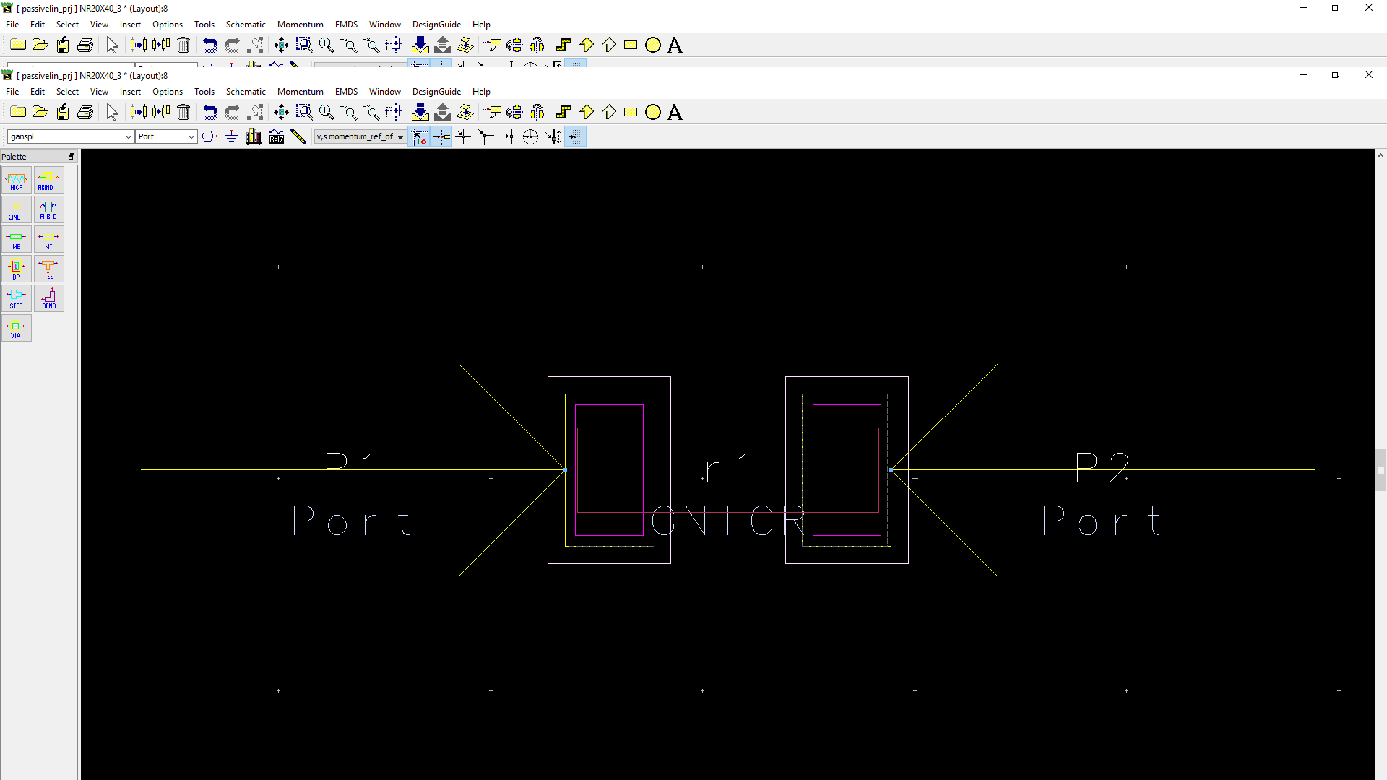
DEFINING PORTS :-
Select Momentum -> Port Editor.
Port editor dialog box is open,
select the Port -> Apply button.
This port need to find the
S-Parameter by using momentum.
Layout of NiCr resistor on GaN
semiconductor substrate also
shown in figure.

Slide 13
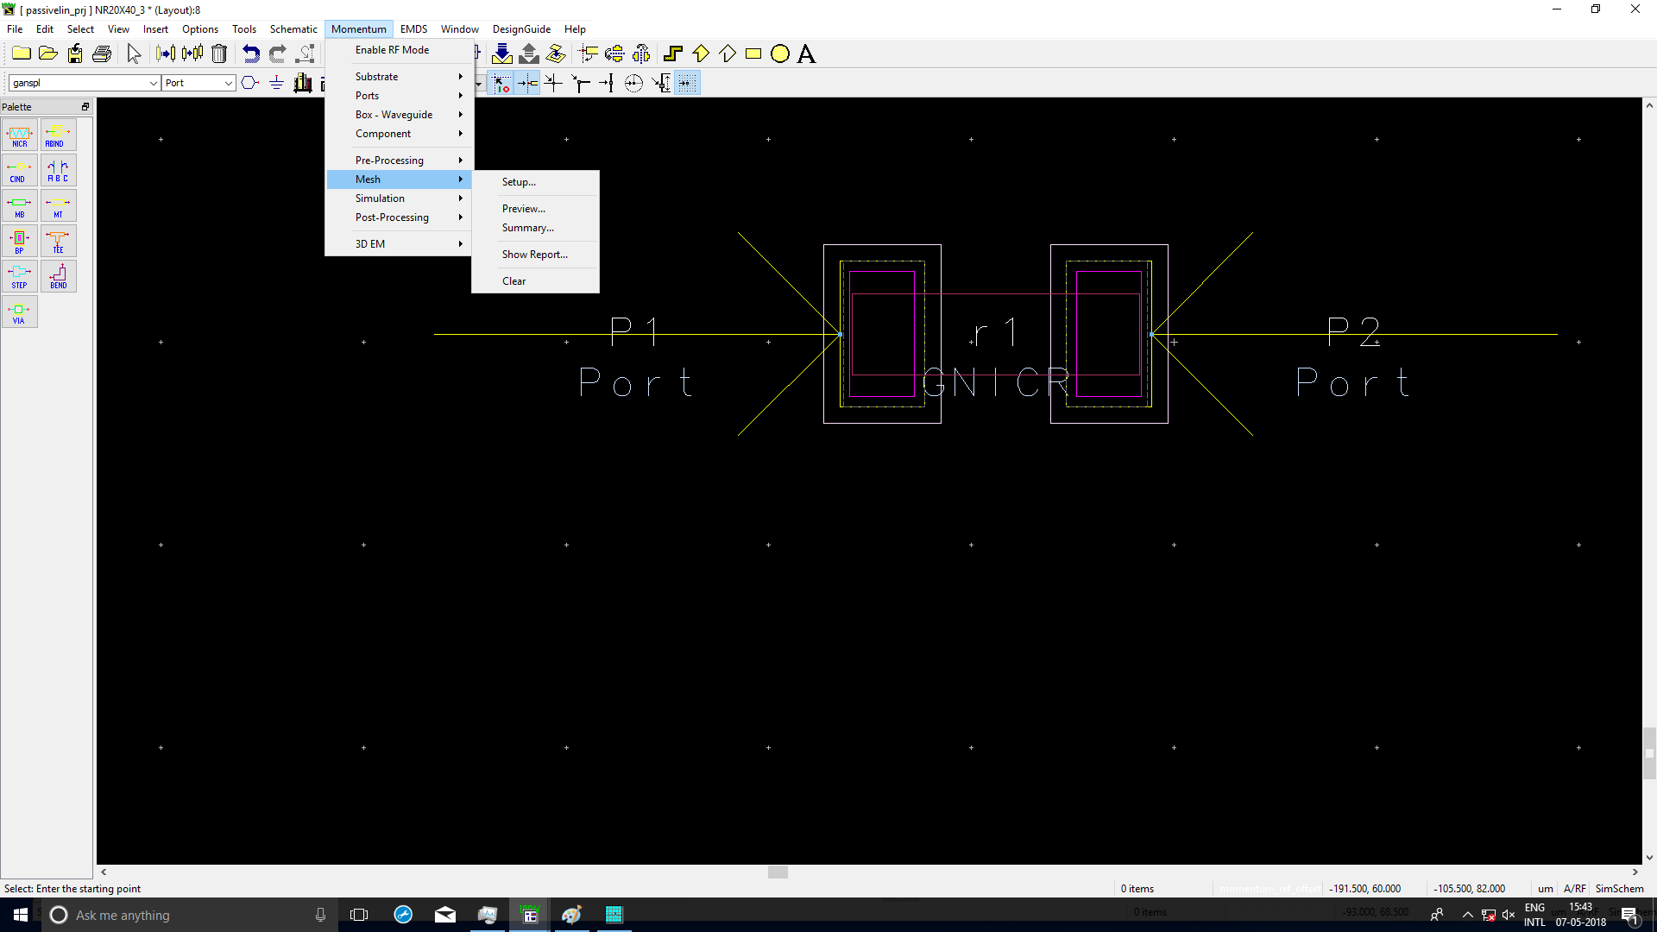
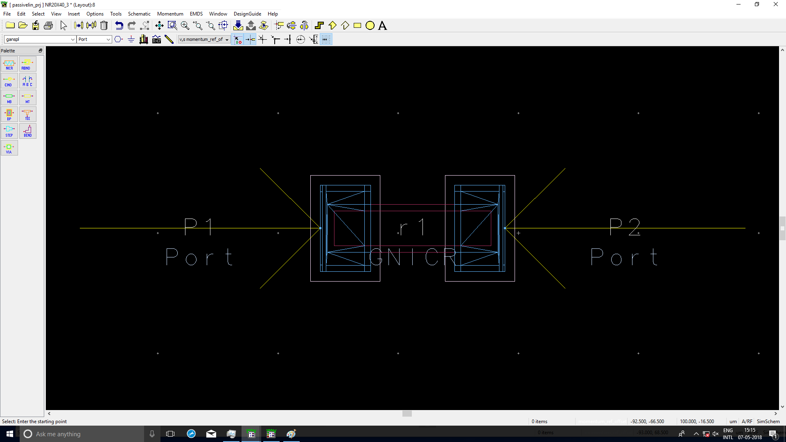
MESH DEFINING :- Before the
simulation, define the mesh setup by
Momentum -> Mesh -> Setup.
The parameter is to set the mesh
frequency to the highest
frequency you want to analysis
the circuit for.

Slide 14
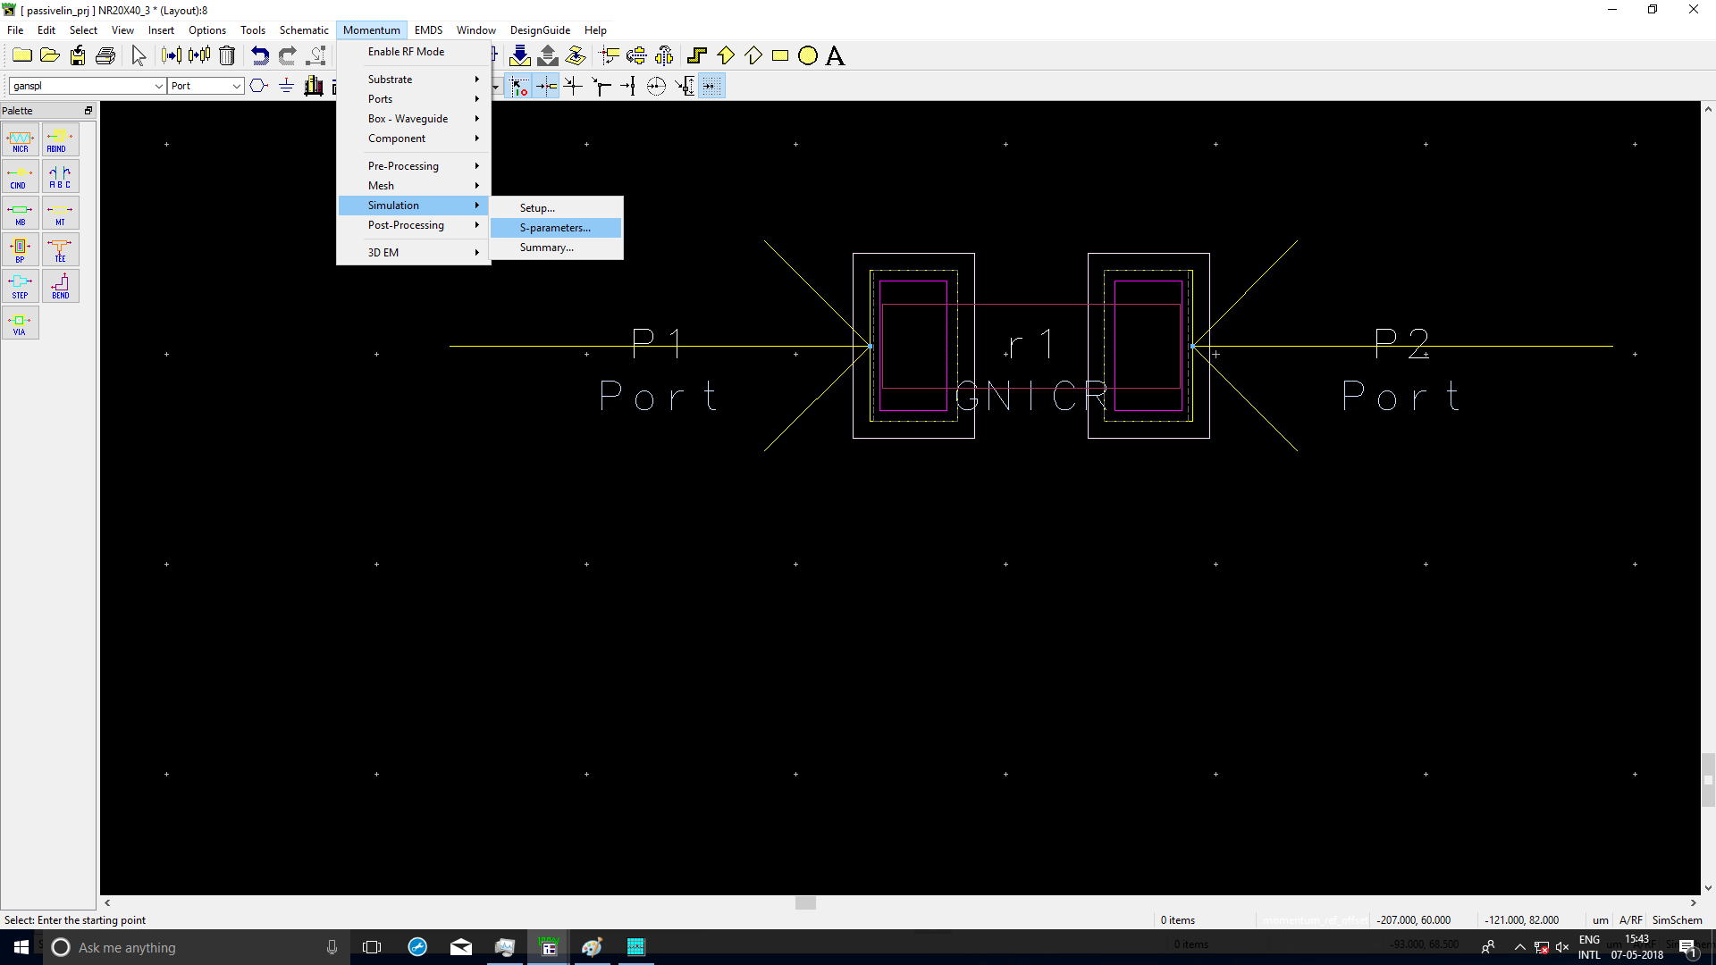
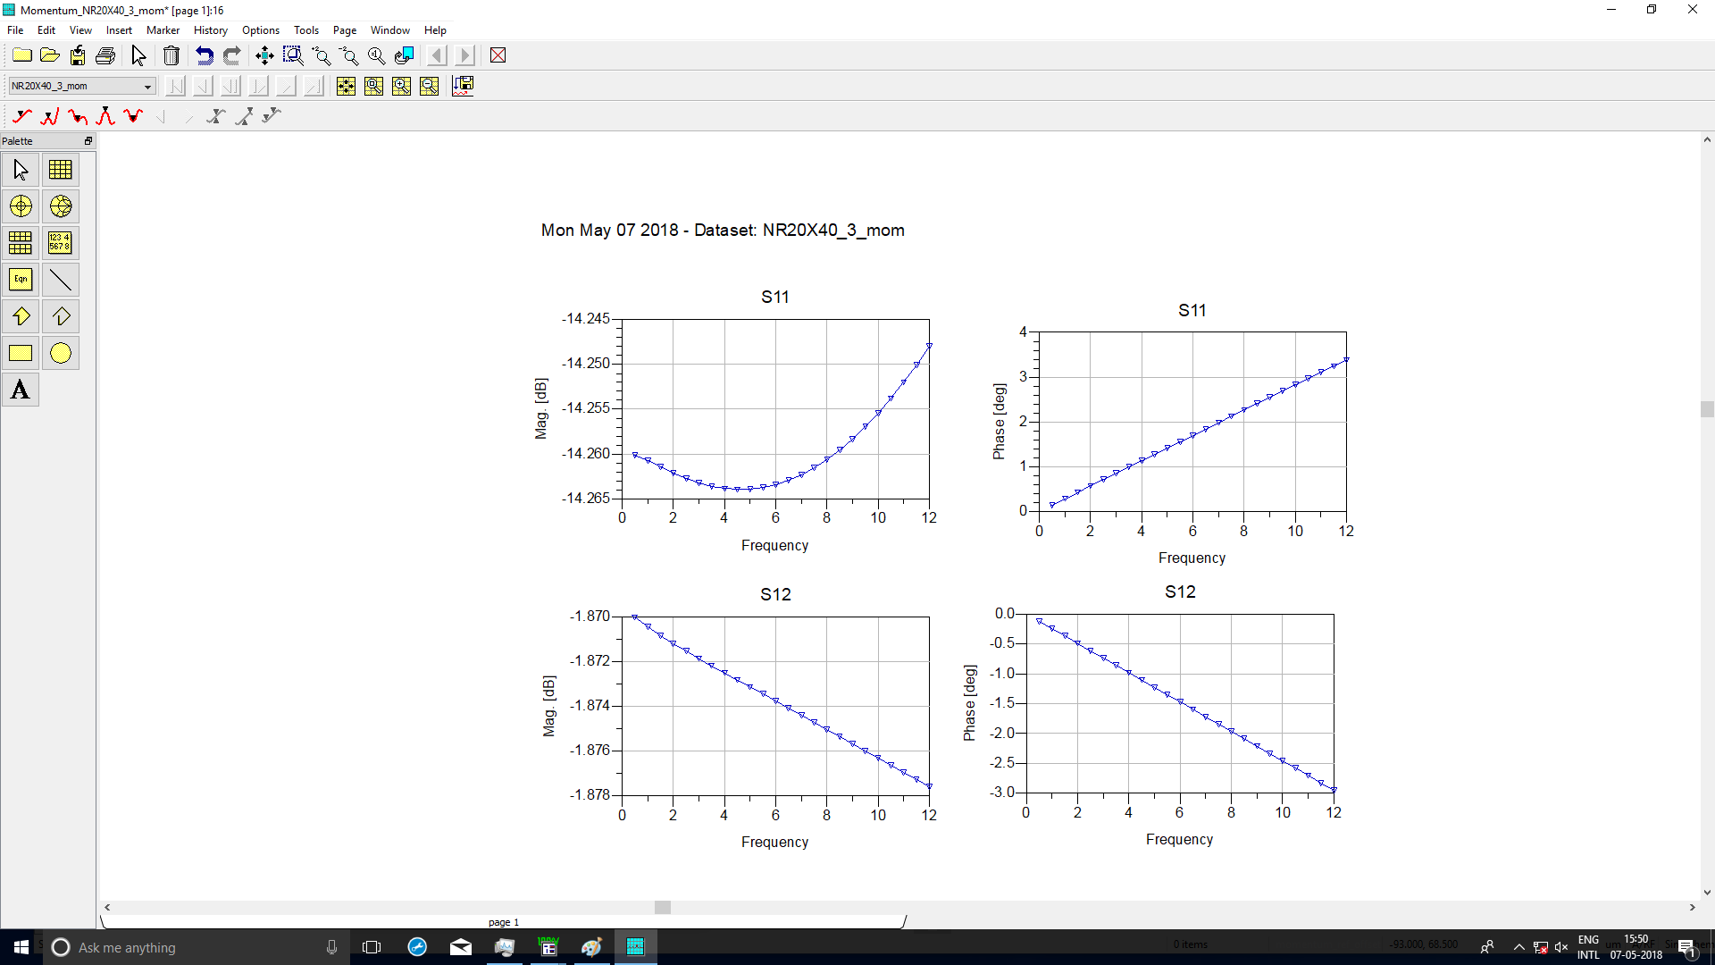
SIMULATION :-
Momentum -> Simulation
-> S-Parameter.
A data display window
automatically opens.

Slide 15
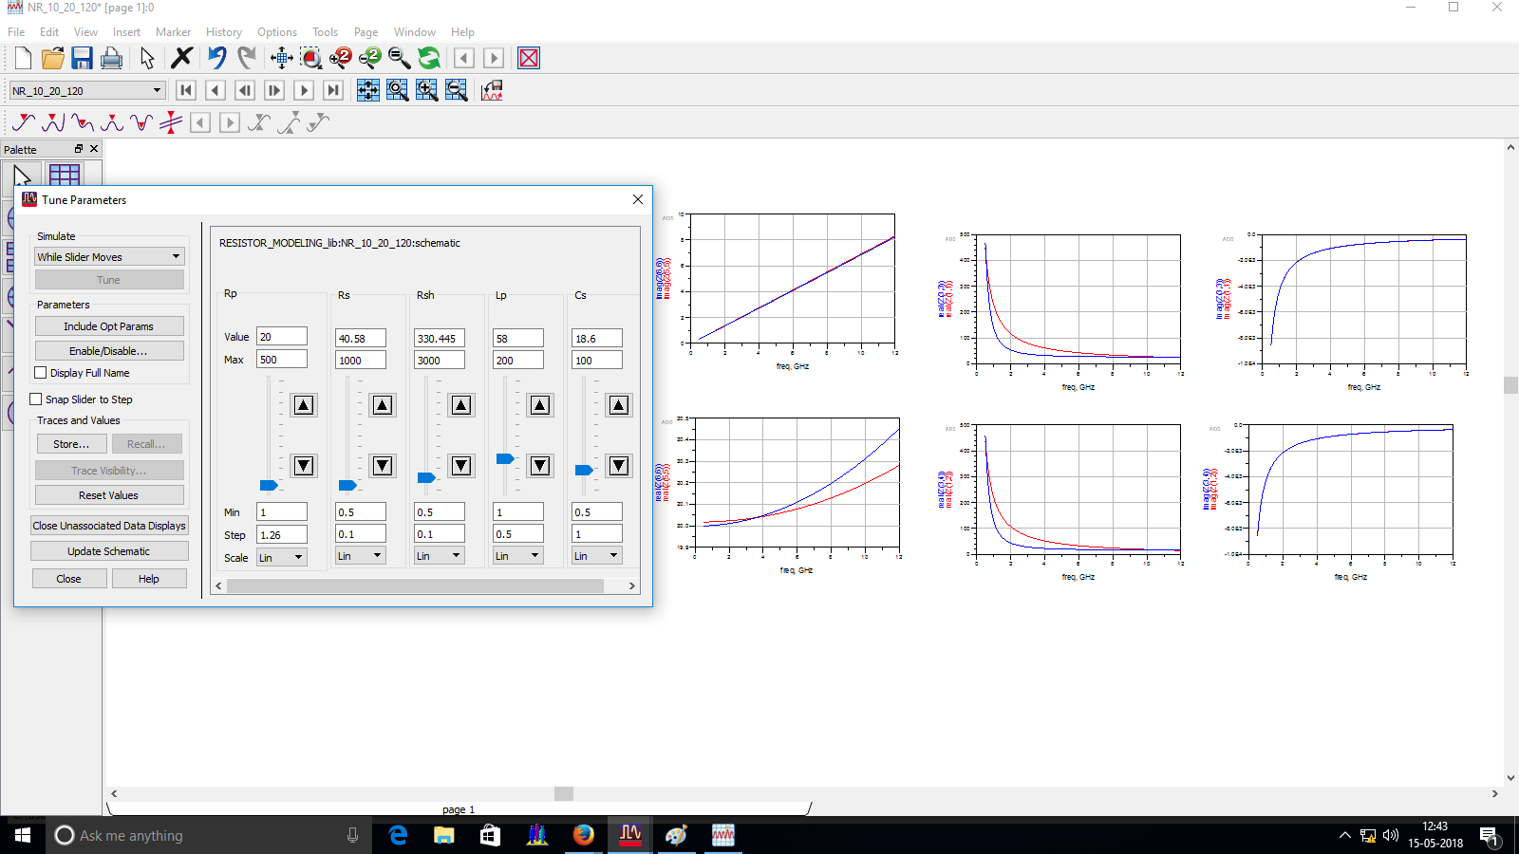
TUNNING OF EXTRACTED OF EQUIVALENT CIRCUIT PARAMETER OF RESISTORS
The ADS tuning capability allows to
change one or more design parameter
values and see its effect on the output
without re-simulating the entire design
again from the beginning.
The equivalent circuit parameter can
be tuned by moving the cursor for a
particular component in such a way,
the s-parameter of equivalent circuit
and designed resistor are matched.

Slide 16
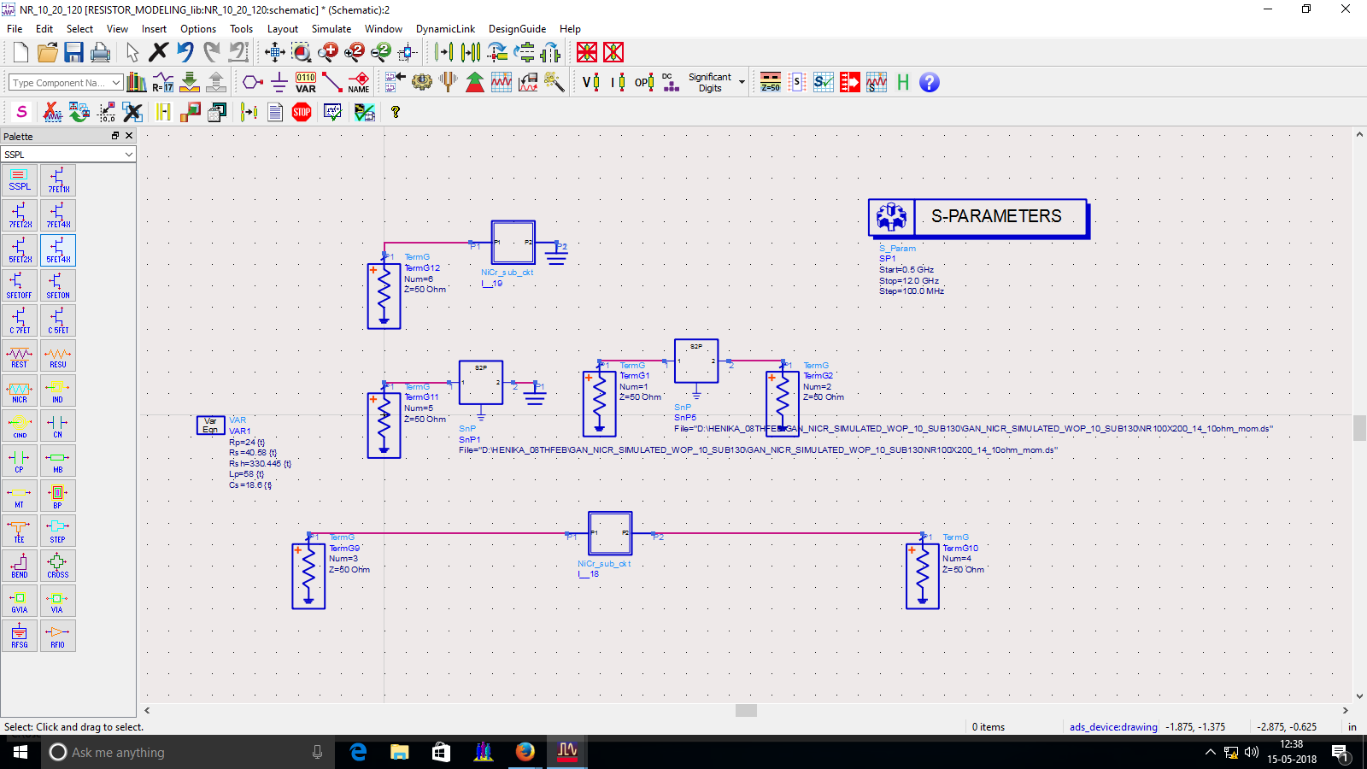
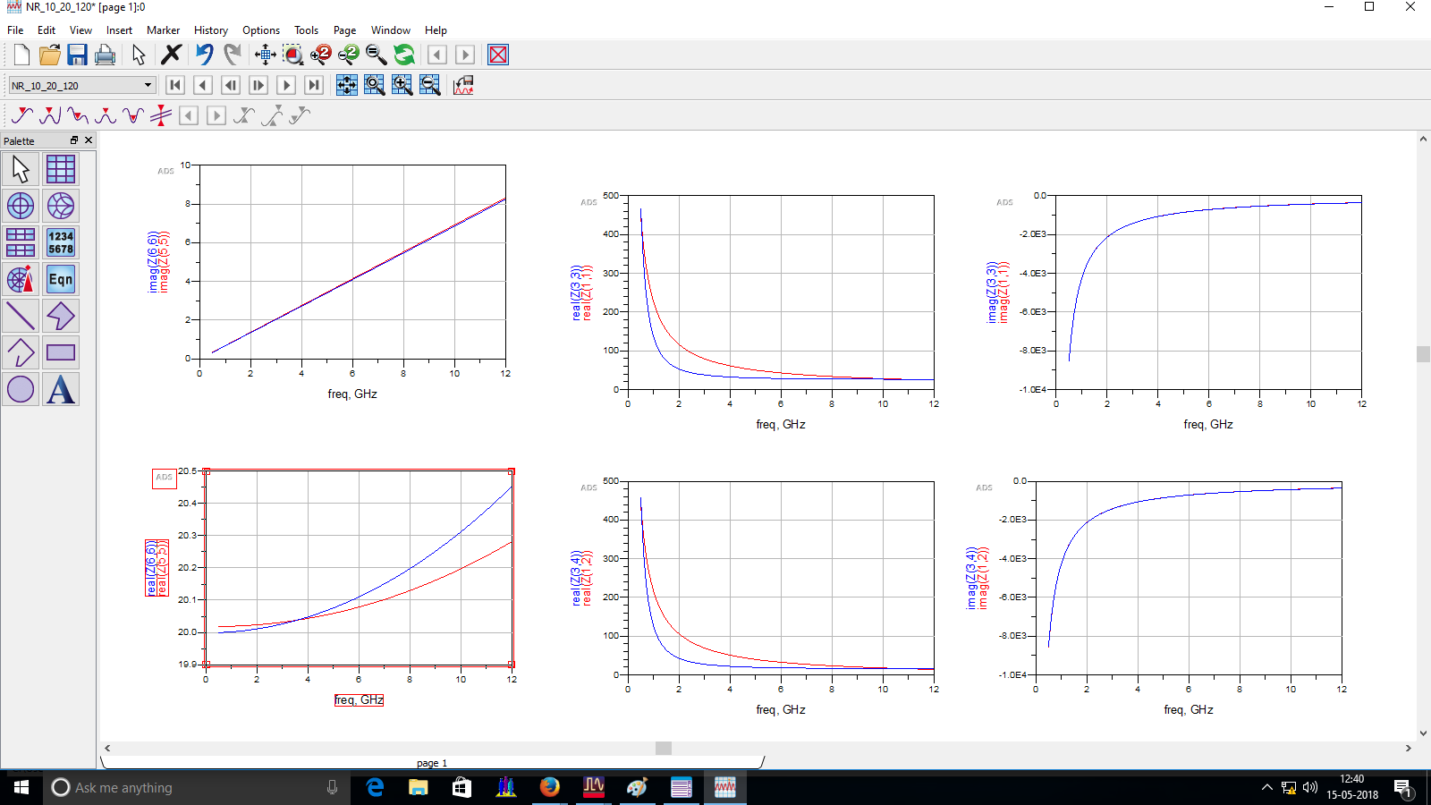
ADS Schematic window shown in a figure.
Input the data files.
Set the extracted equivalent
parameter.
Simulate -> Tuning.
Output of tuning shown in figure.

Slide 17
STUDY THE EFFECT OF TEMPERATURE ON S-PARAMETER OF NiCr RESISTOR
DIELECTRIC CONSTANT is a quantity measuring the ability of a substance to store electrical energy in an electrical field.
EFFECT OF TEMPERATURE ON DIELECTRIC CONSTANT:- Temperature increases, the dielectric constant decreases due to change in the alignment of dipoles with change in the temperature.
DIELECTRIC LOSS is the dissipation of energy through the movement of charges in an alternating electromagnetic field as polarization switches direction.
EFFECT OF TEMPERATURE ON DIELECTRIC LOSS:- The dielectric loss increases with increase in the temperature due to the more defects are created in the structure.

Slide 18
IMPACT OF TEMPERATURE ON S-PARAMETER OF RESISTOR
The S-Parameter of NiCr resistor with different temperature shown that as the temperature rises, i.e. the gain decreases as a temperature varies from 27°C to 127°C due to the slight change in basic properties of material used for fabrication of resistor i.e. NiCr, GaN and SiN. The basic properties include electrical resistivity of NiCr resistor are varies with temperature. As the temperature increases,the resistivity of NiCr resistor increases. The dielectric constant for SiN/GaN is decreases with increase in temperature and tangent loss increases with increase in temperature. Therefore, the changes in basic properties of material with temperature cause the gain reduction.

Slide 19
CONCLUSION
In this presentation, the passive component i.e. Nichrome (NiCr) resistor on GaN substrate has been designed and simulated by using ADS Software. Furthermore, the effect of temperature on dielectric parameters of GaN based microwave passive components i.e. dielectric constant and dielectric loss and the thermal effect on passive components fabricated on GaN substrate has been studied and explored.
Since, the temperature base study are very important for high power application, the thermal model for active and passive devices needs to be developed that can be used for MMICs Also, a comparative study of theoretical model and practical data of MMICs components need be carried out

