Slide 1


Slide 2
Project Name -
PREDICTING LOAN REPAYMENT

Slide 3
PRESENTED BY -
ATANU DE
ATUL KUMAR SINGH
ANKITA GHOSH
TRIASHA KARMAKAR
RAHUL CHAKRABORTY
SARBODARSHI MITRA

Slide 4
INDEX
INTRODUCTION
PROJECT OBJECTIVE
DATA DESCRIPTION
DATA ANALYSIS
RESULTS
FUTURE SCOPE OF IMROVEMENT
CONCLUSION

Slide 5
INTRODUCTION
The two most critical questions in the lending industry are :
How risky is the borrower?
Given the borrower’s risk, should we lend him/her?

Slide 6
PROJECT OBJECTIVE
The main objective of this project is all about to find the following questions :
How risky to give loan to a person
If the person able to repay the loan or not
What are the major aspects to the person for repay the loan
How to solve these problems

Slide 7
DATA DESCRIPTION
Source of Data
Description of all the Rows and Columns
Continuous data sets
Categorical data sets
Percentage of null data sets
How many numbers of outliers are there

Slide 8
DATA ANALYSIS
Analysis each and every data of the given data sets
Continuous & Categorical
Feature Selection
Modeling
Strategies to deal with imbalanced datasets
Build Ensemble models
Each and every plot (Boxplot, Countplot)

Slide 9
RESULTS
Final Model (RANDOM FOREST)
Used Algorithm & finalized the data
Find the best model & find out the original objective of the project

Slide 10
FUTURE SCOPE OF IMPROVEMENT
Here we can use the following algorithms for the improvement of this particular problem or project.
SVM
Random Forest
Neural Network

Slide 11
CONCLUSION
We can use this model to make detail testing selections. It helps the banking system as well as the lending industry to improve their services.
We can also use this type of models to other problems like this.

Slide 12
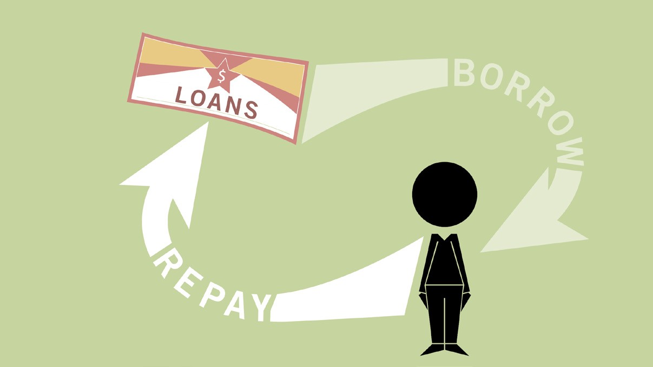
ANY QUERY ??
THANK YOU…..

