Slide 1
Project Presentation of Full Stack Engineering Project (FSE) (22CS037)
On
Real Time Chat App
Saikat Hazra (2210992216)
Sachidanand Gupta (2210992202)
Sachin Kumar (2210992204)
Sarbraj Singh(2210992258)
Supervised By
Mr. Rahul
Department of Computer Science and Engineering,
Chitkara University, Punjab

Slide 2

Introduction
A Real-Time Chat App using the MERN stack (MongoDB, Express.js, React, Node.js) enables seamless, instant messaging between users. It leverages WebSockets (via Socket.io) to establish real-time communication. The backend, powered by Node.js and Express, handles authentication, message storage in MongoDB, and WebSocket connections.
2

Slide 3
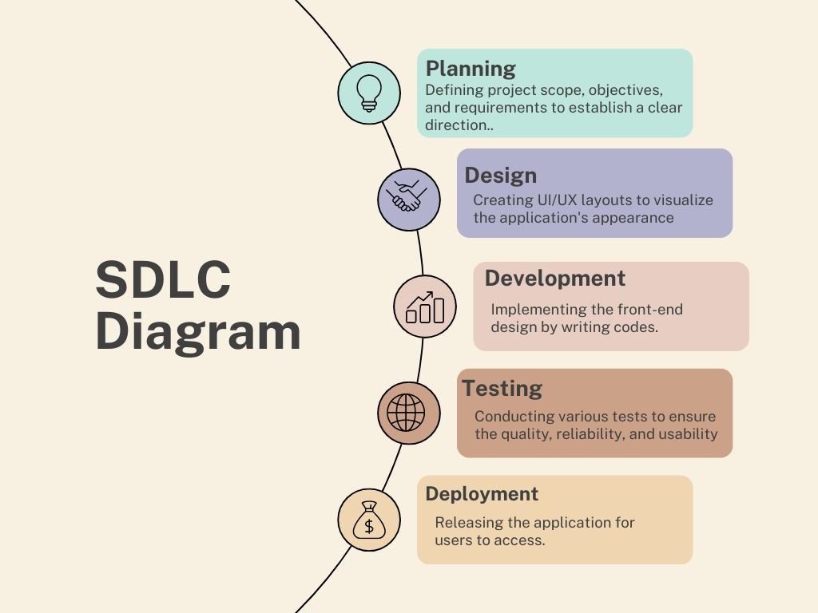
SDLC MODEL

Slide 4



TECHNICAL DETAILS
HTML:
Markup language for creating the structure of web pages.
Utilizes elements like <div>, <p>, <img> to organize content.
Forms for user input, with various input types like text, password, etc.
Semantics for accessibility and SEO.
TAILWIND CSS:
A utility-first CSS framework for styling HTML elements.
Simplifies layout design with classes for the box model: content, padding, border, and margin
Provides utility classes for positioning, display, flexbox, and grid layouts.
Enables responsive design through media query utilities.
REACTJS:
Allows dynamic rendering of HTML content based on real-time data.
Facilitates reusable components like headers, footers, and forms.
Supports conditional rendering to tailor content based on user roles or data.
Seamlessly integrates form handling for actions like login and data submissions.
Efficiently loops through arrays to render dynamic content such as notices, events, or appointments.

Slide 5

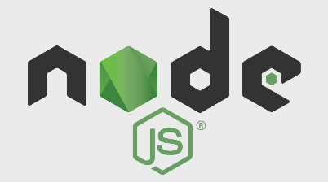
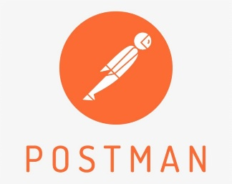
TECHNICAL DETAILS
Backend
MongoDB:
NoSQL database designed for handling large volumes of data.
Uses flexible, JSON-like documents to store data.
Supports dynamic schemas, allowing easy updates to data structure.
Provides horizontal scaling for managing distributed data.
Facilitates fast queries and indexing for efficient data retrieval.
Express:
Express is a minimal and flexible Node.js web application framework
that provides a robust set of features for web and mobile applications.
Express is a lightweight and flexible routing framework with minimal
core features meant to be augmented through the use of Express middleware modules.
Postman:
Postman is a global software company that offers an API platform for developers to design, build, test, and collaborate on APIs.

Slide 6
Features
User Authentication – Secure login/signup using JWT and bcrypt. ✅ Real-Time Messaging – Instant chat using Socket.io for real-time communication. ✅ One-on-One & Group Chats – Support for personal and group conversations. ✅ Online/Offline Status – Show users' availability in real-time. ✅ Message Read Receipts – Indicate when messages are delivered and read.
✅ Typing Indicators – Display when a user is typing. ✅ Media & File Sharing – Send images, videos, and documents. ✅ Notifications – Real-time alerts for new messages. ✅ Search & Filters – Find users or messages easily. ✅ Chat History & Storage – Store messages securely in MongoDB.

Slide 7

Target Audience
Who is this for?
1. General Users
Individuals looking for instant messaging solutions.
2. Businesses & Enterprises
Teams needing real-time collaboration (e.g., Slack alternative).
3. Developers & Tech Enthusiasts
MERN stack developers learning WebSockets & real-time features.
4. Educational Platforms
Online learning portals requiring live discussions.

Slide 8
User-Friendly Interface
Drag-and-Drop File Sharing
Users can easily send images, videos, and documents by dragging and dropping them into the chat.
Rich Messaging Experience
Built-in support for emojis, GIFs, reactions, and formatted text to enhance communication.
Intuitive Navigation
A simple and well-structured UI with easy access to contacts, recent chats, and settings.
Would you like me to add more features or refine the content further?

Slide 9
Languages
MongoDB
A NoSQL database that stores data in flexible, JSON-like documents, perfect for content-rich applications like blogs.
Express.js
A minimal and flexible Node.js web application framework that provides a robust set of features for web and mobile applications.
React
A powerful JavaScript library for building user interfaces, enabling the creation of dynamic, responsive, and interactive blog experiences.
Node.js
A JavaScript runtime built on Chrome's V8 JavaScript engine, allowing server-side scripting and efficient data handling.

Slide 10
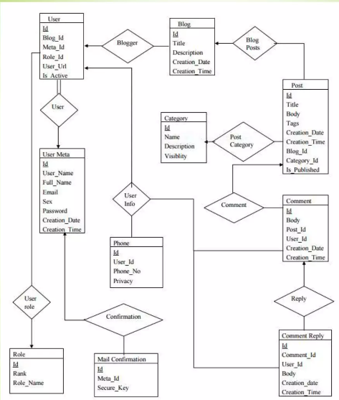
ER Diagram

Slide 11
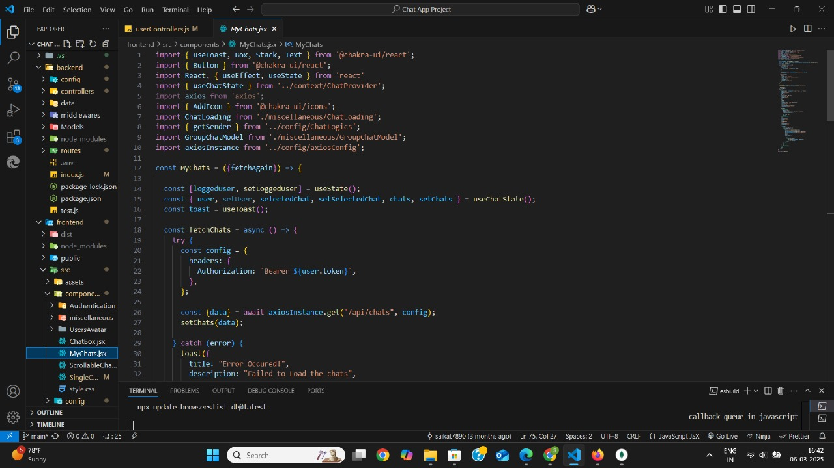
Code Snippets

Slide 12
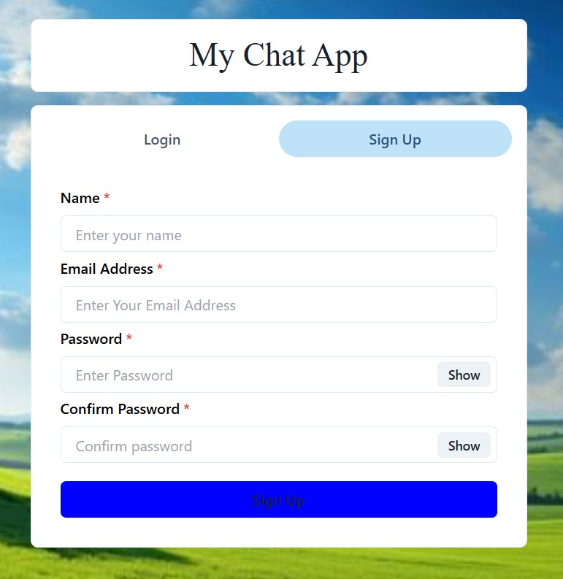
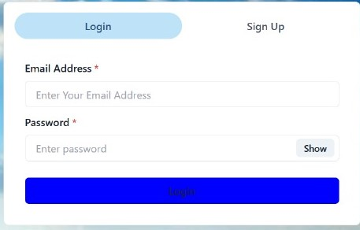
Output
Sign up
👇
Login
👇

Slide 13
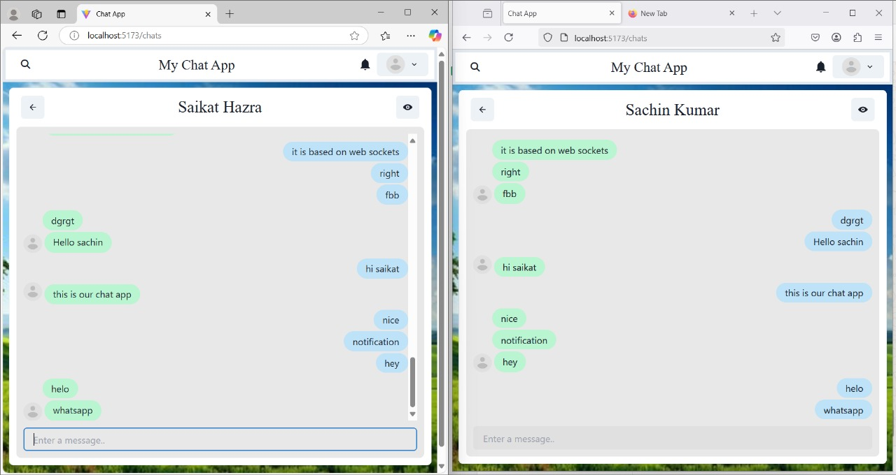
Project Snippet

Slide 14

CONCLUSION
The Real-Time Chat Application built using the MERN stack (MongoDB, Express.js, React.js, Node.js) provides a scalable, secure, and efficient communication platform. By integrating Socket.io for real-time messaging, JWT authentication for security, and cloud storage for media handling, the application ensures a smooth and seamless user experience.Following an Agile development methodology, the project is designed for continuous improvement, scalability, and adaptability to future enhancements like voice/video calls, AI chatbots, and multi-device synchronization.

Slide 15


