Slide 1
US Colleges and Universities
Comparison of undergraduate data
Sara Carlson, Laura Zacharda-Jones (Lindsay Meyer - segment 1)
Notes:
Good evening. Our project is a comparison of US Colleges and Universities undergraduate data.
I’m Laura Zacharda-Jones and our project team consists of Sara Carlson and myself. Lindsay Meyer was part of our team through the first segment.

Slide 2
Topic: There are many factors to consider when choosing a college or university. This project provides comparison data related to undergraduate criteria:
Criteria
Gender
Race
Enrollment total
Price
Location
Type (private/public)
How are schools the same?
How are schools different?
What schools are comparable?
Notes:
We chose to look at college and university admission data with the hope of providing an analysis that could help an individual compare schools to aid in the process of selecting a college or university.
We were able to find several data sets on Kaggle.com. The main data source we used included enrollment data from 2010 to 2014 and included data such as gender, race, total enrollment, total price, location, and type (public or private).

Slide 3



Data Exploration
College Admissions Data
USNWR College Data
Colleges & Universities Data
Imported datasets (Kaggle.com)
Cleaned data using Python / Pandas
Converted some columns to binary data
Selected preferred data
Removed rows with missing values
Created database using pgAdmin / PostgreSQL
Store data in Amazon Web Service Database
ERD
Notes:
Our data exploration process, started with importing the three datasets (from Kaggle.com). Using juypter notebook (python / pandas), we took the main data file of >100 columns and >1500 rows and removed rows with null values, removed columns not related to undergraduate data and converted some columns to binary data using ‘get dummies’. To facilitate the machine learning process. We narrowed this file to ~40 columns and just over 1100 rows.
Our other data sources contained additional information, as an example, one included latitude and longitude data which we knew would be beneficial for the final visualization.
The database was created using PostgreSQL / pgAdmin4 and stored / published to Amazon Web Service.
[Click the link to advance to the ERD slide]
Sara then connected to this database to perform the machine learning.

Slide 4
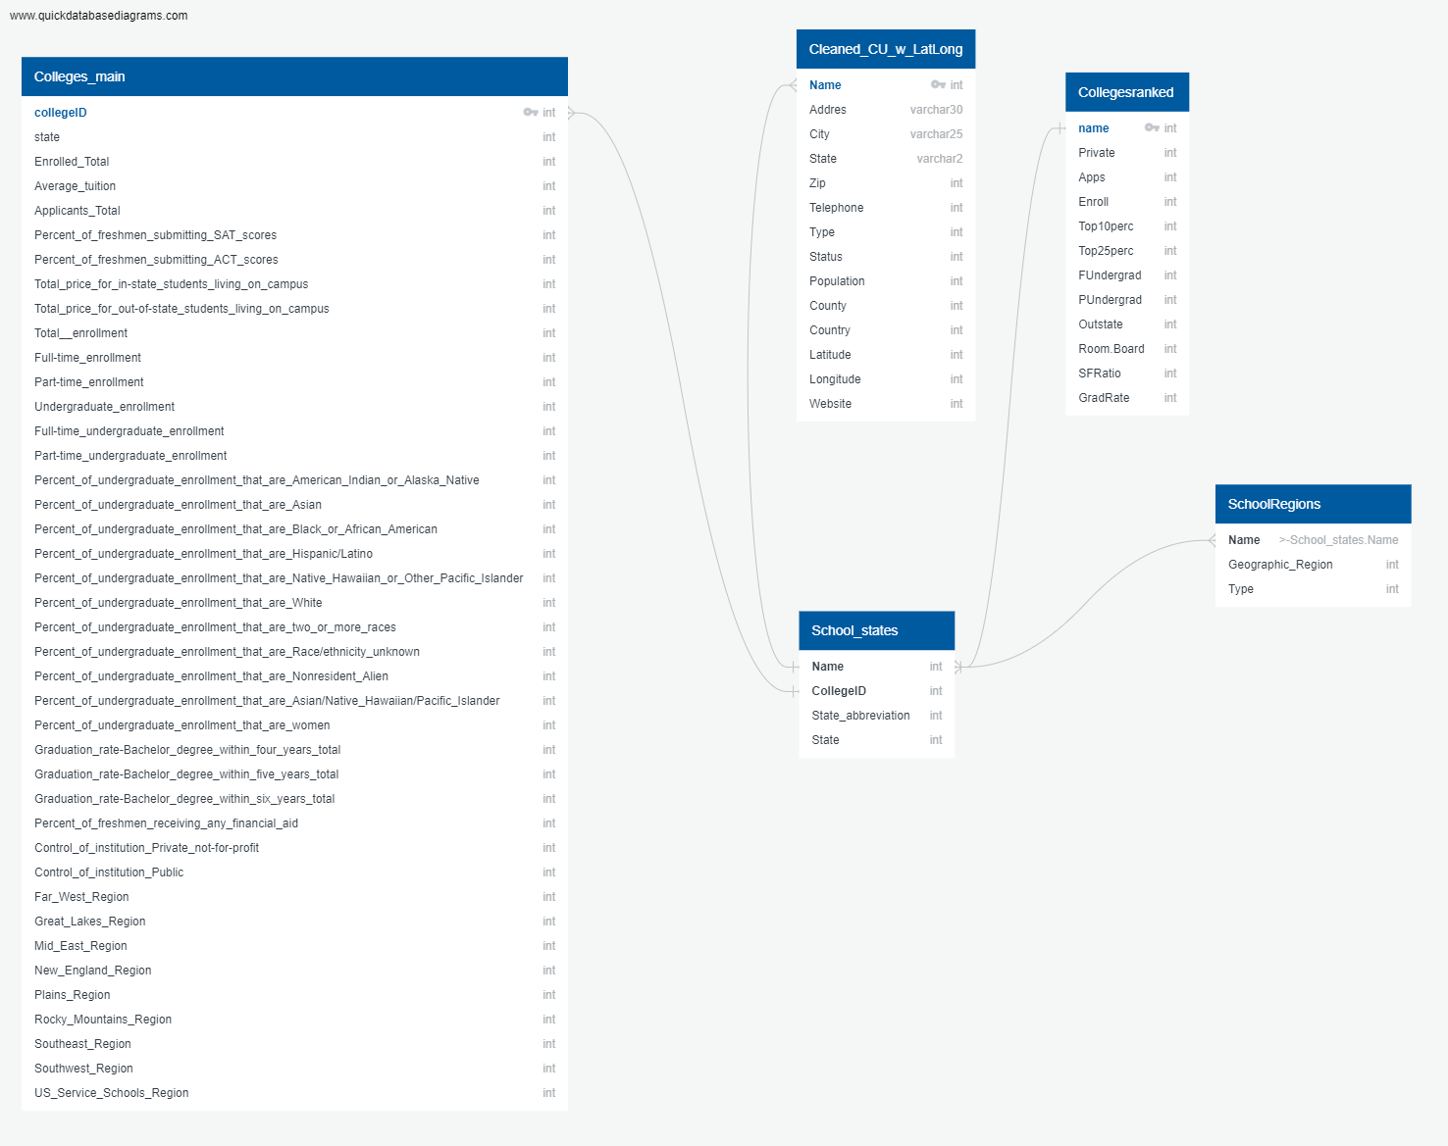
ERD

Slide 5
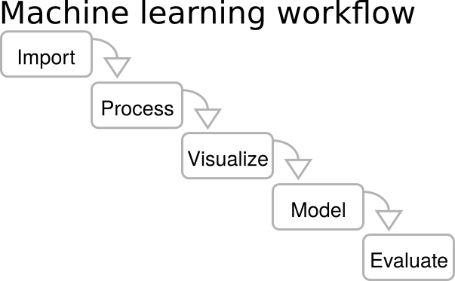
Data Exploration
College Admissions Data
USNWR College Data
Colleges & Universities Data
Imported datasets (Kaggle.com)
Cleaned data using Python / Pandas
Converted some columns to binary data
Selected preferred data
Removed rows with missing values
Created database using pgAdmin / PostgreSQL
Store data in Amazon Web Service Database
ERD
Connect to Machine Learning
Data used for KMeans Cluster
Cluster Analysis
Train, Test, Assess
Cluster info sent back to the DB
Notes:
Sara then connected to this database to perform the machine learning.
Machine Learning Data Exploration
●we connected This Data from Database to our Machine Learning model using Psycopg2
●And then used that data to run the K-Means Cluster
●Cluster Analysis
●Train, Test, Assess
● and Eventually the Cluster info sent back to the database

Slide 6
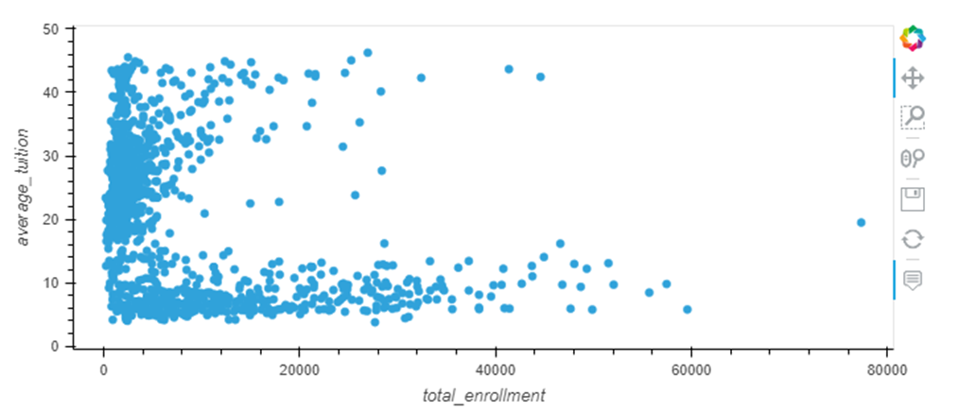
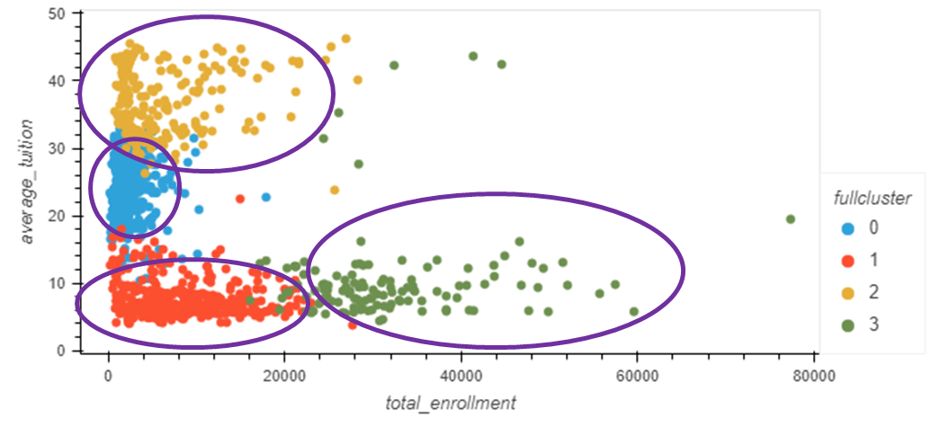
Unsupervised Machine Learning
K-means Clustering
Notes:
As you may remember, unsupervised learning is best used when there is not a clear classification or linear regression or no clear output (y) for logistical regression. A quick analysis of our data showed many features without a clear output (76 columns after initial preprocessing) and so we chose to use an unsupervised machine model – K-Means Clustering
As a team we discussed these 76 features and narrowed them down to 40 by choosing to focus on undergraduate data and limiting the tuition and fee data. Once the tables in the database were cleaned up to reflect these changes, we re-ran the KMeans cluster with this updated data

Slide 7
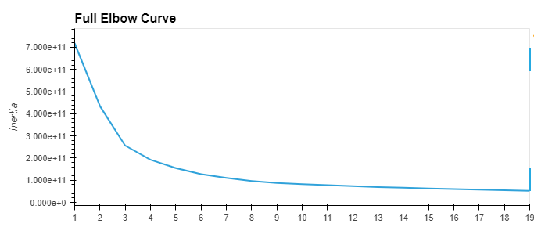
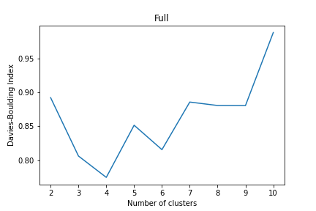
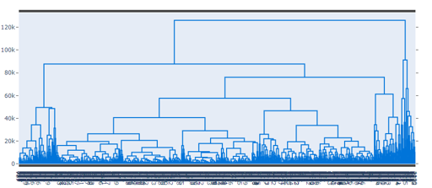
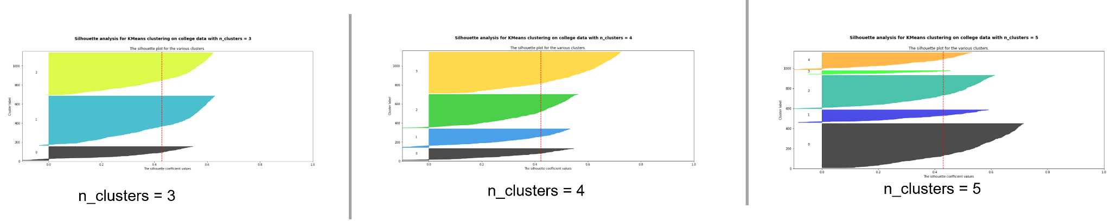
Cluster Evaluation
Notes:
Because we used unsupervised machine learning, the accuracy measures that are available for supervised machine learning are not created in the same way. Instead, we focused on testing the accuracy of the clusters. In order to determine the best number of clusters to use, we used five methods
Two methods we learned in class
Elbow Curve
Hierarchical Testing (Dendrogram)
And three methods that I read about after a google search. I found these methods easier to to interepret
Calinski-Harabasz Index (aka Variance Ratio Criterion)
Silhouette Score - which evaluates the clusters
Davis-Bouldin Index
All five of these methods seemed to point to 4 clusters being the correct number of clusters to use

Slide 8
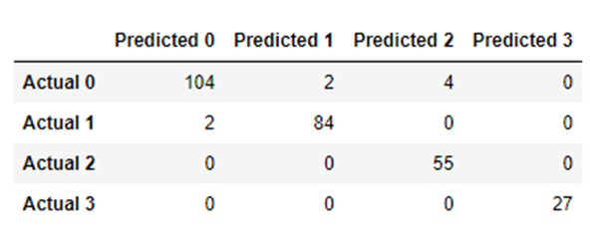
Random Forest Classifier Confusion Matrix
Notes:
As we are using unsupervised machine learning, we are not training a model as is done in supervised machine learning. However, for this project, to attempt to evaluate the clustering model, we treated the assigned cluster as a classification, split the data into training and testing data and then could compared the training and testing data. This allowed us to create a confusion matrix showing that the original “actual” clusters were very closely aligned with the predicted clusters in the test data

Slide 9
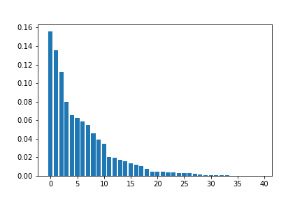
Cluster Feature Importance
[(0.155884826655826, 'instate_price'),
(0.13571468108496387, 'average_tuition'),
(0.11210951662074045, 'outstate_price'),
(0.07973782157694592, 'public'),
(0.06554146661362745, 'ft_enrollment'),
(0.062428464765603896, 'private'),
(0.05890294850314685, 'undergraduate_enrollment'),
(0.05509187464056854, 'ft_undergrad_enrollment'),
(0.046052384618573916, 'total_enrollment'),
(0.039205165445673436, 'enrolled_total'),
(0.03458615589323019, 'applicants_total'),
(0.02064647808874147, 'perc_fresh_financialaid'),
(0.019396665163092873, 'gradrate_bachelor_four_years'),
(0.01718470710286264, 'gradrate_bachelor_five_years'),
(0.01557774441414399, 'gradrate_bachelor_six_years'),
(0.0135700814786587, 'pt_enrollment'),
(0.012414139255510749, 'pt_undergrad_enrollment'),
(0.010635138762378224, 'perc_asiannativehawaiianpacificislander_undergrad'),
(0.007205583689860964, 'perc_asian_undergrad'),
(0.004750784433246922, 'perc_fresh_act_scores'),
(0.004607485482784004, 'perc_white_undergrad'),
(0.004394887097830324, 'perc_women_undergrad'),
(0.0038698591533260582, 'perc_blackafricanamerican_undergrad'),
(0.003794624473812276, 'perc_nonresidentalien_undergrad'),
(0.003194854085562593, 'perc_fresh_sat_scores'),
(0.0027977513170457514, 'perc_multiracial_undergrad'),
(0.0026412021297245775, 'perc_raceunknown_undergrad'),
(0.0024185246417317073, 'perc_hispaniclatino_undergrad'),
(0.0018343601197454904, 'state'),
(0.0008838969381214157,
'perc_nativehawaiian_or_otherpacificislander_undergrad'),
(0.0008413665575730455, 'mid_east_region'),
(0.0005643397704656214, 'great_lakes_region'),
(0.00045827785948574743, 'southeast_region'),
(0.0004026894971574826, 'perc_americanindian_or_alaskanative_undergrad'),
(0.0002516902686616636, 'far_west_region'),
(0.00017052522187339676, 'new_england_region'),
(0.00010405537025820586, 'rocky_mountains_region'),
(8.262494377746268e-05, 'plains_region'),
(5.035626366619233e-05, 'southwest_region'),
(0.0, 'us_service_schools_region')]
Notes:
This also allowed us to determine (and graph) the features in order of importance. As you can see here, some of the features such as average tuition and whether the school was public or private had a stronger Importance than features such as percentages of freshman submitting ACT vs SAT scores or what region the school happened to be in.

Slide 10
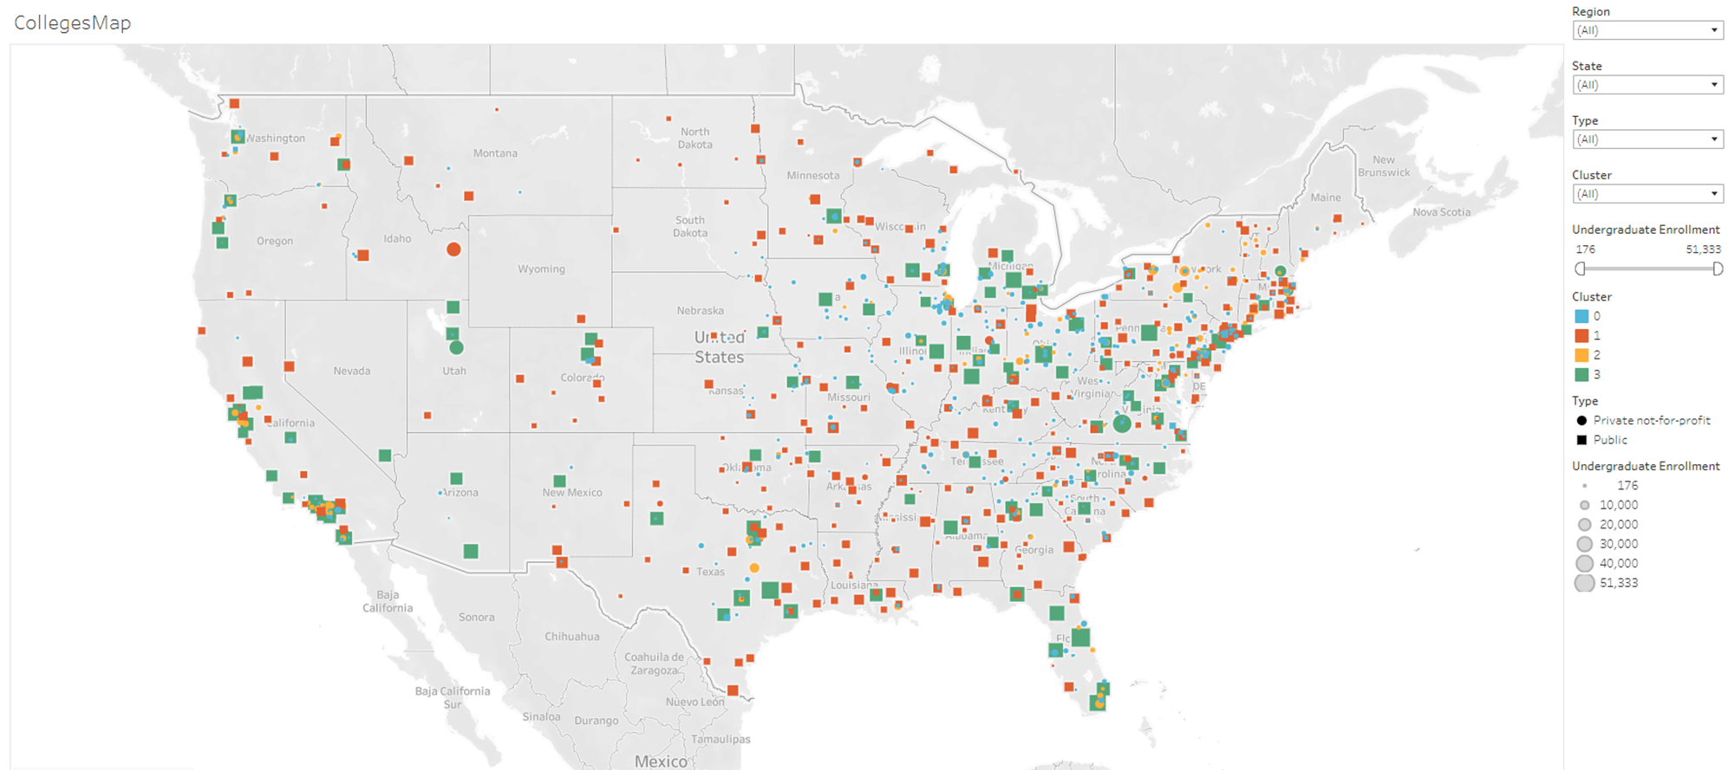
https://public.tableau.com/app/profile/laura.zacharda.jones/viz/Colleges_Clustered_Data_6-3-22/Story1?publish=yes
Notes:
This cluster information ( and feature order of importance) informed our decisions of what to visualize in our dashboard

Slide 11
Technologies Used
We used many of the technologies and tools that we learned throughout the bootcamp
Database:
PostgreSQL
SQL
AWS
Data Processing:
Python
Pandas
SciKitLearn
Psycopg2
Matplotlib
Machine Learning:
Python
Pandas
SciKitLearn
Matplotlib
Plotly
Numpy
hvplot
Visualization:
Tableau
Matplotlib
Holoviews (hvplot)
Notes:
✓ Technologies, languages, tools, and algorithms used throughout the project
We used many of the technologies and tools that we learned throughout the bootcamp

Slide 12
Future Analysis
Locate more current data
Expand / compare colleges within/outside the US
Compare undergraduate, graduate and trade schools
Notes:
✓ Recommendation for future analysis
Our analysis of Colleges and Universities was limited by the data that we chose to use. Simply due to the availability, we choose a dataset that showed data from 2010-2014 for US Colleges and Universities, and chose to focus on undergraduate data for ease of analysis. We think that it could be interesting to expand this analysis to schools outside of the US, graduate and trade schools, and imagine that there could be some significant changes with more recent data, especially with the many changes since the onset of Covid.

Slide 13
Lessons Learned - what we’d do differently
Data selection
Picked a question/data with supervised learning (not unsupervised)
Potential to explore web page for dashboard
More time to explore initial ideas
Team of two
Notes:
✓ Anything the team would have done differently
Our analysis of Colleges and Universities was limited by the data that we chose to use. Simply due to the availability, we choose a dataset that showed data from 2010-2014 for US Colleges and Universities, and chose to focus on undergraduate data for ease of analysis. We think that it could be interesting to expand this analysis to schools outside of the US, graduate and trade schools, and imagine that there could be some significant changes with more recent data, especially with the many changes since the onset of Covid.
Data selection (The importance of picking the right data. Even though we were reminded of the importance I don’t think either of us really understood the kind of data we should have started with. If we could do it all over again, probably choosing something with fewer columns and as many or more rows would have made most aspects of this project easier)
More time to explore initial ideas - Our team did not have a topic chosen before we met initially, and no one had a strong (or even tepid) feeling about any of the ideas we did eventually come up with.
Picked a question with supervised learning (not unsupervised). With help we realized that the data set we found to work with did not easily fit into classification or regression. Not having a strong understanding of either supervised or unsupervised machine learning, we were ameneable to a clustering model but did not realize that most of the analysis methods we learned in class were geared towards supervised machine learning. It was interesting to learn about the new methods for cluster number evaluation, but was difficult (for me) to figure out the proper way to split the data into testing and training, and to analyze the model.
Potential to explore web page for dashboard (html/Flask). While in the end we were really happy with the way our Tableau dashboard turned out and was a great way to show the data and help to answer our initial questions, if we had more time, or could have had someone dedicated to working on Visualizations we would have like to explore using Flask to create a web app.
Team of two - There were certainly some challenges with a small team, (more work to do, would have been nice to have more brains to bounce ideas off of, did not have the ability/time to check each others work as much as we would have liked) the two of us worked really well together, and I feel like I was better able to understand most aspects of this project and really dig into understanding unsupervised machine learning.

Slide 14
Additional Data
Notes:
Content
The presentation tells a cohesive story about their project, including the following:
✓ Selected topic
✓ Reason why they selected their topic
✓ Description of their source of data
✓ Questions they hope to answer with the data
✓ Description of the data exploration phase of the project
✓ Description of the analysis phase of the project
✓ Technologies, languages, tools, and algorithms used throughout the project
✓ Result of analysis
✓ Recommendation for future analysis
✓ Anything the team would have done differently

Slide 15
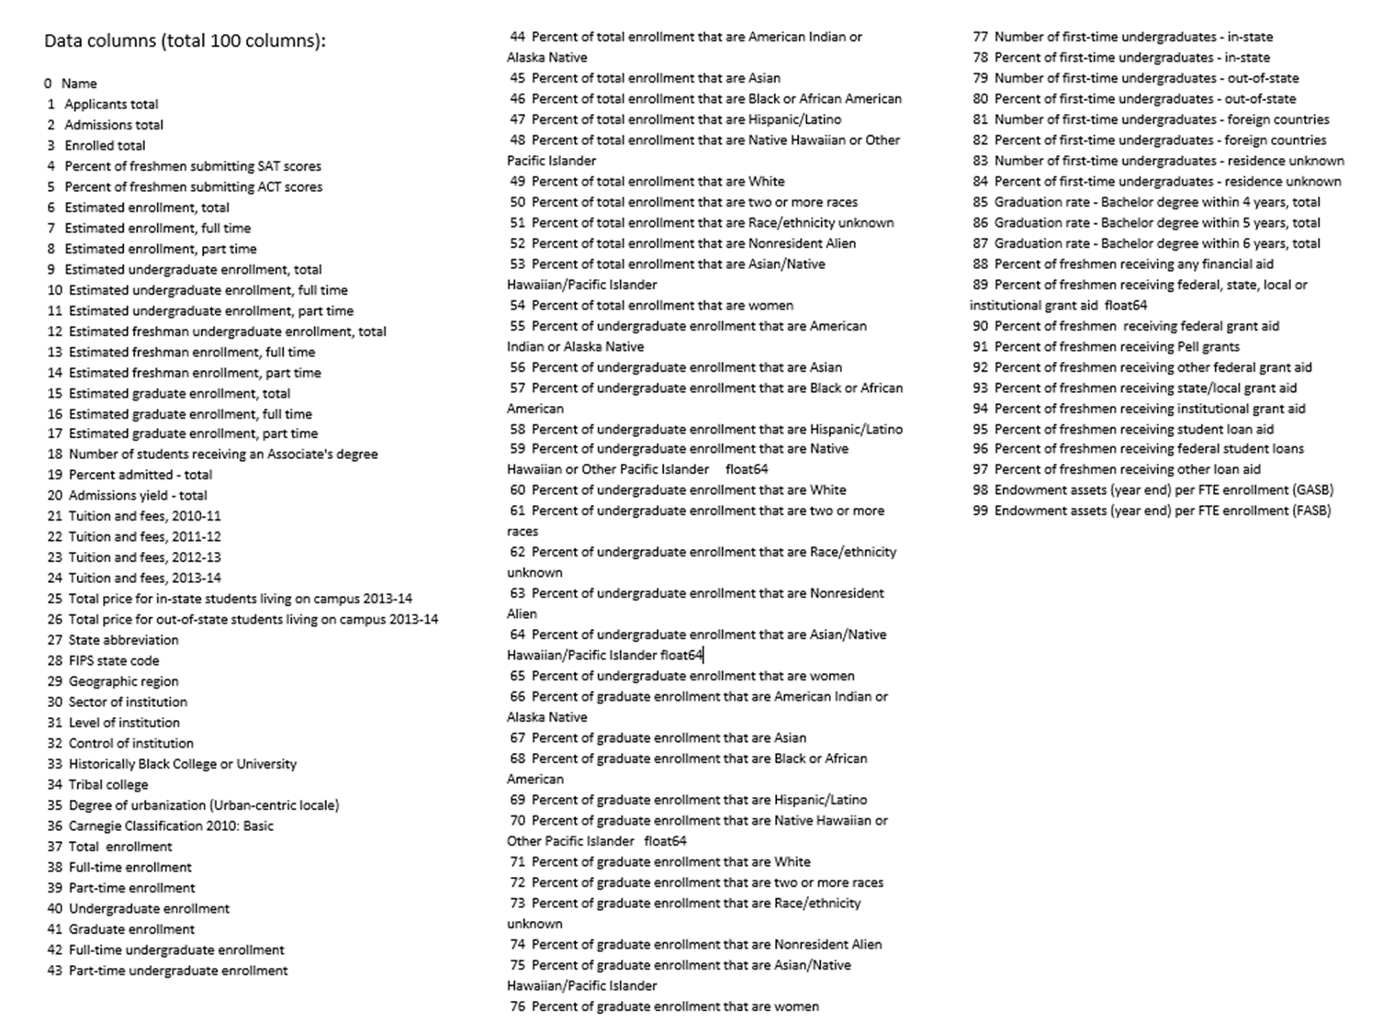
Initial Data(column)

Slide 16
‘state',
'applicants_total',
'enrolled_total',
'perc_fresh_sat_scores',
'perc_fresh_act_scores',
'instate_price',
'outstate_price',
'total_enrollment',
'ft_enrollment',
'pt_enrollment',
'undergraduate_enrollment',
'ft_undergrad_enrollment',
'pt_undergrad_enrollment',
'perc_americanindian_or_alaskanative_undergrad',
'perc_asian_undergrad',
'perc_blackafricanamerican_undergrad',
'perc_hispaniclatino_undergrad',
'perc_nativehawaiian_or_otherpacificislander_undergrad',
'perc_white_undergrad',
'perc_multiracial_undergrad',
'perc_raceunknown_undergrad',
'perc_nonresidentalien_undergrad',
'perc_asiannativehawaiianpacificislander_undergrad',
'perc_women_undergrad',
'gradrate_bachelor_four_years',
'gradrate_bachelor_five_years',
'gradrate_bachelor_six_years',
'perc_fresh_financialaid',
'private',
'public',
'far_west_region',
'great_lakes_region',
'mid_east_region',
'new_england_region',
'plains_region',
'rocky_mountains_region',
'southeast_region',
'southwest_region',
'us_service_schools_region',
'average_tuition'
Final Data(columns)

Slide 17
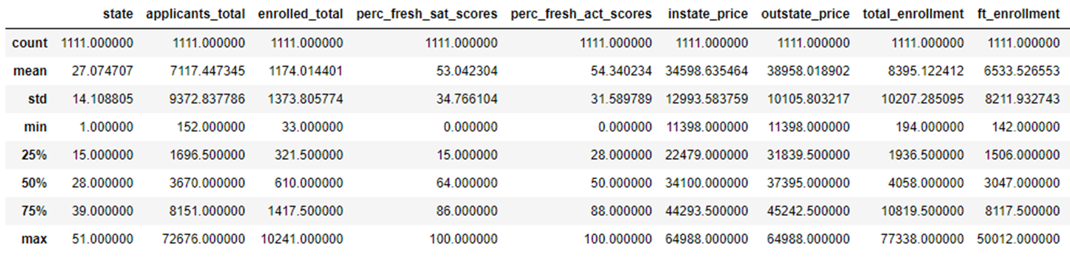
Final Data(describe)

Slide 18
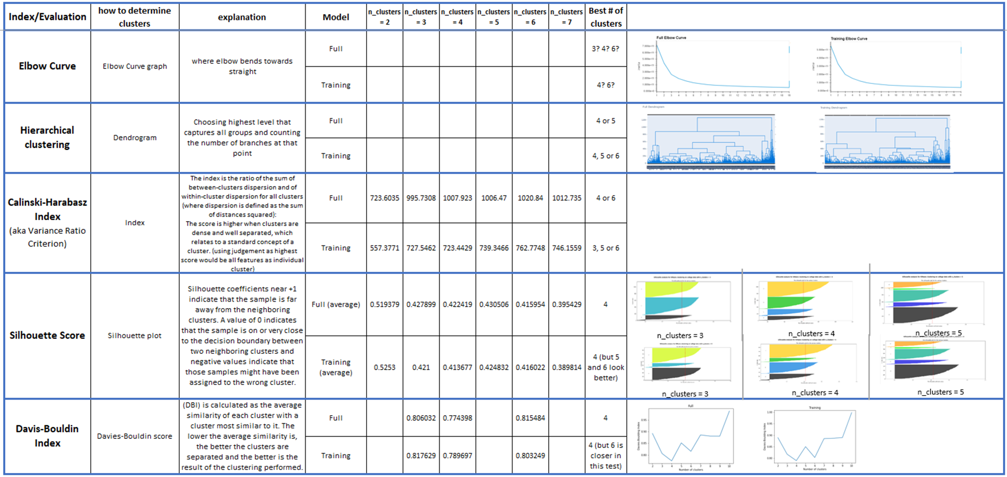
Cluster Evaluation Grid

