Slide 1
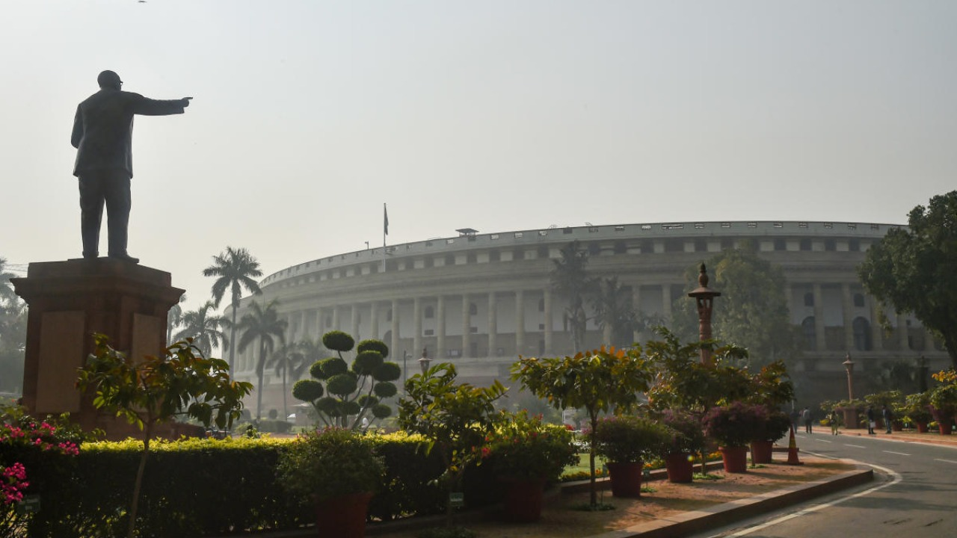
2001 Indian parliament attack
Location New Delhi, Delhi, India
Date 13 December 2001 (UTC+05:30)
Target Parliament Building
Attack type Mass shooting, suicide bombing
Weapons AKM rifles, explosive belt
Deaths 9 (excluding 5 terrorists)
Injured 18
Perpetrators Lashkar-e-Taiba[1]
Jaish-e-Mohammed[2]

Slide 2
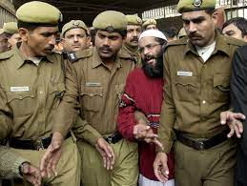
Parliment Attack
The 2001 Indian Parliament attack was a terrorist attack on the Parliament of India in New Delhi, India on 13 December 2001. The perpetrators belonged to Lashkar-e-Taiba (LeT) and Jaish-e-Mohammed (JeM) - two Pakistan-raised terrorist organisations.[1][3] The attack led to the deaths of six Delhi Police personnel, two Parliament Security Service personnel, and a gardener – in total 9 – and led to increased tensions between India and Pakistan, resulting in the 2001–02 India–Pakistan standoff. The 5 terrorists were killed outside the parliament.

Slide 3
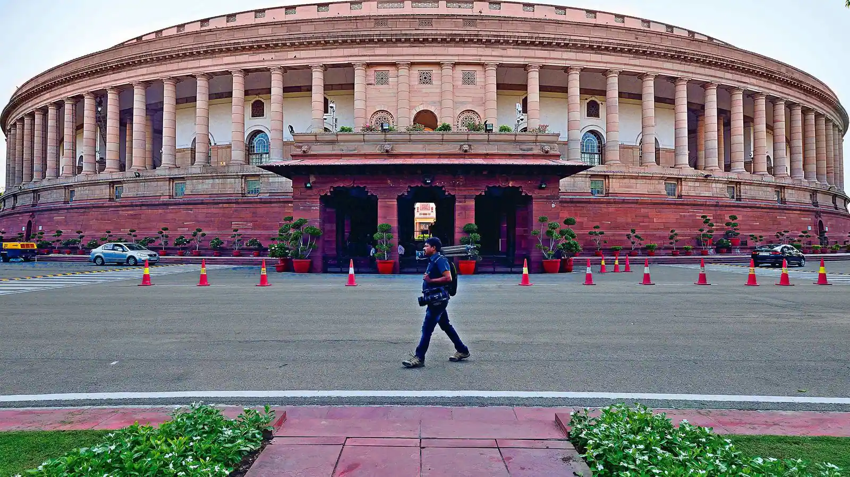
Casualties
Constable Kamlesh Kumari of the Central Reserve Police Force was the first to spot the terrorists and was shot by them as she raised the alarm. She died on the spot. One gunman's suicide vest exploded when he was shot dead; the other four gunmen were also killed. The ministers and MPs escaped unhurt. The total number killed was 9 and at least 17 other people were injured in the attack.[9][6]

Slide 4
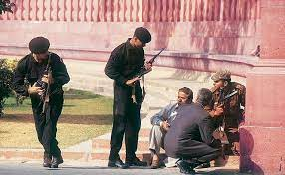
Trial
The attack triggered extensive investigations, which revealed the involvement of four accused, namely Mohammad Afzal Guru, Shaukat Hussain Guru (cousin of Afzal Guru) and S.A.R. Geelani (Syed Abdul Rahman Geelani)[12] (also spelled "Gilani") and Shaukat's wife Afsan Guru (Navjot Sandhu before marriage). Some other proclaimed offenders were said to be the leaders of the banned terrorist organisation known as Jaish-e-Mohammed. After the conclusion of investigation, investigating agency filed the report under Section 173 of Criminal Procedure Code, 1973 (India) against four accused persons on 14 May 2002. Charges were framed under various sections of Indian Penal Code (IPC), the Prevention of Terrorism Act, 2002 (POTA), and the Explosive Substances Act by the designated sessions Court.

Slide 5
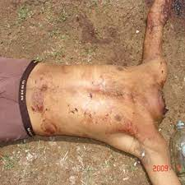
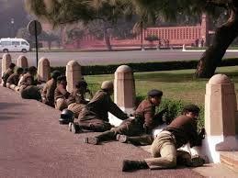
Attack
On 13 December 2001, five terrorists infiltrated the Parliament House in a car with Home Ministry and Parliament labels.[4] While both the Rajya Sabha and Lok Sabha had been adjourned 40 minutes prior to the incident, many members of parliament (MPs) and government officials such as Home Minister LK Advani and Minister of State for Defence Harin Pathak were believed to have still been in the building at the time of the attack.[5] More than 100 people, including major politicians, were inside the parliament building at the time. The gunmen used a fake identity sticker on the car they drove and thus easily breached the security deployed around the parliamentary complex.[6] The terrorists carried AK-47 rifles, grenade launchers, pistols and grenades.[7

Slide 6
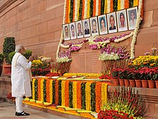
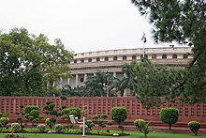
Response
The same day, in a demarche to Pakistani High Commissioner to India, Ashraf Jehangir Qazi, India demanded that Pakistan stop the activities of LeT and JeM, that Pakistan apprehend the organisations' leaders and that Pakistan curb the financial assets and the groups' access to these assets.[1] In response to the Indian government's statements, Pakistani forces were put on high alert the same day. On 20 December, India mobilised and deployed its troops to Kashmir and Punjab in what was India's largest military mobilisation since the 1971 Indo-Pakistani War.
Following the attack, many suspects were arrested, and in December 2002 four Jaish-e-Mohammed members were convicted for roles in the attack.[21] In 2003, the Border Security Force (BSF) killed Ghazi Baba, the commander-in-chief of Jaish-e-Mohammed and the mastermind of the attack, in the Noor Bagh neighborhood of Srinagar, Jammu and Kashmir.[2

