Slide 1
Predicting next day stock values

Slide 2
Table of contents
Research Question
Key Takeaways
Data
EDA
Modeling
Evaluation
Results
Conclusion
Sources

Slide 3
Research Question
How well does a stock’s daily available information help predict its price the next day?

Slide 4
Key takeaways
Predicting Apple’s price movement relative to SPY
What kind of model’s best predict Apple’s price

Slide 5
Data
Apple’s stock price history from 2010 to 2020
SPY (S&P 500 Index) price history from 2010 to 2020
Apple’s Product Launch History
Apple’s Earnings History
Apple’s Revenue by Product History

Slide 6
EDA
Target is ‘Next Day’ which is tomorrow’s price
Boosting Classifiers
LogReg used to get a starting point

Slide 7
EDA
The target will be 1 when the price increases the next day, 0 if anything else
#Create a column that determines if the day’s closing price was higher than the previous day's closing price
df['Gain or Loss'] = np.where(df['Close/Last'] >
df['Close/Last'].shift(-1), 1,0)
#Create a column titled 'Next Day' that shows whether or not the next day was a gain or loss
df['Next Day'] = df['Gain or Loss'].shift(1)

Slide 8
EDA
There were NaNs that needed to be dropped
SPY was in a second data frame that I had to clean and merge with AAPL’s price history
Third data set containing AAPL’s earnings and product release dates that I cleaned and merged

Slide 9
EDA
#Created a column that would divide the dates into quarters
df3['Quarter'] = pd.PeriodIndex(df3.Date, freq='Q')
#Created 4 new columns named Quarter1, Quarter2, Quarter3, and Quarter4 to assign value to each one depending on which quarter of the year we were in.
df3['Quarter1'] = np.where((df3['Quarter'] == '2020Q1') 1, 0)
df3['Quarter2'] = np.where((df3['Quarter'] == '2020Q2') 1, 0)
df3['Quarter3'] = np.where((df3['Quarter'] == '2020Q3') 1, 0)
df3['Quarter4'] = np.where((df3['Quarter'] == '2020Q4') 1, 0)
#Created a new column named Earnings, assigning it 0 to show that it was not an earnings date
df3['Earnings'] = 0
#Added earnings dates to the data set, i couldn't find a data set so i added each one in manually.
df3.loc[df3['Date'] == '01/28/2020', 'Earnings'] = 1
df3.loc[df3['Date'] == '10/30/2019', 'Earnings'] = 1
…
#In excel I created new columns named iPhone, iPad, Mac and Other Hardware and assigned them values of 1 or 0 based on whether or not they occured, then reuploaded the excel file to work on again
#I then combined the rows because some dates had multiple releases and were in the table twice, one for each release (if an iPad and iPhone were released on the same day, it would show up on the table as two separate rows)
agg_functions = {'iPhone':'sum', 'iPad':'sum', 'Mac':'sum', 'Other':'sum'}
df4 = df4.groupby(df4['Date']).aggregate(agg_functions)
#So instead, I dropped all days with NaNs in SPY High since it would remove all the dividend rows
df5a = df5a[df5a['SPY High'].notna()]
#After fixing that problem, I got another error which was that I had a string that was not letting my decision tree work, so I had to find what had the value of '58,126,000'
df5a[df5a.eq('58,126,000').any(1)]
#It turned out that the SPY Volume column had ',' in its values instead of just the numbers, so I had to remove and turn it into a float.
df5a['SPY Volume'] = df5a['SPY Volume'].str.replace(',', '')
df5a['SPY Volume'] = df5a['SPY Volume'].astype(float)

Slide 10
Modeling
LogReg, ADABoost, GradientBoosting, XGBoost and Decision Trees were used as models.
Factors such as SPY’s price, Earnings, Quarters and Product Releases were used for the models

Slide 11
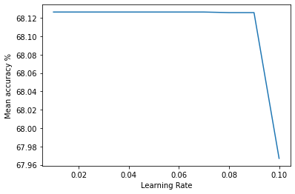
Evaluation
Log Reg
LogReg | Accuracy
SPY Next Day | 0.6812400636
Decision Tree
Tree | Accuracy | Dropped
Tree1 | 0.573098413 | None
Tree2 | 0.573053968 | High, Low, SPY High, SPY Low
ADA Boost
Adaboost | Accuracy | Dropped
ADAB1 | 0.651873016 | None
ADAB2 | 0.662196825 | High, Low, SPY High, SPY Low
ADAB3 | 0.657415873 | High, Low, SPY High, SPY Low, Other, Quarter1, Quarter2, Quarter3, Quarter4
ADAB3 with Learning Rate
learning rate | mean accuracy
0.01 | 68.126349
0.02 | 68.126349
0.03 | 68.126349
0.04 | 68.126349
0.05 | 68.126349
0.06 | 68.126349
0.07 | 68.126349
0.08 | 68.125714
0.09 | 68.125714
0.1 | 67.966984

Slide 12
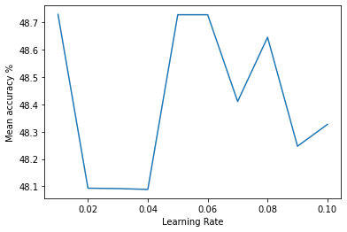
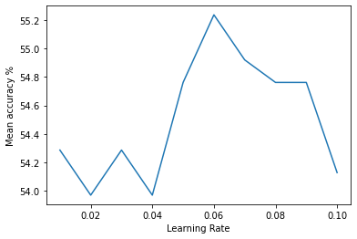
Evaluation
ADA Boost (No SPY Next Day)
Train Accuracy
Test Accuracy
ADAB9 with Learning Rate
learning rate | mean accuracy
0.01 | 48.729524
0.02 | 48.093333
0.03 | 48.092063
0.04 | 48.088889
0.05 | 48.728254
0.06 | 48.728254
0.07 | 48.410794
0.08 | 48.645714
0.09 | 48.246984
0.1 | 48.326984
ADAB9 with Learning Rate
learning rate | mean accuracy
0.01 | 54.285714
0.02 | 53.968254
0.03 | 54.285714
0.04 | 53.968254
0.05 | 54.761905
0.06 | 55.238095
0.07 | 54.920635
0.08 | 54.761905
0.09 | 54.761905
0.1 | 54.126984

Slide 13
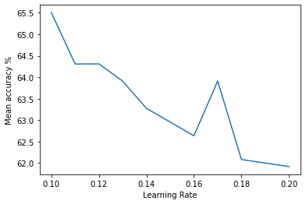
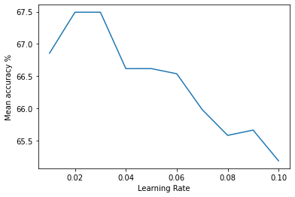
Evaluation
Gradient | Accuracy | Dropped
GB1 | 0.644692063 | None
GB2 | 0.655028571 | High, Low, SPY High, SPY Low
GB3 | 0.651834921 | High, Low, SPY High, SPY Low, Other, Quarter1, Quarter2, Quarter3, Quarter4
GB4 | 0.647853968 | Quarter1, Quarter2, Quarter3, Quarter4
Gradient Boosting
GB2 with Learning Rate
learning rate | mean accuracy
0.1 | 65.502857
0.11 | 64.307937
0.12 | 64.309206
0.13 | 63.909841
0.14 | 63.274921
0.15 | 62.95746
0.16 | 62.635556
0.17 | 63.910476
0.18 | 62.083175
0.19 | 62.00127
0.2 | 61.919365
GB3 with Learning Rate
learning rate | mean accuracy
0.01 | 66.854603
0.02 | 67.491429
0.03 | 67.491429
0.04 | 66.615238
0.05 | 66.615873
0.06 | 66.535873
0.07 | 65.979048
0.08 | 65.579048
0.09 | 65.660952
0.1 | 65.183492

Slide 14
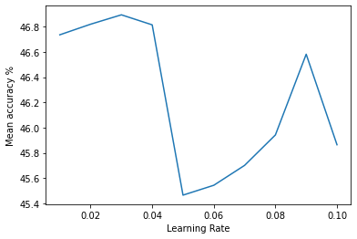
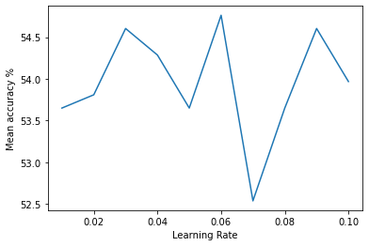
Evaluation
Gradient Boosting (No SPY Next Day)
Train Accuracy
Test Accuracy
learning rate | mean accuracy
0.01 | 46.734603
0.02 | 46.818413
0.03 | 46.892698
0.04 | 46.813333
0.05 | 45.466032
0.06 | 45.544127
0.07 | 45.701587
0.08 | 45.942222
0.09 | 46.580952
0.1 | 45.864762
learning rate | mean accuracy
0.01 | 53.650794
0.02 | 53.809524
0.03 | 54.603175
0.04 | 54.285714
0.05 | 53.650794
0.06 | 54.761905
0.07 | 52.539683
0.08 | 53.650794
0.09 | 54.603175
0.1 | 53.968254

Slide 15
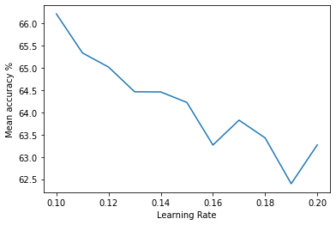
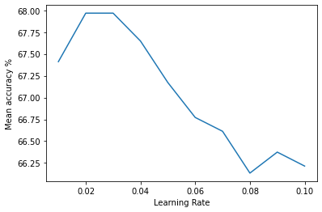
Evaluation
XGB | Accuracy | Dropped
XGB1 | 0.646253968 | None
XGB2 | 0.652609524 | High, Low, SPY High, SPY Low
XGB3 | 0.662146032 | High, Low, SPY High, SPY Low, Other, Quarter1, Quarter2, Quarter3, Quarter4
XGB4 | 0.654996825 | Quarter1, Quarter2, Quarter3, Quarter4
XGBoost
XGB3 with Learning Rate
learning rate | mean accuracy
0.1 | 66.214603
0.11 | 65.337778
0.12 | 65.020317
0.13 | 64.464762
0.14 | 64.460952
0.15 | 64.226032
0.16 | 63.267937
0.17 | 63.826667
0.18 | 63.428571
0.19 | 62.398095
0.2 | 63.271111
XGB3 with Learning Rate
learning rate | mean accuracy
0.01 | 67.411429
0.02 | 67.967619
0.03 | 67.967619
0.04 | 67.648254
0.05 | 67.172063
0.06 | 66.772063
0.07 | 66.613333
0.08 | 66.133968
0.09 | 66.374603
0.1 | 66.214603

Slide 16
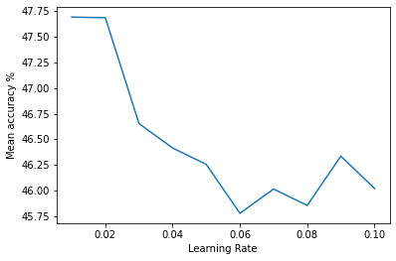
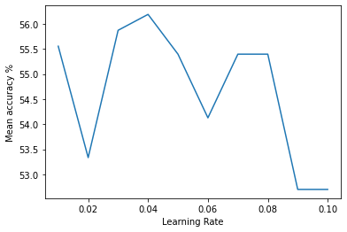
Evaluation
XGBoosting (No SPY Next Day)
Train Accuracy
Test Accuracy
learning rate | mean accuracy
0.01 | 47.69143
0.02 | 47.68571
0.03 | 46.6546
0.04 | 46.41651
0.05 | 46.25651
0.06 | 45.78032
0.07 | 46.01651
0.08 | 45.85714
0.09 | 46.33714
0.1 | 46.02222
learning rate | mean accuracy
0.01 | 55.55556
0.02 | 53.33333
0.03 | 55.87302
0.04 | 56.19048
0.05 | 55.39683
0.06 | 54.12698
0.07 | 55.39683
0.08 | 55.39683
0.09 | 52.69841
0.1 | 52.69841

Slide 17
Results
The best model with training data was only in the 40% range which is not very effective.
Moved up to mid 50s with test data but still not accurate enough

Slide 18
Conclusion
Though some models were accurate, they relied on SPY’s next day value which wouldn’t be available current day
The best model only being accurate 55% or so of the time isn’t very helpful for trading

Slide 19
Sources
https://www.kaggle.com/datasets/tarunpaparaju/apple-aapl-historical-stock-data
https://finance.yahoo.com/quote/SPY/history?period1=1267401600&period2=1582848000&interval=1d&filter=history&frequency=1d&includeAdjustedClose=true
https://finance.yahoo.com/calendar/earnings?symbol=AAPL
https://en.wikipedia.org/wiki/Timeline_of_Apple_Inc._products
https://www.businessofapps.com/data/apple-statistics/#:~:text=Share-,iPhone%20statistics,for%2050%25%20of%20its%20revenue

