Slide 1
Music Genre Classification
& Recommendation
Made by :
Satvik Maheshwari - 102003283
Sundaram Srivastava - 102183036

Slide 2
Introduction:
There are apparently 1264 micro-genres of popular music
Genre recognition is a way to recognize/predict the genre with the help of the audio tracks and the feature datasets.
The internet has huge collection of multimedia data for the purpose of sharing and online browsing, this results in the need for a unambiguous way of identifying the data description based on a fraction of available information.
Digital music databases cannot be easily searched through.
We propose a genre prediction strategy that examines genre distribution and applies the analysis models based on various features of music audio.

Slide 3
About Dataset…
Music. Experts have been trying for a long time to understand sound and what differentiates one song from another. How to visualize sound. What makes a tone different from another.
This data gives the opportunity to do just that.
We have used the GTZAN dataset from Kaggle.
Dataset includes a balanced collection of 10 genres with 100 audio files each, all having a length of 30 seconds and it’s csv file containing all the features.

Slide 4
Python Libraries for Music Genre Classification
NumPy:
Fundamental package for scientific computing in python
Using this, mathematical and logical operations can be performed.
Pandas:
Used for working with datasets.
has functions for analysing, cleaning, exploring and manipulating data.
Scikit-learn:
Features various classification, regression and clustering algorithms.
Designed to interoperate with NumPy and SciPy.
Librosa:
Python package for music and audio analysis.
Helps to represent the audio files in time and frequency domain using various plots.

Slide 5
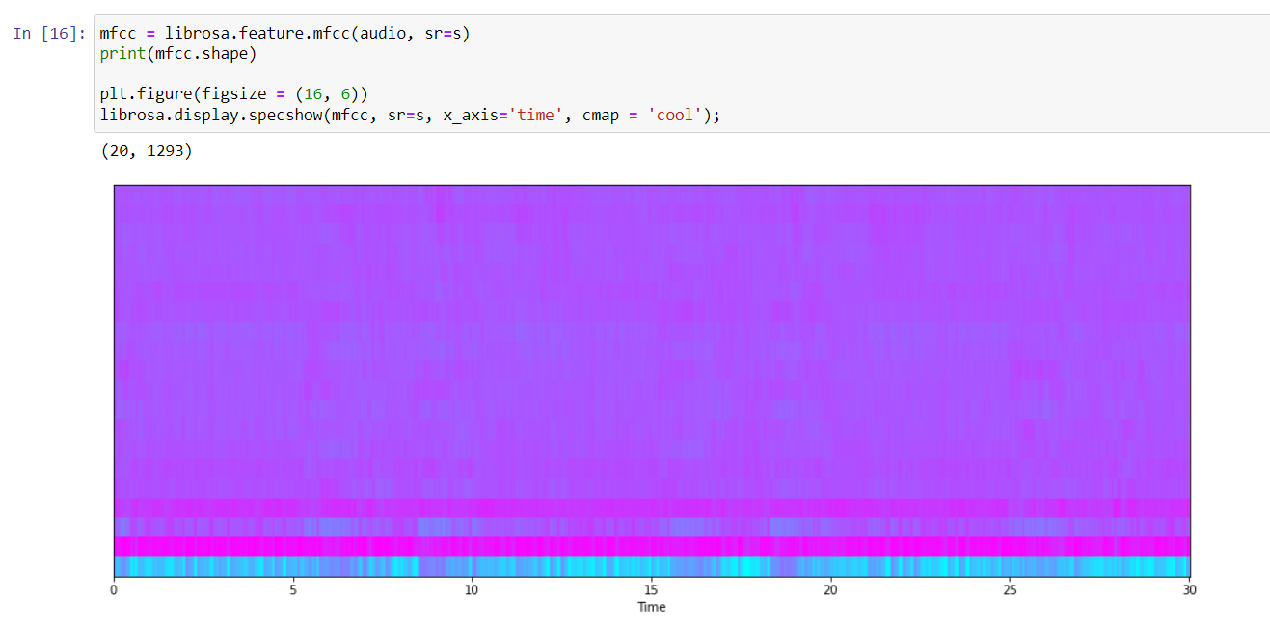
MFCC:
MFCC stands for Mel- frequency cepstral coefficients.
It represents the short-term power spectrum of a sound, based on linear cosine transform.
It is the most commonly used feature extraction used in automatic speech recognition.

Slide 6
KNN
The principle machine learning technique we utilized is K- nearest neighbours.
KNN is based on the concept of feature similarity
It is a lazy learning algorithm, which doesn’t have a specific training stage and uses all the information for training while classification.

Slide 7
Working of KNN Algorithm:
Step 1: Load the dataset and choose the value of K
Step 2: Calculate the distance between test data and each row of the training data.
Step 3: Based on the calculated distance, sort training data rows in ascending order
Step 4: Choose top K rows from the sorted array.
Step 5: Assign a class to the test point based on the most frequent class of these rows, if
problem is or classification type or take mean of the target feature of the selected
rows if problem is related to regression.

Slide 8
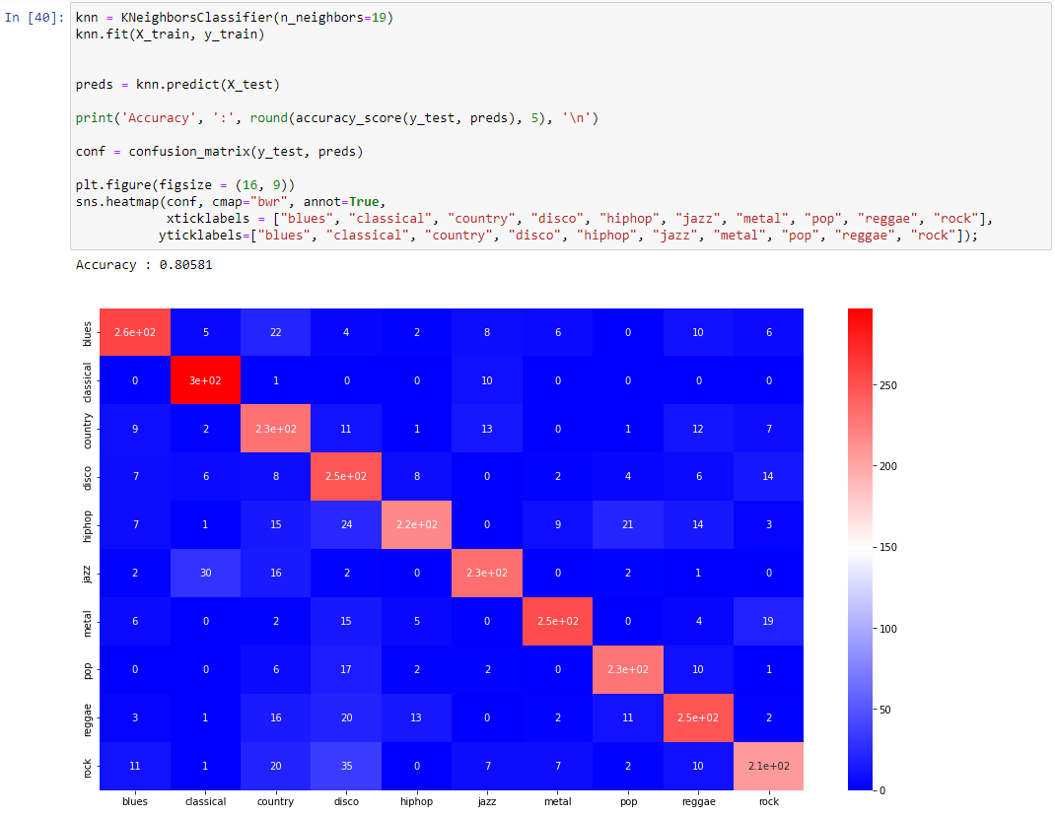
Accuracy and Confusion Matrix of KNN

Slide 9
Thank You

