Slide 1


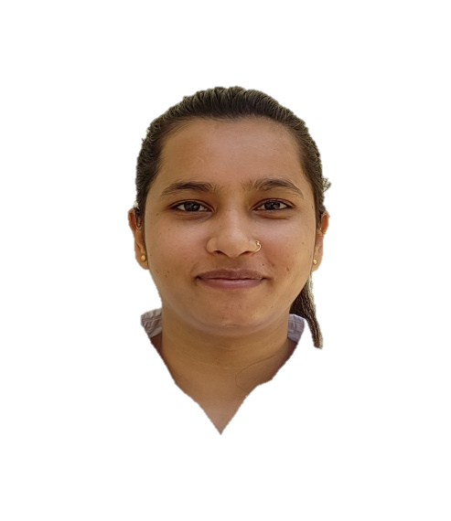
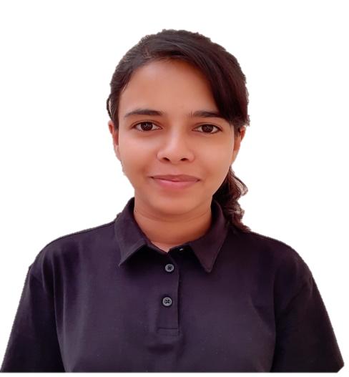
AAKRITI SHARMA
CSE
RASHMI KUMARI
CSE

