Slide 1
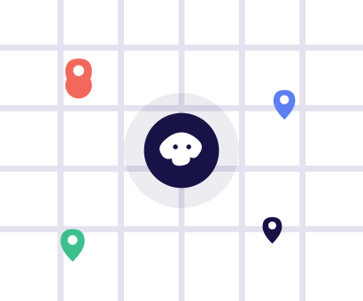

OPTIMAL PATH
CLEARLANE
AI
For Smarter Streets
Expanding visibility, prioritization, and response through real traffic data.
Flipkart GridLock Hackathon 2.0 — Round 2

Slide 2
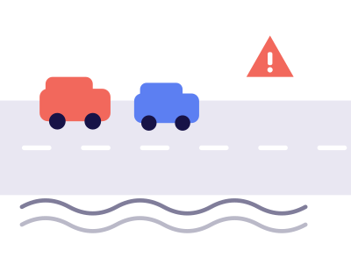
OPTIMAL PATH
BENGALURU'S TRAFFIC
POLICE ARE FLYING BLIND
They write over 3 lakh parking tickets every season — but have no way to know
which ones are actually causing traffic jams. Officers patrol the same routes every
day, guessing where the problem is, with no system telling them where to go.
No Hotspot Map
Reactive Patrols Only
Zero Prioritization

Slide 3


OPTIMAL PATH
WHAT IF THE DATA
COULD TELL THEM
WHERE TO GO?
We built an AI system that reads real violation records and automatically finds
the worst traffic hotspots in the city — then tells officers exactly where to go,
when, and how many people to send.

Slide 4
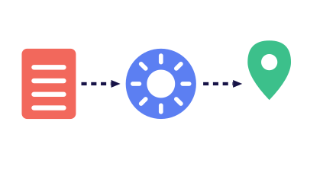
OPTIMAL PATH
FROM MESSY DATA
TO A CLEAR ACTION PLAN
1
Real police records
3 lakh+ raw violation rows from Bengaluru Traffic Police
2
AI finds the patterns
Where, when, and how badly each spot is blocking traffic
3
A live map anyone can read
Color-coded zones, no spreadsheet required
4
A ranked to-do list
Exact officer count and time window, per zone

Slide 5
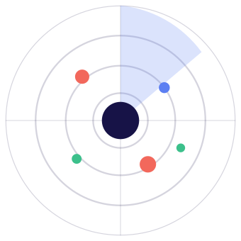
OPTIMAL PATH
THE AI DOES THE
HARD THINKING FOR YOU
Hotspot Finder
Groups thousands of violations into ~179 real trouble zones
Danger Score
Rates every zone 0–100 on how badly it's hurting traffic
48h Forecast
Predicts where problems get worse, two days ahead
Anomaly Alerts
Flags unusual spikes a human would never spot in spreadsheets

Slide 6

OPTIMAL PATH
NOT JUST CHARTS —
ACTUAL INSTRUCTIONS
Turning raw insight into a real enforcement plan.
01
Priority Engine
Ranks the top 10 zones that need attention right now
02
Officer Count + Time
Exact number of officers and the time window to deploy
03
Cascade Awareness
Shows how a jam in one area spills into nearby streets

Slide 7

OPTIMAL PATH
JUST ASK IT
No dashboards to learn — just ask a question.
"Which area needs officers right now?"
Answers grounded only in real data — never makes numbers up
Can't be tricked into answering random off-topic questions
Also auto-writes daily/weekly reports, downloadable as a PDF

Slide 8
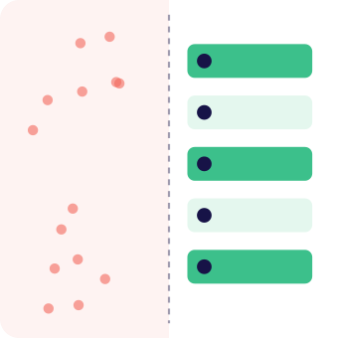




OPTIMAL PATH
A FEW MORE
THINGS IT DOES
Repeat-Offender Spotting
Side-by-Side Comparison
Finds vehicles that break the rules over and over
Compare any two areas at a glance
Trend Tracking
Day Replay
Shows if a zone is getting better or worse over time
Replays a typical day, hour by hour, like a time-lapse

Slide 9

OPTIMAL PATH
BUILT TO
ACTUALLY WORK
Real engineering, not just a hackathon prototype.
AI & Data
Python · pandas · scikit-learn · Prophet · XGBoost
Backend
FastAPI · Groq AI · 15 live endpoints
Frontend
React · TypeScript · Live interactive map
Live Now
Deployed on Render + Vercel, not just a laptop demo

Slide 10
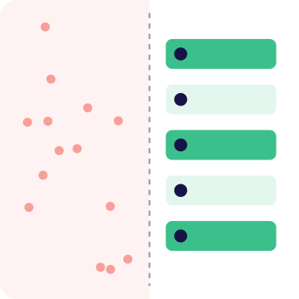
OPTIMAL PATH
FROM REACTING
TO PREDICTING
Evidence, Not Guesswork
Police stop guessing and start acting on real data
Fully Explainable
Every recommendation traces back to a real record — no black box
Honest by Design
We clearly flag what's real data vs. placeholder data — no faking results

Slide 11

OPTIMAL PATH
OPTIMAL PATH
Three builders, one pipeline.
SS
Shitanshu Singh
Team Optimal Path
MS
Md Sajjan
Team Optimal Path
DR
Divyanshu Raj
Team Optimal Path

Slide 12



OPTIMAL PATH
THANK YOU FOR
YOUR ATTENTION
Any questions?
Live Demo https://clear-lane-ai.vercel.app/
GitHub github.com/sarcaxticlarka/ClearLane-AI

