Slide 1
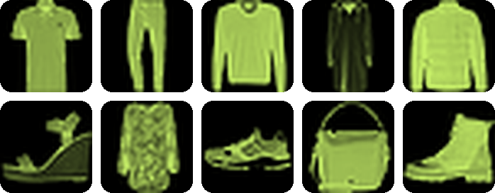


Clothing Category
Recognition
Do handcrafted image features (HOG) beat raw pixels for classical machine learning? A study on 70,000 clothing images.
Fashion-MNIST
10 classes · 28×28 pixels · 4 models · 3 feature sets
Project 11 · Phase 1
Notes:
Introduce the project. We classify small clothing images and test whether a fixed descriptor (HOG) improves classical machine learning compared with raw pixels. This is Phase 1; Phase 2 adds a CNN.

Slide 2

The problem we solve
Do fixed descriptors beat raw pixels, and for which models?
The need
The gap
The goal
A small shop must tag every product photo with a category.
Doing it by hand is slow and inconsistent.
Flattening pixels forgets which pixels are neighbours.
HOG fixes the representation before any model sees an example.
Compare 4 classic models on 3 representations: accuracy, macro-F1, per-class recall, model size and speed.
Notes:
Three points: the need (automatic tagging), the gap (pixels lose neighbourhood structure), and the goal (a fair comparison on accuracy and cost).

Slide 3
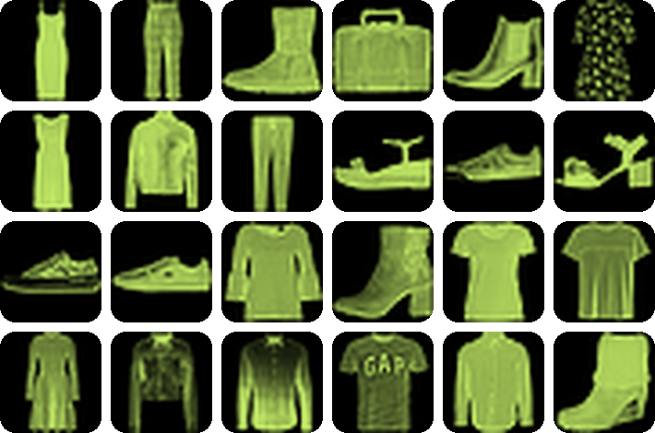
The data: Fashion-MNIST
70,000
28 × 28
grayscale images
pixels per image
10
60k+10k
classes, 10% each
official train + test
Validation = 20% of train only (stratified). Test is used once.
Notes:
Fashion-MNIST by Zalando: 60,000 training and 10,000 test images, 10 balanced classes. The official split is kept; validation images come from the training set only.

Slide 4
Tools we used
NumPy
scikit-image
scikit-learn
Reads the IDX files, scales pixels to [0,1], array maths
skimage.feature.hog builds the HOG descriptor
4 classifiers, PCA, t-SNE, metrics, stratified split
SciPy
Matplotlib · Seaborn · Plotly
Streamlit
Sobel edges, KS test, chi-square for McNemar
EDA and result figures, interactive plots
Interactive presentation and live demo app
Code layout: src/ (eda · features · models · analysis) scripts/ notebooks/ app/ report/
Notes:
Everything is Python. Scikit-learn provides the models and metrics, scikit-image the HOG descriptor, and Streamlit our interactive demo. The repo is modular: one module per stage.

Slide 5
How we did the EDA
01
02
03
04
Audit
Distributions
Structure
Embeddings
md5 hash of every image finds duplicates; checks for NaN, range, blank images, train/test overlap.
Class counts, intensity histogram, brightness and bounding box per class, KS test train vs test.
Pixel correlation vs distance, ANOVA F-score per pixel, distance between class-mean images.
PCA on pixels, then t-SNE on PCA-50 for 5,000 images.
0 problems found
Balanced · no shift · 50% zeros
Neighbours r = 0.75
95% variance in 187 PCs
Notes:
Our EDA has four steps. (1) Audit: hashing finds zero duplicates and zero train/test overlap. (2) Distributions: balanced classes, same distribution in train and test, half the pixels are zero. (3) Structure: neighbouring pixels correlate. (4) Embeddings: PCA and t-SNE.

Slide 6
Neighbouring pixels are related
0.75
adjacent-pixel correlation
0.16
same pixels, shuffled positions
Flattening ignores this layout. HOG uses it.
Notes:
We measured correlation between pixel pairs as a function of distance. Adjacent pixels correlate at 0.75; if we shuffle positions it drops to 0.16. So spatial structure is real, and flattening throws it away. This motivates HOG.

Slide 7
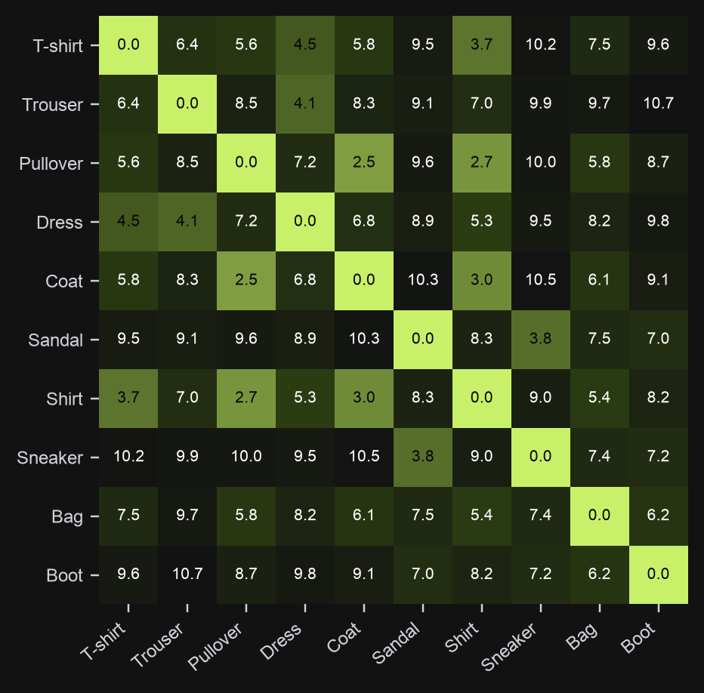
EDA predicts the hard classes
Pullover – Coat
2.48
Pullover – Shirt
2.68
Coat – Shirt
3.02
T-shirt – Shirt
3.72
Small distance = similar look. We expect errors here.
Notes:
Distance between average images of each class. The four closest pairs are all in the upper-body group: pullover, coat, shirt, T-shirt. We predicted this before training any model.

Slide 8
Feature engineering: 3 representations
Raw pixels · 784-d
HOG · 864-d
HOG + stats · 880-d
Image flattened row by row, scaled to [0,1].
The baseline.
Directions of edges in small 4×4 cells, normalised in 2×2 blocks.
HOG plus 16 simple facts: width, height, symmetry, edge density.
Same labels, same split, same [0,1] scaling. Only the representation changes. HOG is computed on upright images (orientation verified in EDA).
Notes:
Three representations. Pixels: 784 numbers. HOG: 864 numbers. HOG plus 16 interpretable shape statistics: 880 numbers.

Slide 9
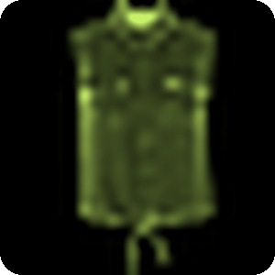
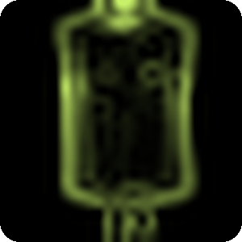
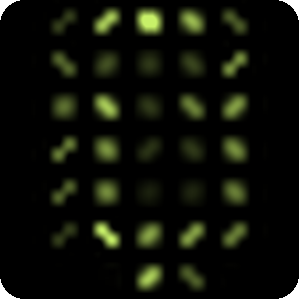
How HOG works
4 steps
Gradients gx, gy; magnitude m = √(gx²+gy²)
7×7 cells of 4×4 px, each a 6-bin histogram weighted by m
2×2-cell blocks, L2-Hys normalised
36 blocks × 4 cells × 6 bins = 864
28×28 input
gradients gx, gy
HOG orientation map
skimage.feature.hog(img,
orientations=6, pixels_per_cell=(4,4),
cells_per_block=(2,2), block_norm='L2-Hys')
→ 864 numbers per image
Notes:
HOG pipeline: compute image gradients, bin their directions inside 4 by 4 cells weighted by magnitude, normalise over 2 by 2 blocks to be robust to brightness, then concatenate. With our settings the descriptor has 864 numbers.

Slide 10
Choosing the HOG settings
Chosen: 864-d
6 bins · 4×4 cells · 2×2 blocks. Best score under a 2,000-number budget; finer cells are slightly better but too slow for kNN and SVM.
+16 shape statistics
Bounding box, aspect ratio, centroid, symmetry, edge density. Scaled to [0,1].
Notes:
We tried 36 HOG settings with a fast logistic-regression probe on the validation set. Smaller cells score a bit higher but give 4,000 to 8,000 numbers, which slows kNN and SVM. We picked 864 numbers under a 2,000 budget. We also built 16 interpretable shape statistics.

Slide 11
A fair experiment
Official split
Validation
Tune
Refit + test
60k train · 10k test
20% of train, stratified
grid search on validation
train+val, test once
No leakage
Equal effort
Full report
Test images never touch tuning. Scalers are fitted on training data only.
Same seed (42), scaling and grid budget for every feature set.
Accuracy, macro-F1, per-class recall, parameters, inference time.
Notes:
The protocol avoids leakage: validation only from training, hyper-parameters chosen on validation, test used once after refitting on train plus validation.

Slide 12
Four classic models
Logistic Regression
k-Nearest Neighbours
Random Forest
SVM (RBF)
LogisticRegression + StandardScaler
KNeighborsClassifier
RandomForestClassifier
SVC(kernel='rbf')
C: 0.001 … 1
k: 3, 5, 9 · uniform or distance weights
300 trees · depth 20 or none · min leaf 1, 2
C: 1, 5, 20 · gamma='scale'
A linear boundary. Tiny and fast.
Compares with stored images.
Many decision trees vote.
A curved margin. Tuned on 15k images.
Notes:
The four models, with the scikit-learn class and the grid searched on the validation set. SVM was tuned on a 15,000-image subsample because it is slow, then refit on all 60,000.

Slide 13
Results: test accuracy (%)
91.3%
best: SVM + HOG, macro-F1 0.913
84.6%
lowest: Logistic Regression on pixels
Notes:
All 12 experiments on the 10,000 test images. SVM with HOG is best at 91.3 percent. The 95 percent bootstrap interval for the best model is 90.8 to 91.9 percent.

Slide 14
Does HOG help? Mostly yes
Logistic Reg.
kNN
SVM-RBF
Random Forest
+4.0
+2.1
+1.4
+0.2
points · p < 0.001
points · p < 0.001
points · p < 0.001
points · p = 0.49 (no gain)
Why? A linear model cannot build edge features itself, so HOG helps it most. Random Forest already finds useful pixel splits. Tested with McNemar's test on the same 10,000 images.
Notes:
Accuracy gain of the best HOG variant over raw pixels for each model, with a McNemar test on the same test images. Three of four are significant. The random forest is unchanged.

Slide 15
Recall per class (SVM-RBF)
0.75
Shirt: hardest class (0.705 with pixels)
≥ 0.96
Trouser, Bag, Sandal, Sneaker, Ankle boot
Notes:
Per-class recall of the best pixel model and the best HOG model. HOG helps the four upper-body classes most, but Shirt still only reaches 0.75. Footwear, trousers and bags are above 0.96.

Slide 16
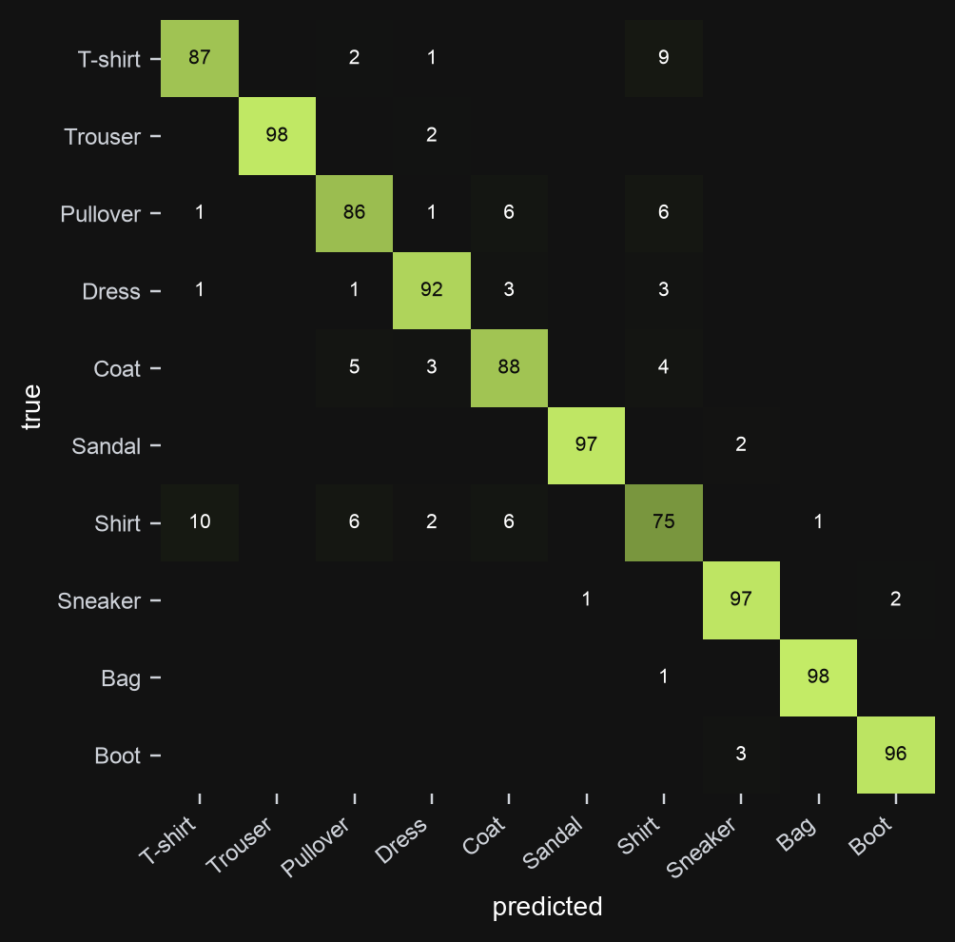
Where it still fails
~60% of all errors
stay inside T-shirt, Pullover, Coat, Shirt.
Shirt ↔ T-shirt
is the largest confusion for every model.
Why? 28×28
hides collars and buttons: 1–2 px wide.
Notes:
Confusion matrix of the best model, in row percentages. The remaining errors are in the upper-body group, as the EDA predicted. At 28 by 28 pixels, collars and buttons are only one or two pixels wide. This motivates the CNN in Phase 2.

Slide 17
Accuracy has a price
Model (HOG features) | Test accuracy | Speed per image | Numbers stored
Logistic Regression | 88.5% | 0.001 ms | 8.7 thousand
kNN | 87.7% | 0.27 ms | 51.8 million
Random Forest | 87.8% | 0.04 ms | 3.2 million
SVM (RBF) | 91.3% | 5.4 ms | 18.1 million
SVM is 2.8 points more accurate than Logistic Regression, but ~4,000× slower and ~2,000× larger. HOG itself adds 0.14 ms.
Notes:
Parameter counts and inference time as required by the project. Latency is single-threaded predict time per image; HOG extraction adds 0.14 ms.

Slide 18
Conclusions and next
HOG helps 3 of 4 models
Phase 2: small CNN
Significant (p < 0.001) for LogReg, kNN, SVM.
2–3 conv blocks with pooling
Dropout and early stopping
Same splits, same metrics
Can a CNN resolve the shirt group better than HOG?
Best classic model
SVM + HOG: 91.3% accuracy, 0.913 macro-F1.
Hard group remains
Shirt, T-shirt, Pullover, Coat cause ~60% of errors.
Notes:
Summary: HOG helps most models; SVM plus HOG is the best classic option; the hard group is the upper-body clothes. Limitations: HOG settings chosen with a probe model, one validation split. Phase 2 tests whether a CNN learns better features.

Slide 19
THANK YOU
VERY MUCH
Team T002 · Section C
Md Sajjan
2401010272
Sibtain Ahmed Qureshi
2401010454
Questions?
Syed Darain Qamar
2401010472
Abuzar Haideri
2401010024
Code, notebooks and report
github.com/sarcaxticlarka/fashions-mnist-project
Antik Mondal
2401010084
Faculty: Sumit Kumar, Indrapal
Notes:
Thank the evaluators and invite questions. Everything is reproducible from the GitHub repository.

