Slide 1
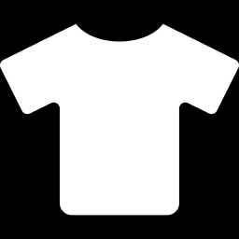
PROJECT 11 · AUTOMATIC CLOTHING CATEGORY RECOGNITION
Phase 2: Teaching a CNN
to See Clothes
From handcrafted features to a calibrated, reliable CNN
95.20%
480
1.28%
98.56%
final test accuracy
errors (SVM: 870)
calibration error
when confident
Team T002 · Newton School of Technology · Deep Learning
MD. Sajjan, Sibtain Ahmed Qureshi, Syed Darain Qamar, Antik Mandal, Abuzar Haideri
Notes:
Open with the headline: a compact CNN beats every classical model from Phase 1, with a statistically definitive margin, while being 60 times smaller and 8 times faster. Then promise the second half: how we turned a good model into a reliable final model.

Slide 2



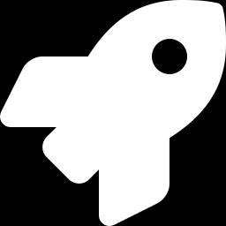

From handcrafted features to learned features
THE STORY IN ONE SLIDE
Phase 1
The ceiling
Phase 2
Phase 2 final
Classical ML + HOG features
74% of errors in 4 upper-body classes
CNNs learn features from raw pixels
Ensemble + calibration + abstain
Best: SVM-RBF 91.30%
Shirt recall only 75%
Best: CNN3Block-GAP 93.09%
Final: 95.20%
Takeaway Phase 2 broke the 91.3% ceiling, explained why, and finished with a model whose confidence can be trusted.
Notes:
Walk left to right. Phase 1 established the ceiling and showed where errors concentrate. Phase 2 replaces handcrafted HOG with learned convolutional filters. The final model is the last part of the talk.

Slide 3

Classical ML hit a ceiling at 91.3%
PHASE 1 RECAP
91.30%
best classical accuracy (SVM-RBF on HOG)
74%
of the SVM's errors are T-shirt, Pullover, Coat or Shirt
75.0%
Shirt recall — 1 in 4 shirts mislabelled
Takeaway Handcrafted HOG features cannot see the subtle collar and hem details that separate a Shirt from a T-shirt.
Notes:
Each bar is the best result for one classical model family on the 10,000 test images. Every family stays below 91.4%. The cards on the right show why: errors are concentrated in four visually similar upper-body classes.

Slide 4
Four CNNs in a 2×2 experiment
ARCHITECTURES
Our best network — CNN3Block-GAP
Input
Block 1
Block 2
Block 3
Global avg
pool
Output
1×28×28
32 filters
14×14
64 filters
7×7
128 filters
7×7
128 numbers
10 classes
Each block = two 3×3 convolutions + batch-norm + ReLU. Global average pooling replaces the big flatten layer → fewer weights, less overfitting.
No augmentation
Crop + flip augmentation
CNN2Block
(flatten, 422k params)
CNN2Block
CNN2Block-Aug
CNN3Block-GAP
(305k params)
CNN3Block-GAP-NoAug (new run)
CNN3Block-GAP ★ best
Takeaway Same 48k / 12k / 10k split as Phase 1 · every choice made on validation · test set used once.
Notes:
The top row is the network architecture. The grid below is the experiment: two architectures times augmentation on or off. The bottom-left cell is new in this revision - without it we could not tell whether depth or augmentation caused the improvement.

Slide 5



The GAP network was still improving when training stopped
RESULTS · TRAINING
Still climbing
CNN3Block-GAP's best epoch was its last (20). More epochs will likely help.
Under-trained
CNN2Block-Aug scores higher on validation than on training — it needed more epochs.
Overfits without augmentation
The GAP net without augmentation peaked at epoch 5 and was stopped at 10.
Takeaway Training budgets — not model limits — ended the best runs. So the final models get 40 epochs.
Notes:
x-axis: epochs; y-axis: accuracy on the 12,000 validation images. Violet keeps rising until the end. The orange dashed-style run (no augmentation) rises fast and then stalls - overfitting.

Slide 6
Depth + GAP only pays off together with augmentation
RESULTS · WHAT CAUSED THE GAIN?
How to read the 2×2
Augmentation on the shallow net: 92.16% → 91.41% (under-trained in 18 epochs)
Depth + GAP alone: 91.38% — overfits after 5 epochs
Both together: 93.09% — augmentation adds +1.71 pts to the GAP net
McNemar between the two GAP runs: p = 1.0×10⁻¹²
Takeaway Neither ingredient works alone: the deeper network needs augmentation to use its extra capacity.
Notes:
This is the new controlled experiment. Before it, depth, GAP and augmentation changed at the same time, so the gain could not be explained. The final models were then repeated with 3 seeds each.

Slide 7
Every class improved — Shirt gained the most (+10.4 pts)
ERROR ANALYSIS · PER CLASS
Shirt
+10.4 pts
75.0% → 85.4% — still the hardest
Pullover
+7.2 pts
85.6% → 92.8%
Coat
+6.0 pts
87.5% → 93.5%
Takeaway The residual ensemble finally closes most of the Shirt gap that handcrafted features and the first CNN left open.
Notes:
Classes are sorted from hardest (bottom) to easiest (top). Recall is the share of each class's 1,000 test images that the model labels correctly. Gains are versus the Phase 1 SVM.

Slide 8
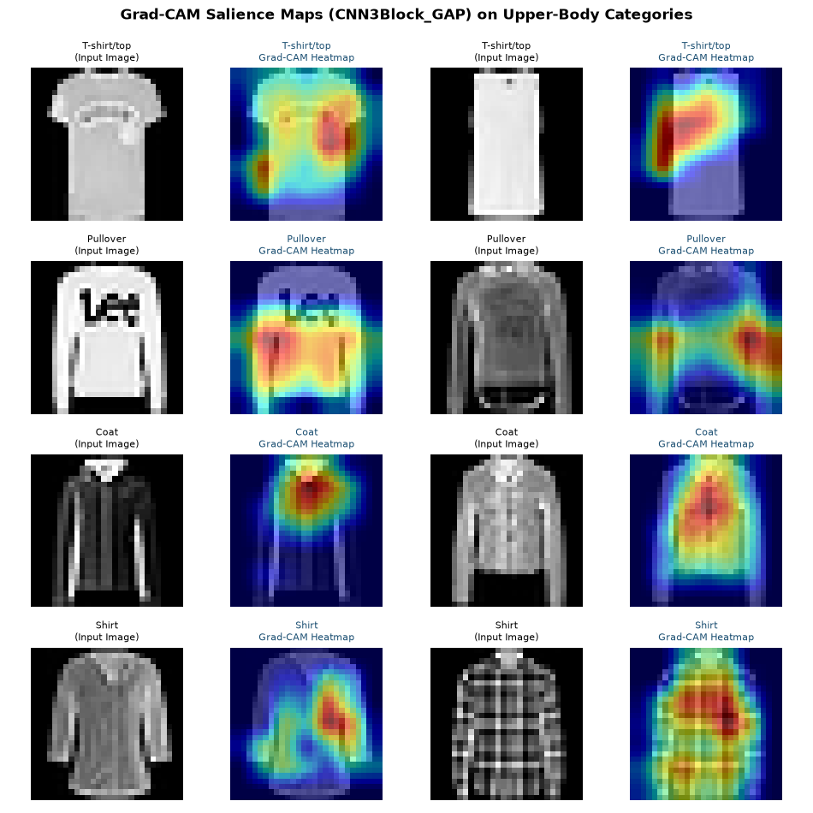

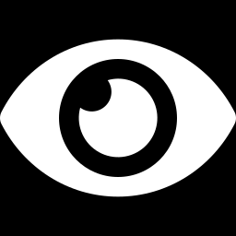

Grad-CAM: where does the CNN look?
EXPLAINABILITY
Red = image regions that pushed the network toward its answer.
Ignores the background
Heat sits on the garment, never on the black border.
Pullover: cuffs & waistband
Ribbed edges are a learned cue HOG could not isolate.
Some maps are diffuse
Checked Shirt and printed T-shirt light up everywhere — consistent with Shirt still being hard.
Needs measurement
8 hand-picked images are evidence, not proof — listed as a limitation.
Notes:
Be honest here: the earlier draft claimed activations sit squarely on collars. The maps show something more mixed. That honesty makes the rest of the results more credible.

Slide 9
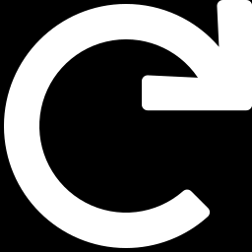

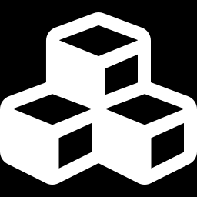

From a good model to a reliable one
FINAL MODEL
Longer + repeated
Residual network
Ensemble + TTA
Trustworthy output
40-epoch budget and 3 random seeds per model
ResNetSmall with Random Erasing and label smoothing
Average several nets and a mirrored copy of each image
Temperature-scaled confidence, abstain option, Shirt-aware rule
results stable across seeds
deeper without vanishing gradients
fewer random mistakes
know when to ask a human
Takeaway Every choice (which ensemble, temperature, Shirt rule, abstain threshold) was made on validation data only.
Notes:
These four upgrades address the weaknesses found in the first Phase 2 runs: under-training, a single seed, the Shirt problem and uncalibrated confidence.

Slide 10
Results hold across three random seeds
FINAL MODEL · ROBUSTNESS
CNN3Block-GAP (40 epochs)
93.80% ± 0.21
mean ± standard deviation over seeds
ResNetSmall
94.62% ± 0.13
mean ± standard deviation over seeds
Every run beats the Phase 1 SVM (91.30%) and the spread between seeds is small — the improvement is not luck.
Takeaway With 40 epochs the GAP network itself improves over the first 20-epoch run — it really was under-trained.
Notes:
Each bar is one complete training run. Different seeds change the random initialisation and the order of training images.

Slide 11
How each improvement adds accuracy
FINAL MODEL · STEP BY STEP
95.20%
final test accuracy
480
errors of 10,000 (SVM: 870)
94.78%–95.62%
95% confidence interval
Takeaway Final model vs Phase 1 SVM: McNemar p = 6.7e-50; vs first CNN: p = 2.9e-27.
Notes:
Read left to right: each bar keeps all previous improvements and adds one more. TTA = test-time augmentation: the model also looks at a mirrored copy of the image and averages both answers.

Slide 12
Calibrated confidence: error 7.6% → 1.3%
FINAL MODEL · CALIBRATION
7.64%
calibration error before (ECE)
1.28%
calibration error after temperature scaling
T = 0.65
temperature fitted on validation data
Takeaway 88% of images sit in the top group, where claimed and actual agree; the small middle groups stay a bit over-confident.
Notes:
ECE, expected calibration error, is the average gap between the confidence the model claims and how often it is actually right. Temperature scaling divides the scores by one number, chosen on validation data; it never changes which class is predicted.

Slide 13
Let the model say “not sure” on the hardest images
FINAL MODEL · KNOWING WHEN TO ASK
87.7%
of images answered automatically
98.56%
accuracy on those images
26%
of the images sent to a human are Shirts
Takeaway Threshold chosen on validation for 99% accuracy: below 95% confidence, a human checks the image.
Notes:
Moving left on the curve, the model answers fewer images but is right more often. In a catalogue-tagging system the low-confidence images would go to a person.

Slide 14
Phase 1 vs first CNN vs final Phase 2 model
FINAL MODEL · SCORECARD
Measure | SVM-RBF (HOG) · Phase 1 | CNN3Block-GAP · first | Final Phase 2 model
Test accuracy | 91.30% | 93.09% | 95.20%
Errors (of 10,000) | 870 | 691 | 480
Shirt recall | 75.0% | 76.3% | 85.4%
Calibration error (ECE) | n/a | not measured | 1.28%
Can abstain when unsure | no | no | yes · 98.56% on 87.7%
Stored numbers | 18.1M | 0.30M | 2.09M
CPU time per image | 5.36 ms | 0.68 ms | 11.3 ms
Takeaway Most accurate and the only model with calibrated confidence — at 11.3 ms per image, still real-time.
Notes:
Be upfront about the cost: an ensemble with test-time augmentation runs several networks twice. It is slower than a single CNN but still in the millisecond range.

Slide 15
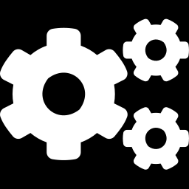
What this project does not show
HONEST LIMITS
Shirt is still the hardest class
Grad-CAM is qualitative
Even the final model misses some shirts; the abstain option routes most of them to a human.
Heat-maps on hand-picked images are evidence, not a measured explanation.
Clean, centred thumbnails
Small hyper-parameter search
Real shop photos (backgrounds, angles, colour) were not tested; the demo's upload is only indicative.
Learning rate, width and augmentation strength were not tuned exhaustively.
Takeaway Naming the limits is part of the result: every claim in this deck is backed by a measured number.
Notes:
Close the technical part by stating clearly what the results do and do not cover.

Slide 16
THREE THINGS TO REMEMBER
1
Learned features beat handcrafted ones
95.20% vs 91.30% for the best Phase 1 model — 390 fewer errors.
2
We know why it works
Depth + GAP only pay off with augmentation; results hold over 3 seeds.
3
The final model knows when it is unsure
Calibrated (ECE 1.28%) and 98.56% accurate on the 87.7% of images it answers.
Thank you — questions?
Live demo: streamlit run app/streamlit_app.py
Notes:
Close with the three takeaways, then switch to the Streamlit demo: page 2 lets you try any test image or upload a photo.

