Slide 1
Moving and Maneuvering

Slide 2
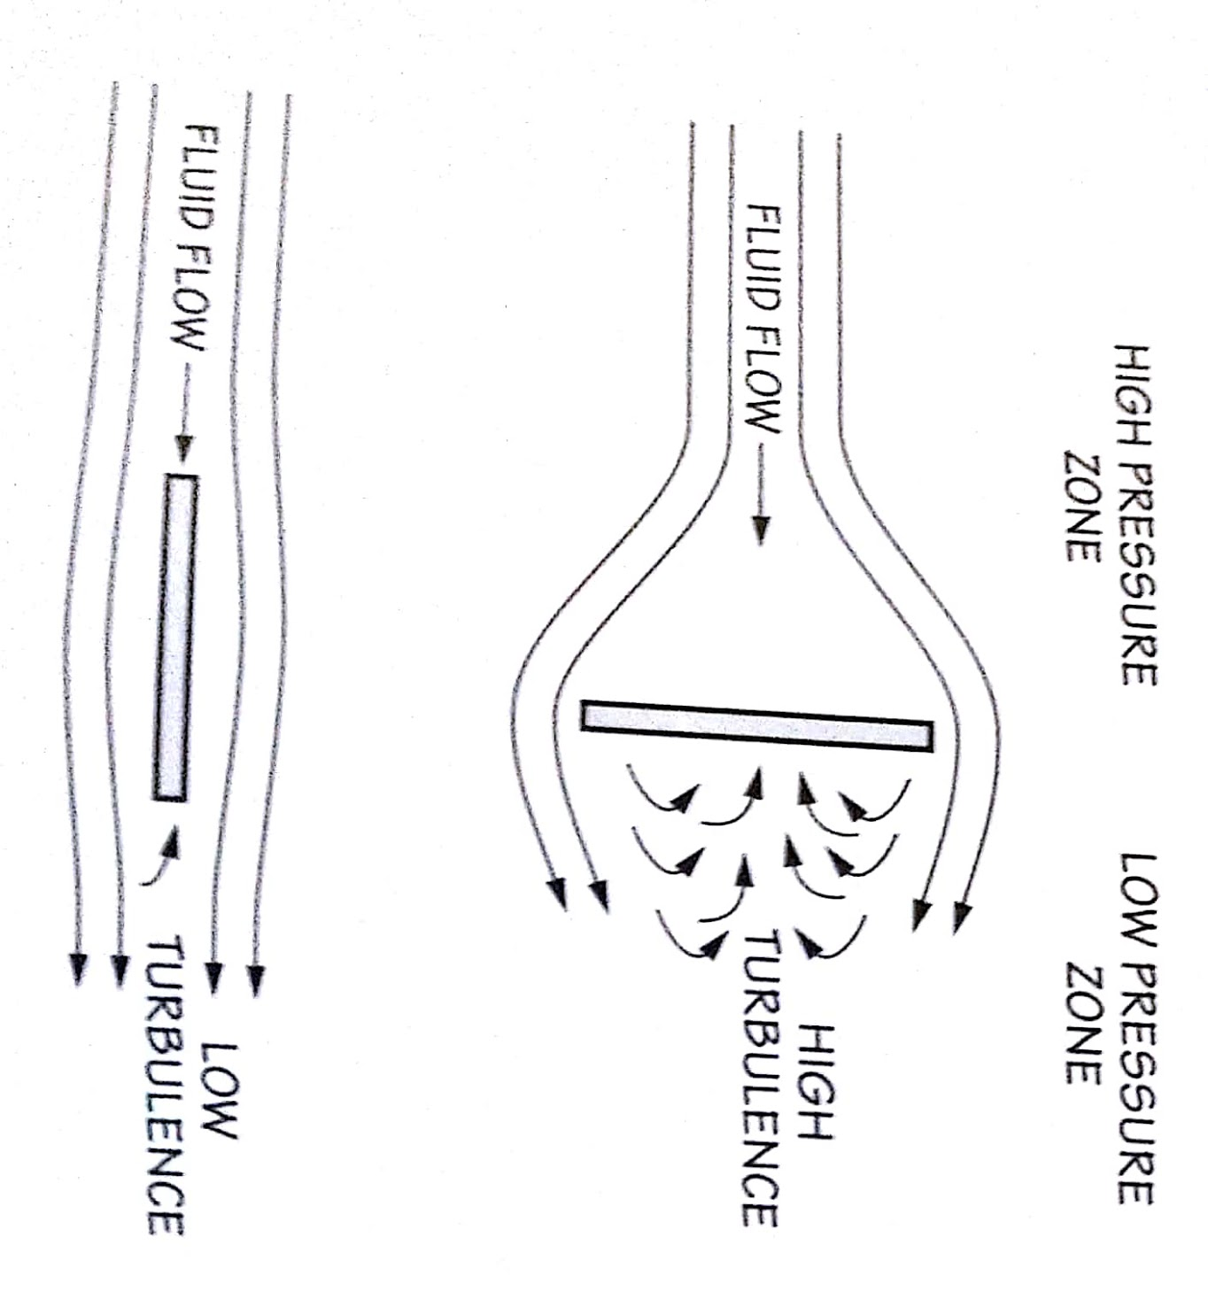
Two types of drag
Viscous Drag
Skin Friction Drag
Negligible for ROV
Pressure drag
Cause by the mass of fluid
Dominates in big objects
Creates high and low pressure zones that causes turbulence

Slide 3

Theoretical Approach
$$D=\frac{1}{2} p C_{d} A U^{2}$$
D = Drag (in Newtons)
P = Fluid Density (kilograms per cubic meters)
1,000 kg/m^3 for water
Cd = Drag Coefficient
1 for ROV
A = Frontal Area (Square meters)
Estimate by finding frontal area of smallest box the ROV can fit into
U = Speed through Fluid (meters per second)

Slide 4
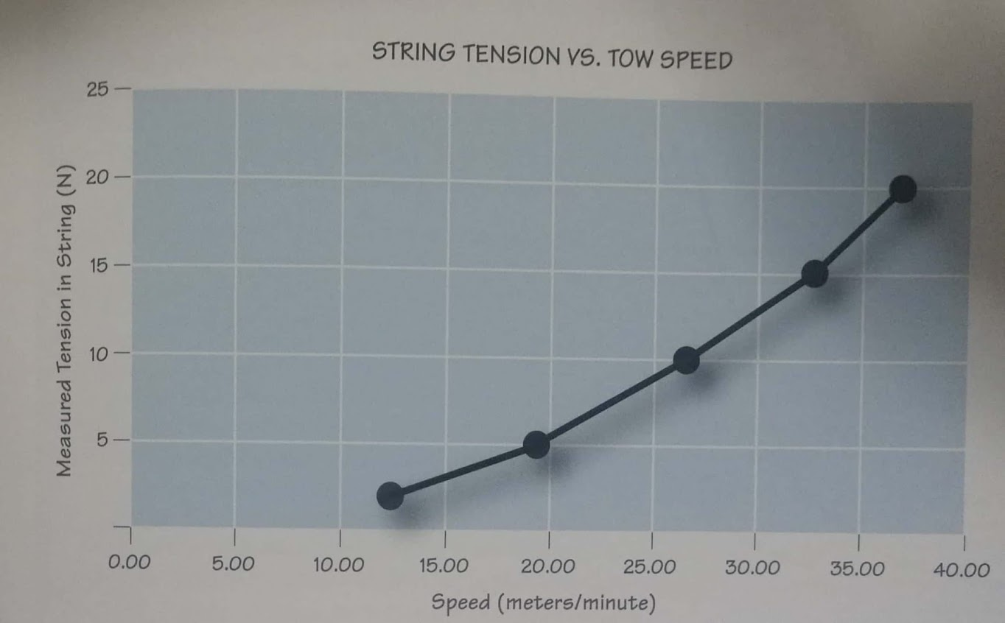
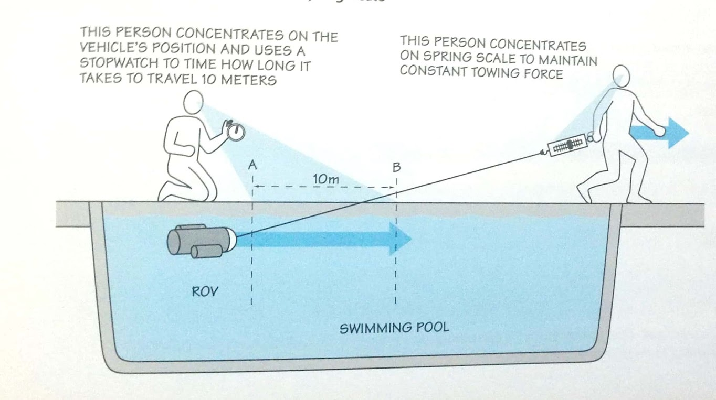
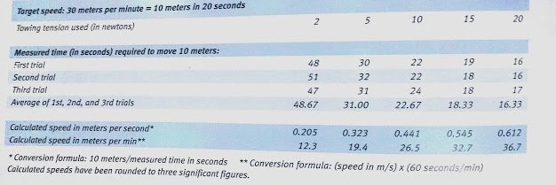
Empirical Approach

Slide 5
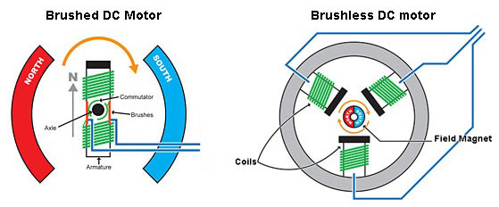
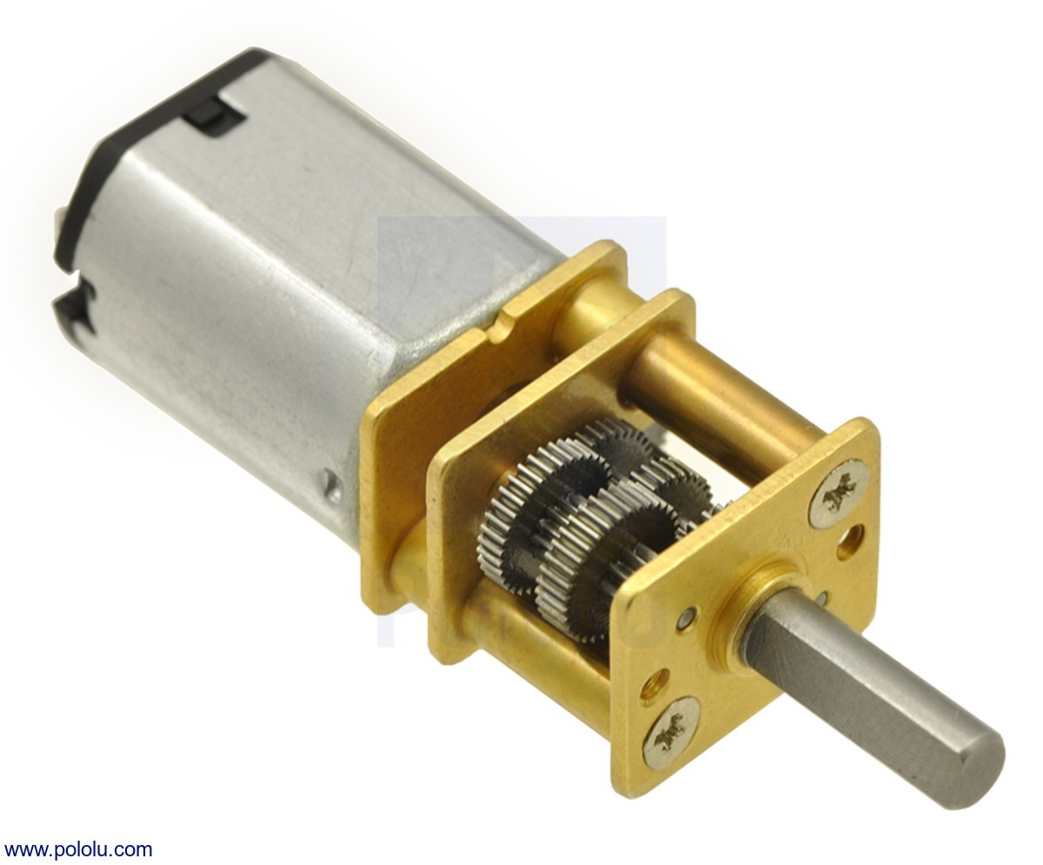
Types of motor
Brushed DC motors
Least Expensive
Most common on ROVs
Brushless motors
More reliable
More expensive
Stepper motors and Servo Motors
Precision control
Gear Motors
Gears attached to shaft to increase torque

Slide 6
Brushed vs Brushless Motors
 | Brushed (BDC) | Brushless (BLDC)
External Motor Controller | Optional | Required
Price | Less Expensive | More expensive
Efficiency | 75 – 80% | 85 – 90%
Sparkles Commutator | No | Yes
Heat Dissipation | No | Yes
Reliability | Good | Excellent

Slide 7
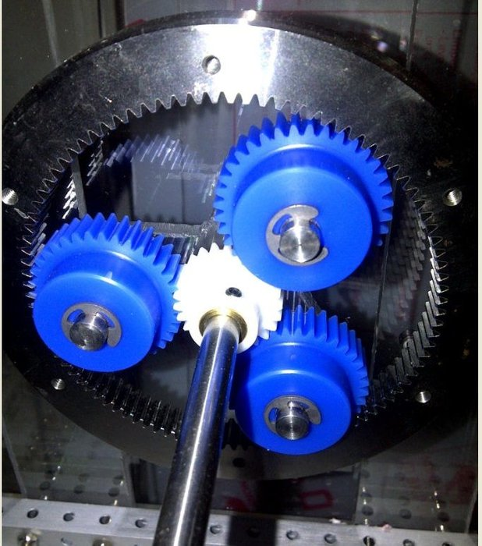
Gears
Increase Torque at Lower Speeds
Gear Ratio
Signify the increase in Torque
Planetary Gears
Planets orbiting a star
Beneficial for thrusters and claws
Recommend ratio: 4 to 8

Slide 8
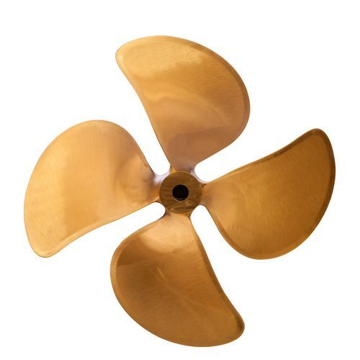
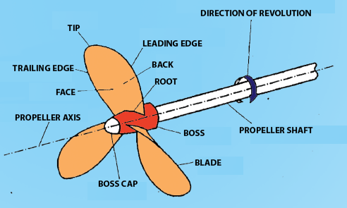
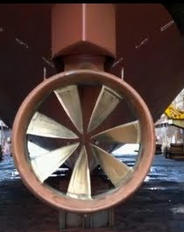
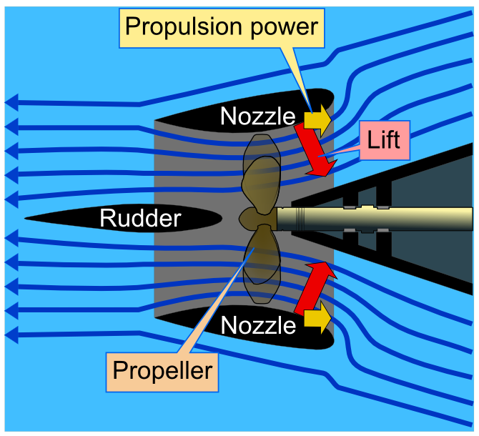
Propellers
Most common device used in ROV
Creates a strong pressure difference that accelerate water backwards
Third law pushes ROV forward
Standard
Kort Nozzles
Have a special shaped housing unit around the propellers
Hubless propellers
Have no center shaft

Slide 9
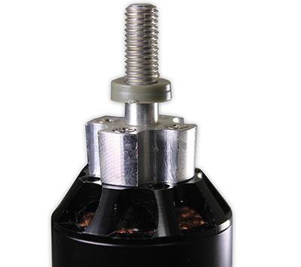
Properties to pay attention to
Diameter
Pitch: Distance the angle of the blades would move the propeller forward after one full rotation
Number of blades
Lower blades are more efficient
More blades can push or pull harder at lower speeds
Blade Shape:
Long, Skinny blades are more efficient under light loads, but can achieve high force
Short, wide blades are less efficient but can achieve higher forces
Method of Attaching Prop Hub to Shaft: Easily attachable and should fit snugly

Slide 10
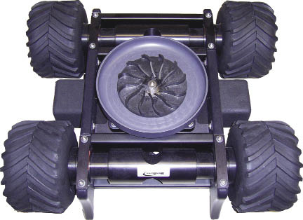
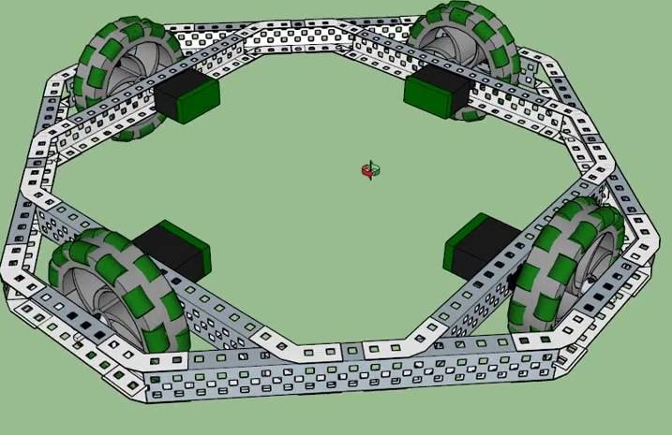
Thruster Arrangement

Slide 11
Benefits and Drawbacks
H - Drive |  | X - Drive
Benefits | Drawbacks | Benefits | Drawbacks

