Slide 1
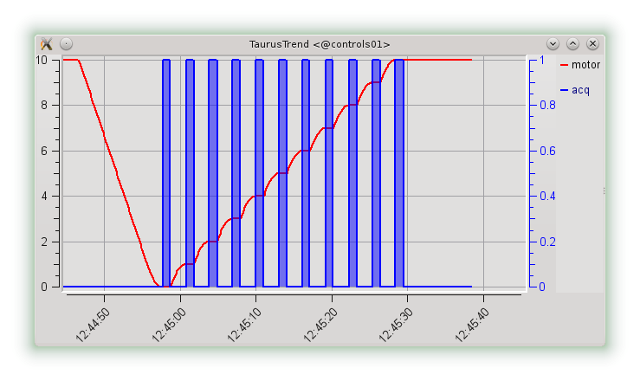
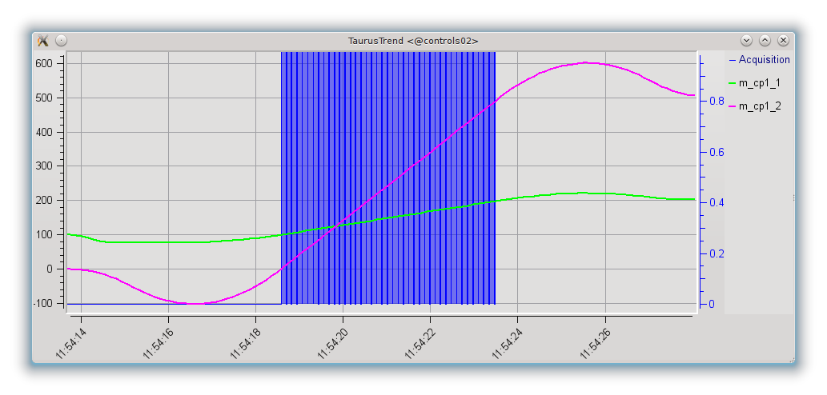
Continuous Scans
Motion & acquisition during the step scan.
Motion & acquisition during the continuous scan
Continuous scans give many benefits, but also their implementation is challenging.
Numerous ad-hoc implementations were developed over years, but they are hard to reuse...
What do we focus on?
  Abstract access to the hardware
  Generic synchronization description (hardware & software; time & position)
  Common experiment configuration (step scan & continuous scan)
  Transparent user experience with the scans: scan inputs and outputs.

Slide 2
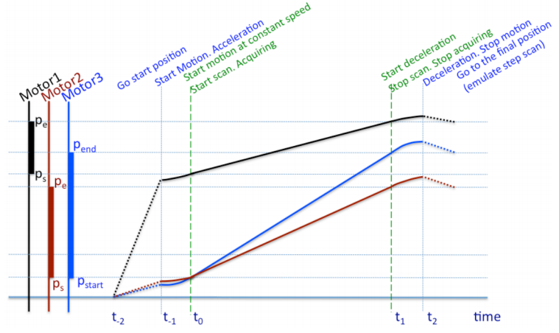
Motion

Slide 3
Coordination & Actions
Measurement Group contains channels and synchronizers
Coordination using acquisition and synchronization actions
Measurement Group
Synchronization Action
Acquisition Action
Hardware Acquisition Action
TG Ctrl#1
SOFTWARE
SYNCHRONIZER
Ch#1
Ch#2
Ch#1
Software Acquisition Action
ExpChan Ctrl#1
ExpChan Ctrl#2
ExpChan Ctrl#3
ExpChan Ctrl#4
Ch#1
Ch#2
Ch#1
Ch#1
Ch#2
Ch#1
Ch#2

Slide 4
Latency time
Total
Active
user latency
ctrl#1 latency
Delay
ctrl#2 latency
Initial
Initial
MG latency time – maximum of its controller latency times
Controller’s latency time – time necessary for rearming
Affects directly total interval (time) and indirectly motors' velocities.

Slide 5
Synchronization description
Repeats
Repeats
Total
Total
Active
Active
Delay
Initial
Initial
[{Delay: {Time: 0.3, Position: 400},
Initial: {Time: None, Position: 0},
Active: {Time: 0.1, Position: 10},
Total: {Time: 0.15, Position: 15},
Repeats: 1000},
...]
Group

