Slide 1

Spock Logging
Teresa Núñez
DESY Photon Science
Motivation for an additional implementation
Default Spock loggings
Additional implementation
Sardana Workshop
ELI Beamlines, 05-06-18

Slide 2
Motivation
Store in a file the spock session as seen in the screen
Default loggings are not well suited
Basic requirements:
- macros like typed in spock session
- output and return macro values
- info/debug/error statements
Easily controlled

Slide 3

Default spock loggings
ipython:
- always active
- saved in ipthong profile directory (history.sqlite), sqlite format
exportable to plain-text with:
%history –g –f filename
- only spock commands
ipython logging:
- activated with:
%logstart
- saved in spock running directory (ipython_log.py), python file
- only spock commands. Timestamping and macro output (NOT
spock output, BUT macro return value) added with:
%logstart –t -o

Slide 4
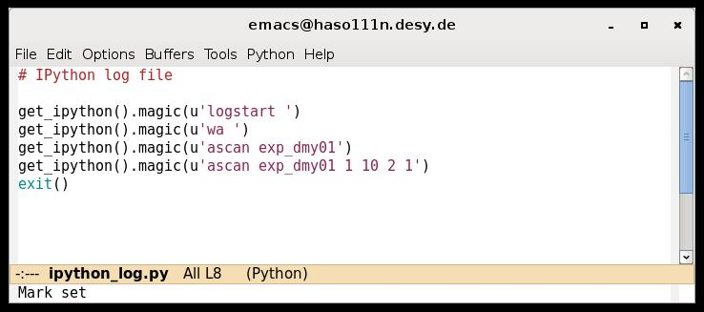
Default spock loggings (ctd.)
Notes:
We need some updates without waiting for the official acceptance and
DESY Nexus implementation.

Slide 5
Additional implementation
Based on RotatingFileHandler (standard python file handler)
Implemented in msmacromanager.py:
added in new class LogMacroManager
instantiated in MacroExecutor.runMacro
controlled via Environment variables:
LogMacro (activate/deactivate)
LogMacroMode (one file/splitted files)
LogMacroDir (default os.sep-tmp)
LogMacroFormat (default %(message)s)
File name: session_[door_mame].log
applied customized FileHandlerFilter:
set the output following the user requests

Slide 6
