Slide 1

General hooks
Teresa Núñez
DESY Photon Science
Motivation
Implementation
Examples
Implemented extensions (DESY):
- stop function
- repeating points condition
Sardana Workshop
ELI Beamlines, 05-06-18

Slide 2
Motivation
Customize scans without defining new macros
Applies to all hookable macros
New hooks positions can be used
All available and user defined macros can be set as general hook
Controlled via Spock environment variables
Macros defined to set/unset general hooks

Slide 3
Implementation
Modification of msmacromanager.py
Added to the macro object like the standard hooks
No extra function to call them
Macros added to env.py to set/unset the general hooks

Slide 4
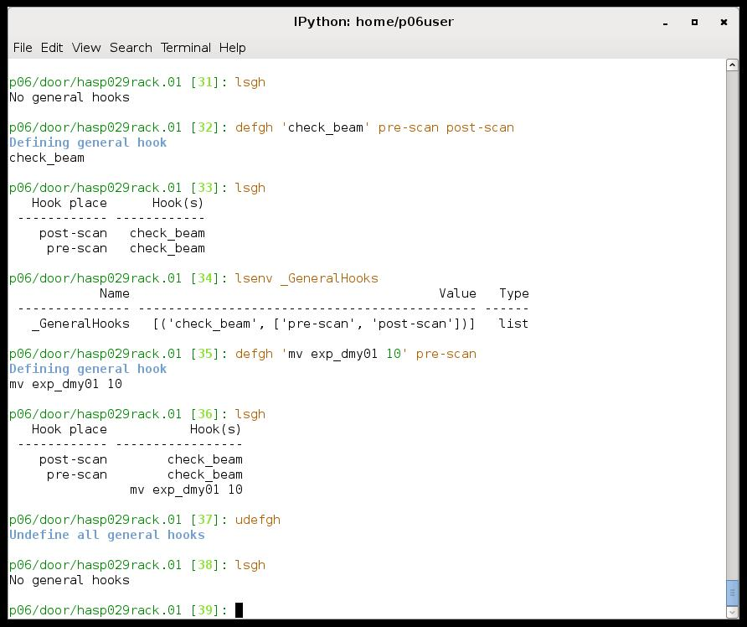


Slide 5
Some remarks
For each hook position can run different macros (hooks)
The different hooks for a hook position will run in the order
they were added
The same macro can run several times in a position if it is added
several times
All hooks can be disable at once for all position, only one hook,
or only one hook for one position

Slide 6
Examples
Check motor limits in step scans (pre-scan)
Prepare 2D detectors: create directories, set save directory, file name, file index, … in detector TS (pre-scan)
Set attenuators, set undulator, check shutter, check current (pre-scan)
Restore changes (post-scan)
Macro to be repeated (defined ‘body’ hook position)

Slide 7
Implemented extensions (DESY)
General Stop function:
Implemented in class Macro (macro.py):
- added getGeneralOnStopFunction
- called by _stopOnError before on_stop
Applies to all macros
Defined as a function in external python file imported by macro.py
Controlled by environment variable
Macros select/deselect its use
Example: check and restore beamline conditions
Define action to be performed if macro is stopped (ctrl-C)

Slide 8
Implemented extensions (DESY)
General condition:
Implemented in classes Macro (macro.py):
- added getGeneralCondition
and Sscan (gscan.py):
- called by stepUp at the end of each step
Applies to step scans
Defined as macro
Controlled by environment variable
Macros select/deselect its use
Example: repeat scan points if beam current under limit
Define condition to be fulfilled for going to next scan point
All points are sent to recorders

