Slide 1

Diffractometer in Sardana
Teresa Núñez
DESY Photon Science
Current status
Details of implementation
Initialization and use
Dedicated macros
Dedicated GUIs
Next steps
Sardana Workshop
ELI beamlines, 05-06-18

Slide 2

Current status
Complete diffractometer control from Sardana
Used at three Petra beamlines (DESY)
Dedicated GUIs developed in PyQt using Taurus
Dedicated SEP with status description (not documentation)

Slide 3
Details of the implementation
Diffractometer as a controller device of type PseudoMotor
Use of the hkl library exclusively done in hkl controller code, not in Sardana core
Base diffractometer class with all calculations
Derived diffractometer classes:
- differing in number of motors and pseudomotors
- not contains explicit use of hkl library
Dedicated macros

Slide 4
Details of the implementation (ctd.)
Creating diffractometer controller in Pool:
Controller type: PseudoMotor
Controller library: HklPseudoMotorController
Controller class: depends on number of motors and roles,
ex. DiffracE6C
Motors and Roles: depending on controller class
Properties:
- DiffractometerType, depending on geometry, ex. E6C

Slide 5
Details of the implementation (ctd.)
Current diffractometer controller classes:
Diffrac6C (types: “PETRA3 P09 EH2”)
- motor roles: mu, omega, chi, phi, delta, gamma
- pseudomotor roles: h, k, l
DiffracE6C (types: “E6C”, “SOLEIL SIXS MED2+2”
- motor roles: mu, omega, chi, phi, gamma, delta
- pseudomotor roles: h, k, l, psi, q, alpha, qper, qpar

Slide 6
Details of the implementation (ctd.)
Current diffractometer classes (ctd.):
DiffracE4C (types: “E4CV”, “E4CH”, “SOLEIL MARS”)
- motor roles: omega, chi, phi, tthh
- pseudomotor roles: h, k, l, psi, q
Diffrac4Cp23 (types: “PETRA3 P23 4C”)
- motor roles: omega_t, mu, gamma, delta
- pseudomotor roles: h, k, l, q, alpha, qper, qpar, tth2,
alpha_tth2, incidence, emergence

Slide 7
Details of the implementation (ctd.)
Controller device interface:
Properties:
- DiffractometerType
Attributes:
- parameters describing current diffractometer status
- commands performing actions, calculations …
(not extra commands can be defined in controllers)

Slide 8
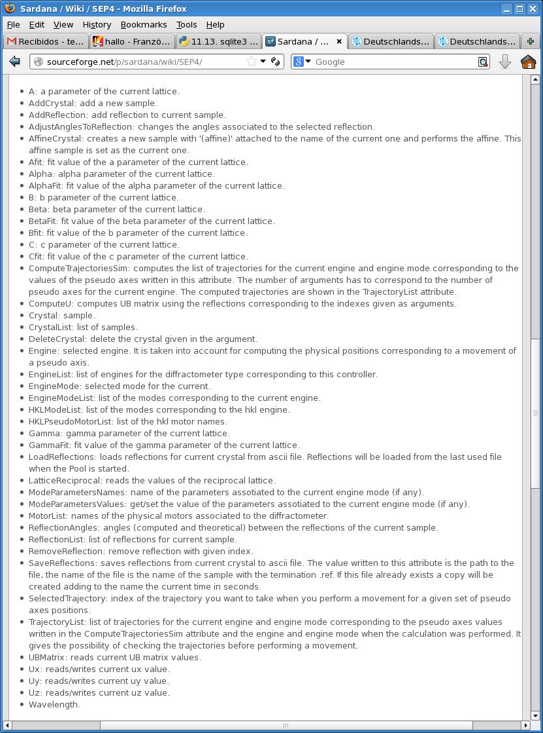

Slide 9
Initialization and use
Initialization:
- sample set to last value or ‘default crystal’
- lattice parameters set to default values
- geometry created according to DiffractometerType
- engine set to ‘hkl’
Initial settings can be read from config file:
- set crystal, ub matrix, reflections, engine and mode
Movements:
- using the corresponding motor and role motor devices
Settings and actions:
- writing to the controller attributes

Slide 10
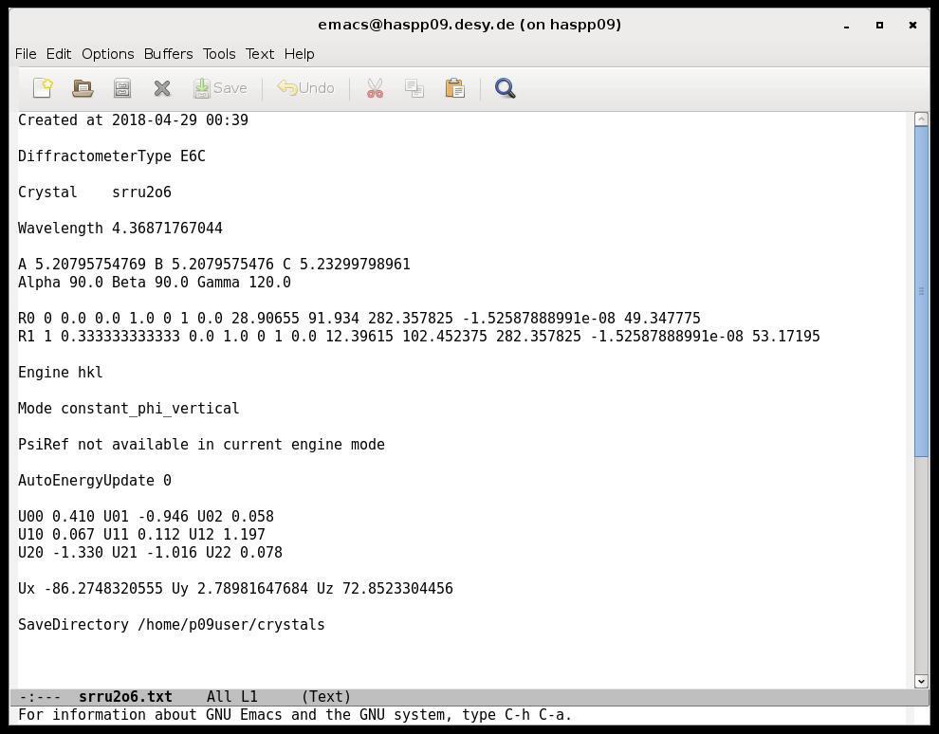
Initialization and use
Configuration file

Slide 11
Dedicated diffractometer macros
Included in standard sardana macros
Control diffractometer and display information
Follow SPEC syntax as close as possible
Not tested in all diffractometer types
Examples:
- br, ubr: move to hkl values
- hklscan, hscan, kscan, lscan: scans in hkl space
- setor0, setor1, setorn: set orientation reflections
- ca, caa, ci: motor positions from hkl values or v/v
- computeub, setlat, loadcrystal, …

Slide 12
Dedicated diffractometer GUIs
Implemented using PyQt and Taurus
Three main GUIs:
- hkl scans
- diffractometer alignment
- UB matrix/lattice parameters
GUIs connects to:
- diffractometer controller device
- MacroServer via Door device

Slide 13
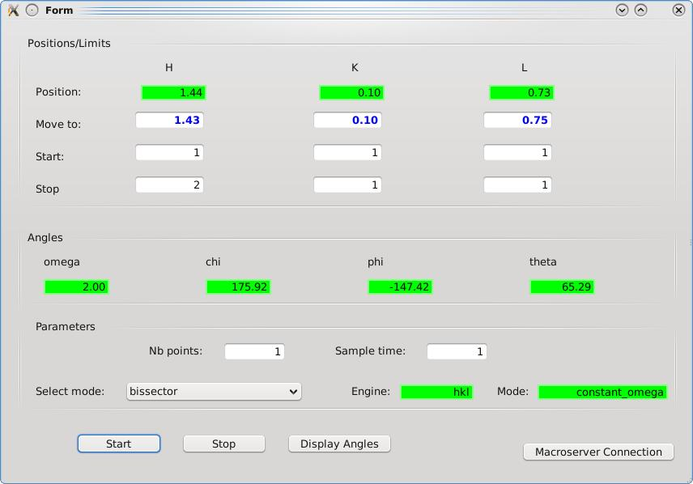

Slide 14
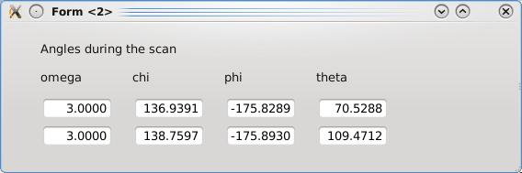

Slide 15
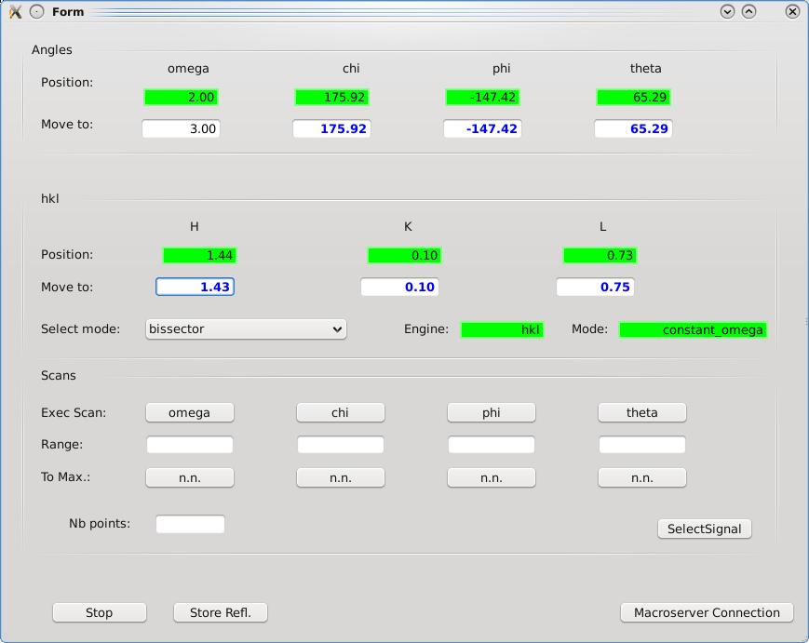

Slide 16
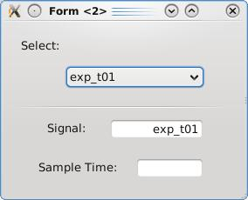

Slide 17
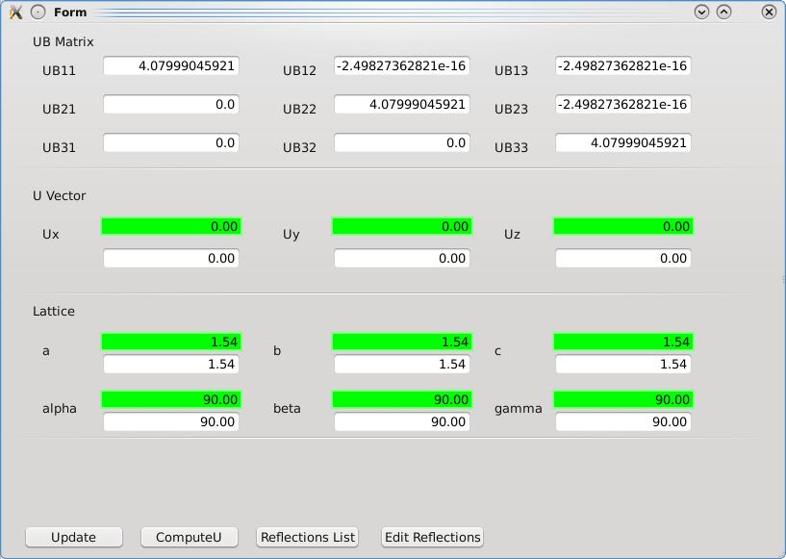

Slide 18
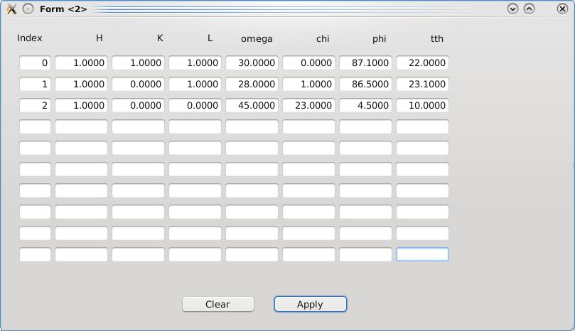

Slide 19
Next steps
Test of current implementation:
- performance
- completeness
Discuss about other possible implementations

