Slide 1
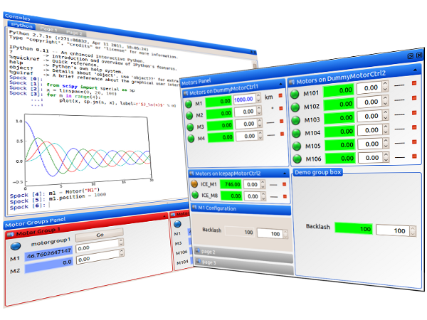

SARDANA – Scientific SCADA Suite
by Guifré CUNí, Grzegorz KOWALSKI, Zbigniew RESZELA
on behalf of Sardana and Taurus Communities
Sardana Workshop @ ICALEPCS2019, New York, 6th October 2019

Slide 2
Outline
Sardana - What is? And what is not?
Sardana Suite overview
Software architecture & layers
Sardana Community

Slide 3
Sardana – What is? And what is not?

Slide 4
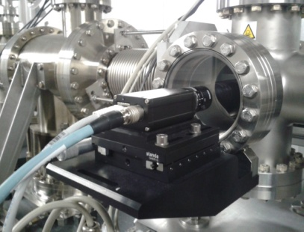
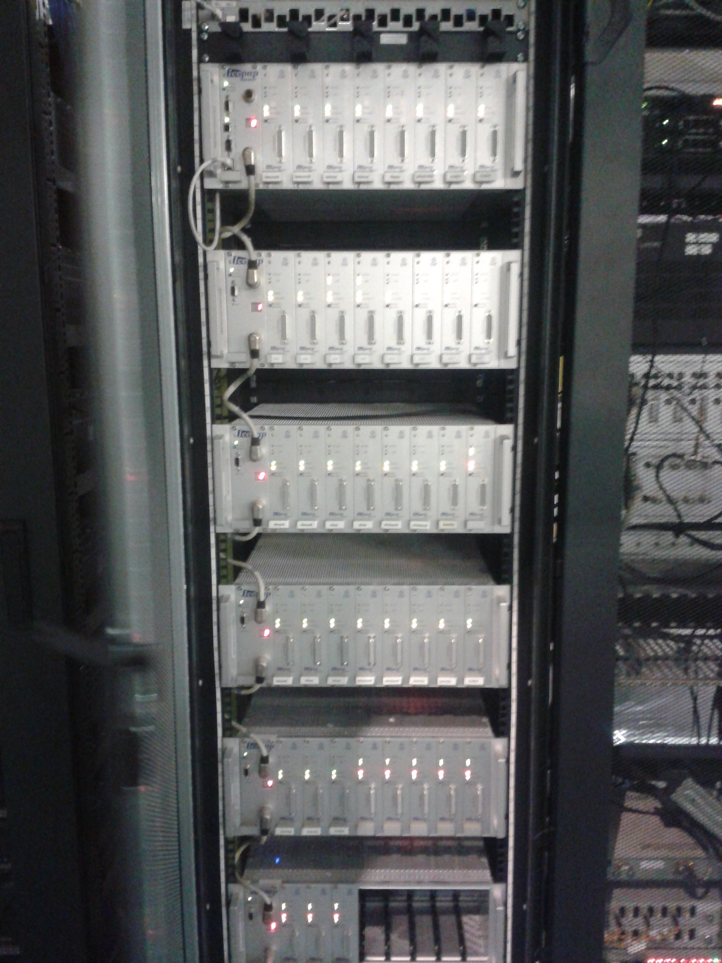
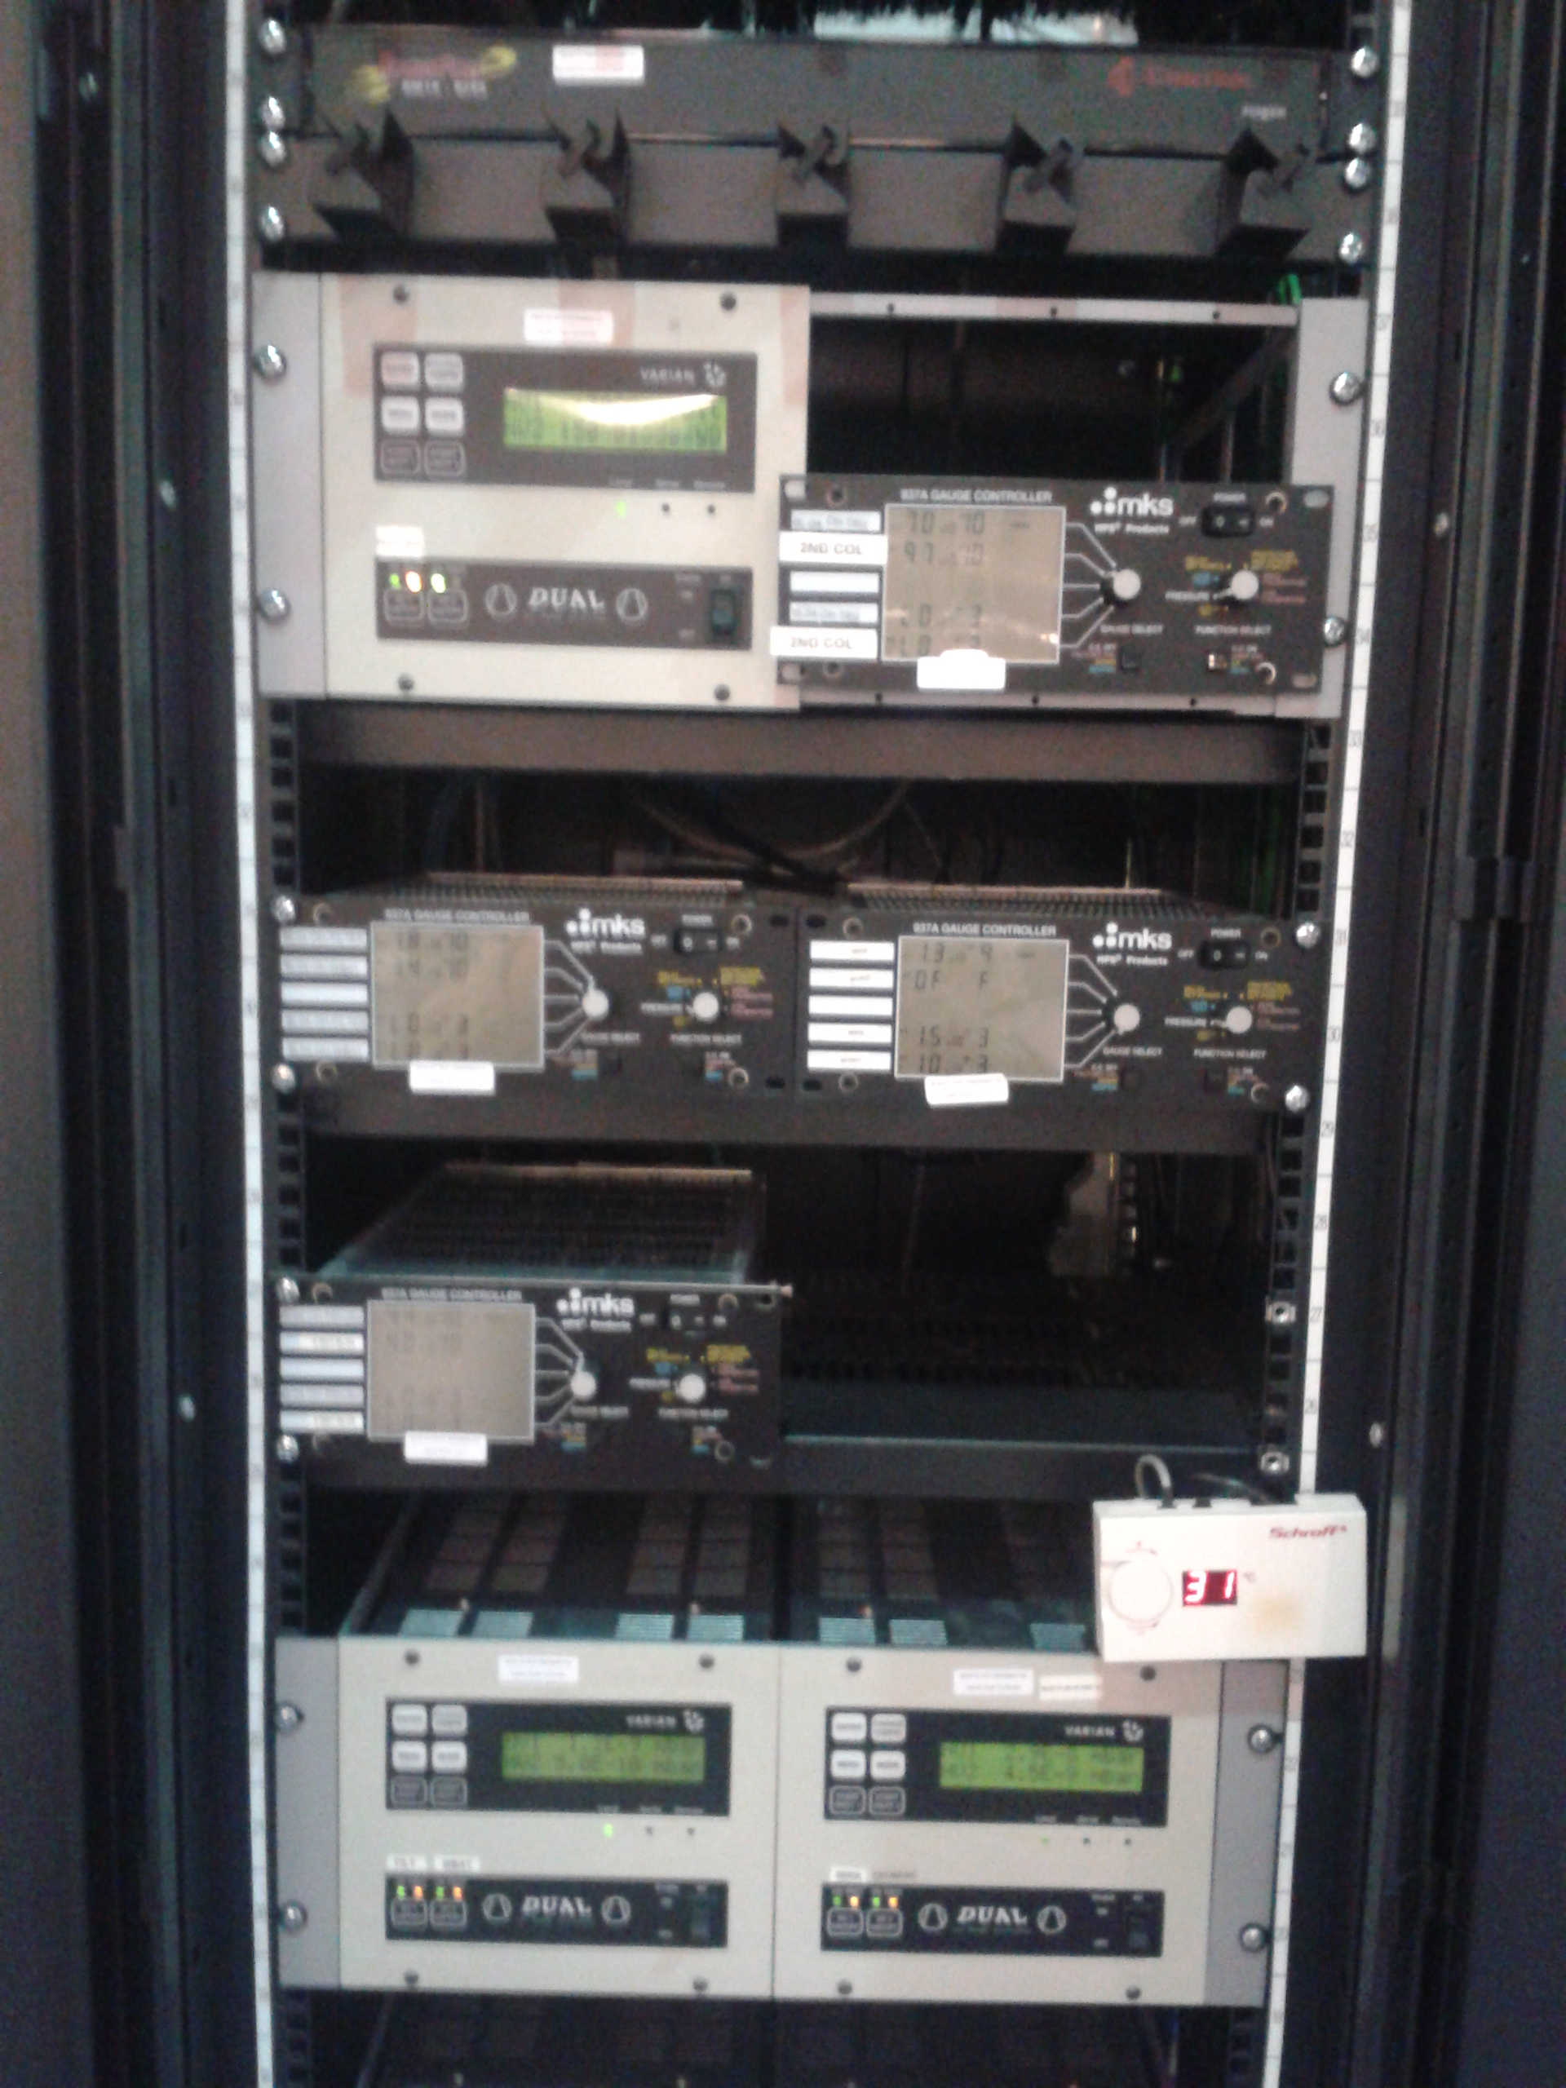
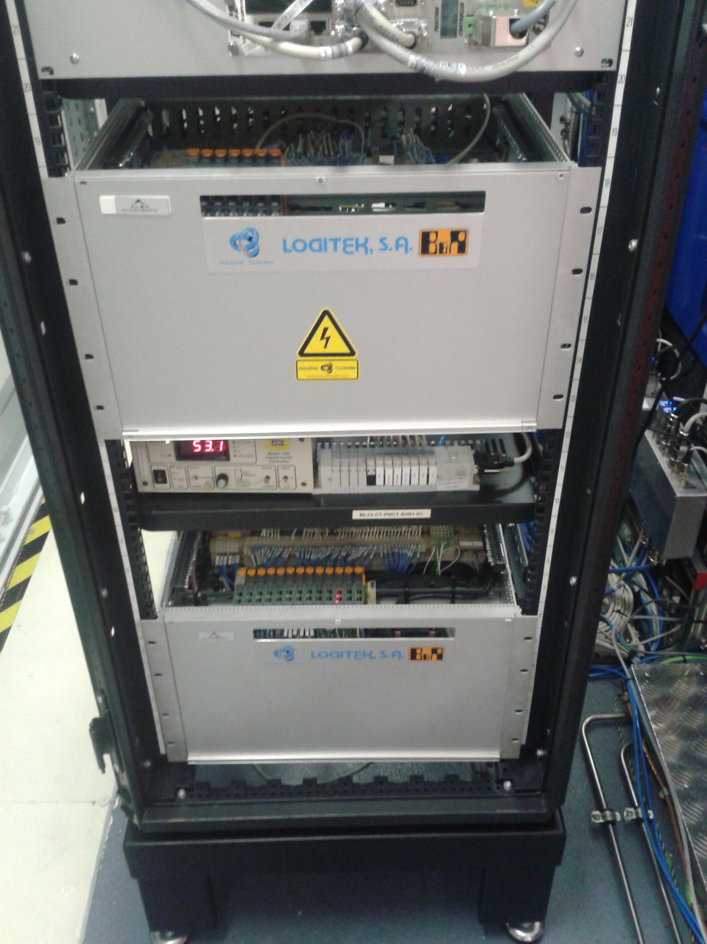
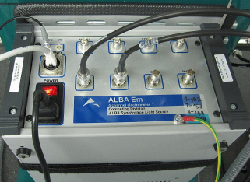
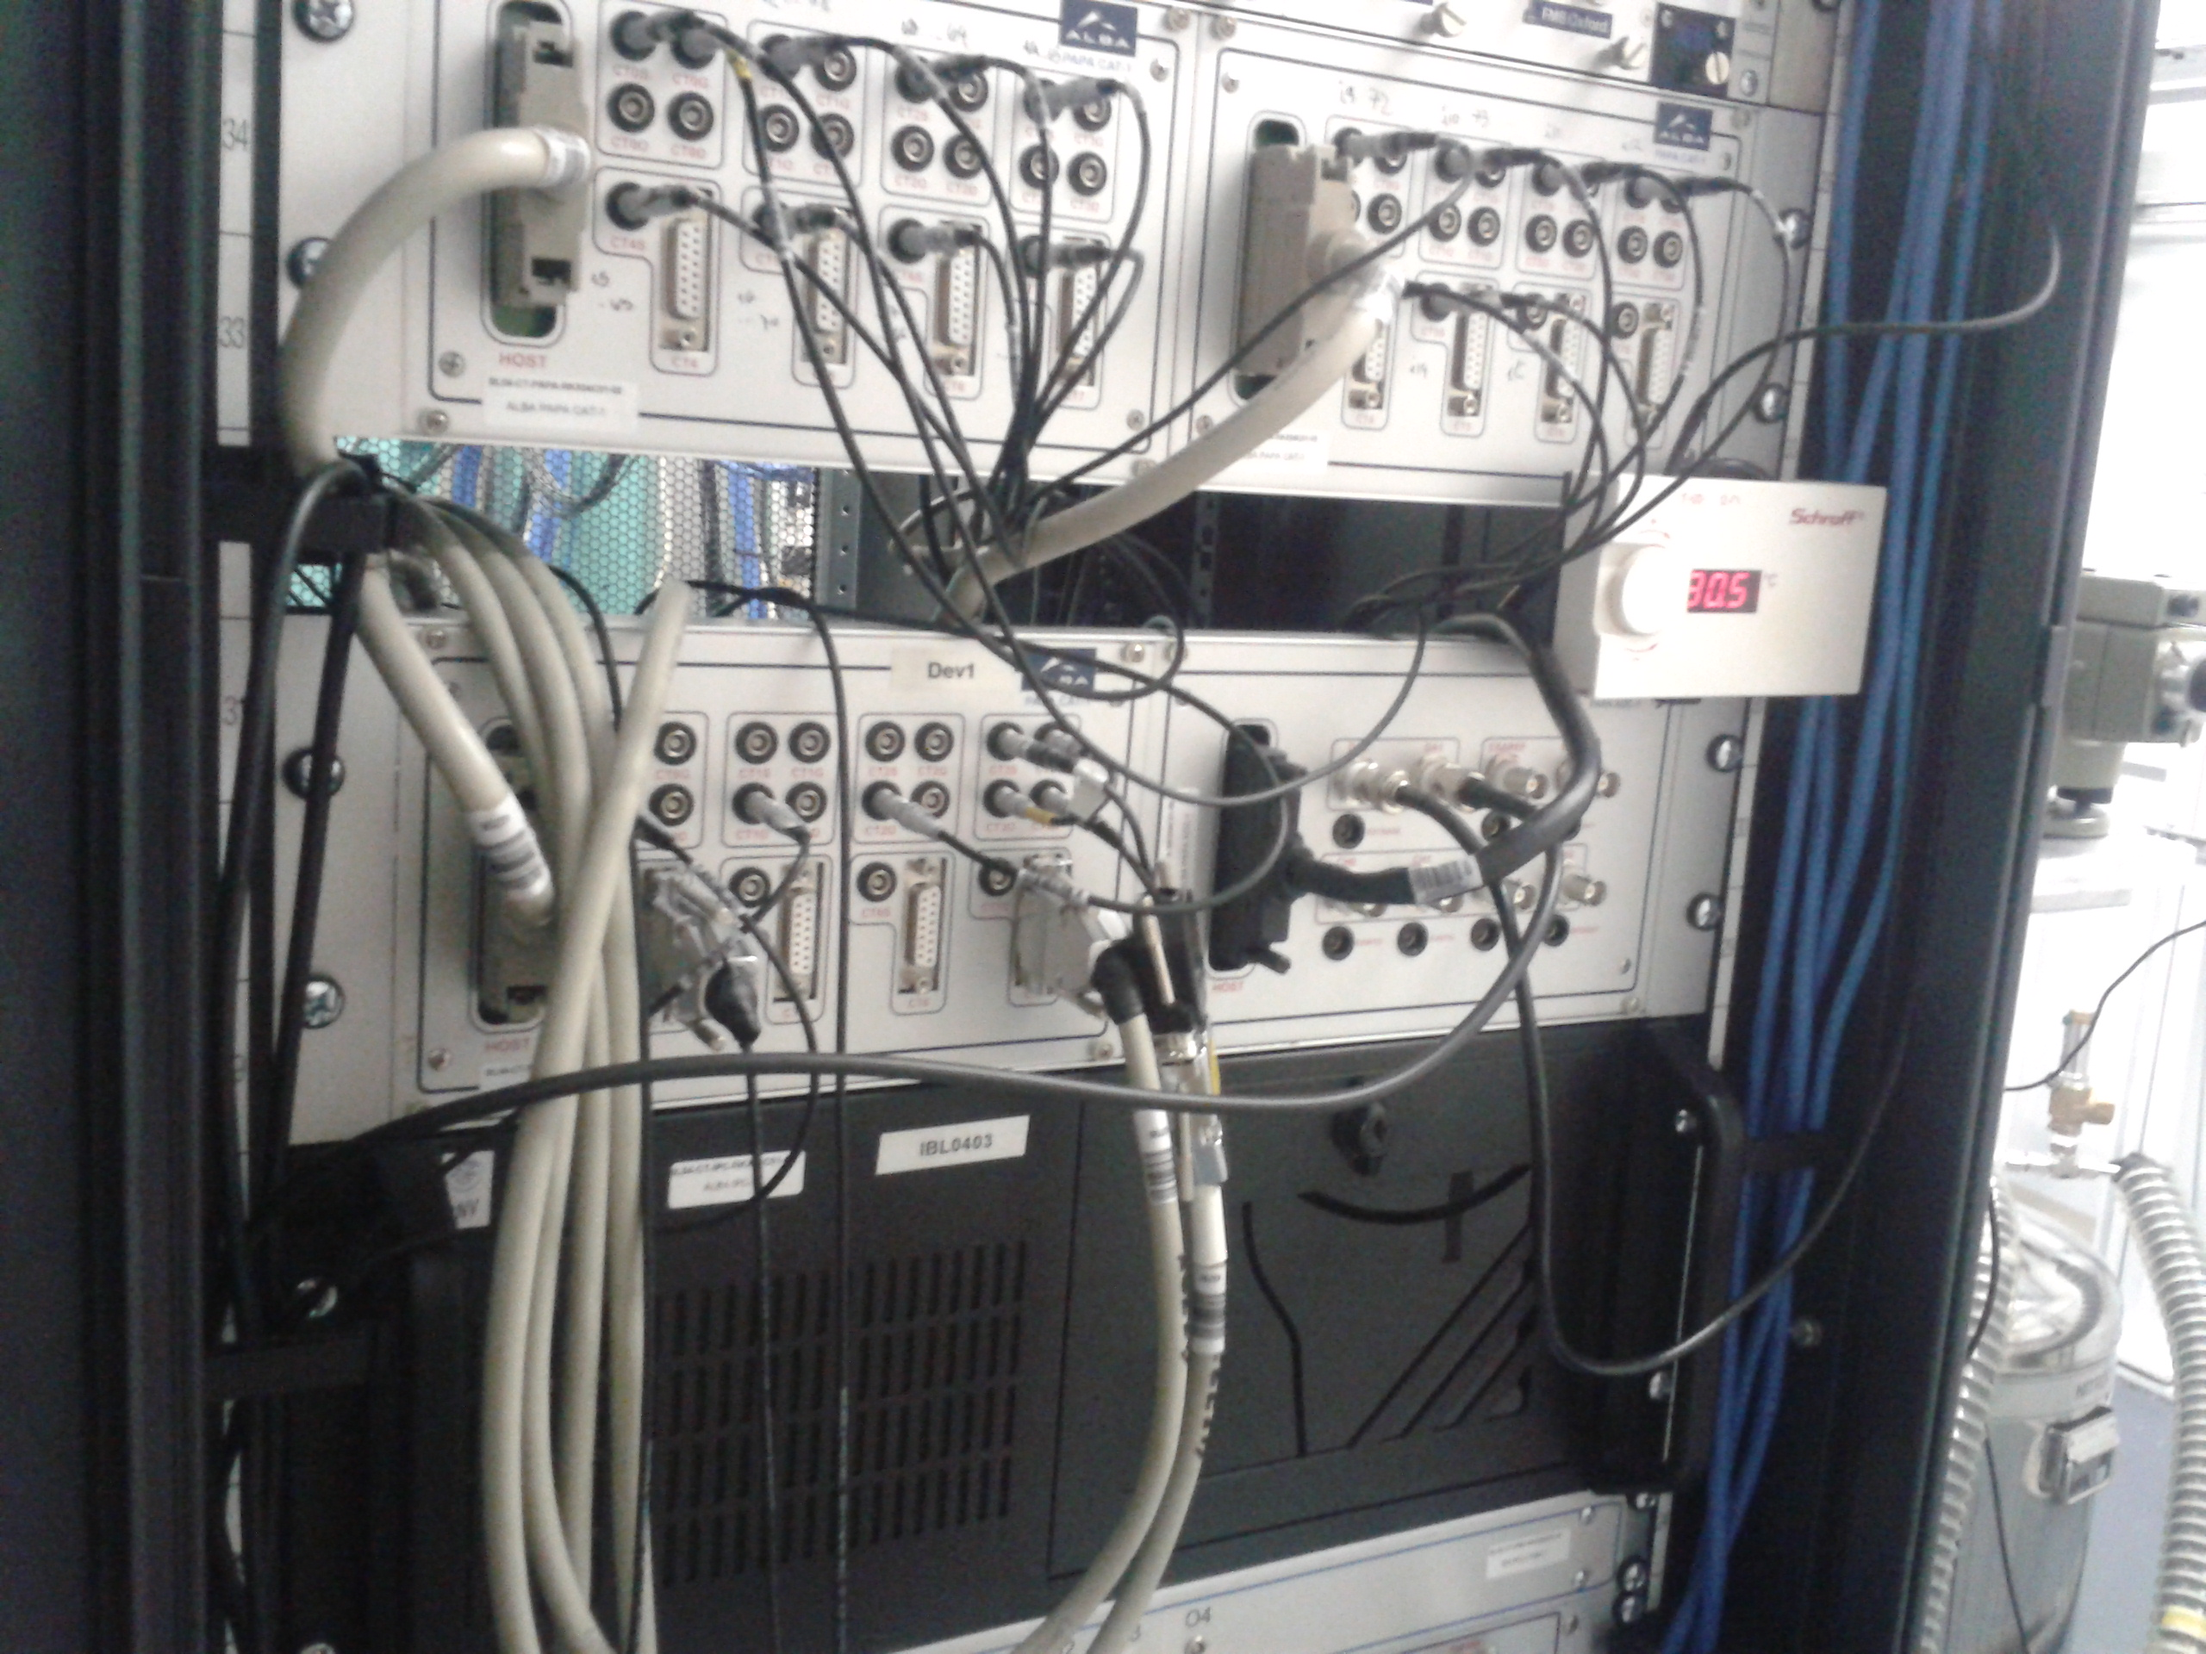
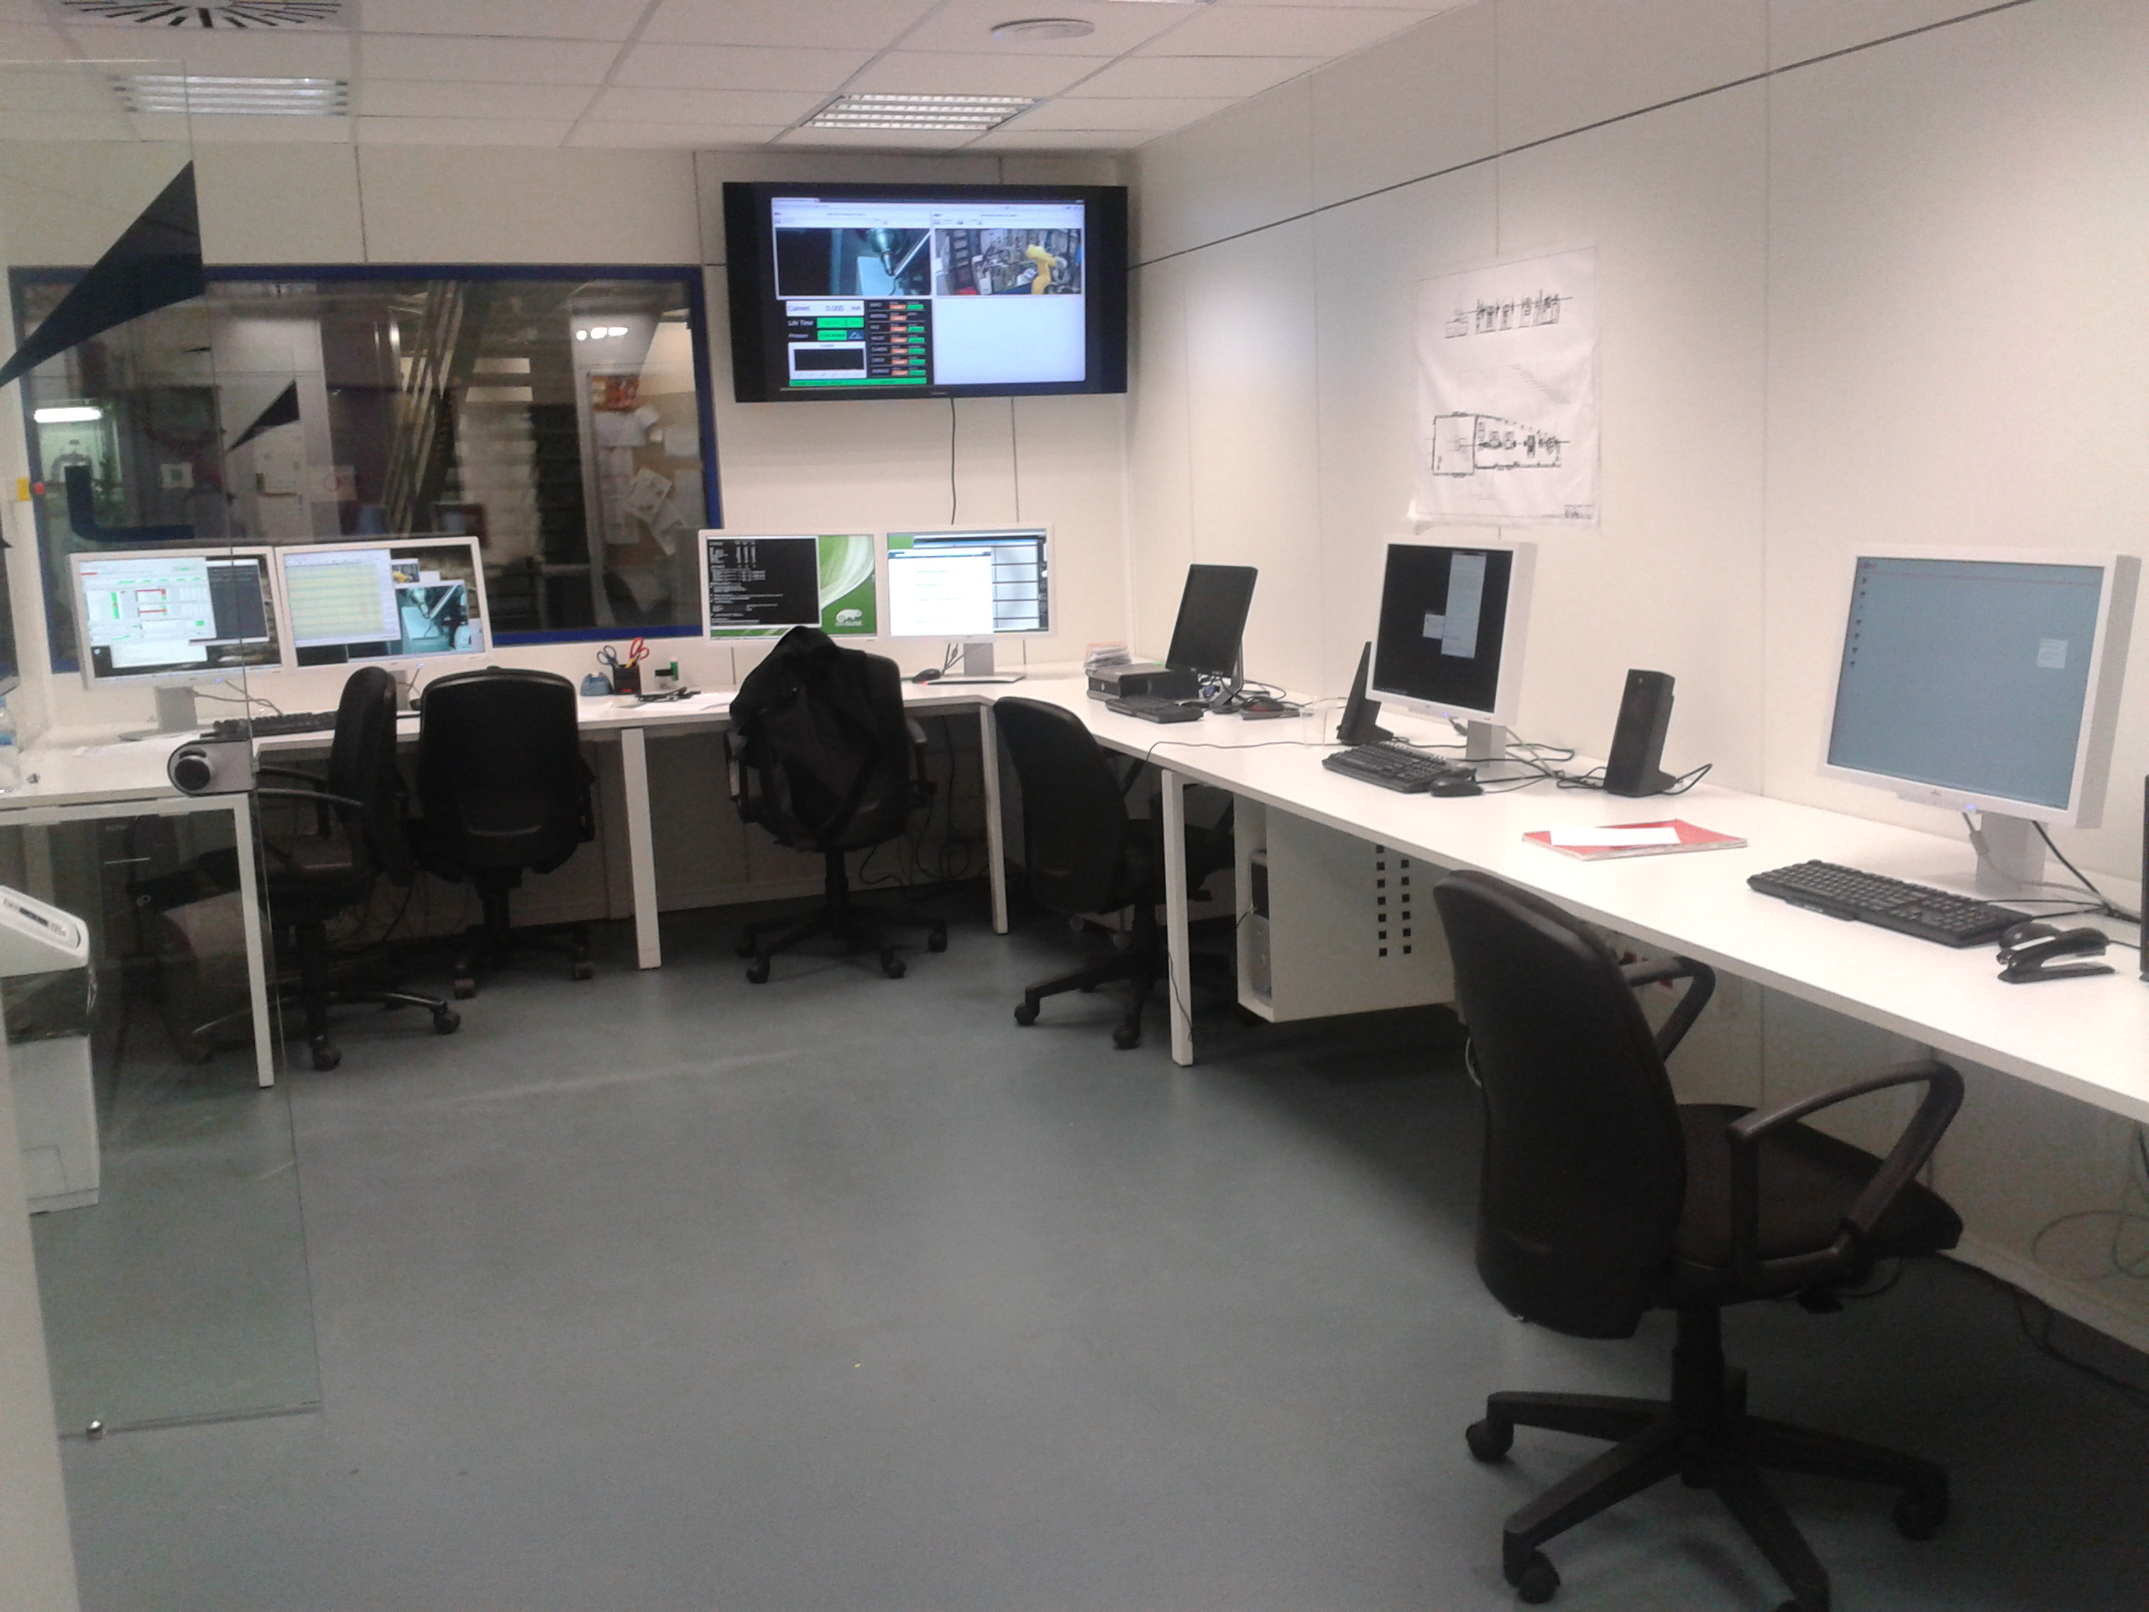
Beamline Hardware Components
CCDs
Motion
Vacumm
PLC
Emeter
AI, AO, DAQ
IPC
Workstations

Slide 5
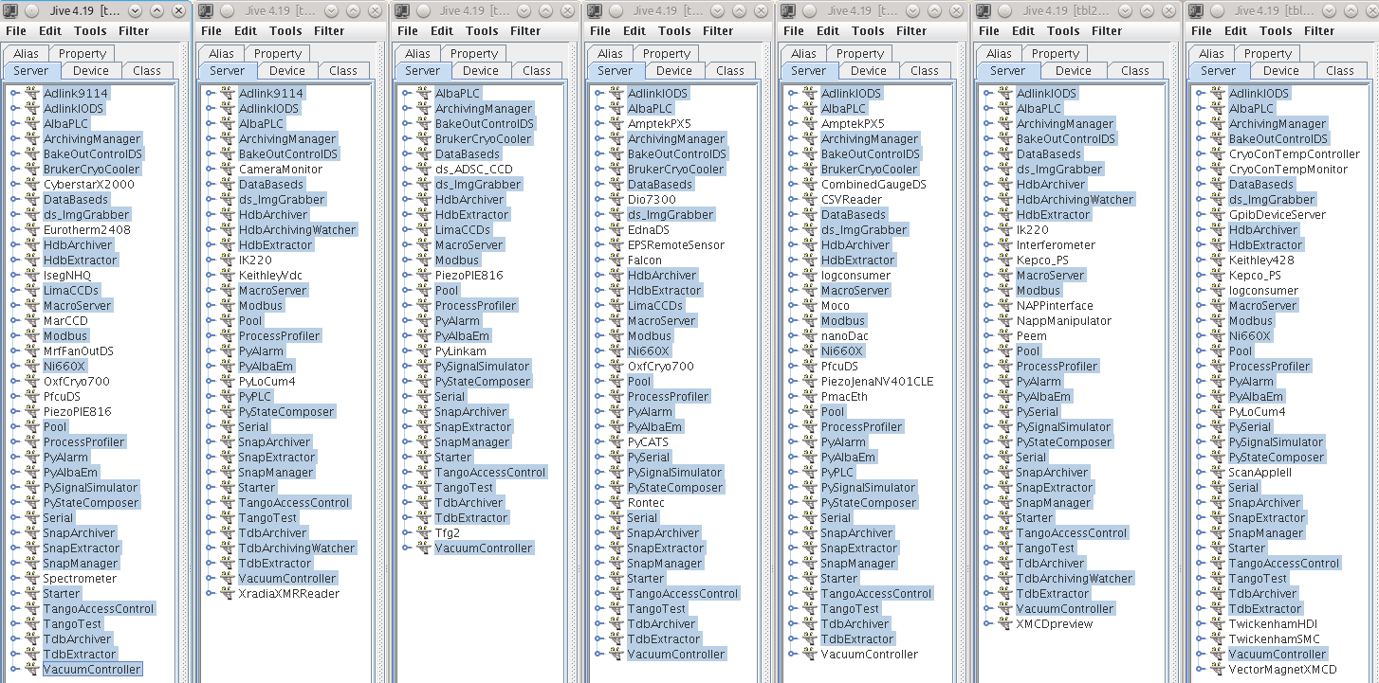
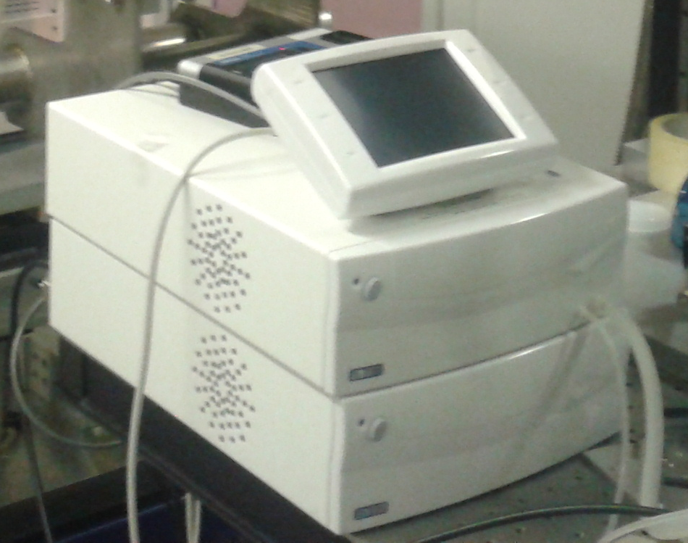
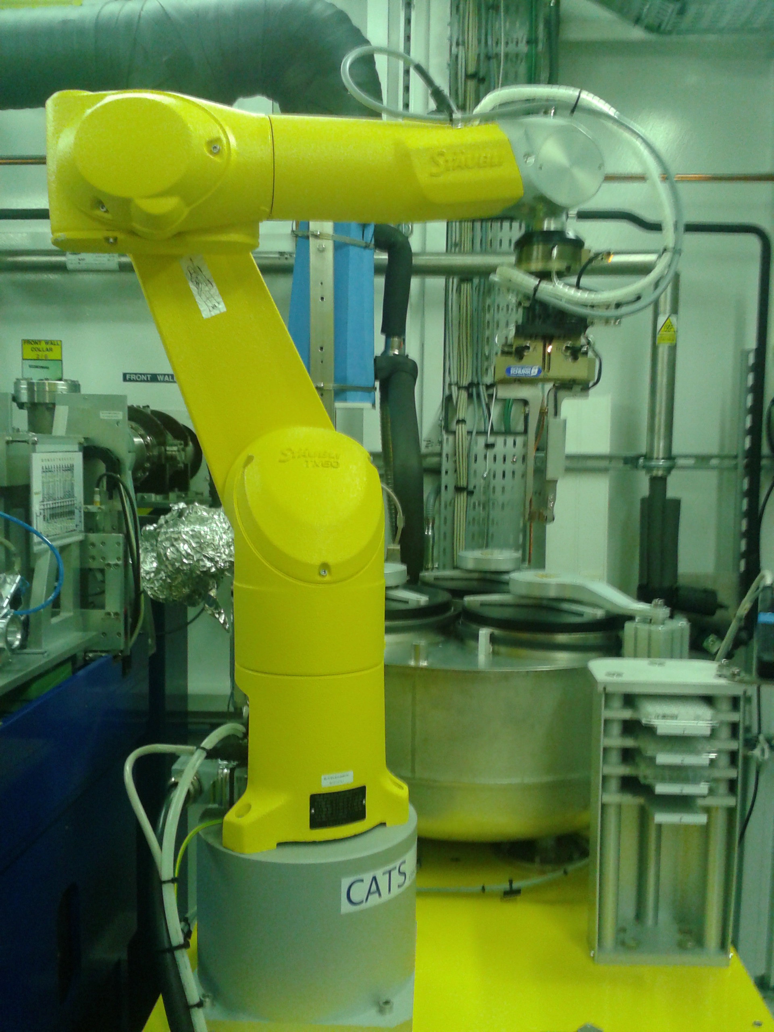
Beamline Control System (on example of Tango)

Slide 6


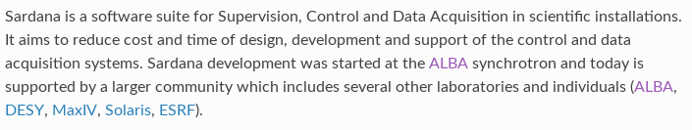
What Sardana is? And what is not?
Motion Control
Vacuum Pumps and Gauges
Equipment Protection System PLC
Diagnostic Cameras, Electrometers, …
AI, AO, DAQ (NI6602, Adlink 2005, …)
Archiving System
Software Alarm System
Experiment automation and synchronization
Program and execute user procedures

Slide 7
Sardana Suite overview

Slide 8

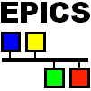
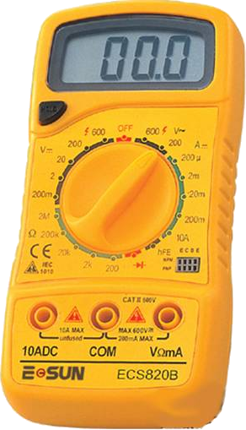
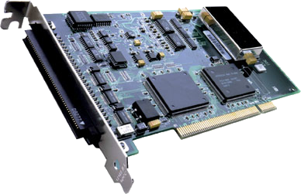
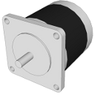
Sardana Suite overview
Generic TaurusGUI
Taurus Widgets
Spock
Taurus Core
SARDANA SUITE
Macros
Macro Server
schemes://
Recorders
Device Pool
Controllers

Slide 9
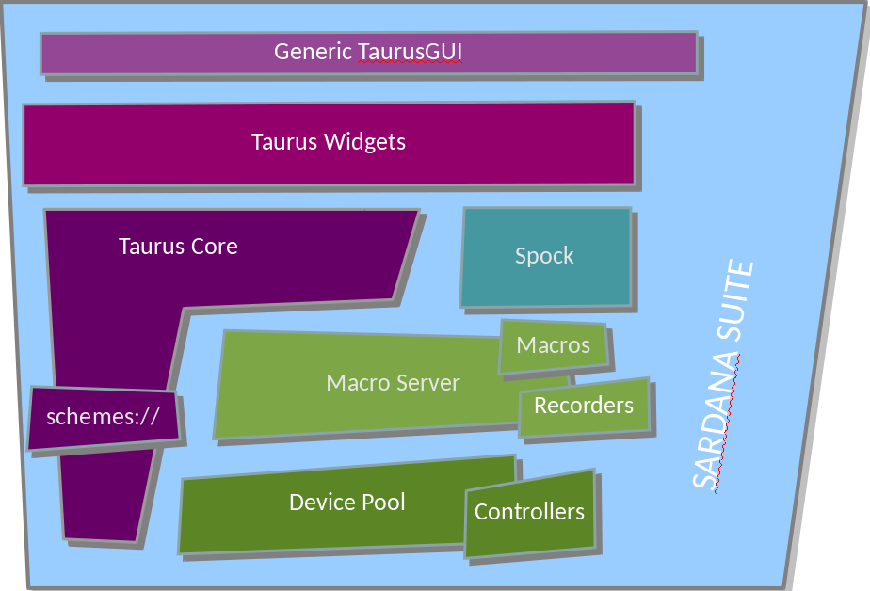
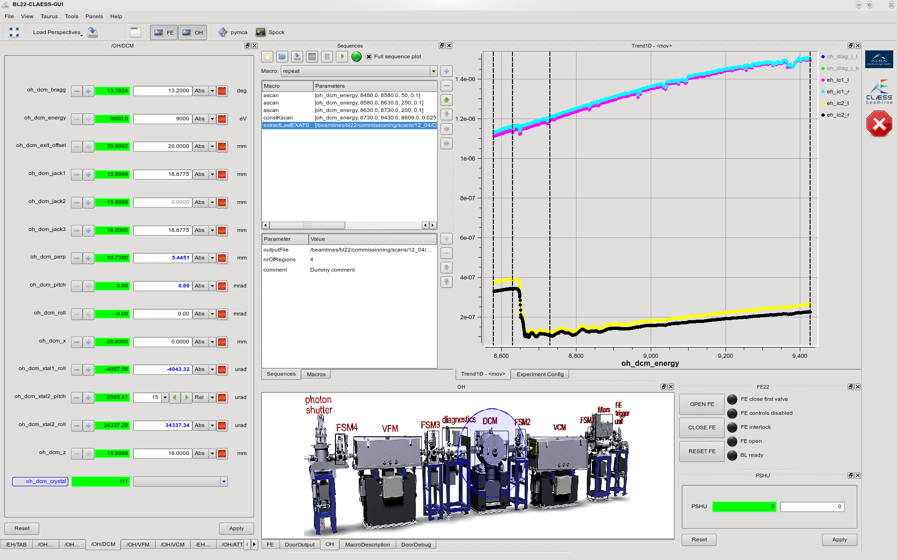
Generic Taurus GUI
User perspectives
1D & 2D plots
Macro execution
widgets
External widgets
Forms with devices
and/or attributes
Interactive synoptic
BL22 (ALBA) GUI created with the TaurusGUI framework
TaurusGUI framework for creating complete GUIs without programming a single line of code!

Slide 10
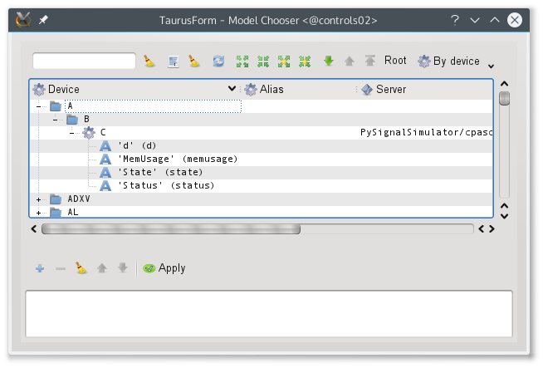
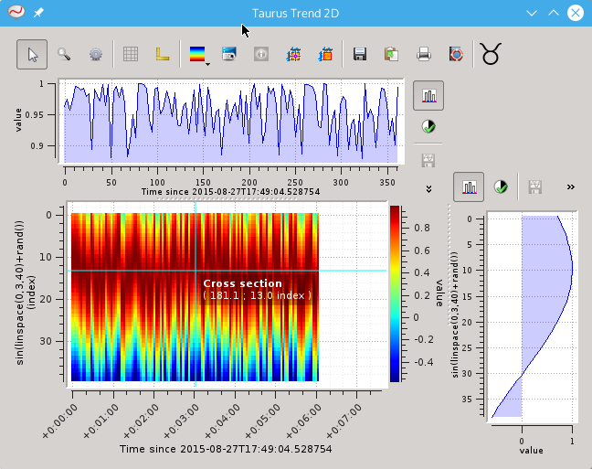
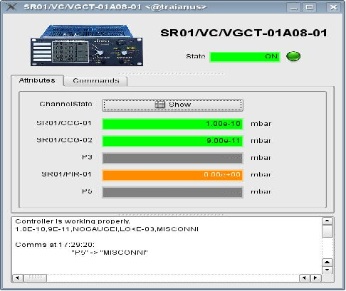
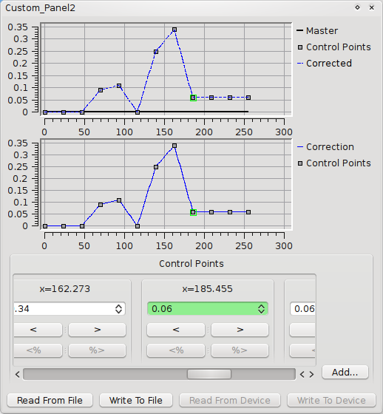
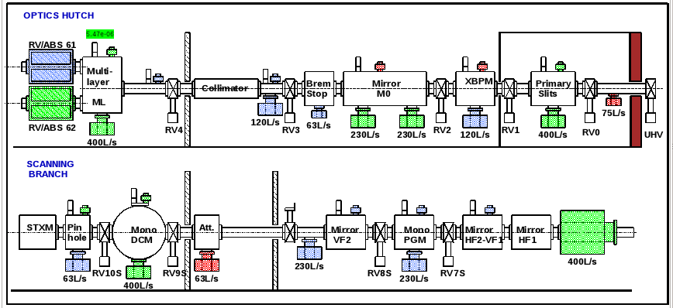
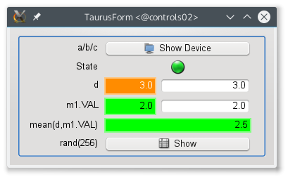
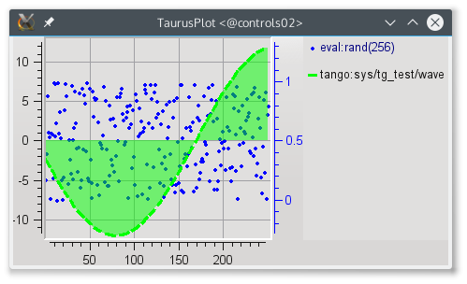
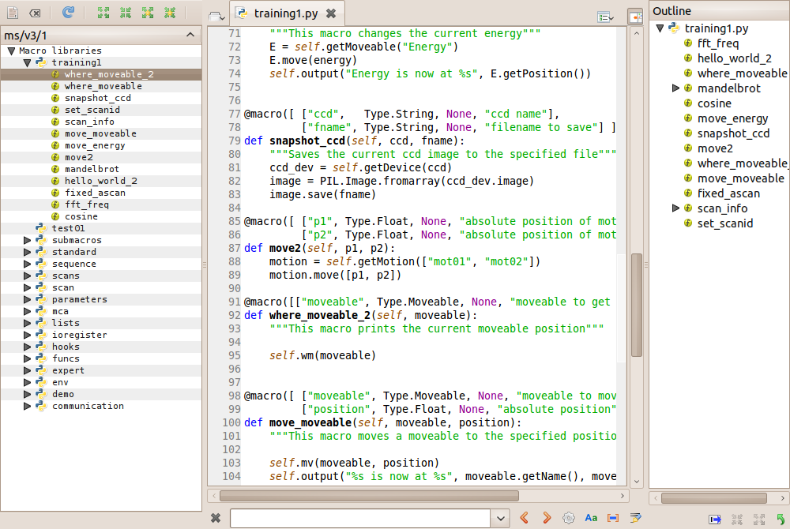
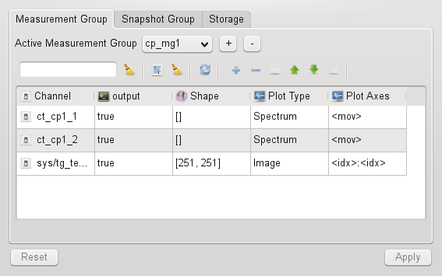
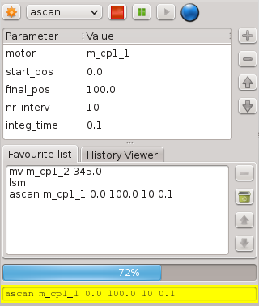
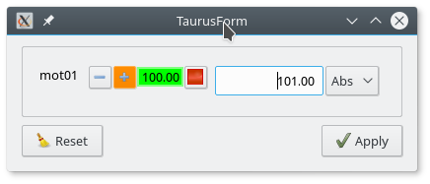
Taurus Widgets
Qt based graphical widgets: generic forms, plots, ...
Sardana specific widgets: macro executor, motor,
experiment configuration, scan plots, …

Slide 11
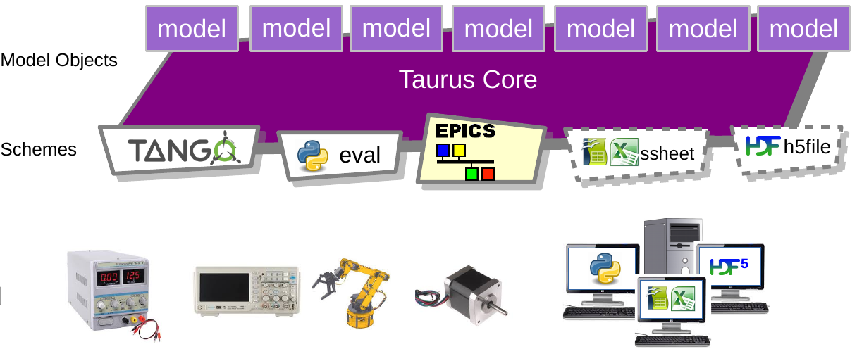
Taurus Core
“Container of unique models”.
Schemes provide access to different type of data sources.
Polling and event mechanism.

Slide 12
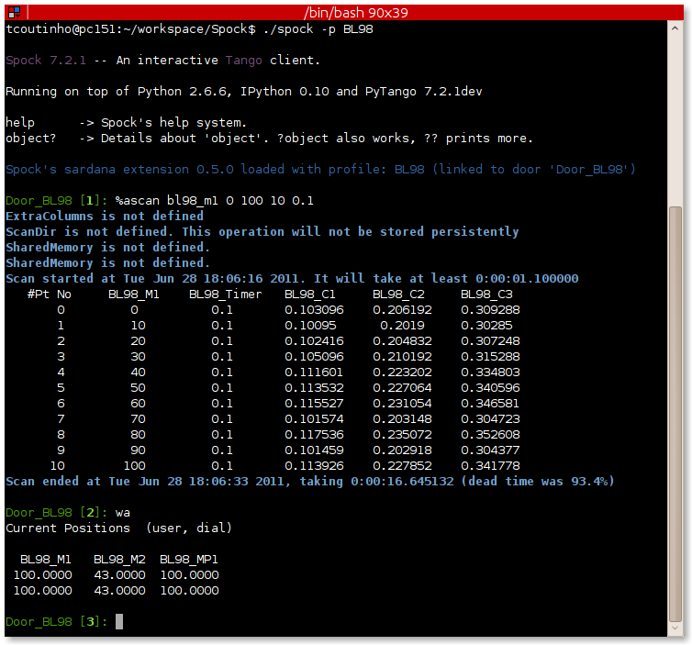
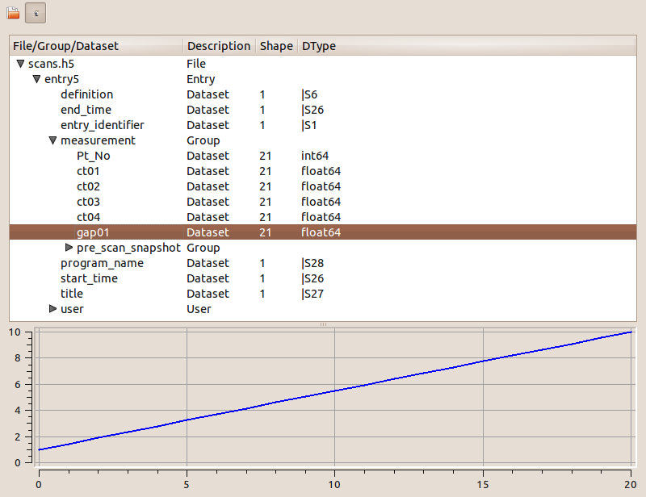
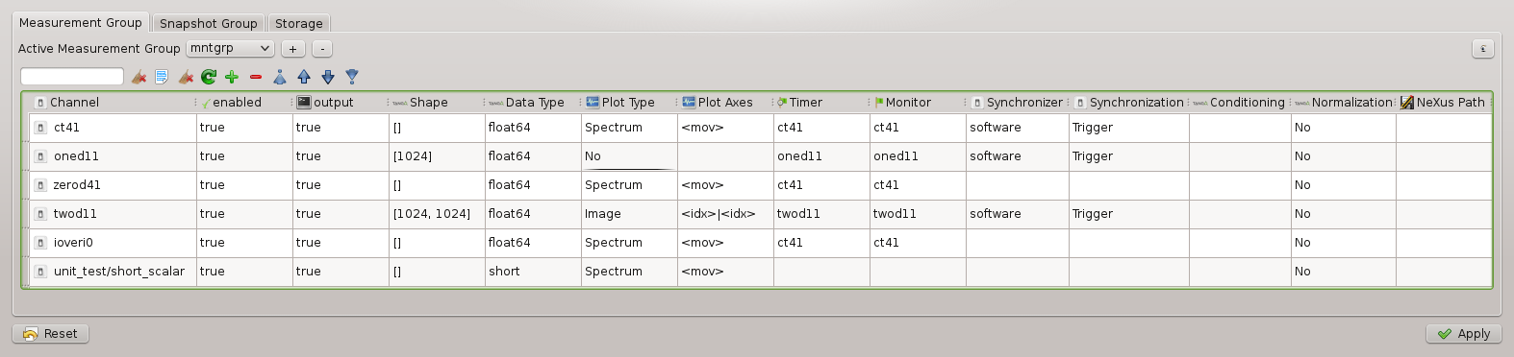
Spock
Spock – IPython based Sardana CLI.
Spock syntax mimics SPEC commands.
Provides total control over the system: executes procedures, interacts with the elements, …

Slide 13
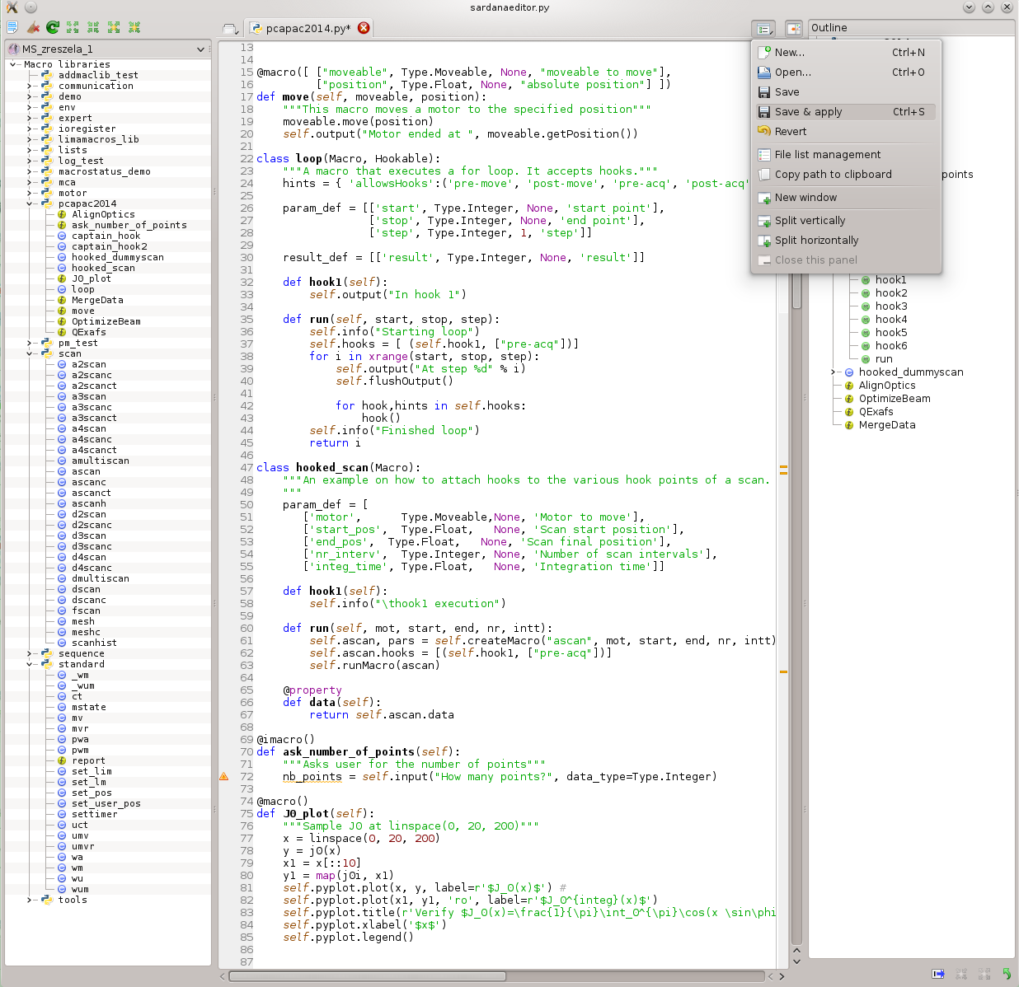
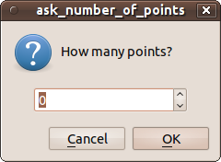

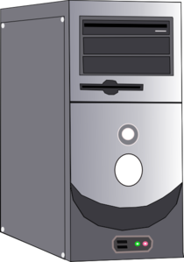
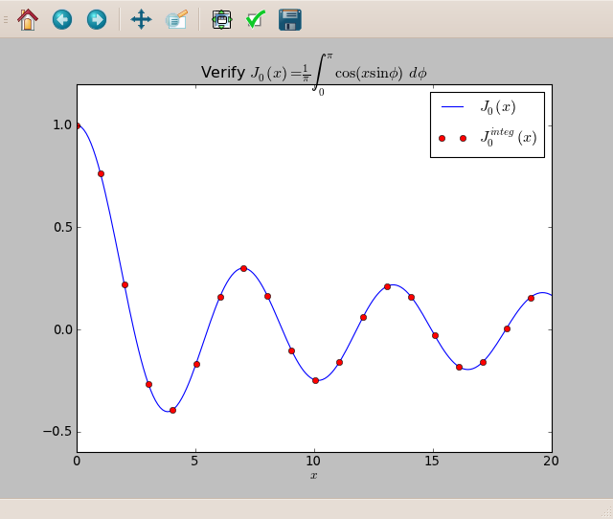







MacroServer
Hooks
Adding, editing macros
at runtime
Door_1 [8]: loop 0 10 3
Starting loop
At step 0
running hook with hints=['pre-acq']
In hook 1
At step 3
running hook with hints=['pre-acq']
In hook 1
At step 6
running hook with hints=['pre-acq']
In hook 1
At step 9
running hook with hints=['pre-acq']
In hook 1
Finished loop
Interactive macros
Input parameters &
results & data
SPEC like commands
Macro Server
macro
Data
Metadata
Plotting
Data Handler
Metadata
System
ShmRec
SpecRec
.spec
StdoutRec
NXScanRec
JsonRec
NXxasRec
FioRec
stdout
.fio
NXscan
NXxas
JSON

Slide 14
Device Pool
All the equipments are interfaced via Device Pool and its plug-in controller classes (Python)
Generic elements' interfaces allow building high level layers on top of them e.g. MeasurementGroup, pseudo elements, generic widgets, etc.
Element Type | Example of application
Motor | stepper, servo or piezo actuator
PseudoMotor | energy, HKL of a diffractometer, slit's gap or offset
CounterTimer | event counter, position measurement, but also… analog to digital converter (ADC), low current electrometer
PseudoCounter | vertical beam position in the X-ray beam position monitor (XBPM)
0DExpChannel | no controlled acq. (software sampling)
1DExpChannel | position sensitive detector (PSD), multichannel analyzer (MCA)
2DExpChannel | CCD camera, 2D X-ray detector
TriggerGate | generators of synchronization signals/events
IORegister | input/output registers of PLC
Pool DS
Pool
Motors
0D
Channels
Controllers
Counters
2D
Channels
Pool Device Server and its elements

Slide 15
Software architecture & layers

Slide 16
Client – Server model
Sardana DS
MacroServer
Doors
Pool A
Motors
0D
Channels
Controllers
Counters
2D
Channels

Slide 17
Client – Server model
Pool DS
Sardana DS
Pool B
MacroServer
Doors
0D
Channels
Motors
Pool A
Motors
0D
Channels
2D
Channels
Counters
Controllers
Controllers
Counters
2D
Channels

Slide 18
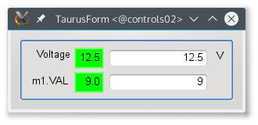
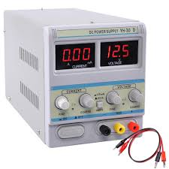
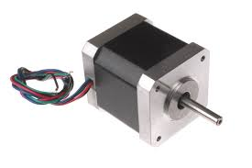
Software layers - Taurus models & schemes
The model objects are singletons
Model names are URIs
Each scheme provides:
  A model factory for:
    Authority
    Device
    Attribute
  Model name validators
Model (Attribute)
tango:powesupply/test/1/voltage
Model (Attribute)
epics:XXX:m1.VAL
Taurus Core

Slide 19
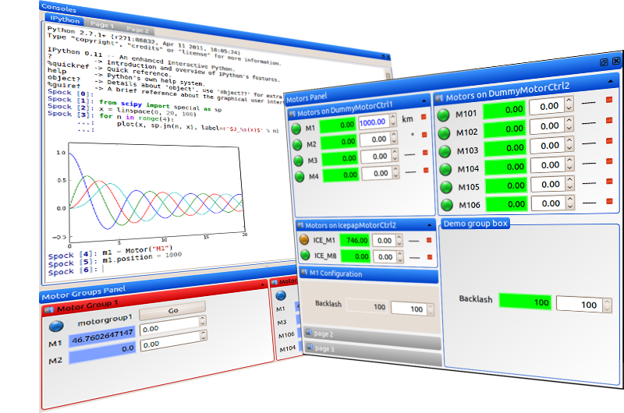
Software layers - Controllers
Sardana is extend-able
from top with server
Interfaces.
Currently only Tango
interface exists.
Sardana server
server
interface
Sardana kernel is
pure Python library.
sardana
kernel
Controller
Sardana is extend-able
from bottom with plugins
(Python).
stepper, servo, piezzo,
counter, timer, electrometer,
MCA, PSD, CCD,
synchronizer, IO register, ...

Slide 20
Software layers - Controllers
Motor
Sardana is extend-able
from top with server
Interfaces.
Currently only Tango
interface exists.
position: float
state: enum
offset: float
sign: int
steps_per_unit
...
Sardana server
Sardana server
server
interface
Motor
Stop()
Abort()
...
Sardana kernel is
pure Python library.
sardana
kernel
PoolMotor
Pool
Controller
Controller
Motor
Controller
class MyMotorCtrl(MotorController):
def StateOne(self, axis):
[...]
def ReadOne(self, axis):
[...]
def StartOne(self, axis, pos):
[...]
def AbortOne(self, axis):
[...]
Sardana is extend-able
from bottom with plugins
(Python).
stepper, servo, piezzo,
counter, timer, electrometer,
MCA, PSD, CCD,
Synchronizer, IO register, ...

Slide 21
Software layers
Sardana is extend-able
from top with server
Interfaces.
Currently only Tango
interface exists.
Sardana server
Sardana server
server
interface
Counter
Timer
Sardana kernel is
pure Python library.
sardana
kernel
PoolCounter
Timer
Pool
Controller
Controller
CounterTimer
Controller
Sardana is extend-able
from bottom with plugins
(Python).
stepper, servo, piezzo,
counter, timer, electrometer,
MCA, PSD, CCD,
Synchronizer, IO register, ...

Slide 22
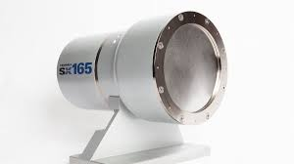
Software layers - Controllers
Sardana is extend-able
from top with server
Interfaces.
Currently only Tango
interface exists.
Sardana server
Sardana server
server
interface
TwoD
ExpChannel
Sardana kernel is
pure Python library.
sardana
kernel
Pool2D
ExpChannel
Pool
Controller
Controller
TwoD
Controller
Sardana is extend-able
from bottom with plugins
(Python).
stepper, servo, piezzo,
counter, timer, electrometer,
MCA, PSD, CCD,
Synchronizer, IO register, ...
etc...

Slide 23
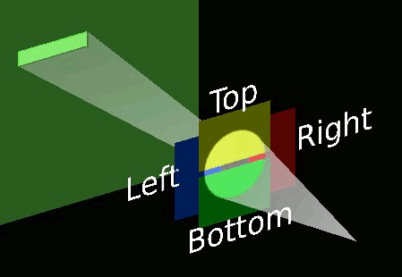
Software layers - Controllers
Sardana is extend-able
from top with server
Interfaces.
Currently only Tango
interface exists.
Sardana server
Sardana server
Sardana server
server
interface
TwoD
ExpChannel
Pseudo
Motor
Sardana kernel is
pure Python library.
sardana
kernel
Pool2D
ExpChannel
Pool
PseudoMotor*
Pool
Controller
Pool
Controller
Controller
TwoD
Controller
PseudoMotor
Controller
Sardana is extend-able
from bottom with plugins
(Python).
stepper, servo, piezzo,
counter, timer, electrometer,
MCA, PSD, CCD,
Synchronizer, IO register, ...
etc...
* Depends on underneeth PoolMotor (or even another PseudoMotor) elements

Slide 24
Software layers - Controllers
Sardana is extend-able
from top with server
Interfaces.
Currently only Tango
interface exists.
Sardana server
Sardana server
Sardana server
server
interface
TwoD
ExpChannel
Pseudo
Counter
Sardana kernel is
pure Python library.
sardana
kernel
Pool2D
ExpChannel
Pool
PseudoCounter*
Pool
Controller
Pool
Controller
Controller
TwoD
Controller
PseudoCounter
Controller**
Sardana is extend-able
from bottom with plugins
(Python).
I/I₀
stepper, servo, piezzo,
counter, timer, electrometer,
MCA, PSD, CCD,
Synchronizer, IO register, ...
* Depends on underneeth experimental channel (or even another PseudoCounter) elements
** Can be based on any type of experimental channel and provide any shape of data (0D, 1D or 2D)

Slide 25
Software layers – Macros & Recorders
Sardana server
Sardana server
Door
Door
Macro
Manager
Recorder
Manager
Macro
Macro
Macro
Macro
Macro
Recorder
Macro
Recorder
Macros and Recorders are loaded in the Sardana server but are not long-lived elements.
Managers are factories of Recorders or Macros and create their instances on demand at runtime.
Macros may use Recorders to propagate the data to the destination.
Door is an interface to execute Macros.

Slide 26
Software layers - groups
Sardana server
Measurement
Group
Pool
MeasurementGroup
Pool2D
ExpChannel
PoolCT
ExpChannel
...
Pool
TriggerGate
etc...
Hide the complexity of multi element actions e.g. acquisition or motion, behind a common interface.
Ensure synchronization of multi element actions e.g. start of movement and optimization of multi element queries e.g. read motor positions.

Slide 27





Other software related aspects...
All software layers have automatic tests (unit, integration or acceptance tests) run in CI (Travis CI & AppVeyor). We practice as much as possible TDD.
Static code analysis (flake8) and documentation builds are also part of the CI.
Sardana and Taurus form part of the Debian releases.
Sardana and Taurus Docker images are provided for newcomers.

Slide 28
Sardana and Taurus Communities

Slide 29







Sardana applications
DESY:
  14 beamlines (all in production)
MAXIV:
  3 beamlines + 8 beamlines in construction
  used in the Accelerator for motion control
SOLARIS:
  2 beamlines (both in production)
  planned to be used in the Accelerator
Max Born Institute:
  2 laboratory setups for time-resolved experiments studying magnetism using femtosecond light pulses (MOKE and XMCD)
  Sardana within Tango and EPICS environment!
ESRF:
  used in the Accelerator - MacroServer only (control the automatic topup system; start/stop the equipments in order to send new electrons in the storage ring)
LPS Orsay (Paris)
  control an Eulerian-4 circle diffractometer to perform scans
ALBA:
  8 beamlines (in production) + 4 more beamlines (planned/in construction)
  Optics and Material Science laboratories
  used in the Accelerator for: motion control, scans and operation
>30 Sardana
applications

Slide 30






























Taurus Community
?
?
#
#
#
User
> Dev
MAX-IV
Observatory Sciences
DESY
KSRS
CEA
PicoQuant
SOLARIS
LULI
MBI
SOLEIL
Prevac
S2Innovation
LAL
KIT
TUM
ELI-BL
INSA
TXO
Nexeya
ESRF
Elettra
ELI-Alps
Cosylab
Onera
ELI-NP
CMAM
ALBA
Tata Consulting
SKA-Au
SKA-SA
$
$
.com

Slide 31







Community – Tools & Events
Docs: http://www.sardana-controls.org
http://www.taurus-scada.org
Projects: https://github.com/sardana-org/sardana
https://github.com/taurus-org/taurus
SEP
TEP
SEP index: https://sardana-controls.org/sep/index.html
TEP index: https://taurus-scada.org/tep/index.html
Sardana Enhancement
Proposal
Taurus Enhancement
Proposal
Videoconf: https://meet.jit.si/sardana
https://github.com/sardana-org/sardana-followup
Plugins Catalogue: https://github.com/sardana-org/sardana-plugins
Training and workshops: https://github.com/sardana-org/sardana-training
(satellite to Tango meetings or ICALEPCS conference)
Announcements: sardana-users@lists.sourceforge.net
tauruslib-users@lists.sourceforge.net
To: List
Coordination: sardana-devel@lists.sourceforge.net
tauruslib-devel@lists.sourceforge.net

Slide 32
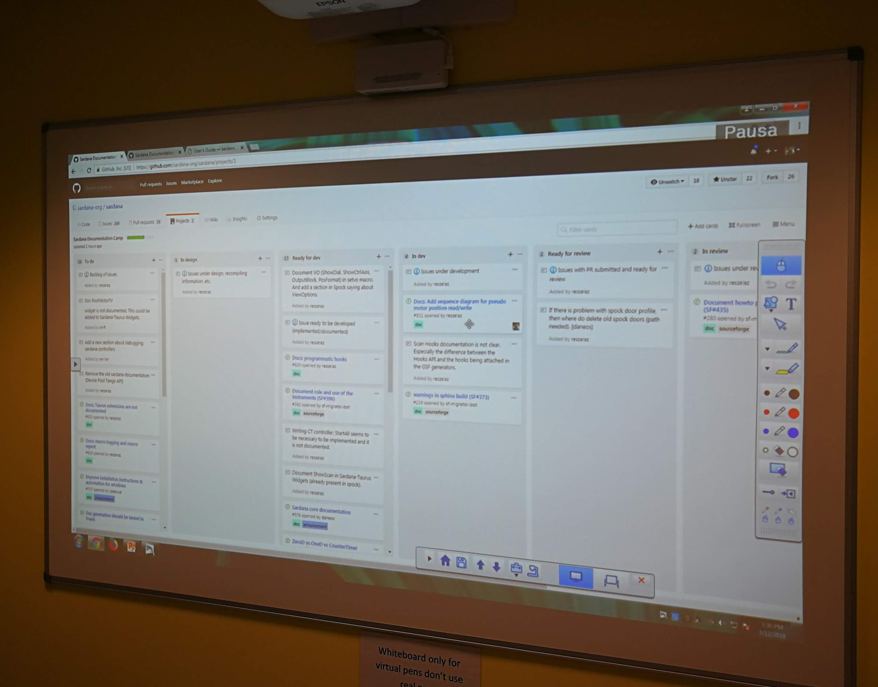
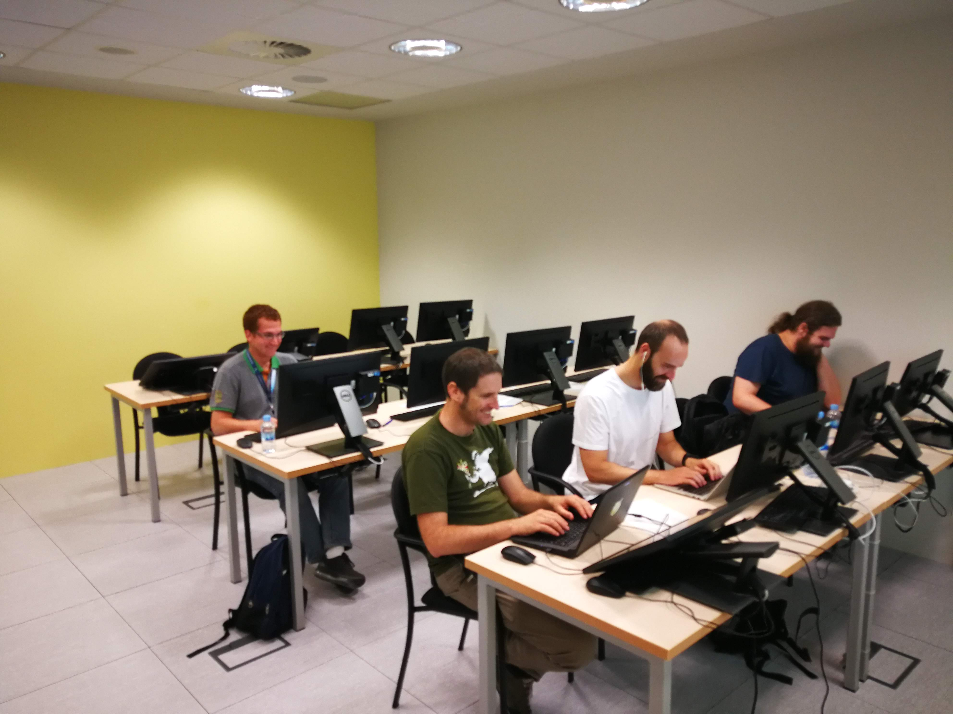
Community – Tools & Events
Docs: http://www.sardana-controls.org
http://www.taurus-scada.org
SEP
TEP
Sardana Enhancement
Proposal
Taurus Enhancement
Proposal
To: List

Slide 33
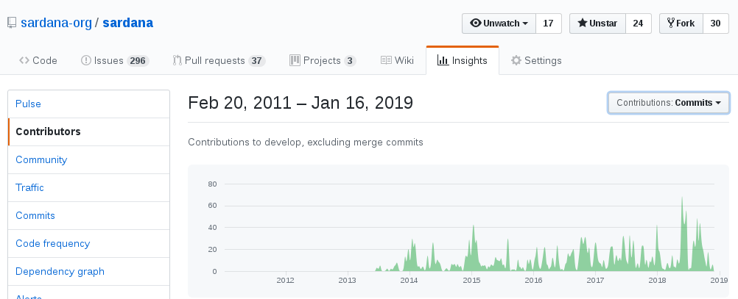
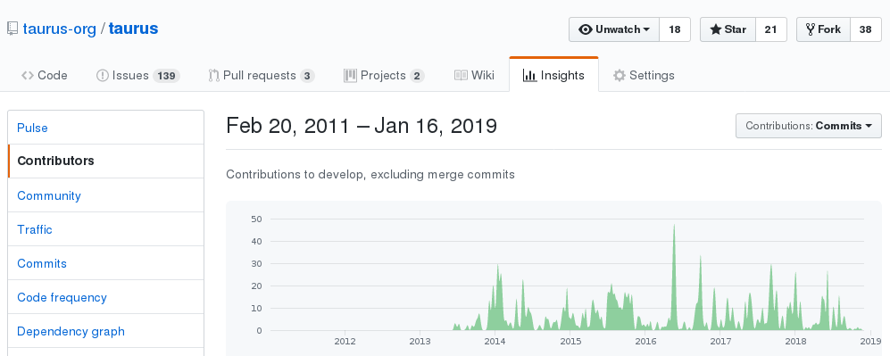
Community – Tools & Events
Projects: https://github.com/sardana-org/sardana
https://github.com/taurus-org/taurus
SEP
TEP
Sardana Enhancement
Proposal
Taurus Enhancement
Proposal
To: List

Slide 34
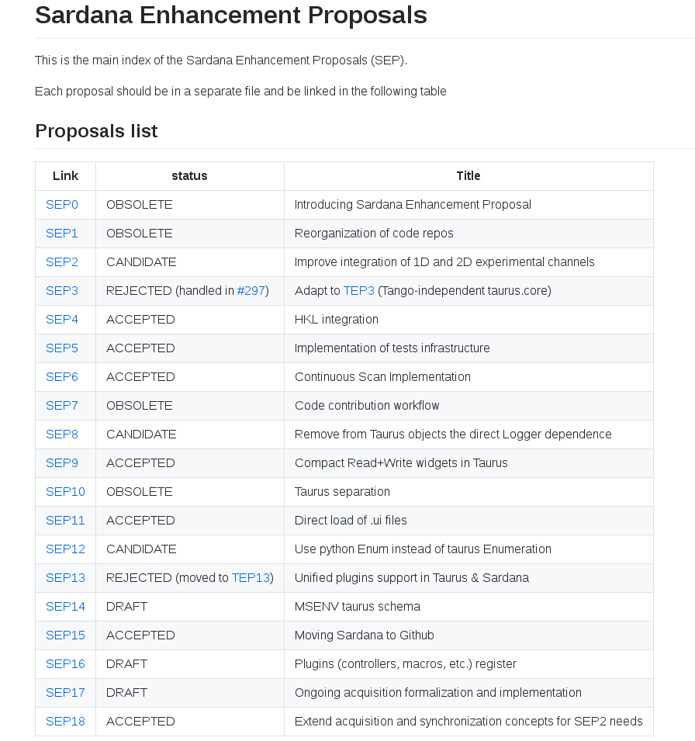

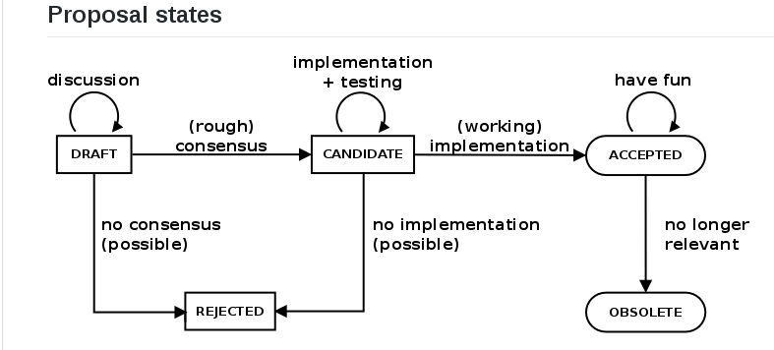
Community – Tools & Events
SEP
TEP
SEP index: https://sardana-controls.org/sep/index.html
TEP index: https://taurus-scada.org/tep/index.html
Sardana Enhancement
Proposal
Taurus Enhancement
Proposal
To: List

Slide 35
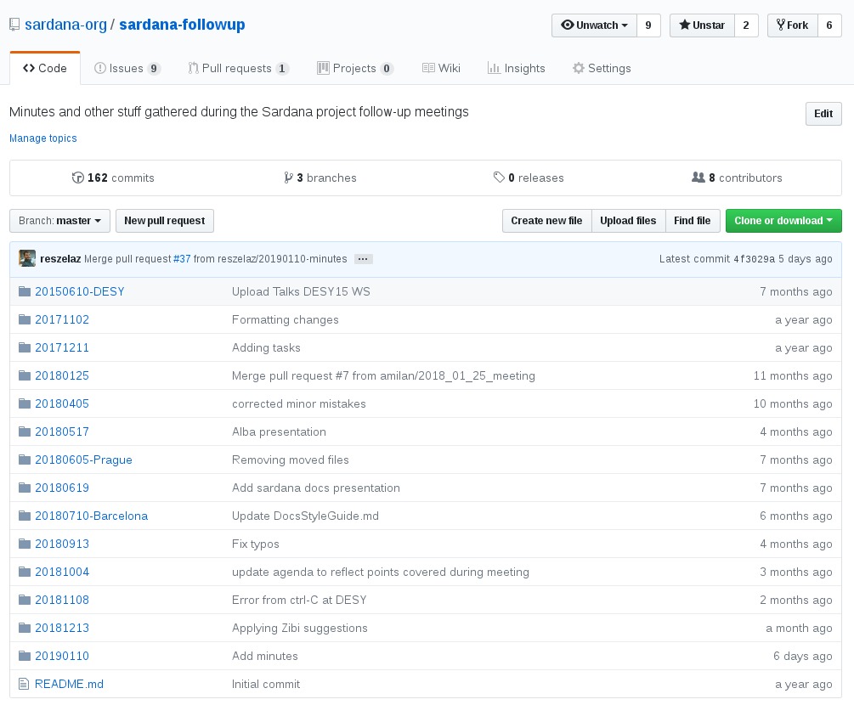
Community – Tools & Events
Videoconf: https://meet.jit.si/sardana
https://github.com/sardana-org/sardana-followup
To: List

Slide 36

Community – Tools & Events
Plugins Catalogue: https://github.com/sardana-org/sardana-plugins
To: List

Slide 37


Community – Tools & Events
Training and workshops: https://github.com/sardana-org/sardana-training
(satellite to Tango meetings or ICALEPCS conference)
To: List

Slide 38
Community – Tools & Events
Announcements: sardana-users@lists.sourceforge.net
tauruslib-users@lists.sourceforge.net
To: List
Coordination: sardana-devel@lists.sourceforge.net
tauruslib-devel@lists.sourceforge.net

Slide 39
Questions?
… you can also reach us at any time!
Acknowledgements:
DESY: Teresa Nuñez, Jan Kotański, Tim Schoft, Thorsten Kracht
SOLARIS: Grzegorz Kowalski, Stanisław Cabała, Ireneusz Zadworny, Michał Fałowski
MAXIV: Antonio Milan, Juliano Murari, Paul Bell, Antoine Dupré, Miriam Lindberg, Vincent Hardion
SOLEIL: Frédéric Picca
Max Born Institute: Daniel Schick
ALBA: all the Computing Division

