Slide 1
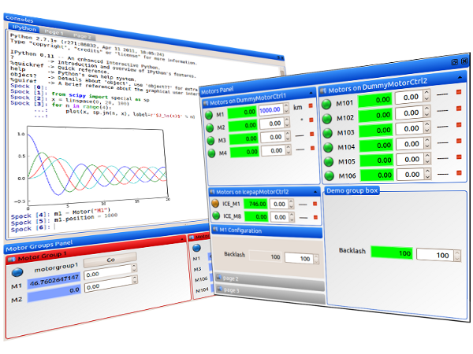

Sardana Suite
Overview
Notes:
Introduction:
* author: on behalf of the Alba Controls Group
* ALBA: TODO
* topic: “Sardana – a Python Based Software Package for Building SCADA Applications”
It aims to reduce cost and time of design, development and support of the control and data acquisition systems
* Sardana name comes from the name of a Catalan dance

Slide 2


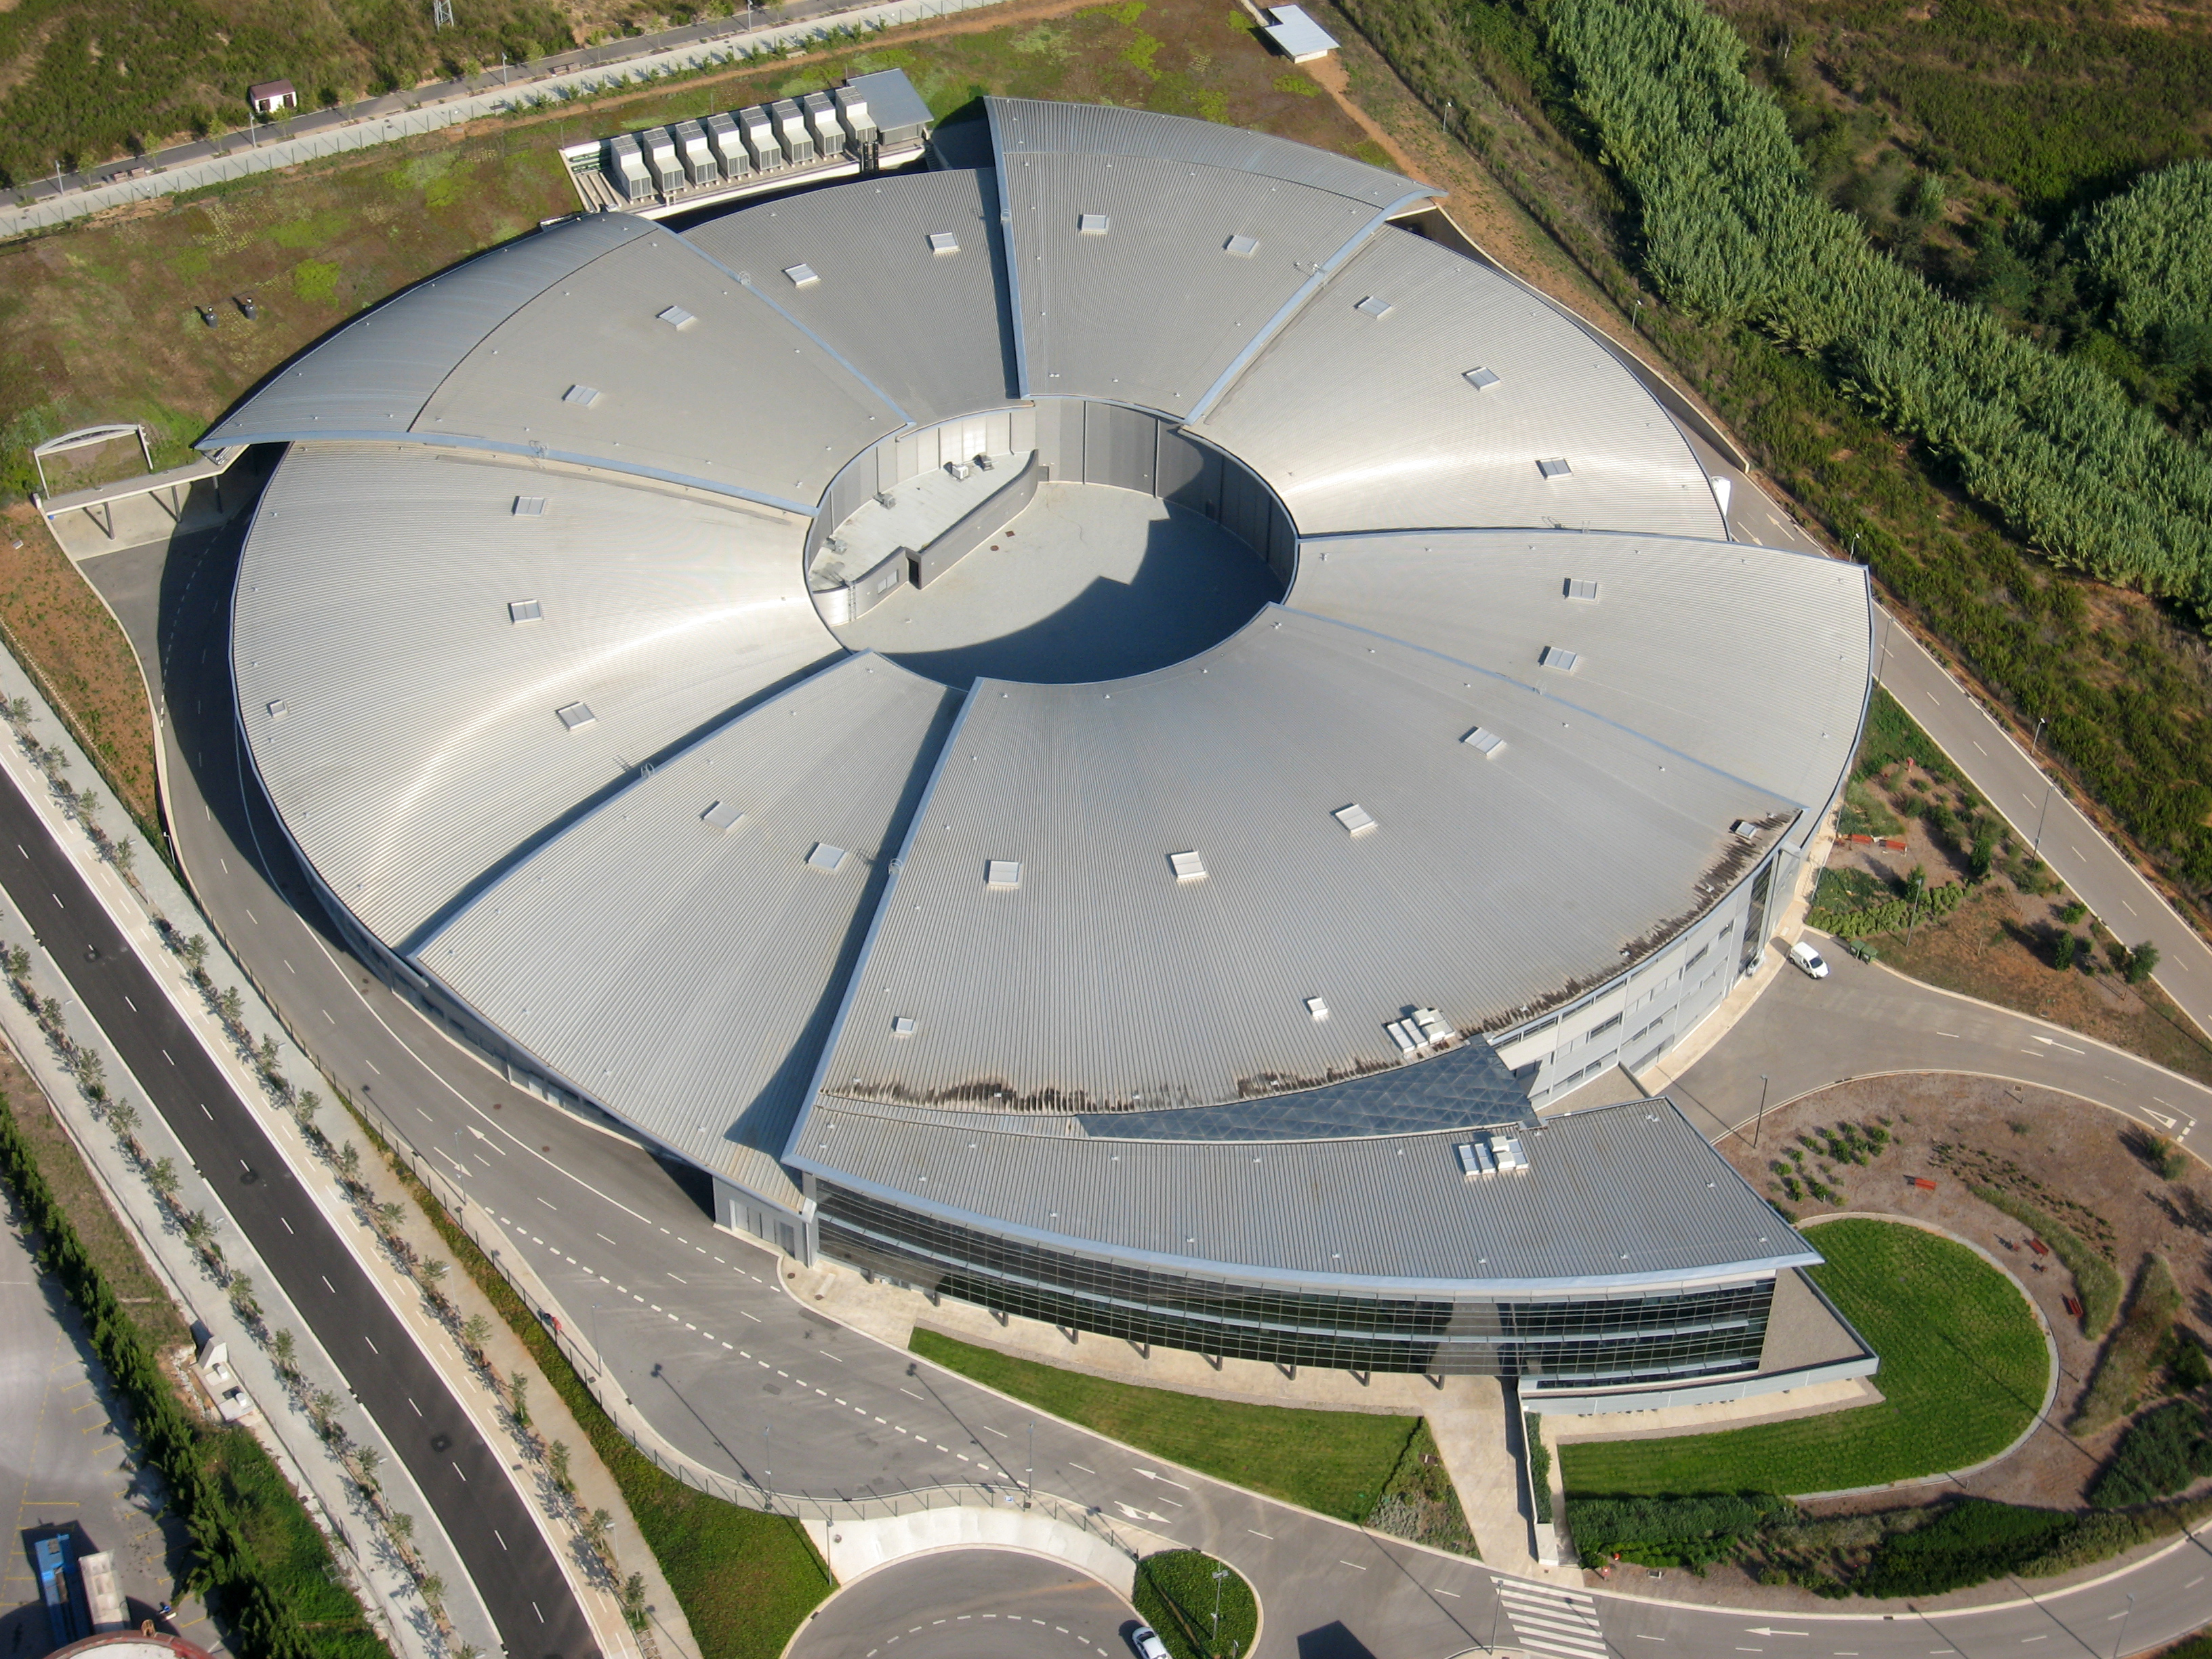




Sardana – Scientific SCADA
Sardana is an open source, Python based, scientific SCADA suite applicable in large spectrum of installations such as particle accelerators, experimental stations or small labs
Sardana was initially an internal Alba project
...but after its successful use in other synchrotrons it became a community driven project
www.sardana-controls.org
www.taurus-scada.org
www.albasynchrotron.es
Notes:
Introduction:
* author: on behalf of the Alba Controls Group
* ALBA: TODO
* topic: “Sardana – a Python Based Software Package for Building SCADA Applications”
It aims to reduce cost and time of design, development and support of the control and data acquisition systems
* Sardana name comes from the name of a Catalan dance

Slide 3

Sardana – Scientific SCADA
Sardana is highly modular
Kernel/Core is software library written in Python
It is heavily based on the concept of plugins what allows easy customization of the system
Its architecture is based on the client-server model
Allows to build distributed control system depending on
the selected server architecture
Currently only Tango communication protocol exists
but others could be implemented as plugins
www.tango-controls.org
Notes:
Introduction:
* author: on behalf of the Alba Controls Group
* ALBA: TODO
* topic: “Sardana – a Python Based Software Package for Building SCADA Applications”
It aims to reduce cost and time of design, development and support of the control and data acquisition systems
* Sardana name comes from the name of a Catalan dance

Slide 4
Sardana Suite
Generic TaurusGUI
Taurus Widgets
Spock
Taurus Core
SARDANA SUITE
Macros
Macro Server
schemes://
Recorders
Device Pool
Controllers
Notes:
Introduction:
* author: on behalf of the Alba Controls Group
* ALBA: TODO
* topic: “Sardana – a Python Based Software Package for Building SCADA Applications”
It aims to reduce cost and time of design, development and support of the control and data acquisition systems
* Sardana name comes from the name of a Catalan dance

Slide 5
Taurus library – client
Generic TaurusGUI
Taurus Widgets
www.taurus-scada.org
Taurus Core
Taurus is a framework for creating
GUI and CLI to interact with control
systems or other data sources
Taurus based graphical widgets e.g. generic: forms, plots; Sardana specific: macro executor, motor,
experiment configuration, scan plots, …
schemes://
TaurusGUI framework for creating complete GUIs
without programming a single line of code!
Taurus used model-view pattern.
Any data source could be accessed!
Notes:
Introduction:
* author: on behalf of the Alba Controls Group
* ALBA: TODO
* topic: “Sardana – a Python Based Software Package for Building SCADA Applications”
It aims to reduce cost and time of design, development and support of the control and data acquisition systems
* Sardana name comes from the name of a Catalan dance

Slide 6
Taurus library – client
Generic TaurusGUI
Taurus Widgets
www.taurus-scada.org
Taurus Core
Taurus is a framework for creating
GUI and CLI to interact with control
systems or other data sources
Taurus based graphical widgets e.g. generic: forms, plots; Sardana specific: macro executor, motor,
experiment configuration, scan plots, …
schemes://
TaurusGUI framework for creating complete GUIs
without programming a single line of code!
Taurus used model-view pattern.
Any data source could be accessed!
Notes:
Introduction:
* author: on behalf of the Alba Controls Group
* ALBA: TODO
* topic: “Sardana – a Python Based Software Package for Building SCADA Applications”
It aims to reduce cost and time of design, development and support of the control and data acquisition systems
* Sardana name comes from the name of a Catalan dance

Slide 7
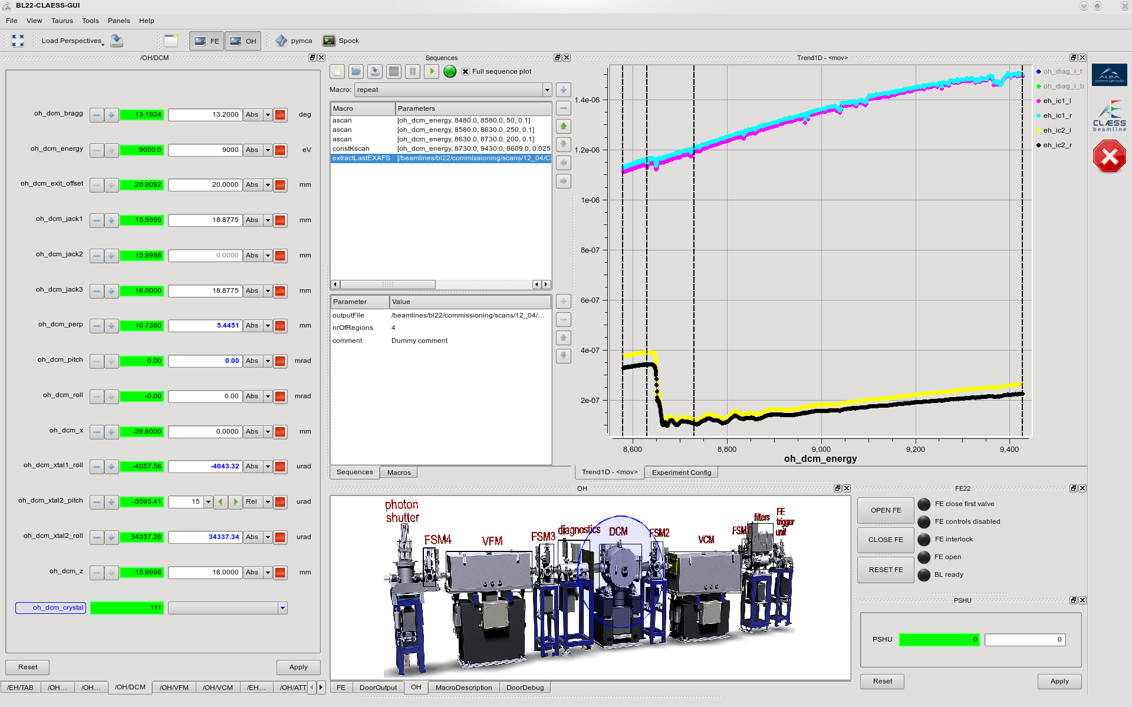
SardanaGUI w/o programming
User perspectives
1D & 2D plots
Macro execution
widgets
External widgets
Forms with devices
and/or attributes
Interactive synoptic
BL22 (ALBA) GUI created with the TaurusGUI framework
Notes:
Introduction:
* author: on behalf of the Alba Controls Group
* ALBA: TODO
* topic: “Sardana – a Python Based Software Package for Building SCADA Applications”
It aims to reduce cost and time of design, development and support of the control and data acquisition systems
* Sardana name comes from the name of a Catalan dance

Slide 8
Taurus library – client
Generic TaurusGUI
Taurus Widgets
www.taurus-scada.org
Taurus Core
Taurus is a framework for creating
GUI and CLI to interact with control
systems or other data sources
Taurus based graphical widgets e.g. generic: forms, plots; Sardana specific: macro executor, motor,
experiment configuration, scan plots, …
schemes://
TaurusGUI framework for creating complete GUIs
without programming a single line of code!
Taurus used model-view pattern.
Any data source could be accessed!
Notes:
Introduction:
* author: on behalf of the Alba Controls Group
* ALBA: TODO
* topic: “Sardana – a Python Based Software Package for Building SCADA Applications”
It aims to reduce cost and time of design, development and support of the control and data acquisition systems
* Sardana name comes from the name of a Catalan dance

Slide 9
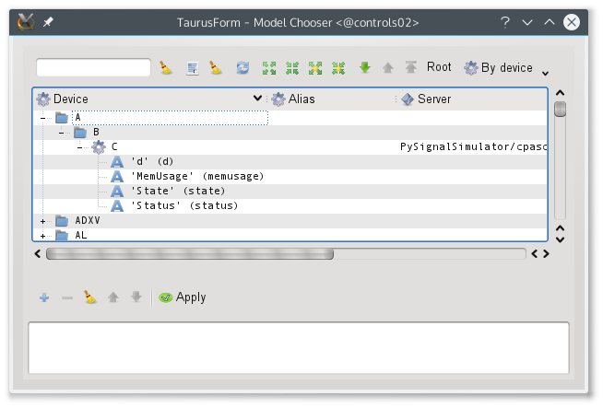
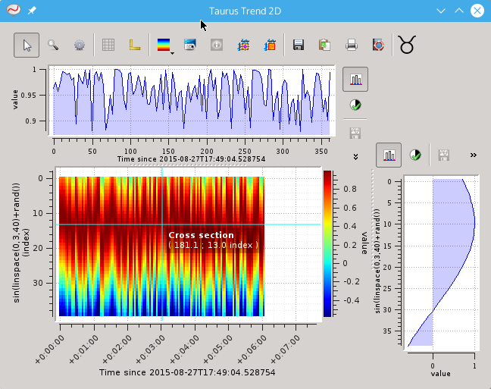
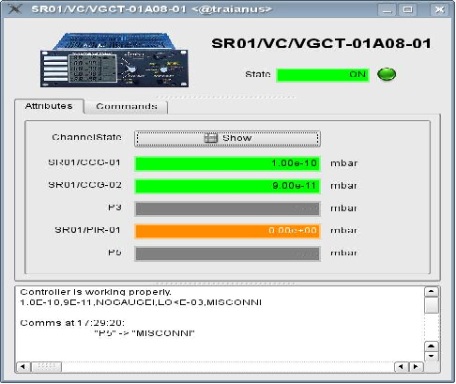
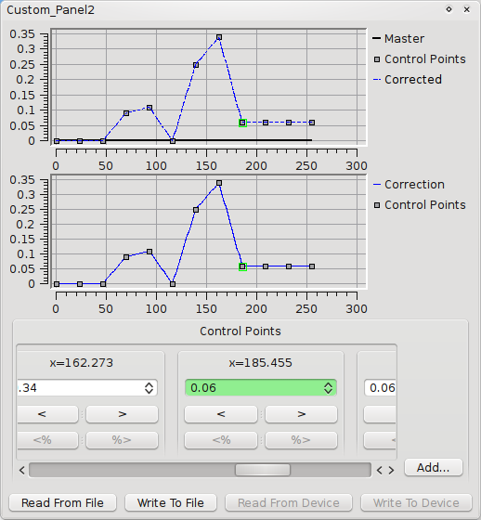
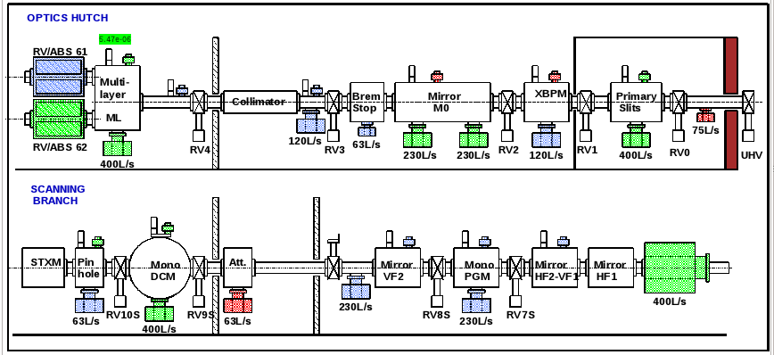
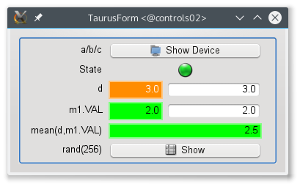
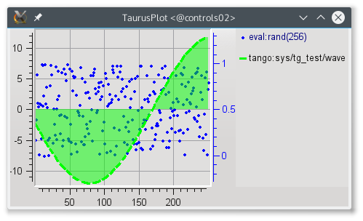
Taurus Widgets
Taurus widgets are implemented by subclassing from the Qt
widgets
Taurus generic widgets: forms, plots, trends, grids…
Sardana specifc widgets: motor, channel, macroexecutor,...
Notes:
Introduction:
* author: on behalf of the Alba Controls Group
* ALBA: TODO
* topic: “Sardana – a Python Based Software Package for Building SCADA Applications”
It aims to reduce cost and time of design, development and support of the control and data acquisition systems
* Sardana name comes from the name of a Catalan dance

Slide 10
Taurus library – client
Generic TaurusGUI
Taurus Widgets
www.taurus-scada.org
Taurus Core
Taurus is a framework for creating
GUI and CLI to interact with control
systems or other data sources
Taurus based graphical widgets e.g. generic: forms, plots; Sardana specific: macro executor, motor,
experiment configuration, scan plots, …
schemes://
TaurusGUI framework for creating complete GUIs
without programming a single line of code!
Taurus used model-view pattern.
Any data source could be accessed!
Notes:
Introduction:
* author: on behalf of the Alba Controls Group
* ALBA: TODO
* topic: “Sardana – a Python Based Software Package for Building SCADA Applications”
It aims to reduce cost and time of design, development and support of the control and data acquisition systems
* Sardana name comes from the name of a Catalan dance

Slide 11
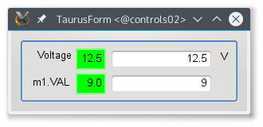

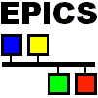
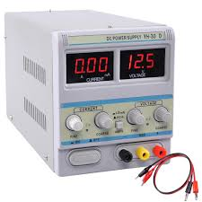
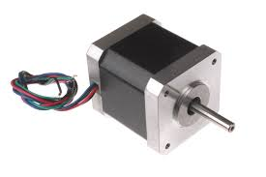
Taurus Core
Model (Attribute)
tango:powesupply/test/1/voltage
Model (Attribute)
epics:XXX:m1.VAL
Taurus Core
Notes:
Introduction:
* author: on behalf of the Alba Controls Group
* ALBA: TODO
* topic: “Sardana – a Python Based Software Package for Building SCADA Applications”
It aims to reduce cost and time of design, development and support of the control and data acquisition systems
* Sardana name comes from the name of a Catalan dance

Slide 12
Spock – client
Generic TaurusGUI
Taurus Widgets
Spock
Taurus Core
SARDANA SUITE
Macros
Macro Server
schemes://
Recorders
Device Pool
Controllers
Notes:
Introduction:
* author: on behalf of the Alba Controls Group
* ALBA: TODO
* topic: “Sardana – a Python Based Software Package for Building SCADA Applications”
It aims to reduce cost and time of design, development and support of the control and data acquisition systems
* Sardana name comes from the name of a Catalan dance

Slide 13
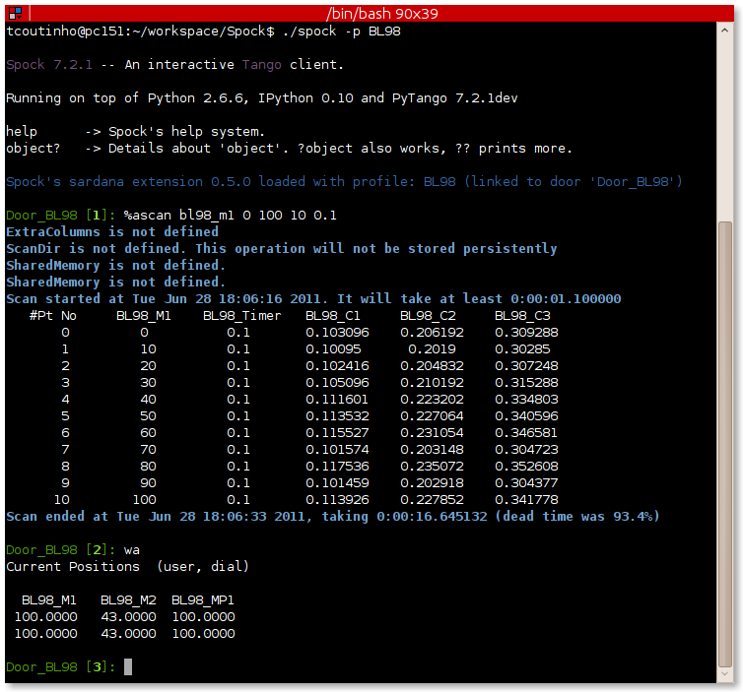
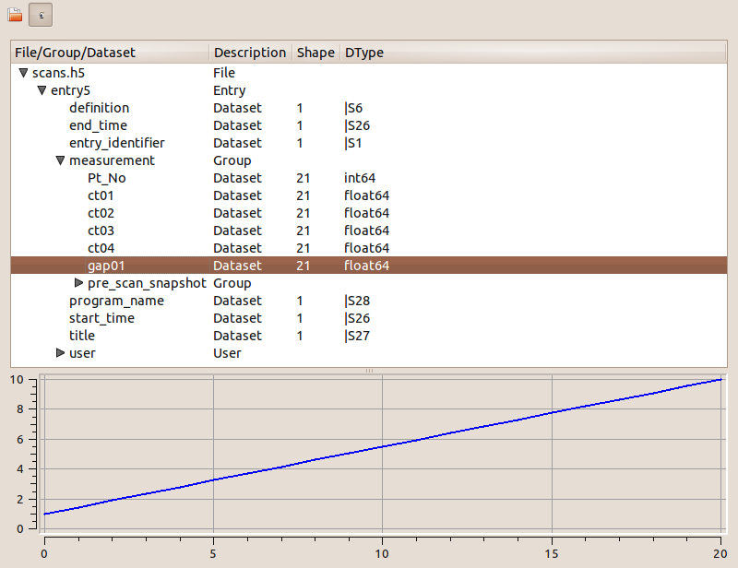
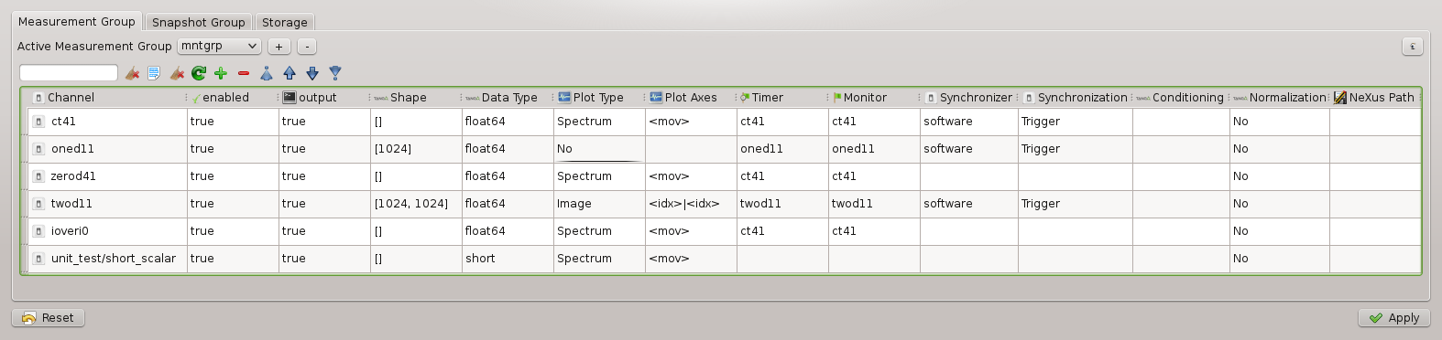
Spock – client
Spock – IPython based Sardana CLI which syntax mimics SPEC commands, provides total control over the system: executes procedures, interacts with the elements, …
Notes:
Introduction:
* author: on behalf of the Alba Controls Group
* ALBA: TODO
* topic: “Sardana – a Python Based Software Package for Building SCADA Applications”
It aims to reduce cost and time of design, development and support of the control and data acquisition systems
* Sardana name comes from the name of a Catalan dance

Slide 14
MacroServer
Generic TaurusGUI
Taurus Widgets
Spock
Taurus Core
SARDANA SUITE
Macros
Macro Server
schemes://
Recorders
Device Pool
Controllers
Notes:
Introduction:
* author: on behalf of the Alba Controls Group
* ALBA: TODO
* topic: “Sardana – a Python Based Software Package for Building SCADA Applications”
It aims to reduce cost and time of design, development and support of the control and data acquisition systems
* Sardana name comes from the name of a Catalan dance

Slide 15
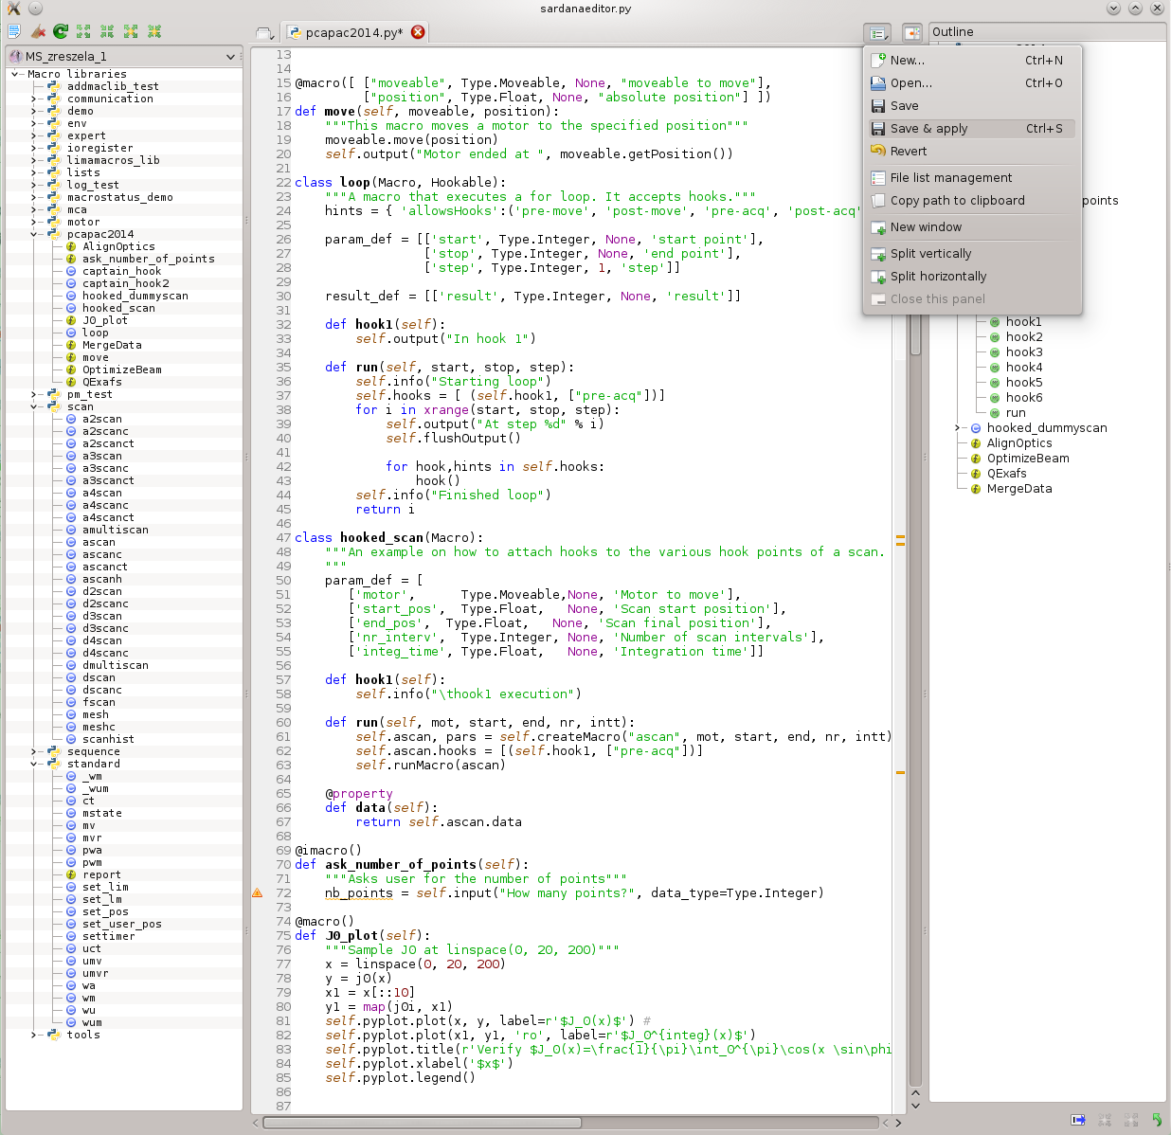
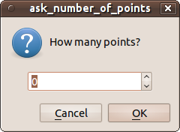
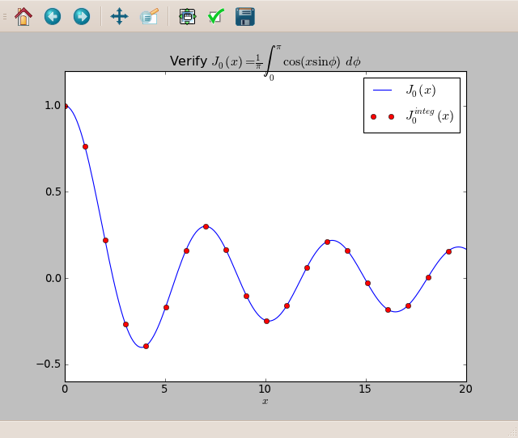
MacroServer & User Procedures
Hooks
Adding, editing macros
at runtime
Door_1 [8]: loop 0 10 3
Starting loop
At step 0
running hook with hints=['pre-acq']
In hook 1
At step 3
running hook with hints=['pre-acq']
In hook 1
At step 6
running hook with hints=['pre-acq']
In hook 1
At step 9
running hook with hints=['pre-acq']
In hook 1
Finished loop
Interactive macros
Input parameters &
results & data
Plotting
SPEC like commands
Macro editor with exemplary macros demonstrating advanced macro programming features.
Notes:
Introduction:
* author: on behalf of the Alba Controls Group
* ALBA: TODO
* topic: “Sardana – a Python Based Software Package for Building SCADA Applications”
It aims to reduce cost and time of design, development and support of the control and data acquisition systems
* Sardana name comes from the name of a Catalan dance

Slide 16
Pool
Generic TaurusGUI
Taurus Widgets
Spock
Taurus Core
SARDANA SUITE
Macros
Macro Server
schemes://
Recorders
Device Pool
Controllers
Notes:
Introduction:
* author: on behalf of the Alba Controls Group
* ALBA: TODO
* topic: “Sardana – a Python Based Software Package for Building SCADA Applications”
It aims to reduce cost and time of design, development and support of the control and data acquisition systems
* Sardana name comes from the name of a Catalan dance

Slide 17
Pool - Unifies Hardware Access
All the equipments are interfaced via Pool and its plug-in controller classes (Python)
Generic elements' interfaces allow building high level layers on top of them e.g. MeasurementGroup, pseudo elements, generic widgets, etc.
Element Type | Example of application
Motor | stepper, servo or piezo actuator
PseudoMotor | energy, HKL of a diffractometer, slit's gap or offset
CounterTimer | event counter, position measurement
PseudoCounter | vertical beam position in the X-ray beam position monitor (XBPM)
0DExpChannel | analog to digital converter (ADC), low current electrometer
1DExpChannel | position sensitive detector (PSD), multichannel analyzer (MCA)
2DExpChannel | CCD camera, 2D X-ray detector
Pool DS
Pool
Motors
0D
Channels
Controllers
Counters
2D
Channels
Pool Device Server and its elements
Sardana element types and its examples
Notes:
Introduction:
* author: on behalf of the Alba Controls Group
* ALBA: TODO
* topic: “Sardana – a Python Based Software Package for Building SCADA Applications”
It aims to reduce cost and time of design, development and support of the control and data acquisition systems
* Sardana name comes from the name of a Catalan dance

Slide 18
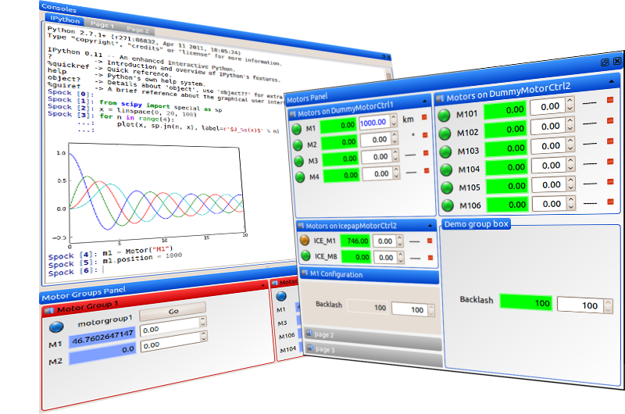
Server architectures
Sardana DS
MacroServer
Doors
Pool
Motors
0D
Channels
Controllers
Counters
2D
Channels
A diagram representing a Sardana server and its objects
Notes:
Introduction:
* author: on behalf of the Alba Controls Group
* ALBA: TODO
* topic: “Sardana – a Python Based Software Package for Building SCADA Applications”
It aims to reduce cost and time of design, development and support of the control and data acquisition systems
* Sardana name comes from the name of a Catalan dance

Slide 19
Server architectures
Pool DS
MacroServer DS
Pool
Motors
0D
Channels
MacroServer
Doors
Controllers
Counters
2D
Channels
Sardana configured to be a single
MacroServer DS (no Pool present)
Sardana configured to be a single
Pool DS (no MacroServer present)
Notes:
Introduction:
* author: on behalf of the Alba Controls Group
* ALBA: TODO
* topic: “Sardana – a Python Based Software Package for Building SCADA Applications”
It aims to reduce cost and time of design, development and support of the control and data acquisition systems
* Sardana name comes from the name of a Catalan dance

Slide 20
Server architectures
MacroServer DS
MacroServer
Doors
Pool DS
Pool
Motors
0D
Channels
Controllers
Counters
2D
Channels
Sardana configured with a MacroServer DS connecting to an underlying Pool DS
Notes:
Introduction:
* author: on behalf of the Alba Controls Group
* ALBA: TODO
* topic: “Sardana – a Python Based Software Package for Building SCADA Applications”
It aims to reduce cost and time of design, development and support of the control and data acquisition systems
* Sardana name comes from the name of a Catalan dance

Slide 21
Server architectures
Pool DS
Sardana DS
Pool B
MacroServer
Doors
0D
Channels
Motors
Pool A
Motors
0D
Channels
2D
Channels
Counters
Controllers
Controllers
Counters
2D
Channels
Sardana configured with a Sardna DS connecting to another underlying Pool DS
Notes:
Introduction:
* author: on behalf of the Alba Controls Group
* ALBA: TODO
* topic: “Sardana – a Python Based Software Package for Building SCADA Applications”
It aims to reduce cost and time of design, development and support of the control and data acquisition systems
* Sardana name comes from the name of a Catalan dance

Slide 22
Sardana Suite – Summary
Generic TaurusGUI
Taurus Widgets
Spock
Taurus Core
SARDANA SUITE
Macros
Macro Server
schemes://
Recorders
Device Pool
Controllers
Notes:
Introduction:
* author: on behalf of the Alba Controls Group
* ALBA: TODO
* topic: “Sardana – a Python Based Software Package for Building SCADA Applications”
It aims to reduce cost and time of design, development and support of the control and data acquisition systems
* Sardana name comes from the name of a Catalan dance

Slide 23
Thank you for your attention!
Notes:
Introduction:
* author: on behalf of the Alba Controls Group
* ALBA: TODO
* topic: “Sardana – a Python Based Software Package for Building SCADA Applications”
It aims to reduce cost and time of design, development and support of the control and data acquisition systems
* Sardana name comes from the name of a Catalan dance

