Slide 1
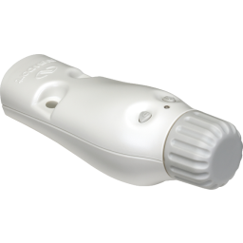
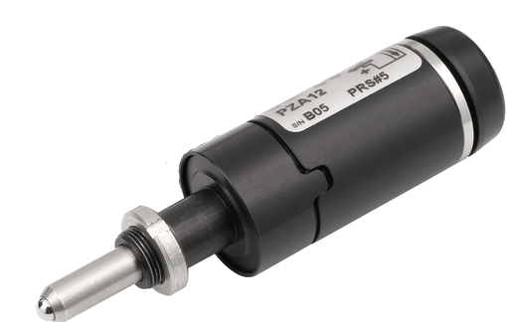
Sardana DS
Motor
“np_mot1”
Pool
MacroServer
Doors
Controller
“np200ctrl”
NSC200Controller

Slide 2
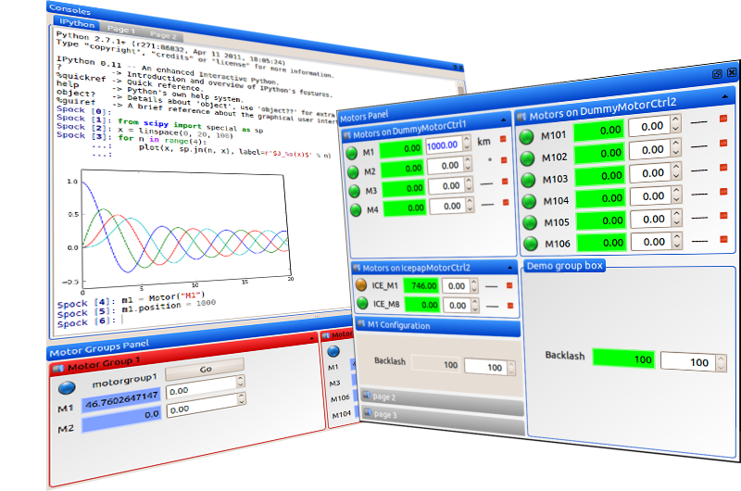
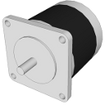
Sardana server
Sardana server
tango
interface
Motor
sardana
kernel
PoolMotor
Pool
Controller
Controller
Motor
Controller

Slide 3
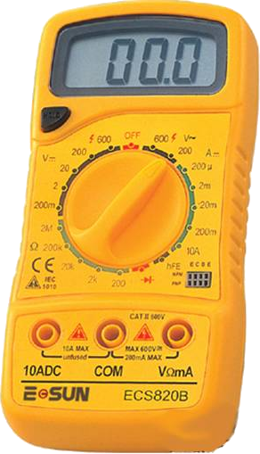
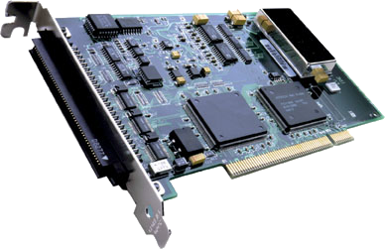
Sardana server
Sardana server
sardana kernel
tango
interface
Motor
Pool
Motor
Pool
Controller
Motor
Controller
sardana
kernel
Sardana server
ZeroD
ExpChannel
sardana kernel
Pool
0D
ExpChannel
Pool
Controller
ZeroD
Controller
Controller
Sardana server
CT
ExpChannel
sardana kernel
Pool
Counter
Timer
Pool
Controller
CounterTimer
Controller

Slide 4
Sardana server
sardana kernel
Motor
sl2t
Pool
Motor
Pool
Controller
Motor
Controller
Motor
sl2b
Pool
Motor
sl2t
PseudoMotor
gap
Pool
PseudoMotor
Pool
Controller
PseudoMotor
Controller
offset
gap
PseudoMotor
offset
Pool
PseudoMotor
sl2b

Slide 5
Motor
Pool
Motor
Pool
Controller
Motor
Controller
read
position
get_position()
read_position(axis)
PreReadAll()
PreReadOne(axis)
ReadAll()
ReadOne(axis)
position
position
position
position

Slide 6
Pseudo
Motor
Pool
PseudoMotor
Pool
PseudoMotor
Controller
PseudoMotor
Controller
Position
read
position
get_position()
Update physical
positions by
reading from
MotorController(s)
update()
position
attribute
get_value()
calc_pseudo()
get_physical_positions()
calc_pseudo(axis,
physical_pos)
CalcPseudo(axis,
physical_pos)
position
position
position
position

Slide 7
Motor
Pool
Motor
Pool
Controller
Motor
Controller
write
position(pos)
set_position(pos)
calculate
motion(pos)
check
preconditions()
start_move(dial_pos)
set_position
(axis, dial_pos)
PreStartAll()
PreStartOne
(axis, dial_pos)
True
True
True
StartOne
(axis, dial_pos)
StartAll()

Slide 8
Pseudo
Motor
Pool
PseudoMotor
<moveable>
Pool
Controller
PseudoMotor
Controller
Position
write
position(pos)
<moveable> may be
PoolPseudoMotor
Or
PoolMotor
set_position(pos)
start_move(pos)
calculate_motion(pos)
get_siblings_positions(
use, write_pos)
get_physical_positions()
positions(s)
calc_all_physical(
pseudo_positions,
curr_physical_positions)
CalcAllPhysical(
pseudo_positions,
curr_physical_positions)
position(s)
position(s)
calculate_motion(pos)
position(s)
Next step is to
start a move
on a single
or a group
of physical motors

Slide 9
Motor
Pool
Motor
Pool
Controller
Motor
Controller
read
state
get_state()
read_state(axis)
PreStateAll()
PrestateOne(axis)
StateAll()
StateOne(axis)
state
state
state
state

Slide 10
Sardana DS
Motor
npm_1
Motor
icem_1 .. 5
Pool
MacroServer
Controller
np200ctrl_1
Controller
icectrl_1
IcepapController
NSC200Controller

Slide 11
Sardana DS
Motor
npm_1
Pool
MacroServer
Controller
np200ctrl_1
NSC200Controller

Slide 12
Sardana DS
Motor
icem_[1..5]
Pool
MacroServer
Controller
icectrl_1
IcepapController

Slide 13
Sardana DS
Motor
“np_mot1”
Pool
MacroServer
Doors
Controller
“np200ctrl”
NSC200Controller

Slide 14
Pool DS
MacroServer DS
Pool
Motors
0D
Channels
MacroServer
Doors
Controllers
Counters
2D
Channels

Slide 15
MacroServer DS
MacroServer
Doors
Pool DS
Pool
Motors
0D
Channels
Controllers
Counters
2D
Channels

Slide 16
Sardana DS
MacroServer
Doors
Pool
Motors
0D
Channels
Controllers
Counters
2D
Channels

Slide 17
Pool DS
Sardana DS
Pool B
MacroServer
0D
Channels
Motors
Doors
Pool A
Motors
0D
Channels
2D
Channels
Counters
Controllers
Controllers
Counters
2D
Channels

Slide 18
-2 -1 0 1 2 right
left 2 1 0 -1 -2
left
(0)
right
(0)
gap = 0 & offset = 0
gap (0)
move gap to 1
offset (0)
left
(0.498)
right
(0.5)
gap (0.998)
move gap to 2
offset (0.001)
left
(0.997)
right
(1.001)
gap (1.998)
offset (0.002)
move gap to 3
left
(1.496)
right
(1.502)
gap (2.998)
offset (0.003)

Slide 19
-2 -1 0 1 2 right
left 2 1 0 -1 -2
left
(0)
right
(0)
gap = 0 & offset = 0
gap (0)
move gap to 1
offset (0)
left
(0.498)
right
(0.5)
gap (0.998)
move gap to 2
offset (0.001)
left
(0.998)
right
(1)
gap (1.998)
offset (0.001)
move gap to 3
left
(1.498)
right
(1.5)
gap (2.998)
offset (0.001)

Slide 20
Repeats
Repeats
Total
Total
Active
Active
Delay
Initial
Initial
Group

Slide 21
Generic TaurusGUI
Taurus Widgets
Spock
Taurus Core
SARDANA SUITE
Macros
Macro Server
schemes://
Recorders
Device Pool
Controllers

