Slide 1



Auditing using Generative AI
Sponsor & Mentor: Eda Mae Badilla, Nabanita Roy (EY)
Supervisor: Dr. Michael MacDonnell
Team:
Pranoti Dahiwal
Gagan Sardana
Shivani Bhardwaj

Slide 2
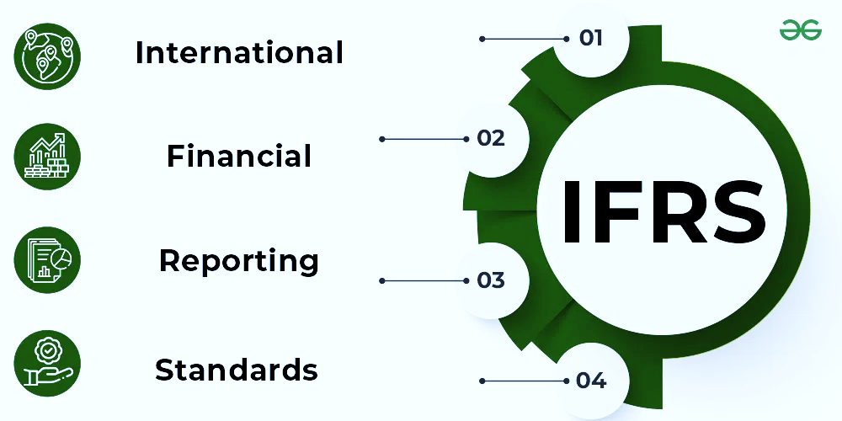
Research Background
IFRS Standards: Enhancing Transparency and Consistency in Financial Reporting.
Exploring OpenAI’s Technological breakthroughs: from Embeddings to Prompt Engineering.

Slide 3




Tools Supporting IFRS Standards Contemporary
Offers a cloud-based platform that streamlines financial reporting, compliance, and data management.
ERP solution that includes financial modules aligned with IFRS requirements
Helps in ensuring compliance with IFRS standards through accurate financial reporting
Provides software solutions for financial reporting, auditing, and analytics
Business Motivation
Time sensitivity
Interpretation variability
Reducing manual efforts
Addressing the rapidly evolving complexity of standards and annual reports
Limited guidance

Slide 4
Business Scope
Goal
Deliverables
Key Stakeholders and Teams
Project Boundaries
Focus and Dedication
Automating the IFRS Standards using OpenAI and prompt engineering
Addressing IFRS Standards by utilising annual reports with precision
Stakeholders: Financial Professionals,
Technical Professionals
Teams: Enterprise Resource Planning (ERP)
Achieving human level precision in logical reasoning
Simplified IFRS Compliance: Answering Standards without Accounting Expertise

Slide 5
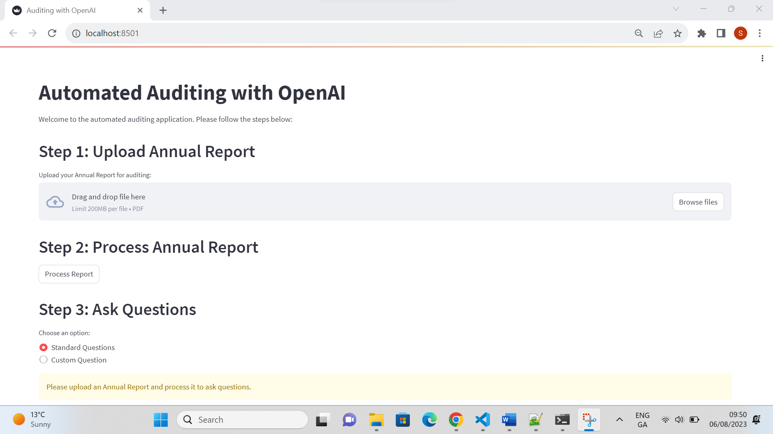
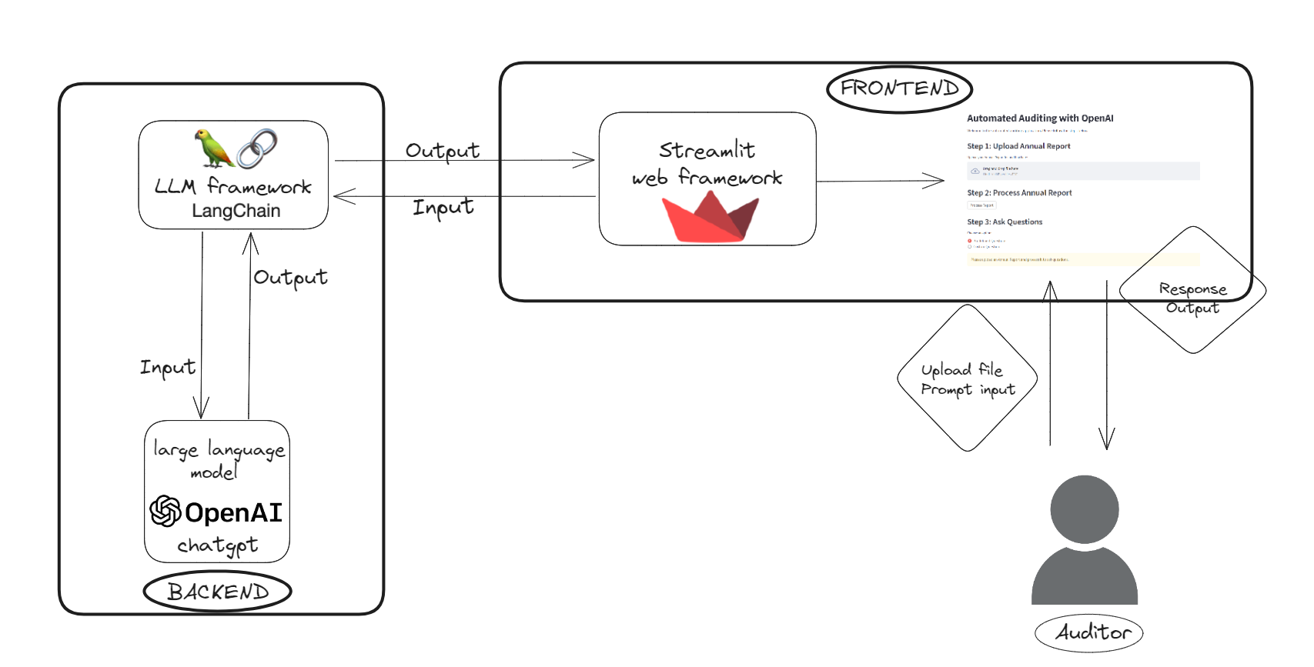

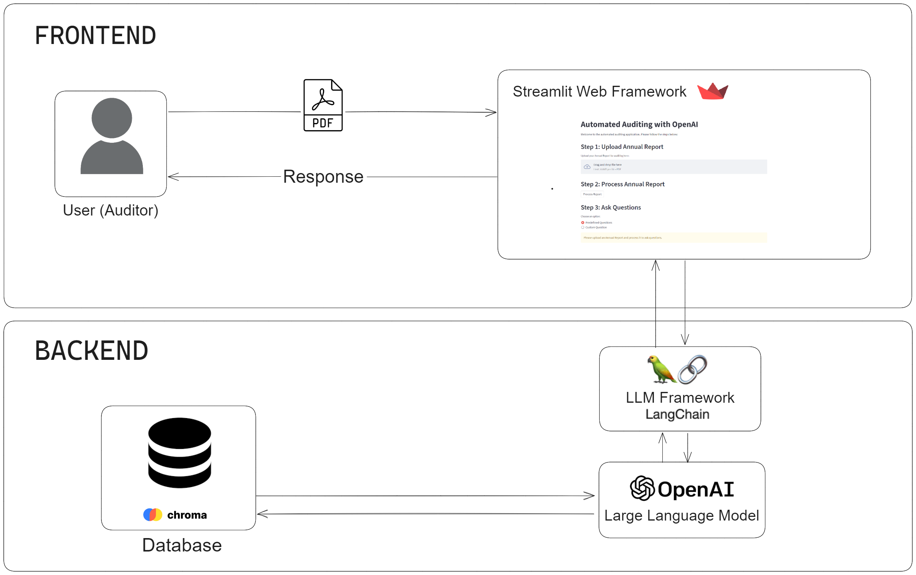
Approach
High level Architecture
User Interface

Slide 6
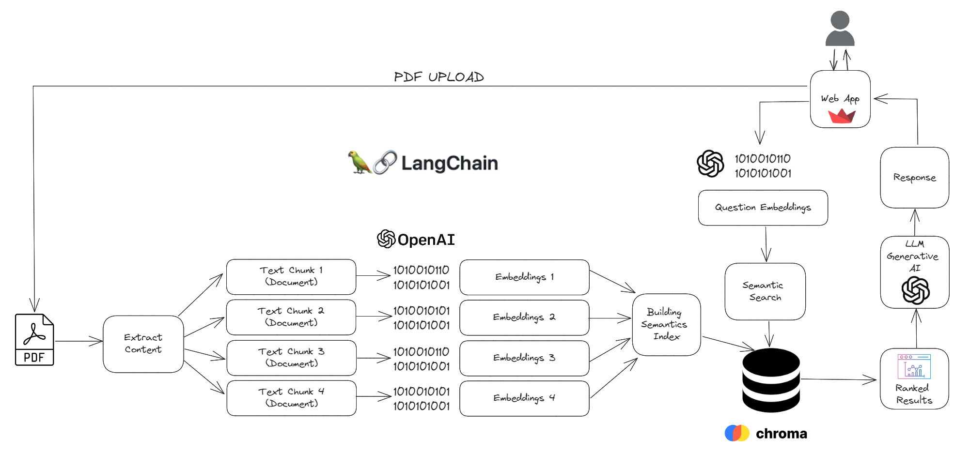
Methodology
Low level Architecture
PDF UPLOAD

Slide 7
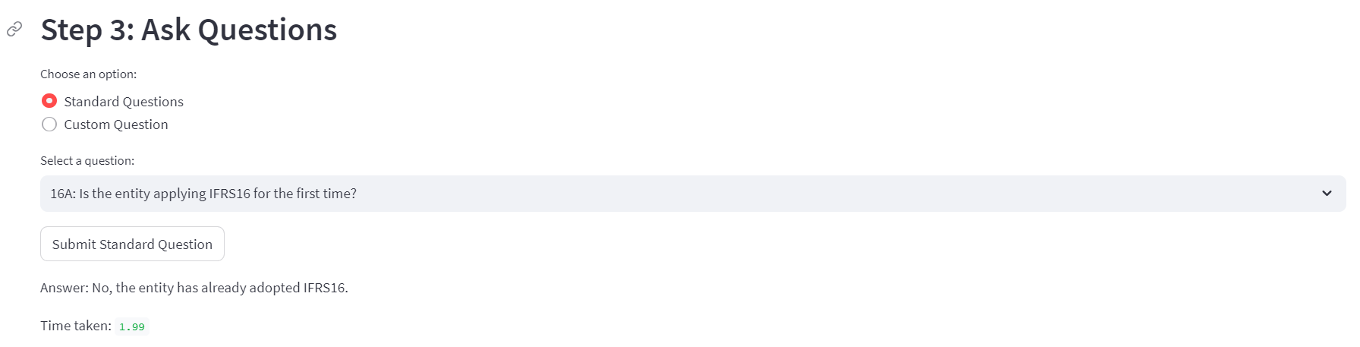
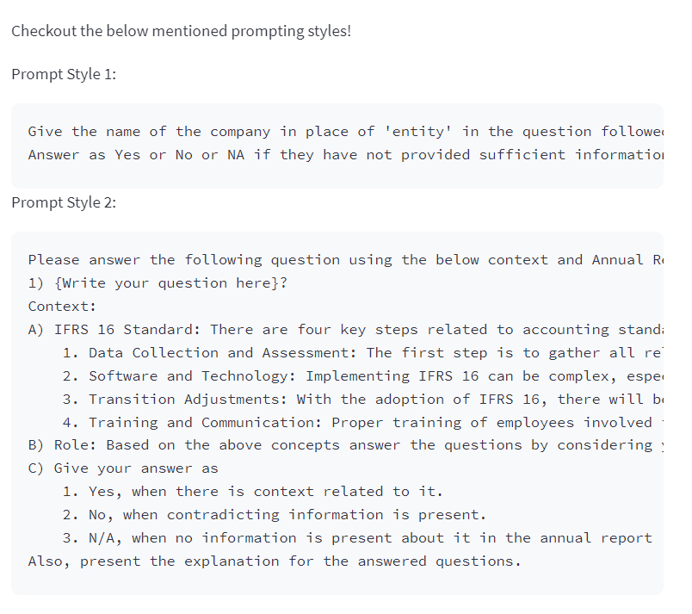
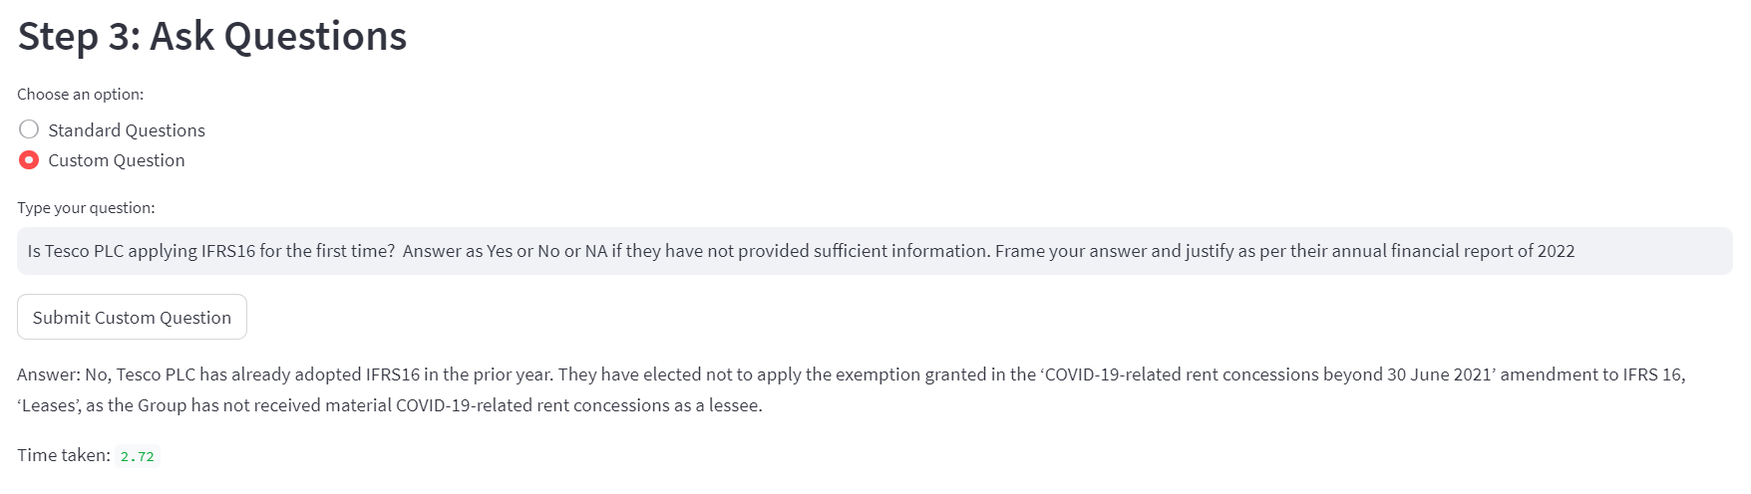
Response Generated
Standard Question Response
Prompt Styles
Custom Question Response

Slide 8
Results (IFRS 16)
Tesco PLC 2022
Question Type | Precision | Recall | F1 Score | Accuracy
Standard Question | 1 | 0.6 | 0.75 | 0.63
Prompt Style 1 | 1 | 0.5 | 0.67 | 0.56
Prompt Style 2 | 1 | 0.8 | 0.89 | 0.86
Marks and Spencer PLC 2023*
Question Type | Precision | Recall | F1 Score | Accuracy
Standard Question | 1 | 0.6 | 0.75 | 0.63
Prompt Style 1 | 0 | 0.0 | 0.00 | 0.29
Prompt Style 2 | 1 | 0.4 | 0.57 | 0.57
“N/A” and “NO” are considered as equal answers
* Based on our understanding of manual auditing
Notes:
The application was tested for IFRS 16 Standard used for auditing, specifically for retail industry. We asked the questions for Tesco’s annual report of 2022 and M&S’s report of 2023. Before discussing the results, I just want to highlight that Tesco results were calculated based on EY’s answers provided after manually auditing the report whereas m&s’s results are purely based on our understanding of IFRS 16. Also, we confirmed from EY’s auditing team and considered No and NA as equal results.
We tried three types of questions, which were standard (present in auditing checklist), prompt style 1 which gave context of report to be addressed and specified the answering format and prompt style 2 which had complete context of IFRS 16, Role of open ai as financial analyst and answer generation format. The results of Tesco’s report Show best accuracy with prompt style 2, whereas results of M&S were best for standard questions. Interestingly, both showcased same accuracy for Standard question answering.

Slide 9
Business Value
Enablement of Non-Financial Experts
Time Efficiency
Insightful Reasoning
Enhanced Scalability
By minimising manual hours
Standard response with elucidation
Adaptability to varying report structure and size
Via user friendly accessible tool
Notes:
The business value of our application can be segmented broadly into four categories, which are:
Time efficiency: In general, IFRS 16 takes around 15-45 minutes to complete manually, depending on the industry as well which was confirmed by EY. Whereas our tool could reduce the time significantly to 10-15mins per report.
The tool provides reasons with its Reponses which are typically yes, no or NA. Hence, this could essentially be treated as an aiding tool for auditors help them identify and confirm the reasoning behind the answers they typically generate.
The tool effectively works for varied pdf structures and sizes.
The tool is very user friendly and simple to use, even for non-financial people like us.

Slide 10
Conclusion and Future Work
The groundwork laid by this processing can be replicated for other standards
IFRS 16 with average accuracy of 63% without prompts and 71.5% with prompt style 2
Total Standards to be addressed *
Prospective Future Enhancements:
Prompt changes the accuracy (Development of generalised Prompts)
Processing text and tables effectively
Overlapping chunks for better context
Handling token size (context + query)
Inclusion of chat history for context
Generating Standard Auditing Reports
* Count based on Deloitte IFRS checklist
Notes:
To conclude, we have achieved an accuracy of 63% with standard questions and 71.5% with prompt style 2 and we believe similar process could be replicated for other standards. Typically, an industry usually requires auditing for around 20 standards for their annual reports.
As we saw in the results that prompts do have the ability to manipulate the accuracy of the results. Hence, further enhancements could include development of generalised prompts which could approximately give similar accuracy with all kinds of annual reports. Apart from this we saw a consistent accuracy of 63% when we used standard questions for both reports. We believe this implies that if can we improve the text processing, we could achieve better results even with standard question and after that one should go for prompt engineering to increase the accuracy if required.
Overlapping chunks could be beneficial for providing context and handling of token size which is typically 4078 right now with the api we used it required.
A functional enhancement could include generation of a standard report post completion of question-answering such as an auditor would require.

Slide 11
Thank you!

