Slide 1

Architecture of Open Source Technology
Ankur Sarda
Charitha Hegde

Slide 2
Problem Statement
Enhancement of Tayga to stateful NAT64 translation, which allows
IPv6-only clients to contact IPv4 servers using unicast UDP, TCP
Notes:
What is the improvement you plan to make
-Tayga follow nat64 specification and is stateless It does not maintain any
Track connection session or port number mappings.basically its 1 to 1 mapping.
Why did you choose this problem.
Initially We had taken up Enhancing Apache for WSGI support But research on it showed modules were already implemented and not much of work
Tayga was looked more useful as the stateful implementation didn't show much of effectiveness in saving the ipv4 address space extension of network after 6th sem quite a bit of learning
Precise scope of the problem being worked on.
Specify what you don't intend to do

Slide 3
Our Open Source code
TAYGA is an out-of-kernel stateless NAT64 implementation for Linux that uses the TUN driver to exchange IPv4 and IPv6 packets with the kernel
Its Compatible
Configuration is simple
Free
Notes:
It is intended to provide production-quality NAT64 service for networks where dedicated NAT64 hardware would be overkill

Slide 4
Our Approach
1st Step
Installing the software by going through README
2nd Step
Understand the source code to know where exactly change has to be incorporated
3rd Step
Read the Specification of stateful nat64 [RFC 6146] to know how it has to be done
Notes:
How did you go about doing your work.
How much you have to spend to understand what and where to make changes.
What was your initial estimate (man days).
Was it under (or over) estimate? what caused mis-calculation.
How is the existing code organised.
What it will take you to make similar changes in other projects

Slide 5
Implementation
Translator - address translation mechanism and protocol translation mechanism.
Protocol translation from an IPv4 packet header to an IPv6 packet header and vice versa is performed according to the IP/ICMP Translation Algorithm [RFC6145]
Notes:
Explain your implementation
Challenges you faced and your approach to address the same.
How did you organize and track your progress.
What kind of design/documentation you did?
rough sketches of design, summary of (group) discussions
External help - friends, community
What is pending (still to be achieved)

Slide 6
Implementation
Address translation maps IPv6 transport addresses to IPv4 transport addresses and vice versa
IPv6 address pool – Pref64::/n, IPv4 address – statically configured
Dynamic bindings are generated so that reply packets can be translated and forwarded back to the initiator
Notes:
The binding state is kept while packets are flowing. Once the flow stops, and based on a timer, the mapping is removed.

Slide 7
Implementation
Transport Layer Protocols
UDP
TCP

Slide 8
UDP
A cache entry specifies a mapping between an IPv6 transport address and an IPv4 transport address:
(ipv6,port6) <--> (ipv4,port4)
A cache entry is created when a new packet arrives at NAT64 from IPv6 network
If a cache entry already exists, it reuses the same. Lifetime of cache entry is timer dependent

Slide 9
TCP
Cache entry management (same as UDP)
State Machine for TCP Processing in the NAT64

Slide 10
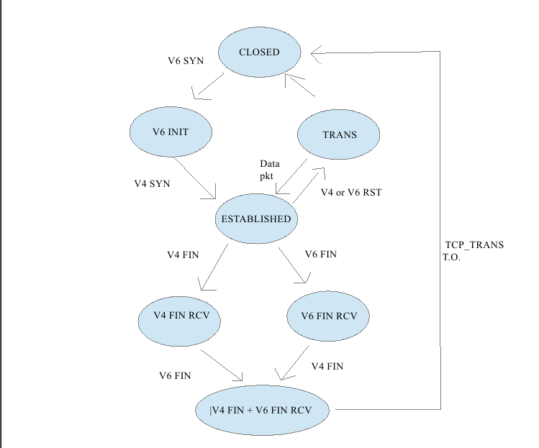

Slide 11
NAT64 + DNS64
BIND 9.8.0 offers DNS64 support, which is an IPv4-IPv6 co-existence feature that enables IPv6 hosts to connect to IPv4 destinations via a NAT64
Converts A records into AAAA records using Nat64 prefix. Hence it serves both A and AAAA record to the client

Slide 12
Performance
Runs in userspace
Protocol Translation
Address Translation – scanning of cache entries

Slide 13
Tools used
GDB
Wireshark
Bind

Slide 14
Experience
Pair Programming
Writing blogs was something new!
Sticking on to specification
gdb for debugging
Looking through the mailing list to get developers perspective on similar problems

Slide 15
Thank You!!

